Slide 1


Routine UAV atmospheric observations:
Are we ready for that ?
J. Sciare et al.
Contribution for JRA1 – ACTRIS2
www.cyi.ac.cy

Slide 2
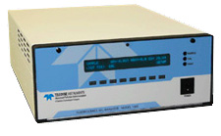
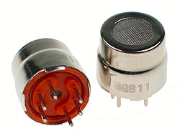
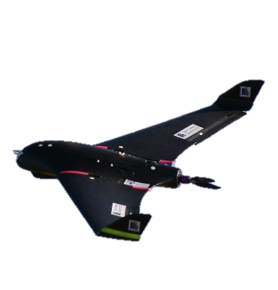
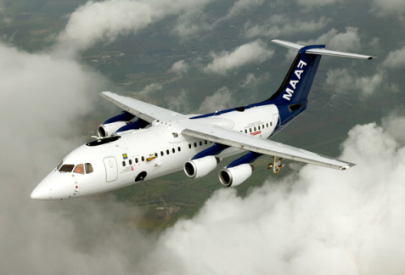
Motivations
In the near future Atmospheric instrument will become smaller and cheaper offering new field of applications
The use of Unmanned Aerial Vehicle (UAV) offers new potential for atmospheric observations
How mature are these new atmospheric sensors for ACTRIS ? (data quality)
How mature are these new technical developments for routine operation in the ACTRIS network ? (monitoring capacity)
What is the added value for the ground-based ACTRIS network ?
How easily these techniques can be disseminated to end-users ?

Slide 3
Strategy
Establish a UAV research infrastructure that has a the capacity to integrate miniaturized instrumentation and fly them
Operate routine (weekly) flights for a period of 1 years and learn from this experience
To evaluate the real added value compared to ground-based in-situ observations
Cyprus – CAO station
2016-2017

Slide 4
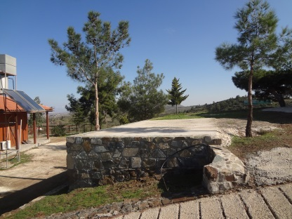
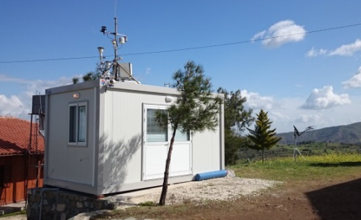
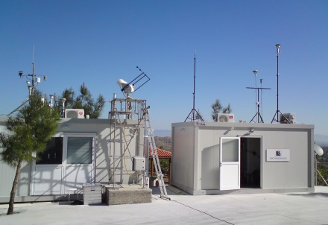
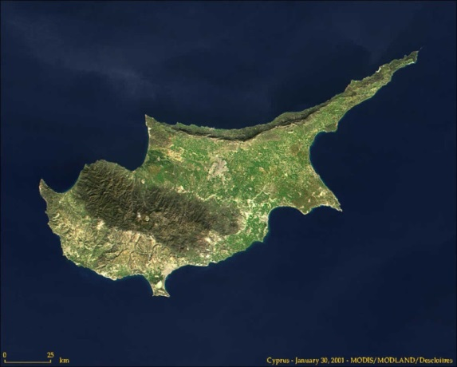


















Cyprus Atmospheric Observatory
Latitude :35°02′18″N
Longitude :33°03′38″E
Altitude : 550m asl
December 2014
March 2015
April 2016
EU-H2020 ACTRIS2 Trans-national Access
100 access days for users
LSCE
MD
LaMP
CNRS-GAME
LA
LOA

Slide 5


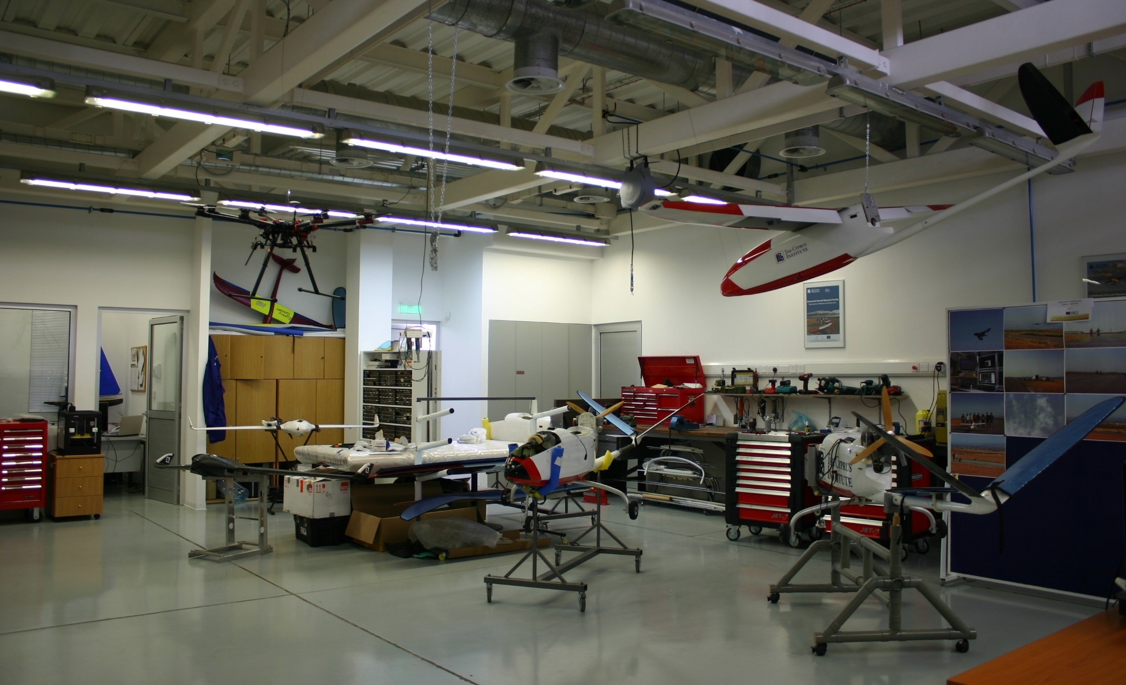
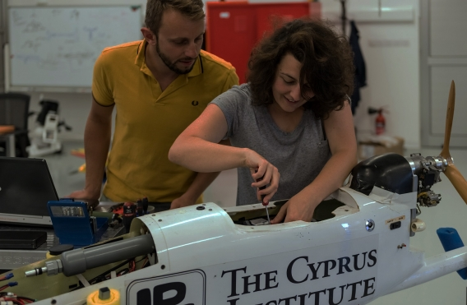
Unmanned System Research Laboratory (USRL)
http://www.cyi.ac.cy/index.php/usrl.html
New lab facilities (Est. since 2014)
Hands-on training in our accredited Ph-D on Atmospheric Sciences
100 m² Laboratory (workshop facilities, 3D printing, …) equipped for unmanned systems research & development
Next to the CyI Instrumentation & Chemistry laboratories for atmospheric sciences

Slide 6
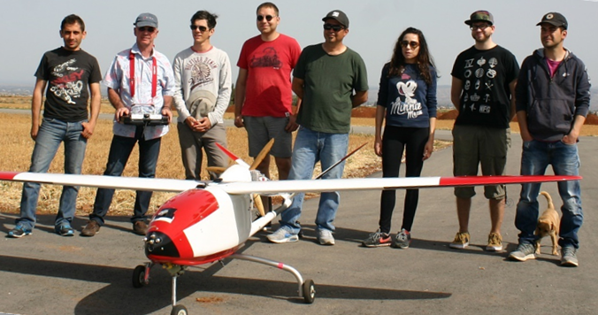
Unmanned System Research Laboratory (USRL)
http://www.cyi.ac.cy/index.php/usrl.html
Two professional pilots (flying on commercial companies – Airbus family)
→ Unparalleled knowledge on safety procedures and flight operations in liaison with the Civil Aviation Authorities
Two electronic engineers
→ Design, optimization and realization of the Unmanned Systems’ wiring, maintenance and enhancement of the electronic components, Research and integration of new technologically advanced and innovative electronic components on the UAVs
Two mechanical engineers
→ Designing/Operating 2d and 3d drawings using computer-aided modelling software& manufacturing machines for prototyping, UAV construction/maintenance of parts using various material
Two post-doctoral fellows in experimental atmospheric sciences
→ Operating, calibrating, processing data from miniaturized instruments running onboard UAV

Slide 7
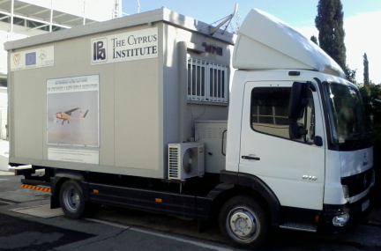
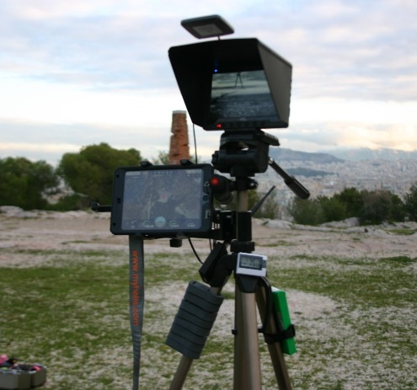
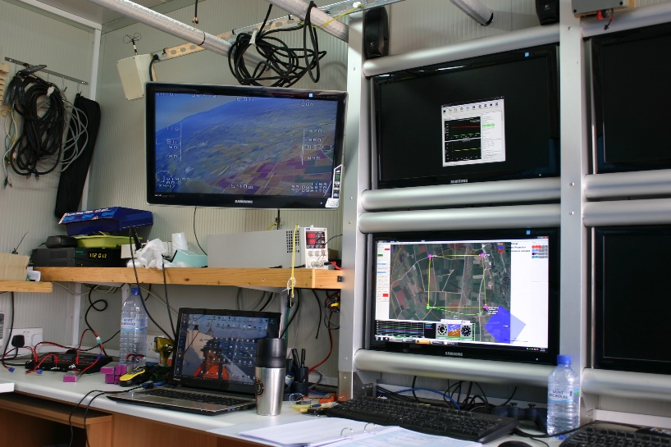
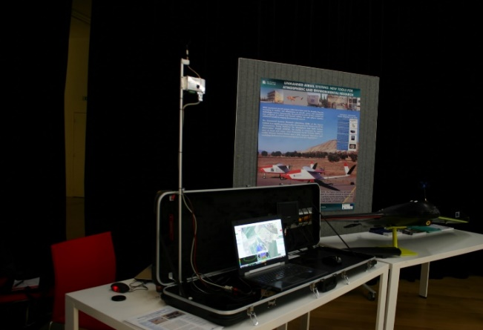
Mobile Ground Control Station (GCS)
Unmanned System Research Laboratory (USRL)
http://www.cyi.ac.cy/index.php/usrl.html
Truck with GCS
Monitoring & Control of UAV, Payload, Camera
Portable GCS
Monitoring & Control of UAV, Payload, Camera

Slide 8
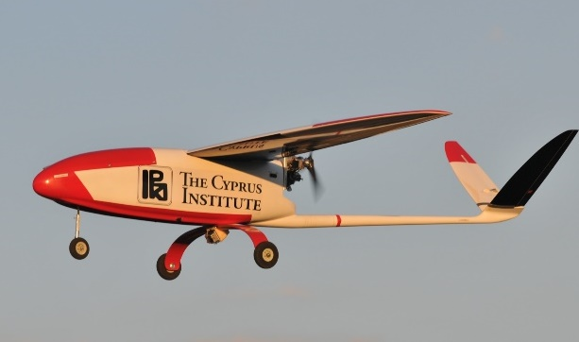
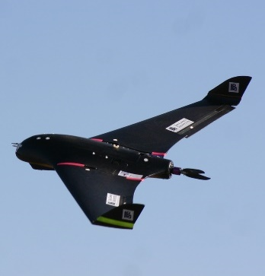
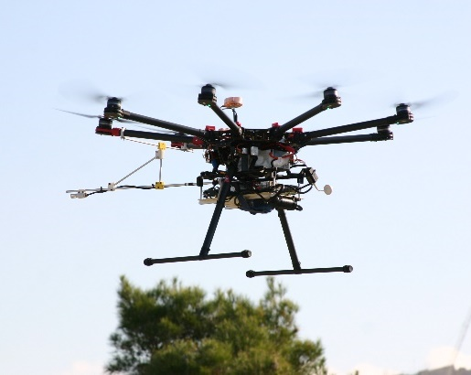
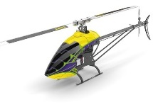
Fleet of Unmanned Aerial Vehicles (UAVs)
Unmanned System Research Laboratory (USRL)
http://www.cyi.ac.cy/index.php/usrl.html
Fixed Wing
Medium Size: 35 Kg Weight Payload: 12 Kg Endurance: up to 4 hours Ceiling: up to 4 Km
Small Size: 5 Kg Weight Payload: 2 Kg
Endurance: up to 2 hours Ceiling: up to 4 Km
4 platforms
4 platforms
Rotary Wing
Small Size: 10 Kg Weight Payload: 4 Kg Endurance: ~30 min Ceiling: up to 2 Km
Small Size: 9 Kg Weight Payload: 2 Kg Endurance: ~20 mins Ceiling: up to 1 Km
1 platform
1 platform

Slide 9
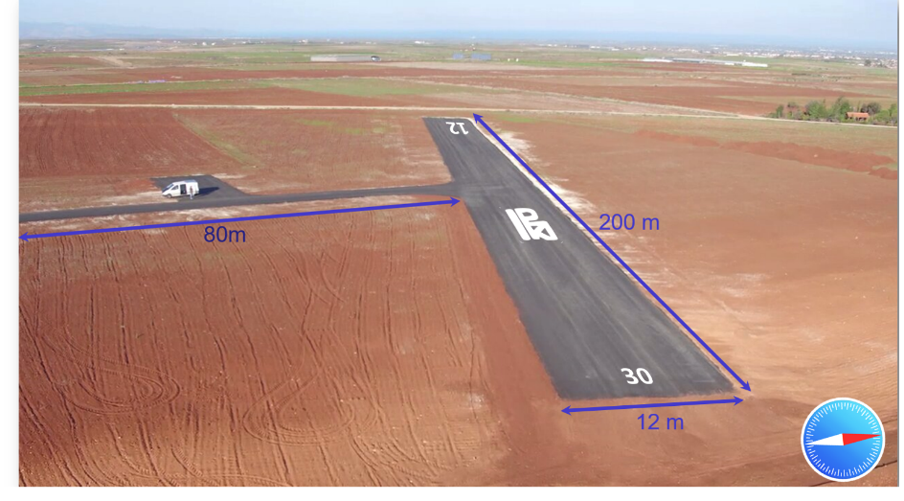
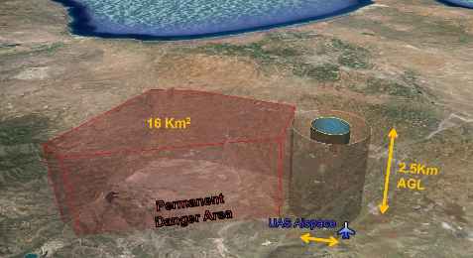
Unmanned System Research Laboratory (USRL)
http://www.cyi.ac.cy/index.php/usrl.html
Private UAV runway and Airspace facility
Private Runway (CyI)
Flat Terrain Remote Area
25 Km West of Nicosia
Exclusive Overhead Airspace committed for CyI UAVs up to 3km asl
Located 4 Km from CyI ground-based Atmospheric Observatory (Agia Marina)

Slide 10
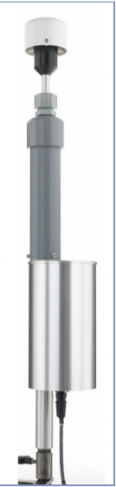
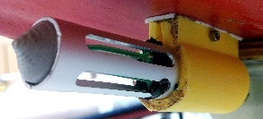
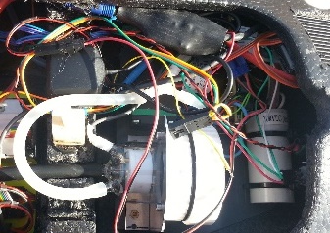
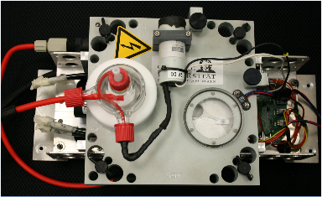
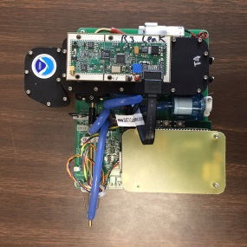

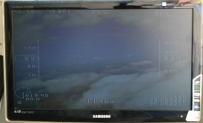
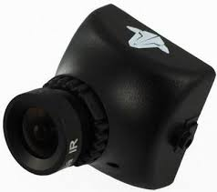

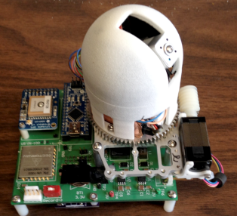
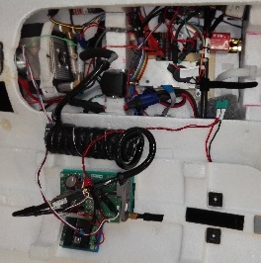
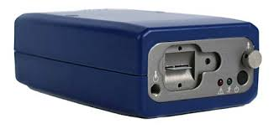
Unmanned System Research Laboratory (USRL)
http://www.cyi.ac.cy/index.php/usrl.html
Unmanned Aerial Instrumentation
UAV - BASIC
AEROSOL SIZE DISTRIBUTION
ICE NUCLEI SAMPLER
MetOne Optical Particle Counter (OPC)
T – RH
Printed Optical Particle Spectrometer (POPS)
Ice Nuclei (IN) single & multi-Sampler prototype: University of Frankfurt
On-Screen-Display Video
ABSORPTION
AEROSOL OPTICAL DEPTH
μ-aethalometer
Dual Wavelength Prototype (DWP) Aethalometer prototype: Aerosol d.o.o.,Slovenia
Autopilot - ADC

Slide 11
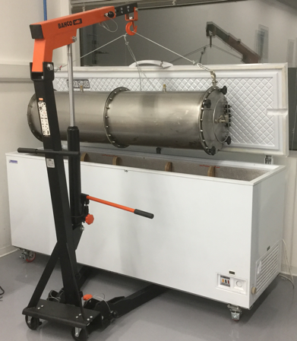
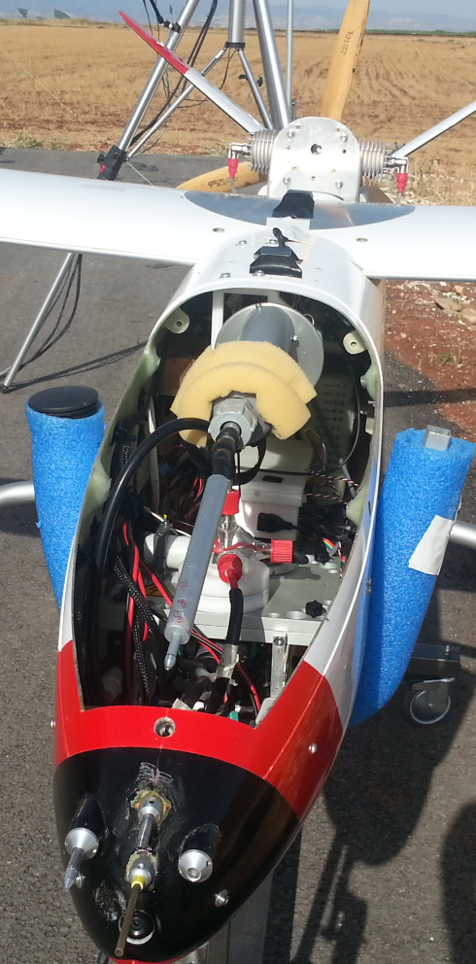
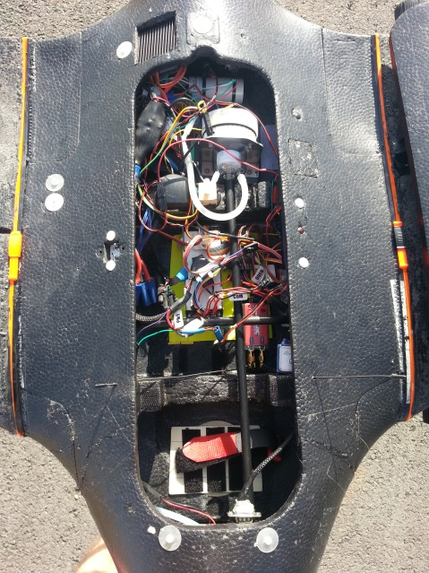
Unmanned System Research Laboratory (USRL)
http://www.cyi.ac.cy/index.php/usrl.html
Integration & in-flight qualification
Weather simulation chamber (P, T, RH)
Integration of instrumentation to match UAV payload, size constrains, weight balance
Interference with UAV control systems
In-flight conditions (P, T, RH) on instrumentation performance

Slide 12


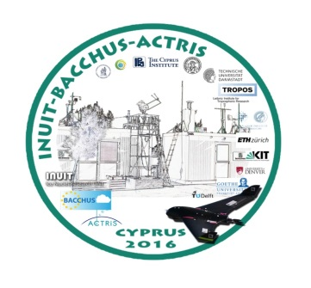
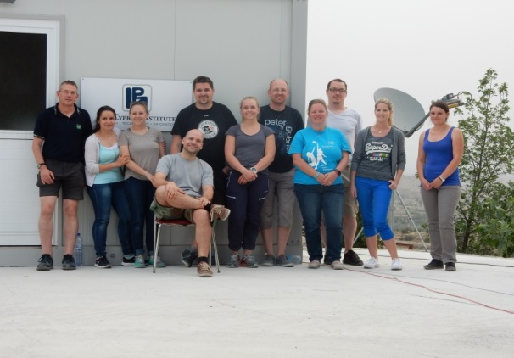


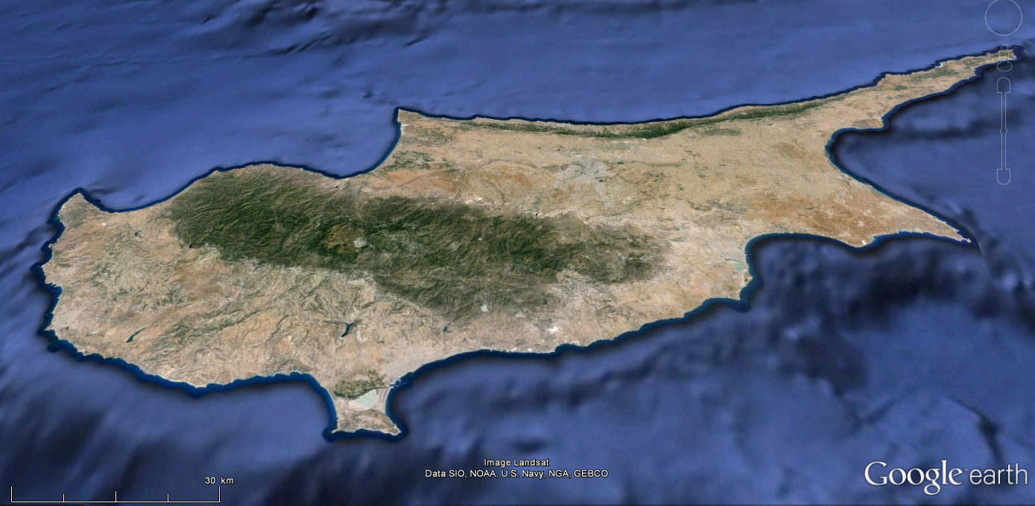
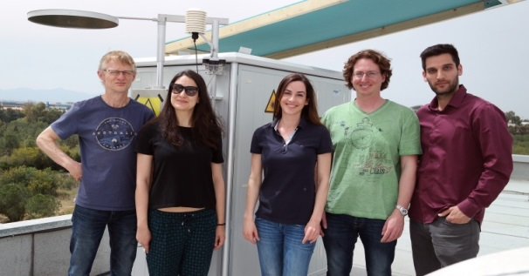


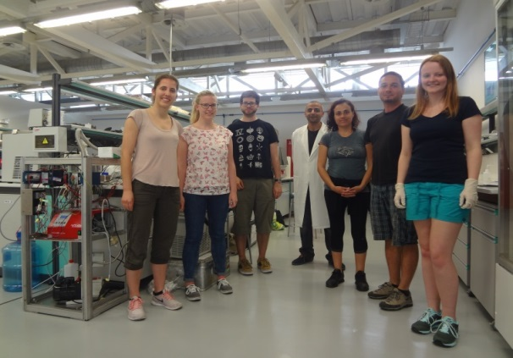
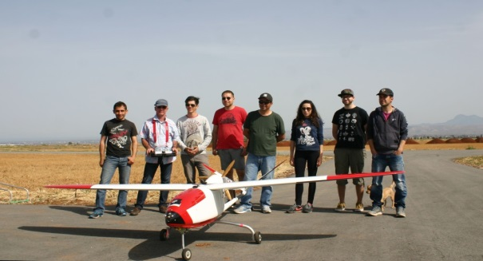
Field campaigns (2016)
INUIT - BACCHUS-ACTRIS
(April 2016)
Agia Marina Xyliatou team
Nicosia
Agia Marina
Xyliatou
Limassol
Remote sensing team
A total of 50 flights within a period of 3 weeks with up to 3-4 profiles (0-3km asl) during dust episods
Analytical lab team
UAV team

Slide 13
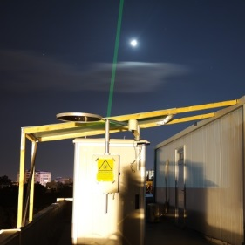
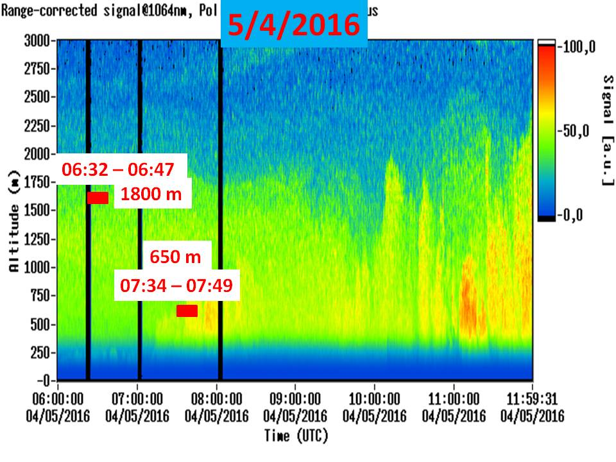
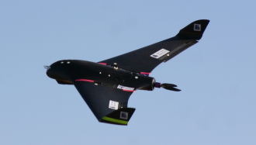

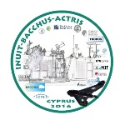
Investigating the atmospheric column:
Synergy between remote sensing (Lidar) and in-situ (UAV)
boundary
layer
BC
INUIT – BACCHUS - ACTRIS
Cyprus ( April 2016)

Slide 14

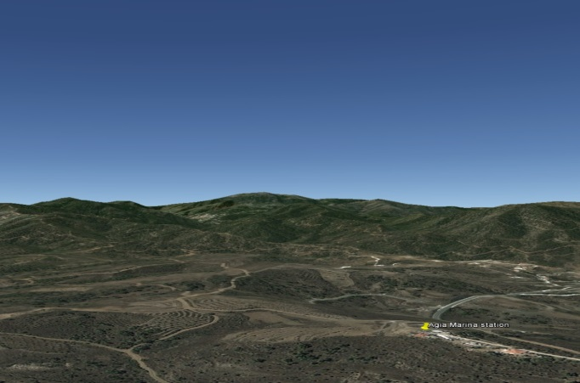

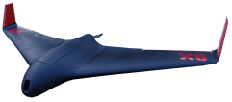
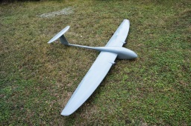
UAV monitoring activities : Experimental setting
(July 2016 – July 2017)
Payload = DWP, T, RH, video
350-3,000 m asl
Payload = IN sampler, T, RH
Free troposphere
UAV
Troodos station
(1880m asl)
Payload = miniSASP, POPs, OPC (MetOne)
1000-1500m
Agia Marina Xiliatou Station
(500 m asl)
Payload = to be defined (2kg)
boundary layer
Flight Strategy – 1 day flight / week / Focus on contrasted situations
- Clean (Med.) vs Polluted (Europe/Turkey/Middle East)
- Dust (Africa) vs Dust (Middle East)
- Aerosol layer (boundary layer) vs aerosol layer (Free troposphere)
- Aircraft campaigns (March-April 2017)

Slide 15
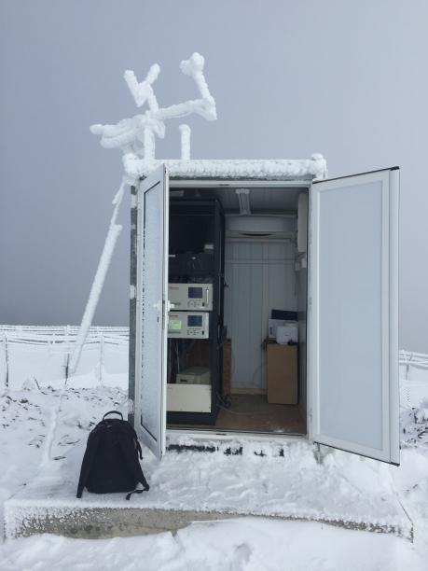


Multi-level comparison of key parameters
O₃
BC
OPC
UAV
(350- 3,000 m asl)
350-3,000 m asl
Free troposphere
UAV
PM_{2.5} (POPs)
O₃
BC
OPC
Sunphotomer (MiniSASP)
Troodos station
(1900m asl)
1000-1500m
Troodos Station
(1,900 m asl)
Agia Marina Xyliatou Station
(500 m asl)
boundary layer
PM_{2.5}
O₃
BC
OPC
Sunphotomer
Agia Marina Xyliatou Station
(550 m asl)

Slide 16
Conclusions & Perspectives
This UAV atmospheric monitoring program will be used as a “proof of concept” to evaluate to 1) its real added value compared to ground-based (in-situ + remote sensing) observations, 2) its potential for replicability and dissemination, 3) its real operating cost
Several communities may be interested in atmospheric UAV tools (EUFAR, ACTRIS, ICOS, …). We need to identify in which community such tools would better fit
We have also to explore what are the needs from end-users (services, training, easy-to-use integrated tool, …) and evaluate if they can be afforded and at which cost

