Slide 1

JRA1: Aerosol vertical profiling utilizing the synergy of lidar, sunphotometry and
in-situ measurements in the framework of the ACTRIS-2 campaigns in:
Athens, Cyprus, Crete
A. Tsekeri, V. Amiridis, A. Lopatin, E. Marinou,
J. Sciare, M. Pikridas, E. Liakakou, I. Stachlewska, H.Baars,
K. Eleftheriadis, E. Gerasopoulos, B. Wehner, M. Kottas, P. Kokkalis, I.P. Raptis, S. Solomos, I. Binietoglou, P. Fetfatzis,
R. Engelmann, A. Papayannis, E. Giannakaki, M. Komppula
U. Wandinger, A. Ansmann, O. Dubovik, N. Mihalopoulos,
National Observatory of Athens, Laboratoire d’Optique Atmosphérique, The Cyprus Institute,
Leibniz Institute for Tropospheric Research, University of Crete, University of Warsaw,
N.C.S.R. “DEMOKRITOS”, Finnish Meteorological Institute, National Technical University of Athens,

Slide 2
JRA1 scope
Advance our knowledge on absorption profiling by optimizing
in-situ measurement techniques and remote sensing retrievals
Compare remote sensing retrievals of absorption coefficient and SSA profiles with airborne in-situ profiles
Remote sensing algorithms available:
GARRLiC sunphotometer+lidar (daytime) and lunar/star photometers+lidar (nighttime)
Lidar stand-alone constraint with lunar/star photometers (nighttime)
Airborne and surface in-situ:
Aethalometers, absorption photometers
Dedicated ACTRIS-2 campaigns:
Past: Melpitz, Athens, Cyprus, Sierra Nevada
Future: Melpitz and Crete

Slide 3
GARRLiC sunphotometer+lidar
 | GARRLiC
Input | Lidar backscatter signal at 355, 532, 1064 nm Sunphotometer AOTs and total scattered radiances at 440, 670, 870, 1020 nm
Output | Concentration profiles Column-averaged size distribution, refractive index and spherical particle fraction, different for fine and coarse particles Optical property profiles (absorption, SSA)
lidar
sunphotometer

Slide 4
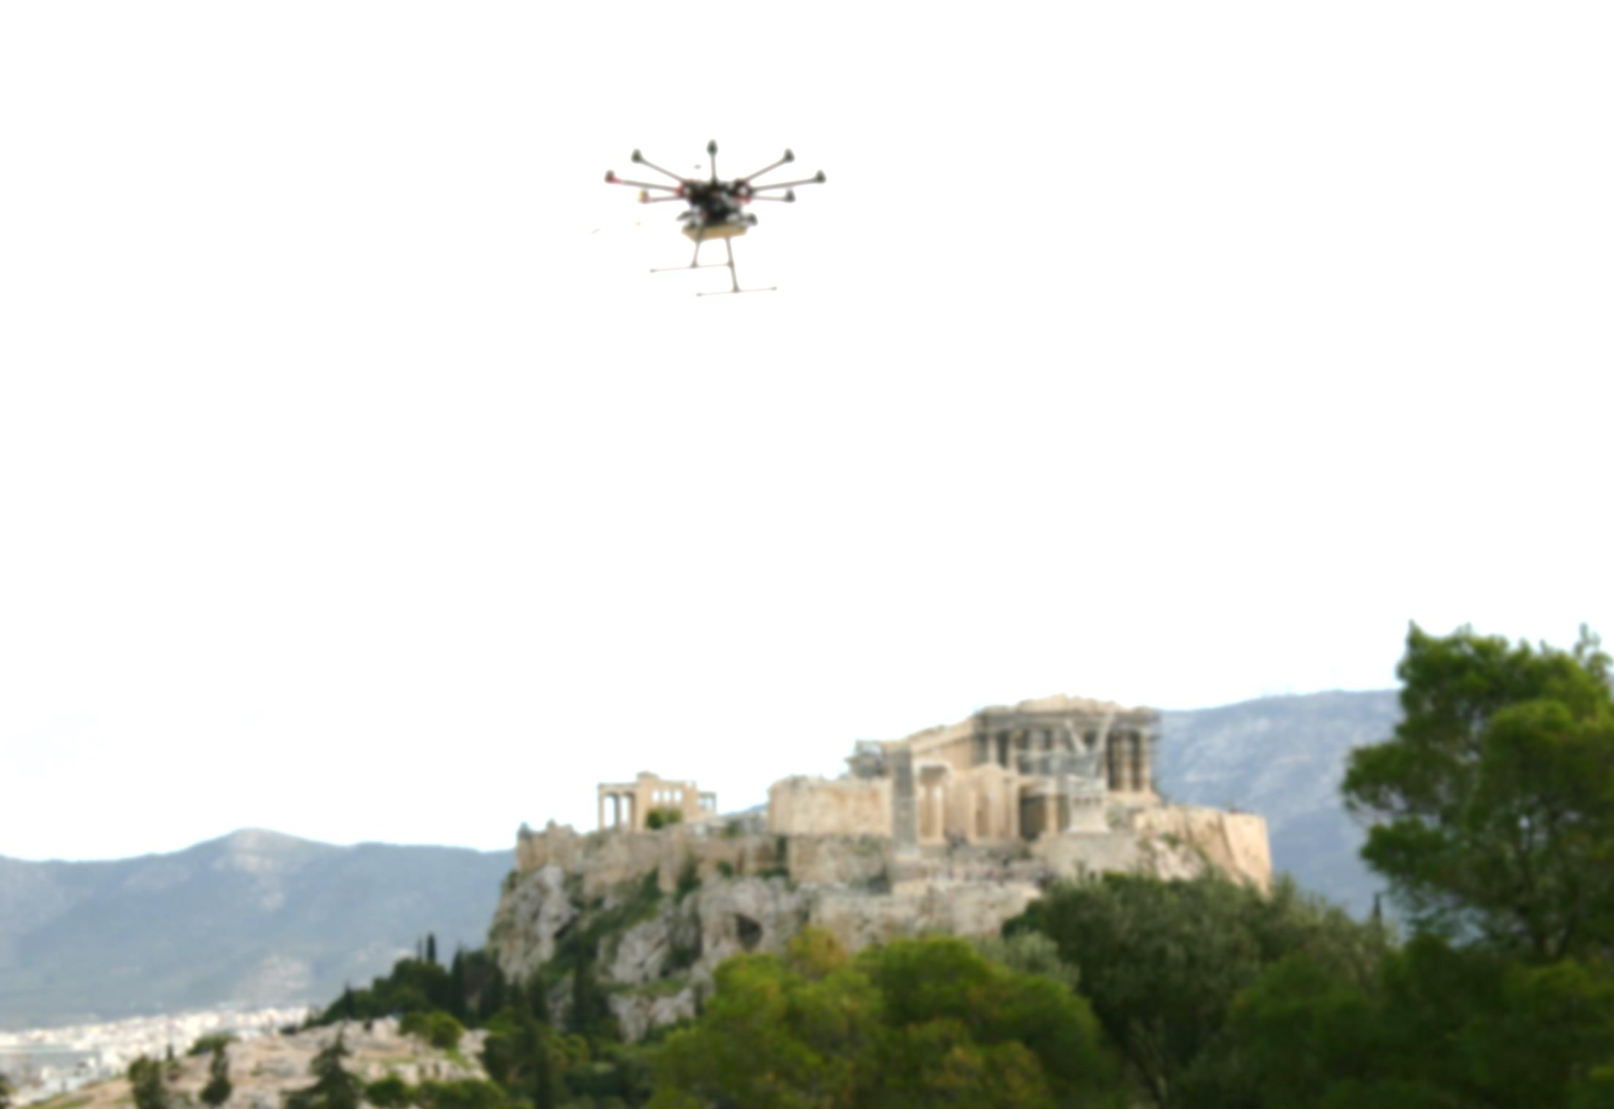
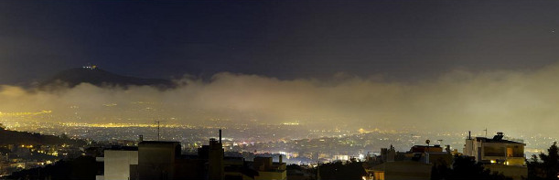
Athens smog campaign winter 2016
Scope:
characterizing the alteration of the urban environment of Athens due to economic crisis, focusing on absorbing aerosols, like "smog" from wood-burning for heating purposes.
Visit: http://actris-athens.eu/
(Photo courtesy of Christos Keleshis)

Slide 5
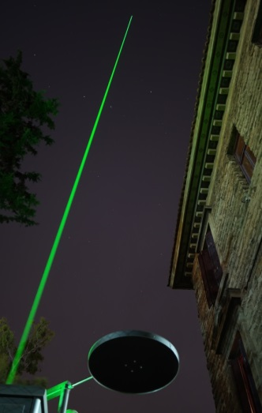
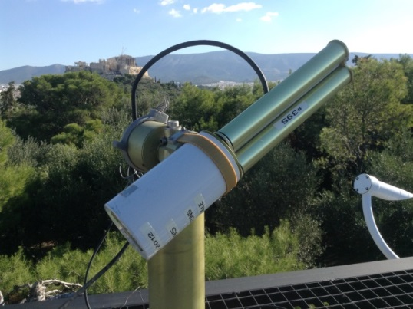
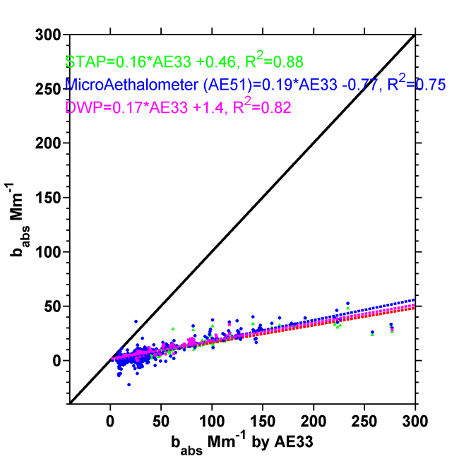
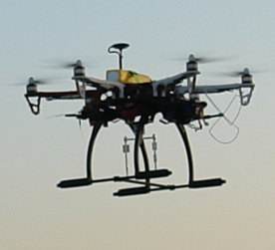
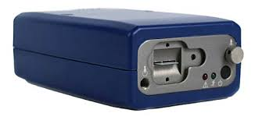
Instrumentation
Ground-based remote sensing:
PollyXT-NOA multi-wavelength lidar with NARLa near-range receiver
CIMEL sunphotometer
Also: EOLE raman lidar, HALO wind lidar, Ceilometer, PANDORA sunphotometer, PSR sunphotometer
Airborne (UAV) in-situ:
Miniature black carbon aethalometer (ETS AE51)
Coarse Mode Aerosol Collector (CMAC)
Meteorological data
Surface in-situ:
Aethalometers, absorption photometers, particle sizers, gas analyzers and other
CIMEL sunphotometer and PollyXT lidar
NOA UAV
(CyI) ETS AE51 absorption coefficient compared
with two miniaturized absorption instruments
TSI AE51

Slide 6
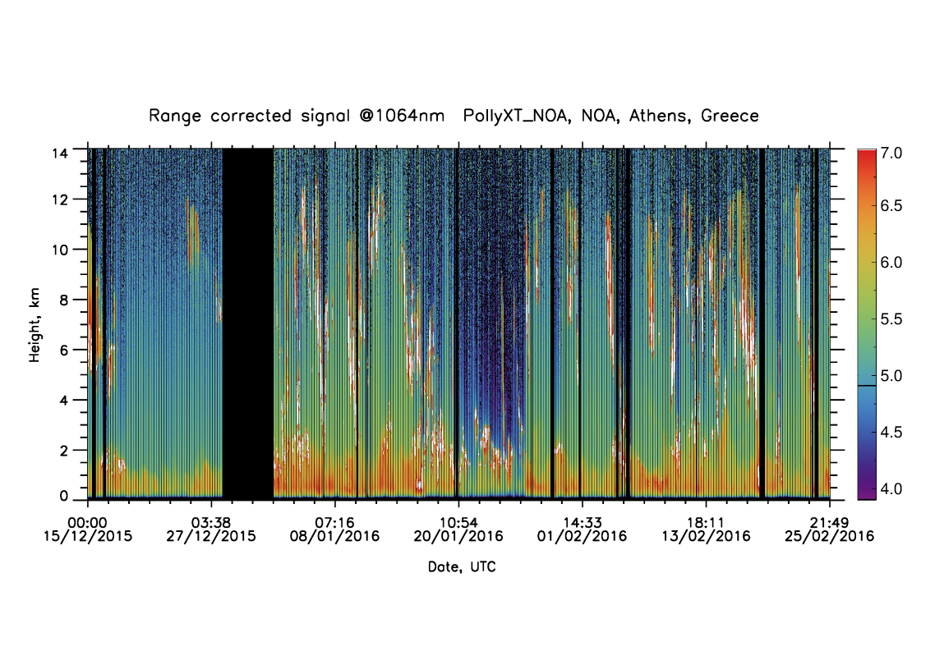
Measurements
Selected case:
Relatively cloud-free
AOD=0.2
Increased level of pollutants and biomass burning contribution during night
Relatively low AODs
during intensive measurement period
Not many cloud-free days
Alexandra Tsekeri, ACTRIS-Frascati, 29 February – 4 March 2016

Slide 7
Absorption profiles 19/1/2016
Remote sensing/ in-situ comparison
In-situ UAV
Surface in-situ
GARRLiC
Differences but also similarities in GARRLiC/in-situ profiles
Surface and UAV in-situ agree

Slide 8
Conclusions
Overall good agreement of remote sensing/ in-situ absorption profiles
But more analysis is required:
Ingest near-range measurements
Smog cases were accompanied with cloudiness during the Athens campaign, so GARRLiC is difficult to be applied in more smog cases
Future: analyze smog cases lidar stand-alone algorithms

Slide 9
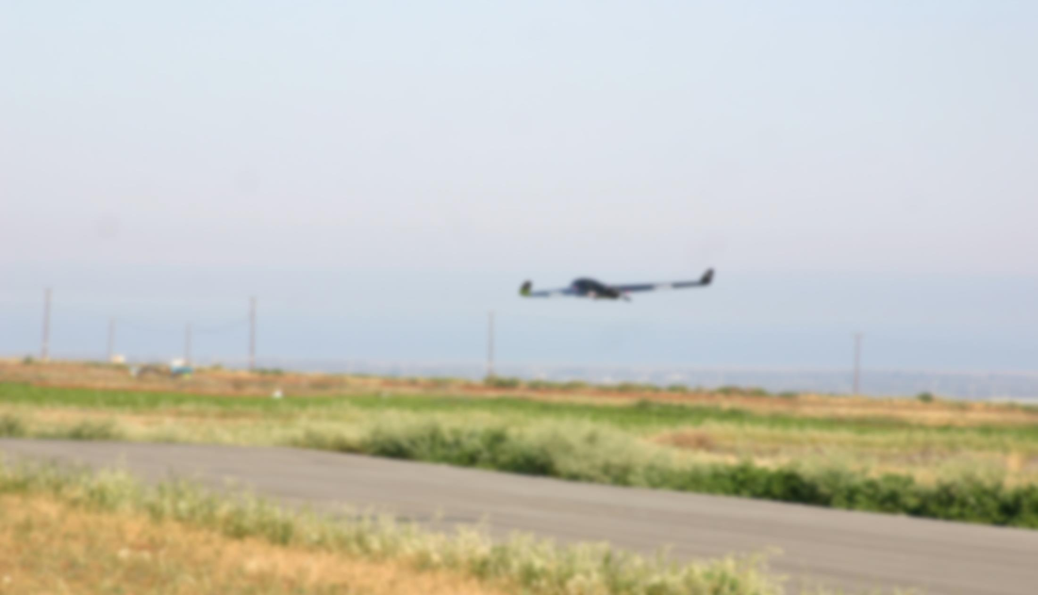
Cyprus campaign April 2016
Scope:
characterizing the absorption characteristics of dust, along with its mixtures with pollution, smoke and marine aerosol.

Slide 10
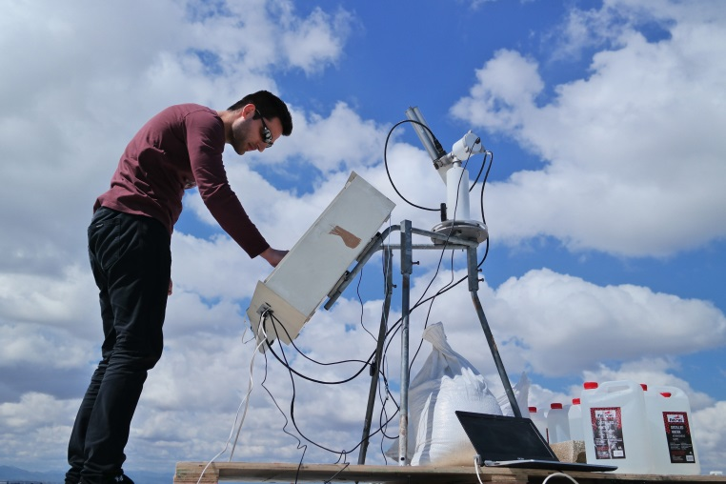
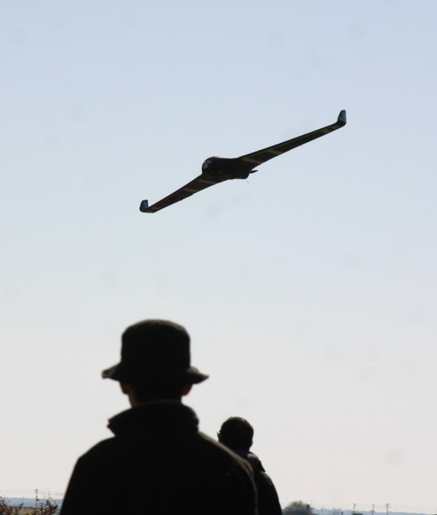
Instrumentation
At CyI:
Ground-based remote sensing
PollyXT-NOA multi-wavelength lidar
CIMEL lunar/sun photometer
At Orounda:
Airborne (UAV) in-situ
Miniature black carbon aethalometer (ETS AE51)
At Agia Marina Xyliatou:
Surface in-situ
Aethalometers, absorption photometers, particle sizers, gas analyzers and other
Installation of CIMEL lunar/sun photometer
TSI AE51
UAV flight

Slide 11
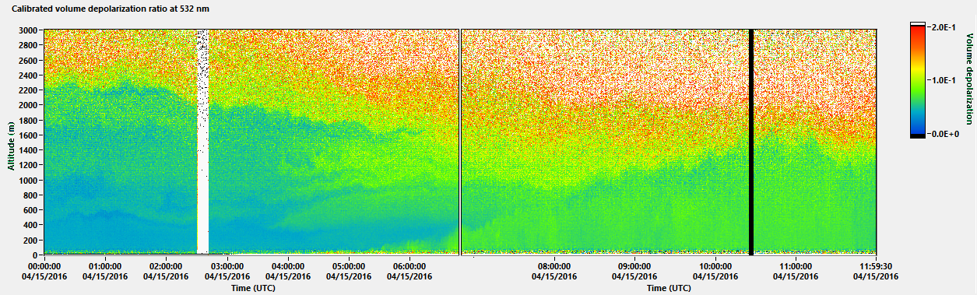
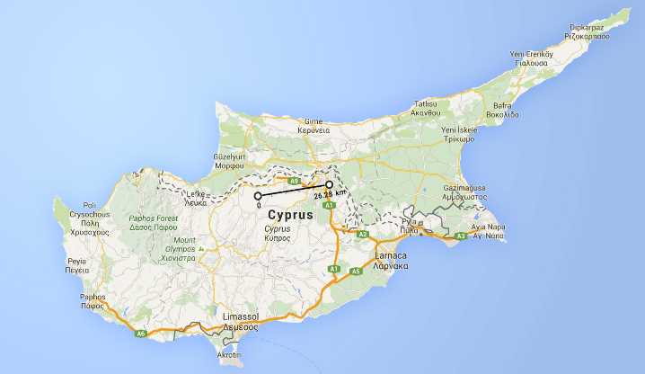
GARRLiC / in-situ preliminary comparison
GARRLiC
UAV in-situ
The differences seen may be due to the time difference and the 35 km distance between the measurements
35 km
Lidar
Flights
Absorption coefficient at 880nm calculated from BC measurements, using multiple scattering optical enhancement factor c=2,05 (by the manufacturer)

Slide 12
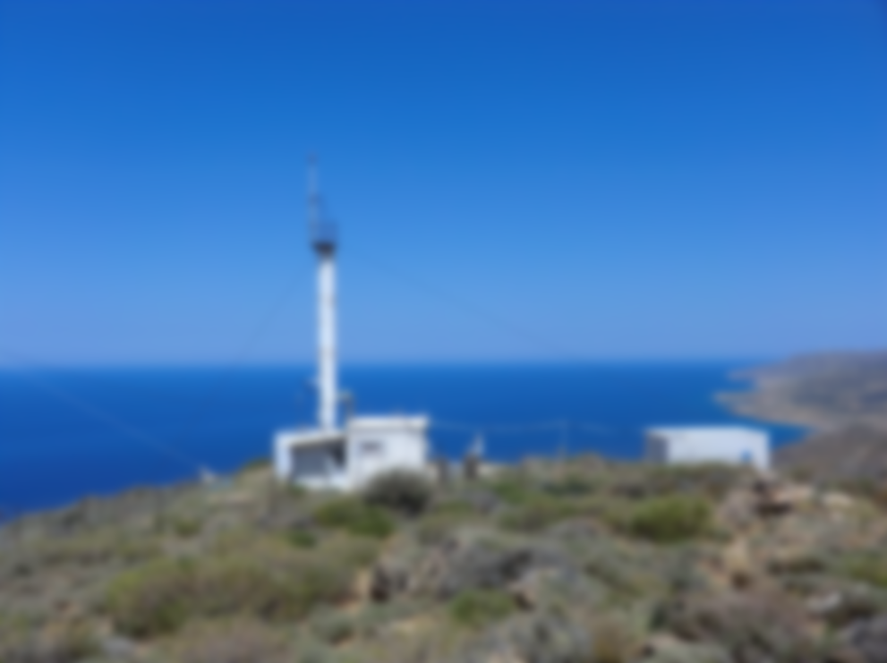
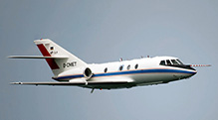
Crete campaign April 2017
Scope:
characterizing the absorption characteristics of dust.
Synergy with:
EUFAR and ERC campaigns in Crete and Cyprus.

Slide 13
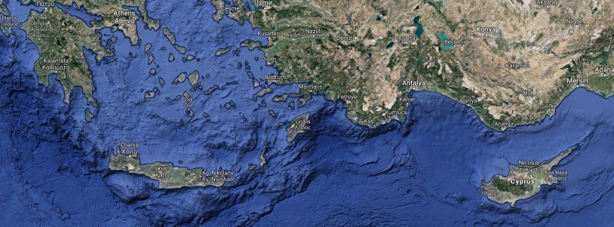
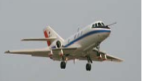
ACTRIS/EUFAR/ERC cluster
A-LIFE ERC campaign
Finokalia ACTRIS campaign
Cyprus BACHUS campaign
EUFAR and ERC campaigns:
30 hours DLR Falcon flight over Crete
30 hours DLR Falcon flight over Cyprus

Slide 14
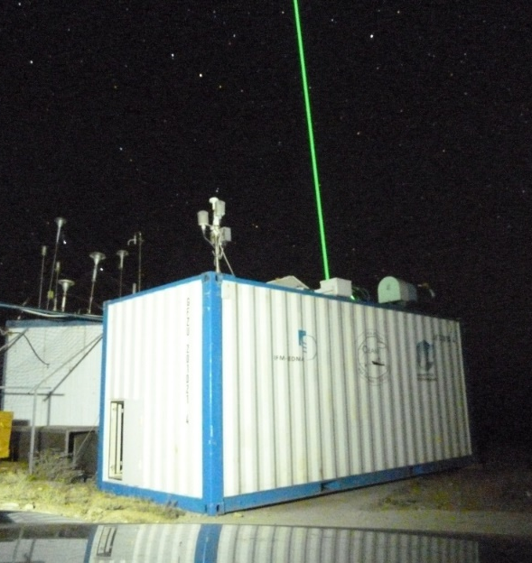
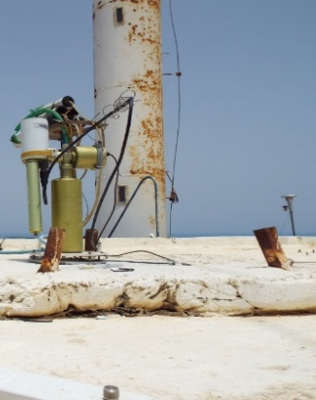
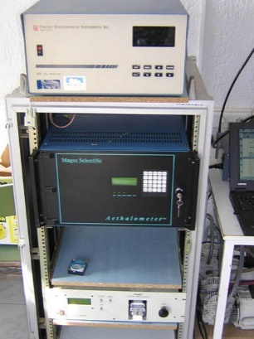
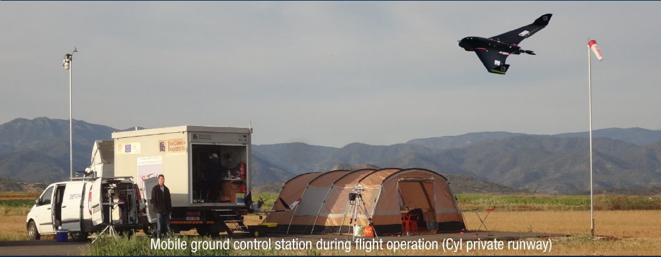
Instruments in Crete and Cyprus
Remote sensing and in-situ in Finokalia, Crete
Remote sensing and in-situ in Cyprus
Cimel sunphotometer
TROPOS LACROS super-site mobile facility
PollyXT lidar
surface in-situ (aethalometer)
NOA UAV
CUT UAV

Slide 15
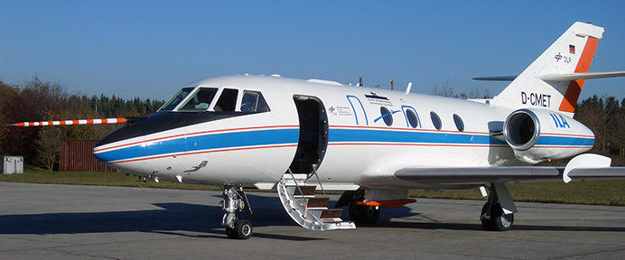
Instruments on DLR Falcon research aircraft
In-situ:
Particle size: several CPCs and OPCs, UHSAS-A, PCASP, DMT cloud, Aerosol and Precipitation Spectrometer CAPS
Black carbon: DMT SP2
A-HEAD system
DMT Duale column CCNC
Particle sampling for offline analysis
Remote sensing (wind lidar system):
Attenuated backscatter at 2 μm
Horizontal and vertical wind
Meteorological data:
P, T, RH, wind

Slide 16
Thank you!

