Slide 1



SLOPE Preliminary Results
Lucas Alados-Arboledas IISTA Team and friends
Andalusian Institute for Earth System Research (IISTA-CEAMA), Granada (Spain)

Slide 2
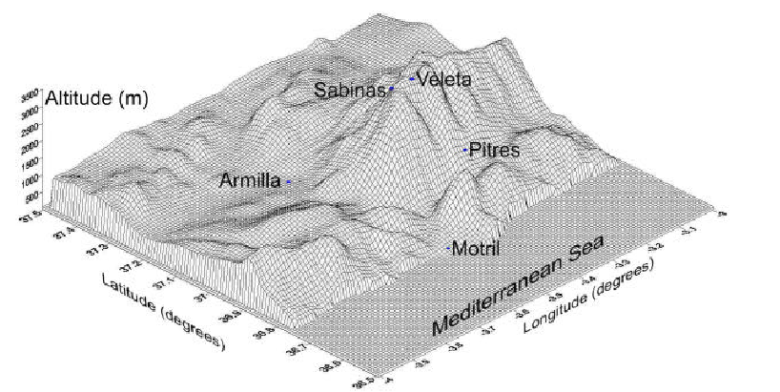


SLOPE
Sierra Nevada
Lidar
AerOsol
Profiling
Experiment
MOJÓN TRIGO
VELETA
CERRO DE LOS POYOS
GRANADA
Sierra Nevada
The campaign combined active and passive remote sensing of the vertical column with in-situ measurements, at several levels in the northern slope of Sierra Nevada. Furthermore, several flights with an instrumented plane provided aerosol vertical profiling. Different retrievals schemes will be applied to the remote sensing data, to get aerosol microphysical profiles that will be checked with the in-situ information.

Slide 3
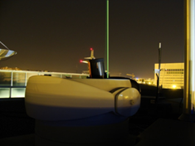
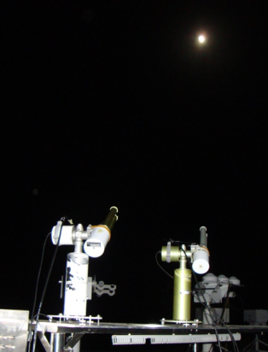
SLOPE
Special care were paid to night-time remote sensing, combining multispectral Raman lidar with lunar and star/photometer and sky-cameras. Simultaneous operation of lunar and star photometer during several lunar cycles will be used for testing and comparing both methodologies.

Slide 4


SLOPE
Extinction
α 355 nm
α 532 nm
Inversion
Algorithm
[1,2]
PARTICLE MICROPHYSICAL PROPERTIES
Backscatter
β 355 nm
β 532 nm
Β 1064 nm
The data set will be used for testing lidar stand-alone night-time retrievals. The retrievals will be tested against simultaneous measurements of optical and microphysical properties of the aerosol with in-situ instruments operated at different levels in Sierra Nevada’s slope

Slide 5
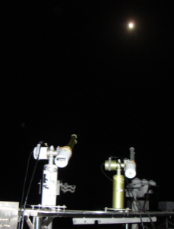
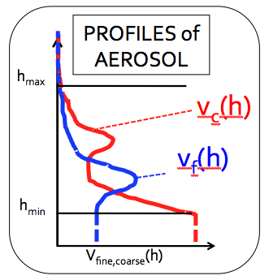
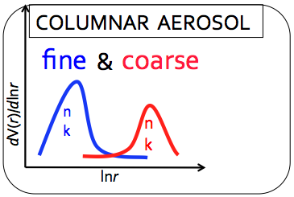
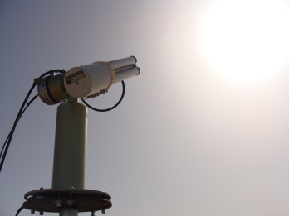
SLOPE
GRASP
24h measurements will be used for testing GRASP algorithm at day and night-time. The retrievals will be tested as in lidar stand-alone night-time retrievals, although airborne measurements are also possible.

Slide 6
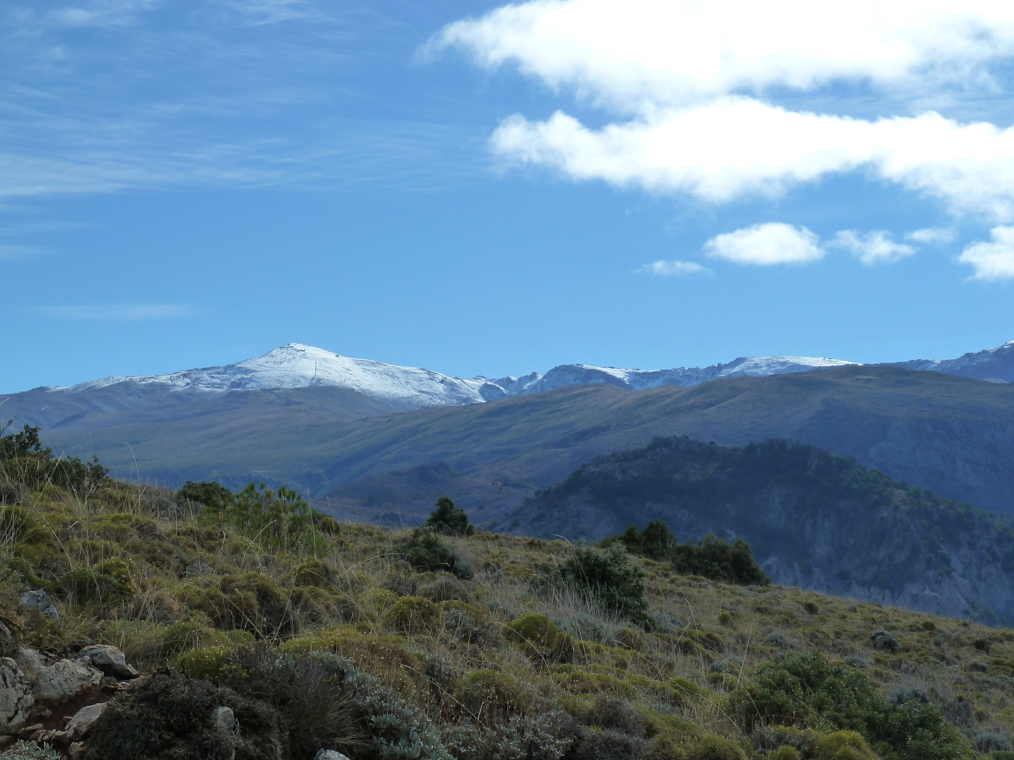
SLOPE
CORE PERIOD 3 MAY-30 JUNE 2016
EXTENDED PERIOD JULY-AUGUST
Remote sensing instrumentation at valley level (680 m a.s.l)
In-situ instrumentation at different levels in Sierra Nevada Northern slope.
MOJÓN TRIGO
VELETA
CERRO DE LOS POYOS
GRANADA
Sierra Nevada

Slide 7
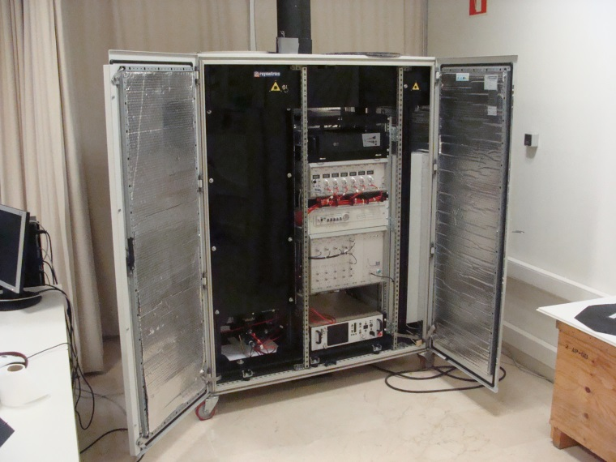
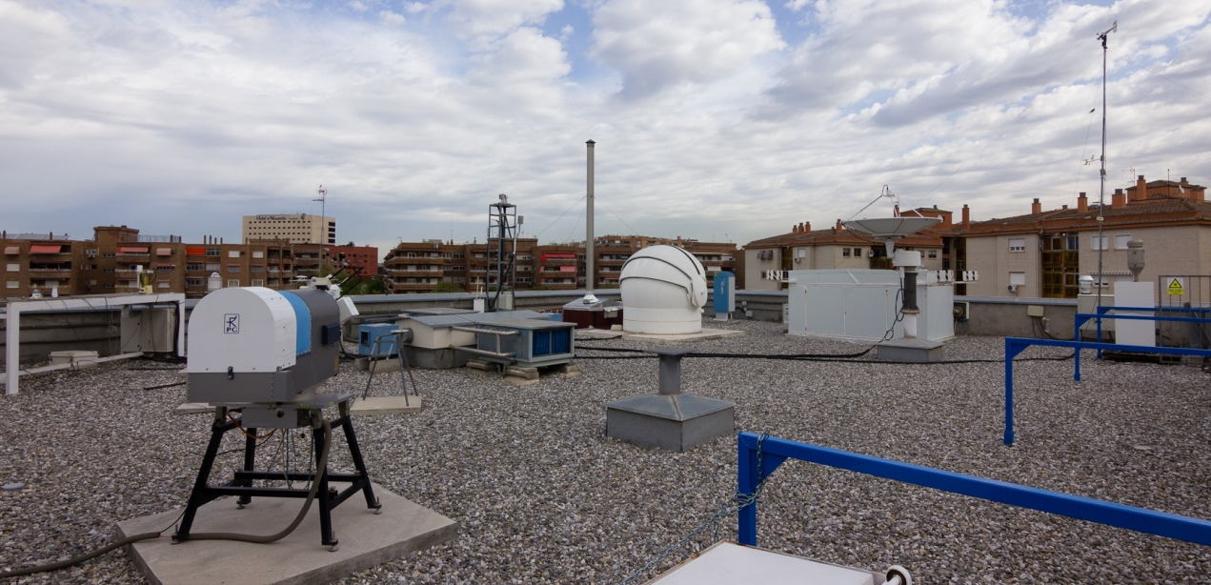
SLOPE
VELETA 3398m
ALBERGUE UNIVERSITARIO 2500m
3
CERRO POYOS and
BOTANIC GARDEN 1830m
2
GRANADA 680 m
1
5
10km
6km
7 km
11 km
MOTRIL 0 m
CORE STATION:
Multiwavelength Raman Lidar, Wind Doppler Lidar, Microwave Radiometer, Ceilometer, Radio Sounding.
∼40 km
∼40 km

Slide 8
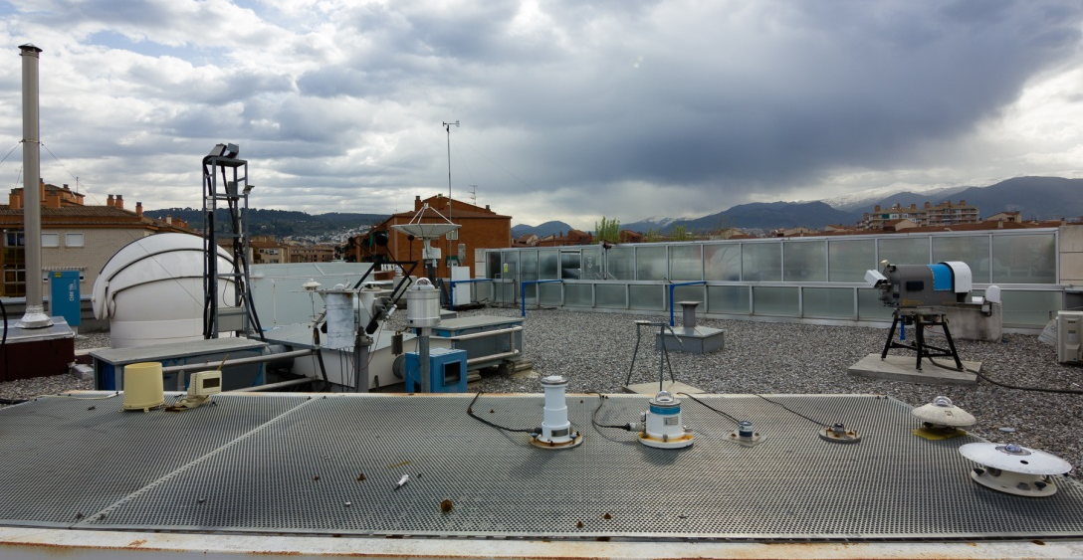
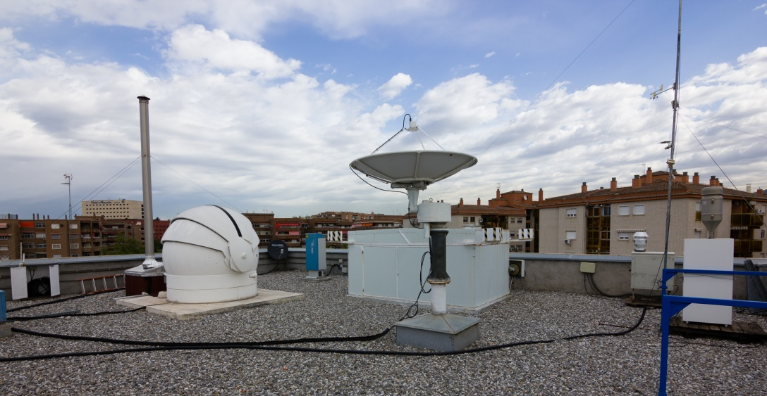
INSTRUMENTATION IISTA

Slide 9
SLOPE
1 CIMEL SUN/LUNAR/SKY RADIOMETER
EXCALIBUR STAR-PHOTOMETER
CIMEL SUN/SKY RADIOMETER
CIMEL SUN/LUNAR/SKY RADIOMETER
VELETA 3398m
ALBERGUE UNIVERSIATRIO 2500m
3
CERRO POYOS and
BOTANIC GARDEN 1830m
2
GRANADA 680 m
1
5
10km
6km
7 km
11 km
MOTRIL 0 m
∼40 km
∼40 km

Slide 10
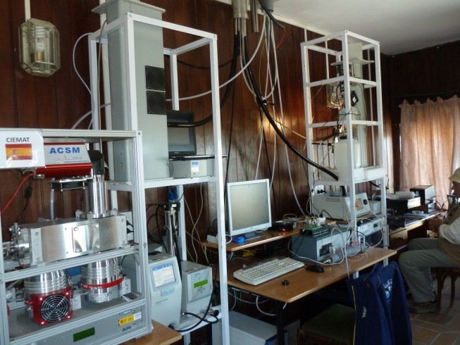
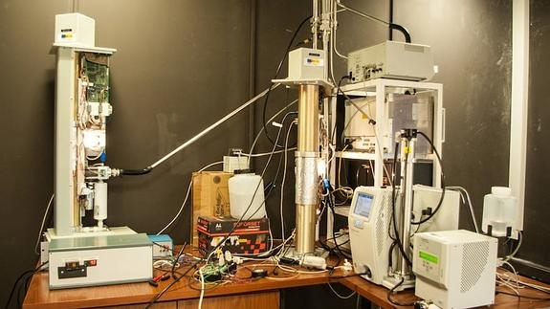
SLOPE
In situ measurements:
3. SMPS, APS, MAAP, A33, GRIMM,
INTEG NEPHELOM, ACSM, POLAR NEPH
VELETA 3398m
ALBERGUE UNIVERSIATRIO 2500m
3
CERRO POYOS and
BOTANIC GARDEN 1830m
2
GRANADA 680 m
1
5
10km
6km
7 km
11 km
MOTRIL 0 m
∼40 km
2. GRIMM, A31
1. SMPS, APS, MAAP, A33, INTEG NEPHELOM (HYGRO)

Slide 11
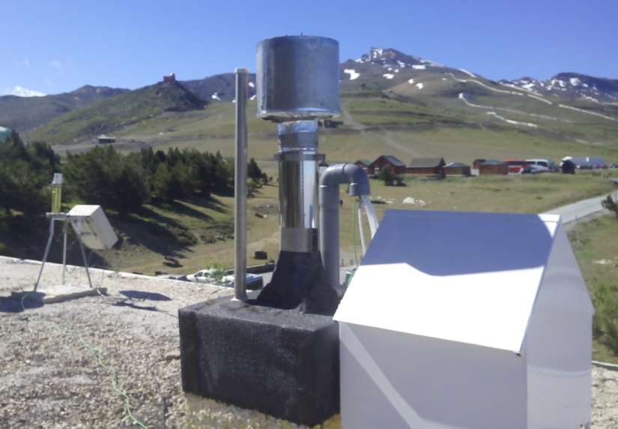
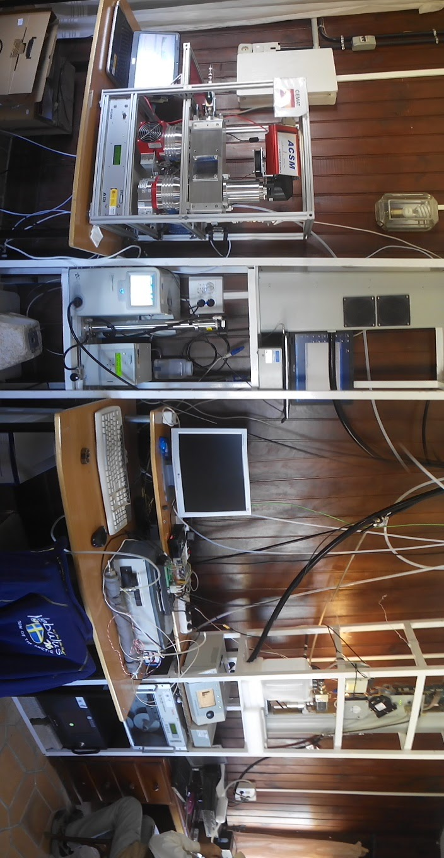
ALBERGUE UNIVERSITARIO 2500 m a.s.l.

Slide 12
SLOPE
Different group contributed with instrumentation:
CIEMAT (Madrid) ACSM
University of Lecce (CIMEL SUN/LUNAR/SKY)
GOA University of Valladolid (CIMEL SUN/LUNAR/SKY)
Universidad de Elche (GRIMM )
University of Vienna (POLAR NEPHELOMETER)
IDAEA (Complete set of in-situ instruments on board plane)
Aerosol d.o.o (A33 AVIO)

Slide 13
Coincident night measurements from Raman Lidar & Lunar/Star photometer
SLOPE CAMPAIGN
May-July/August 2016

Slide 14
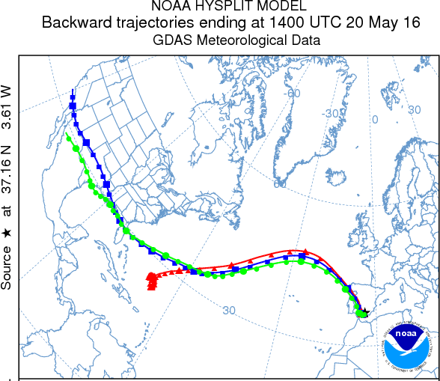
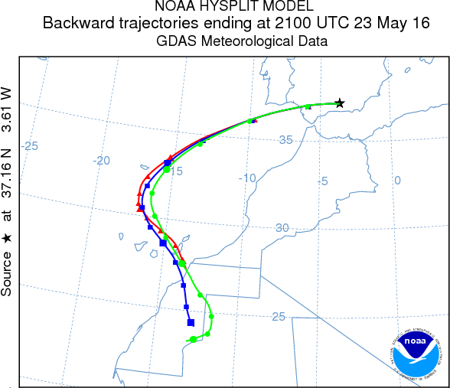
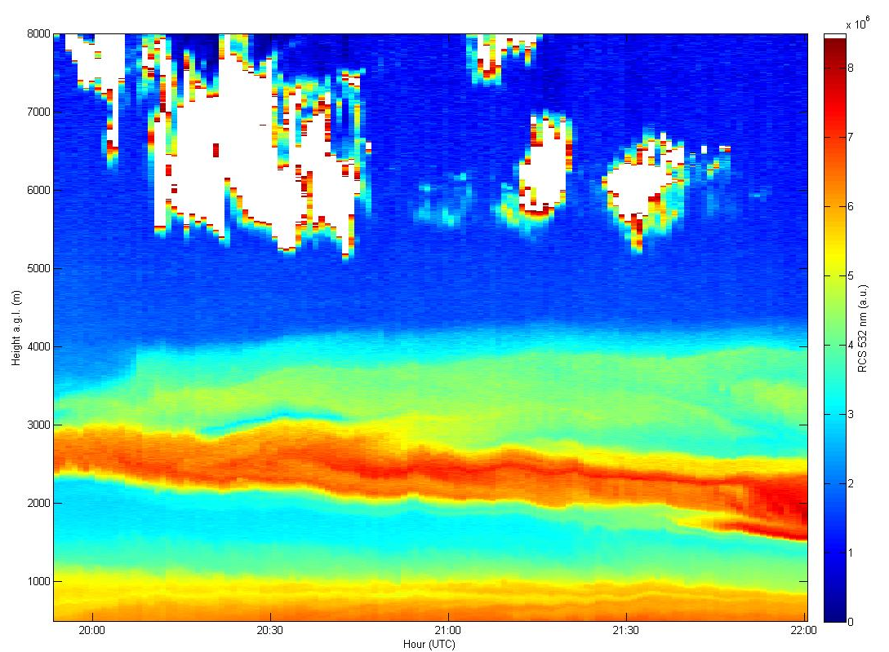
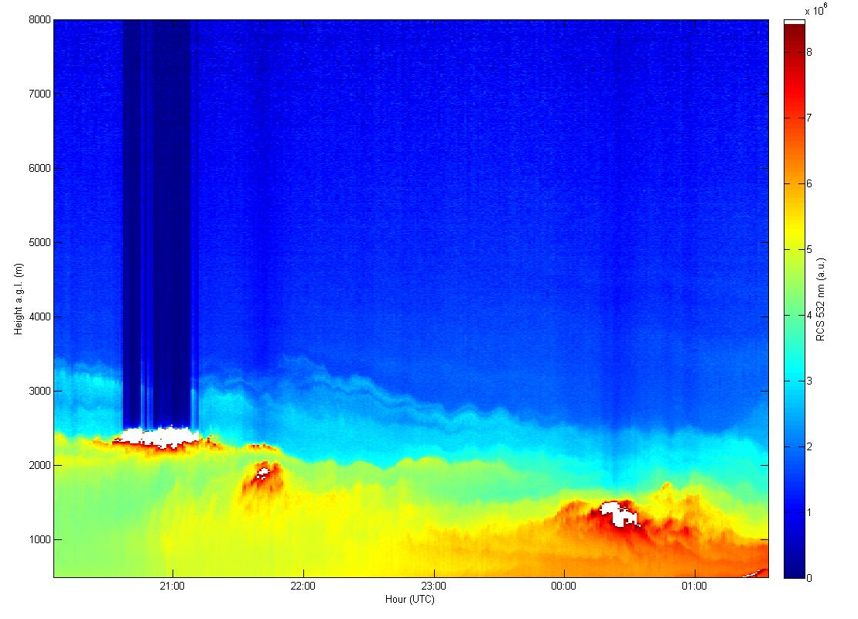
MAY
 |  |  |  |  |  | 1
2 | 3 | 4 | 5 | 6 | 7 | 8
9 | 10 | 11 | 12 | 13 | 14 | 15
16 | 17 | 18 | 19 | 20 | 21 | 22
23 | 24 | 25 | 26 | 27 | 28 | 29
30 | 31
 | Raman + Star
 | Raman + Lunar + Star
Canadian Smoke
Saharan Dust

Slide 15
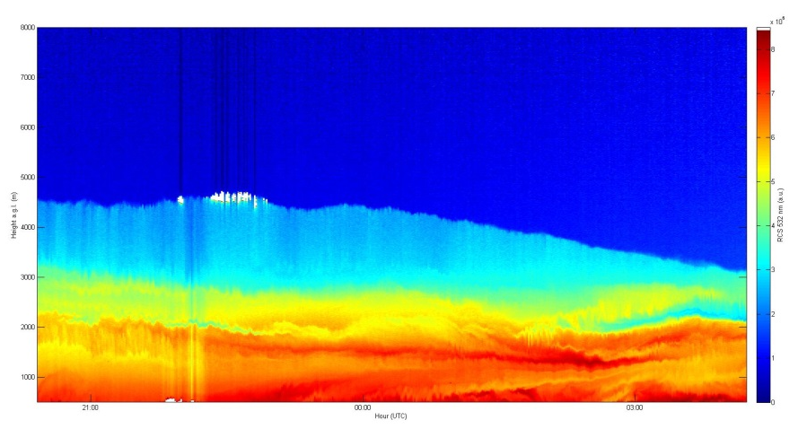
JUNE
 |  | 1 | 2 | 3 | 4 | 5
6 | 7 | 8 | 9 | 10 | 11 | 12
13 | 14 | 15 | 16 | 17 | 18 | 19
20 | 21 | 22 | 23 | 24 | 25 | 26
27 | 28 | 29 | 30
 | Raman + Star
 | Raman + Lunar + Star
Flight (daytime)
Saharan Dust
In-situ station at 2500 m a.s.l. operating during the whole campaign, starting on this month

Slide 16
JULY
 |  |  |  | 1 | 2 | 3
4 | 5 | 6 | 7 | 8 | 9 | 10
11 | 12 | 13 | 14 | 15 | 16 | 17
18 | 19 | 20 | 21 | 22 | 23 | 24
25 | 26 | 27 | 28 | 29 | 30 | 31
 | Raman + Star
 | Raman + Lunar + Star
AUGUST
1 | 2 | 3 | 4 | 5 | 6 | 7
8 | 9 | 10 | 11 | 12 | 13 | 14
15 | 16 | 17 | 18 | 19 | 20 | 21
22 | 23 | 24 | 25 | 26 | 27 | 28
29 | 30 | 31
Saharan Dust
TOTAL: Measurements: 42 nights
31 nights with Raman lidar + Lunar photometer + Star photometer
11 nights with Raman lidar + Star photometer
(Potential) Events: ~4 nights with Canadian Smoke
~15 nights with Saharan Dust
Validation for the inversion algorithms: 3 (daytime) flights over the lidar station
2-3 months with in situ station at 2500 m a.s.l.

Slide 17
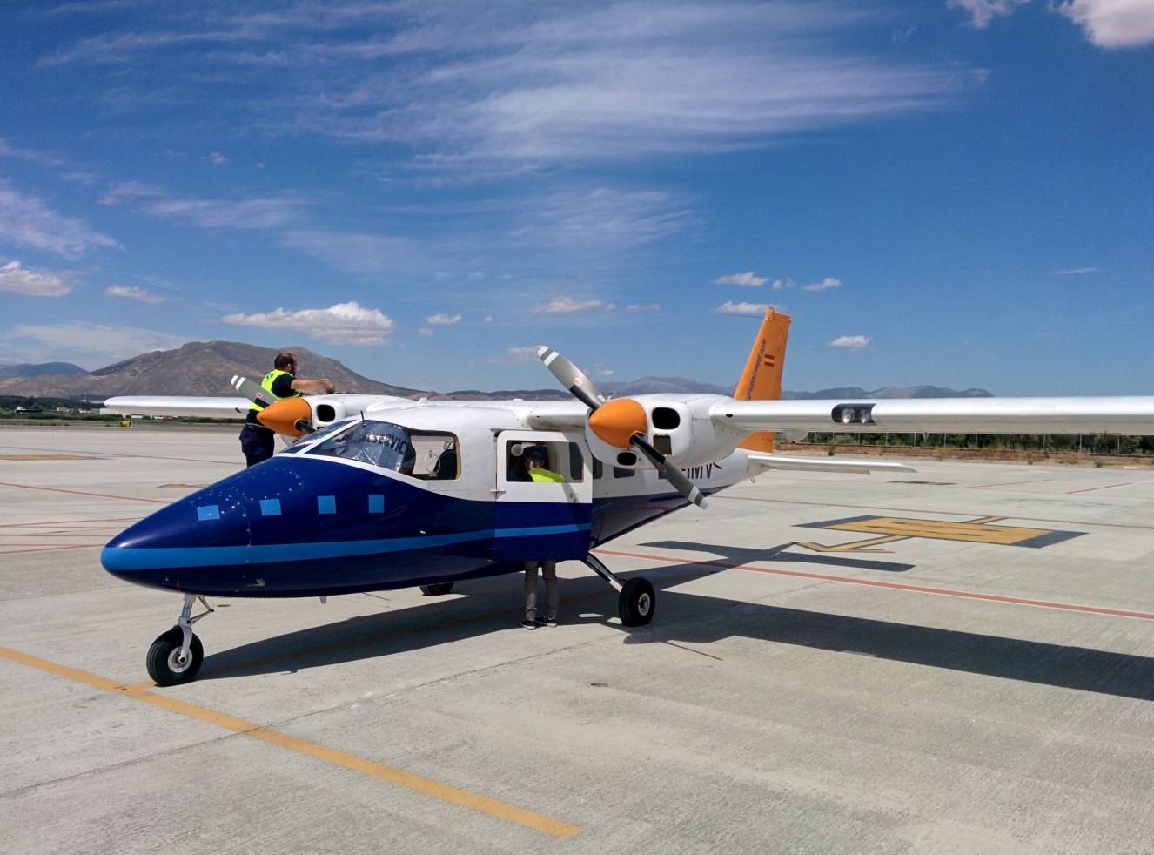
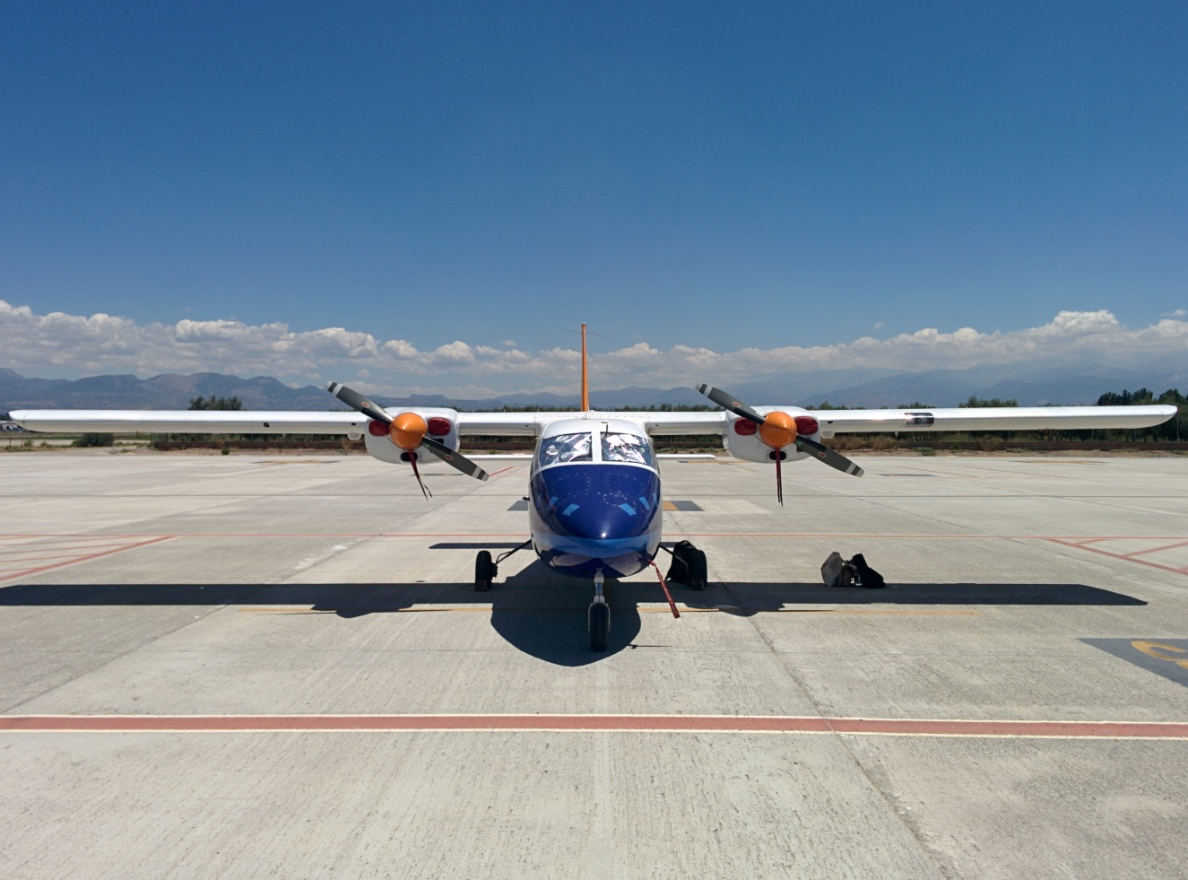
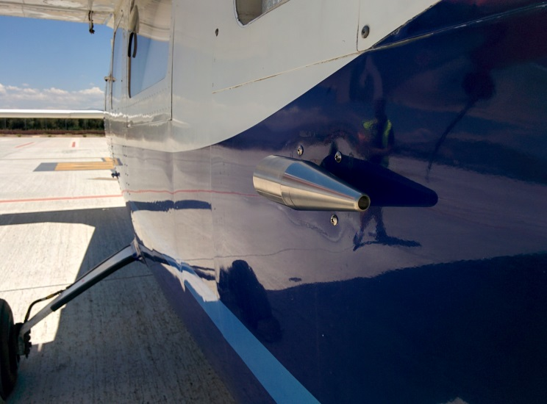
INSTRUMENTED FLIGHT
Partenavia P68

Slide 18
Instrumentation onboard
Ecotech Aurora nephelometer: total scattering and hemispheric backscattering coefficients at 450, 525 and 635 nm. Time resolution: 10 s
Aethalometer AVIO AE33: absorption coefficient at 7 wavelengths. Time resolution: 1 min (flights1 & 2), 1 s (flights 3, 4 & 5)
GRIMM sky-opc spectrometer: number size distribution in the range 0.3-30 um, PM10 and PM1. Time resolution: 5 s
Water based CPC 3787 TSI: number concentration > 5 nm. Time resolution: 10 s
Vaisala DMT: Dew point temperature of outside air
Rotronic sensor: RH & T of the sampled air
GPS
Altimeter Kestrel

Slide 19
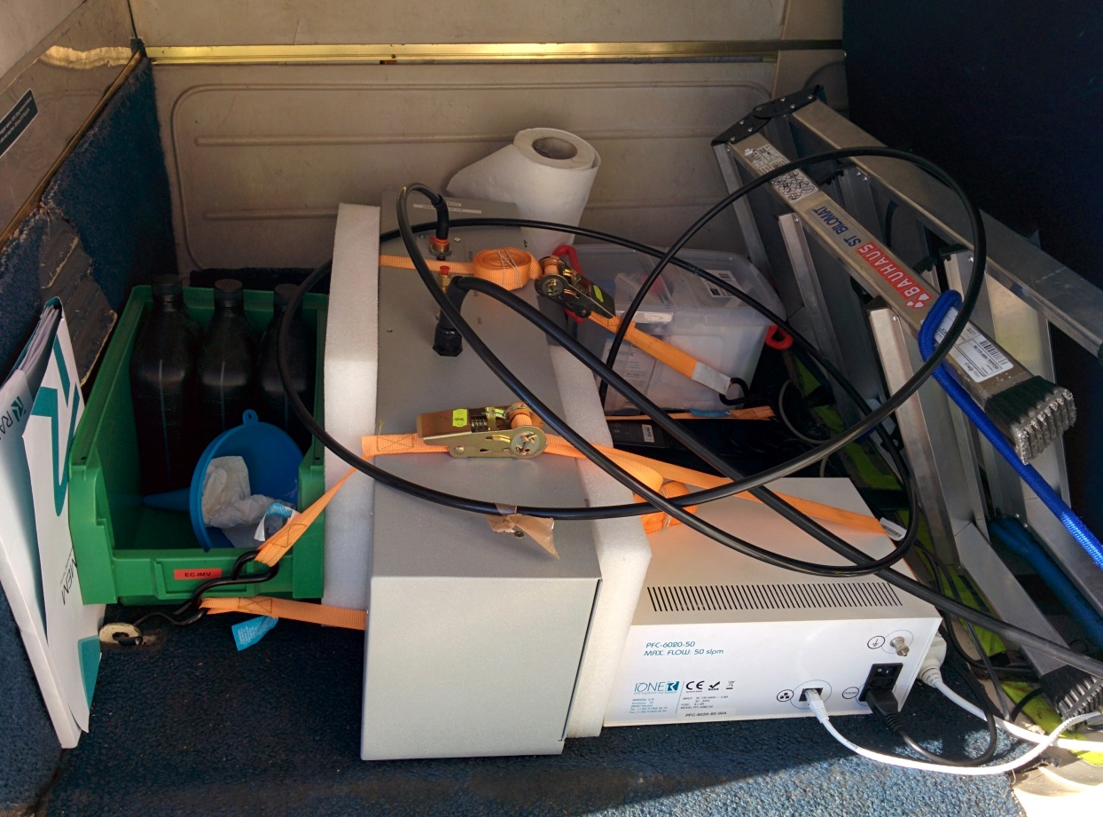
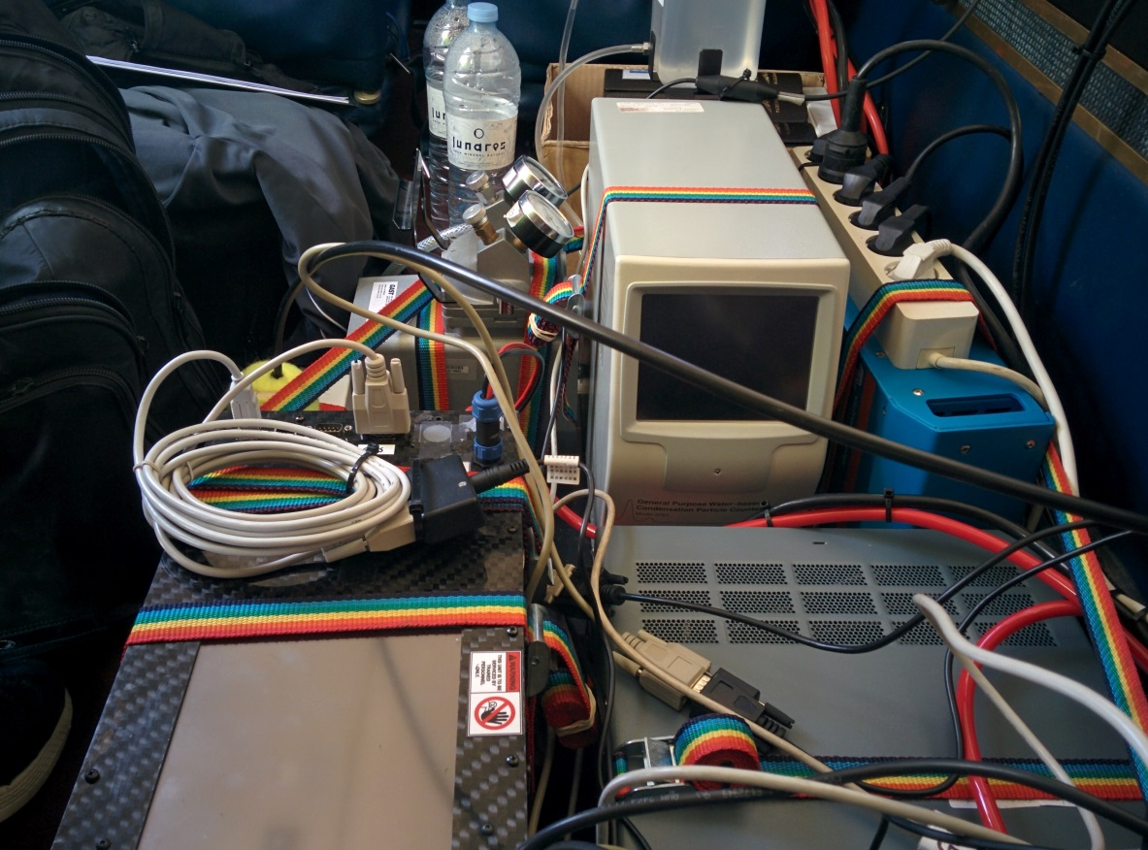
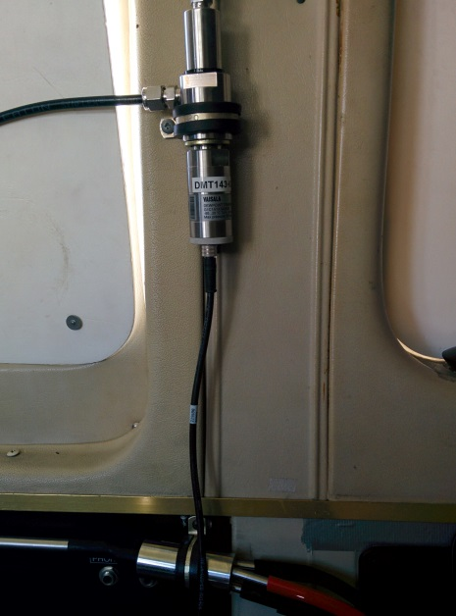
INSTRUMENTED FLIGHT

Slide 20
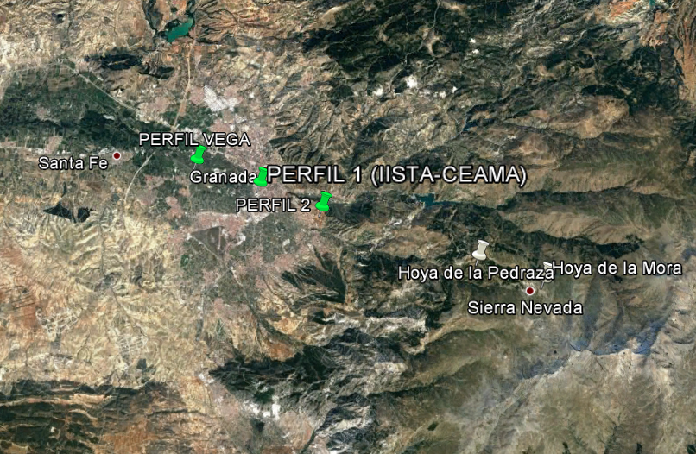
INSTRUMENTED FLIGHT

Slide 21
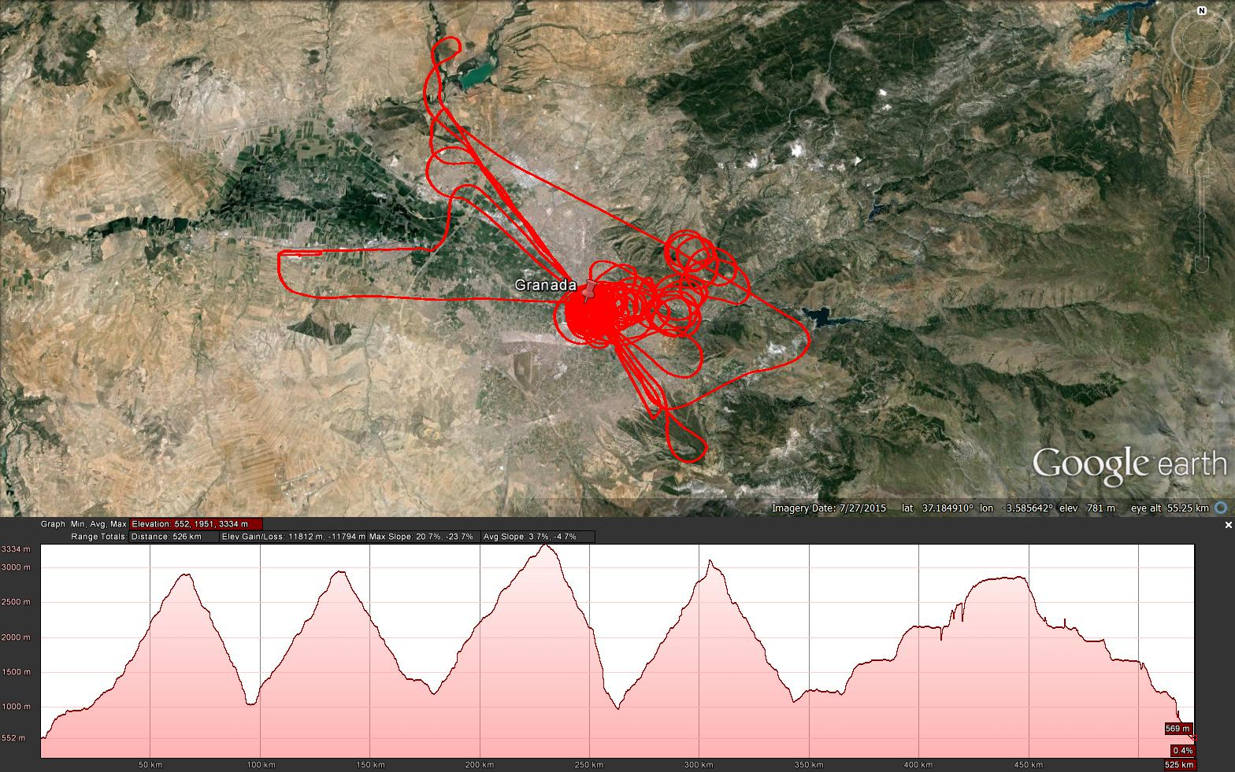
Flight 1
INSTRUMENTED FLIGHT

Slide 22
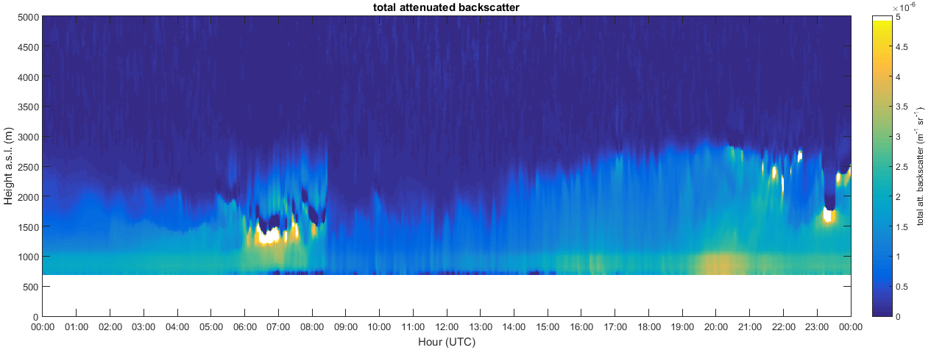
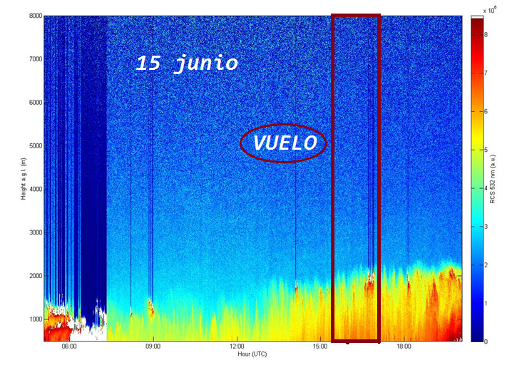
Flight 1
1 2 3 4

Slide 23
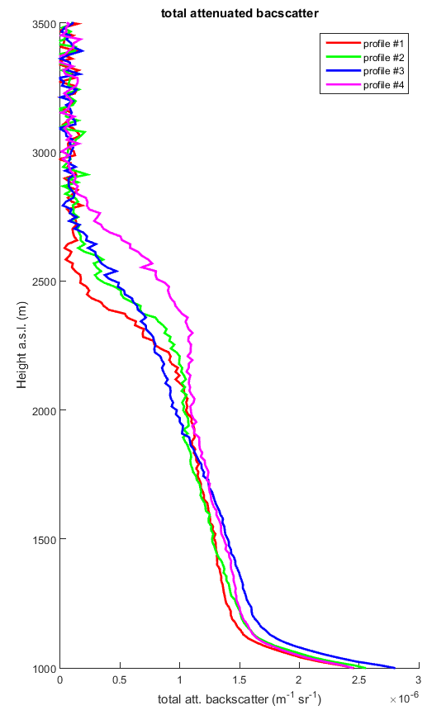
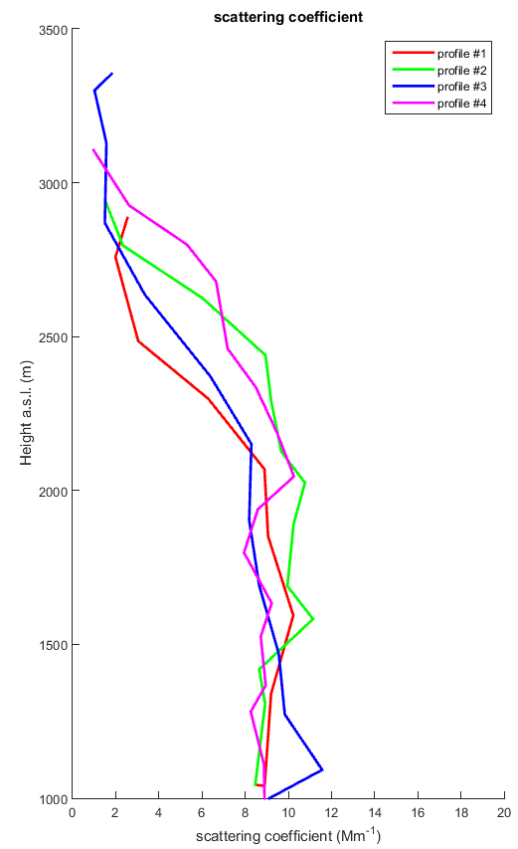
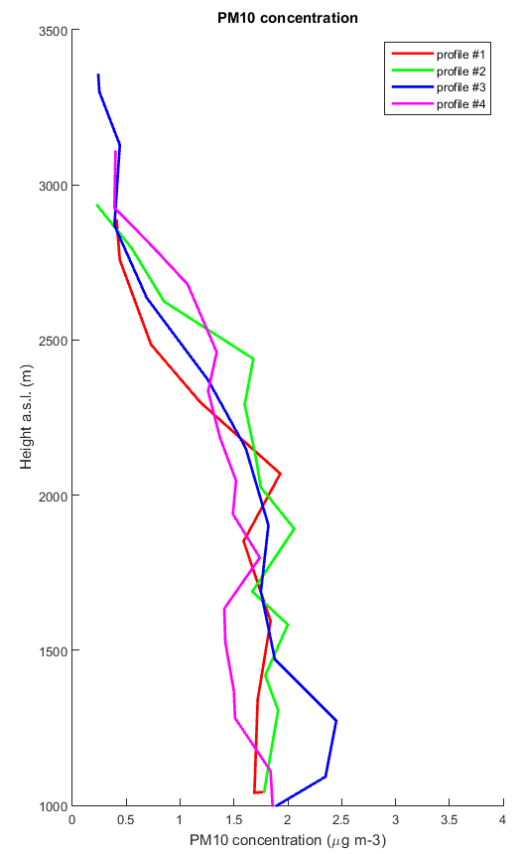
Flight 1
Se observa el ascenso de la capa límite por convección desde el perfil #1 al perfil #4

Slide 24
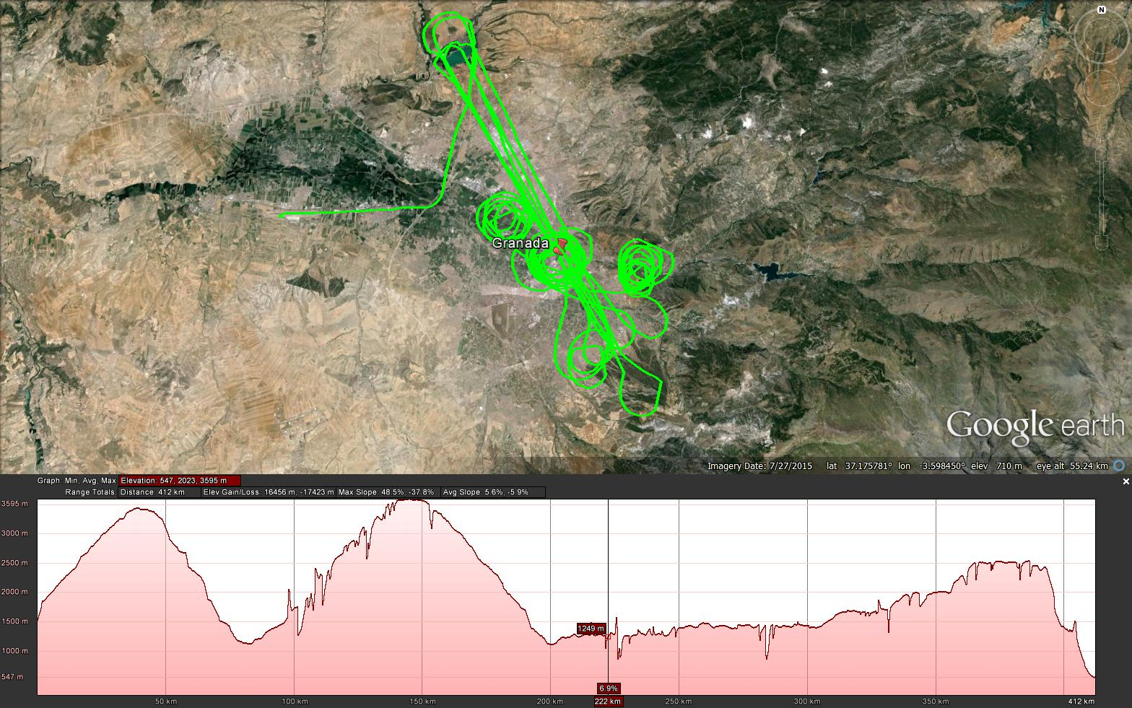
Flight 2

Slide 25
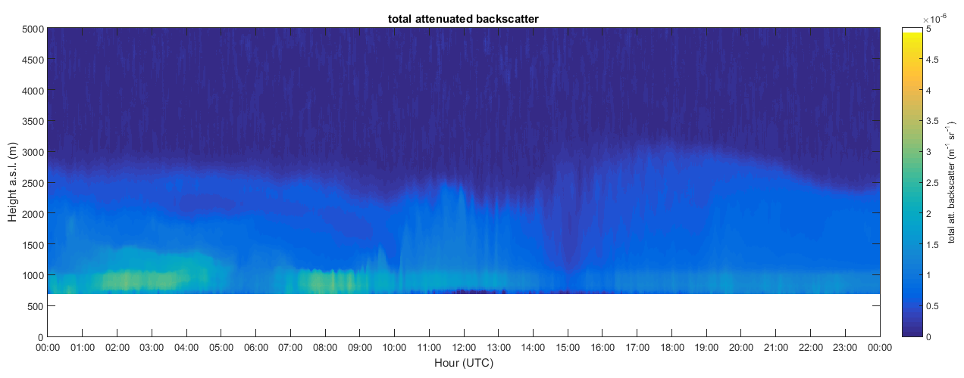
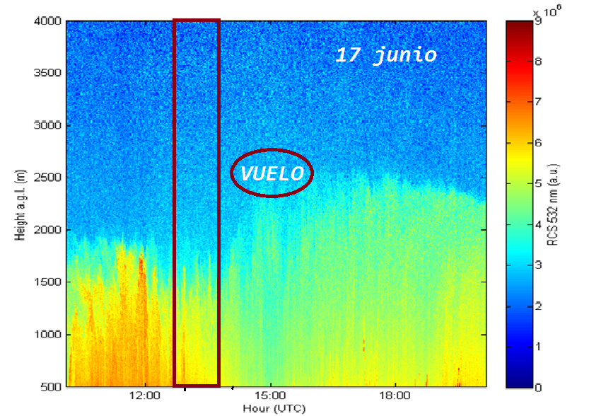
Flight 2
1 2

Slide 26
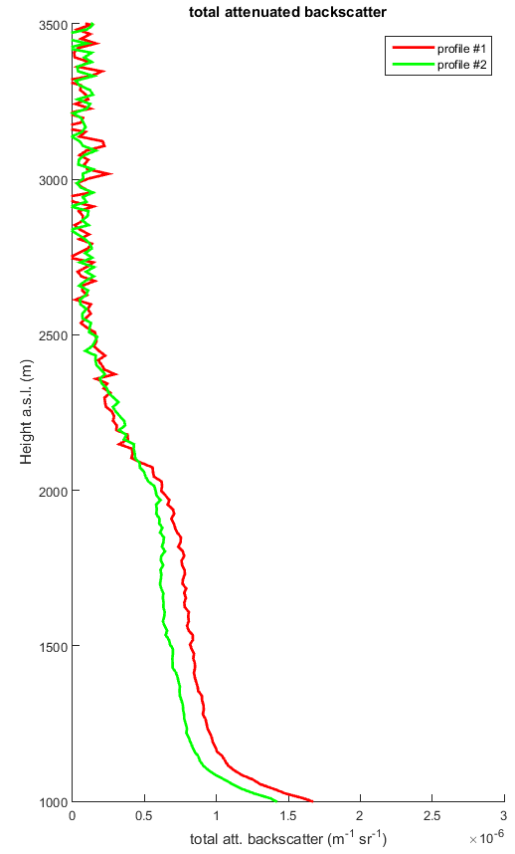
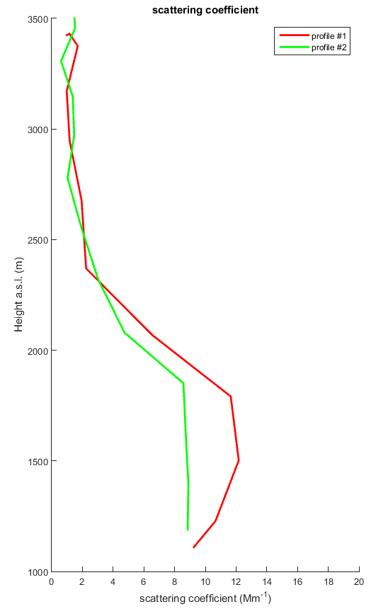
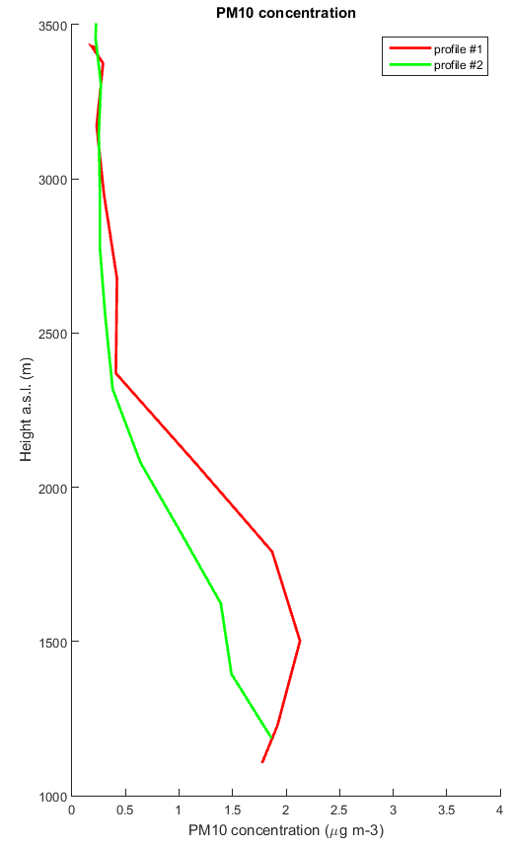
Flight 2

Slide 27
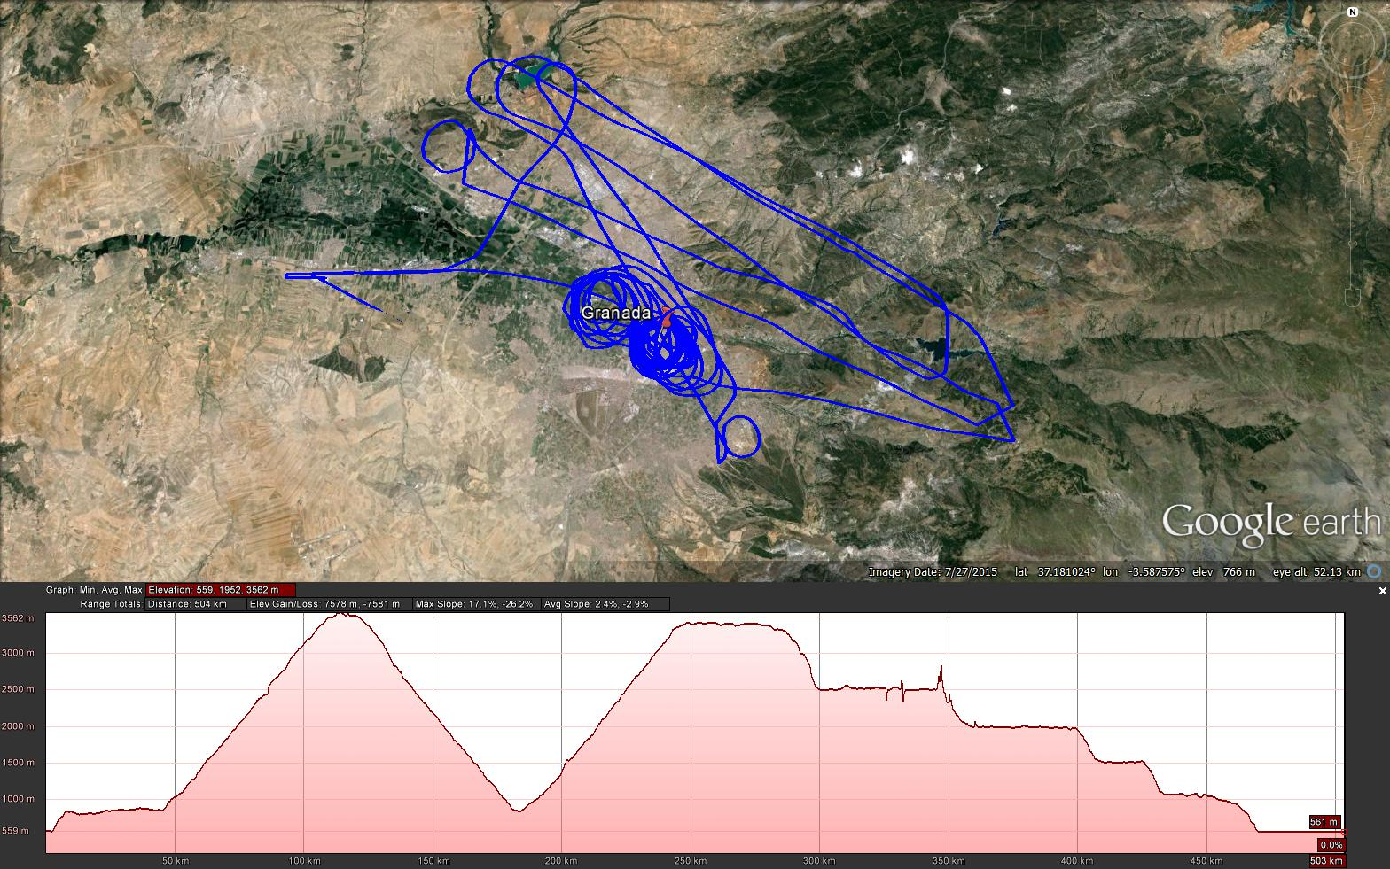
Flight 3

Slide 28
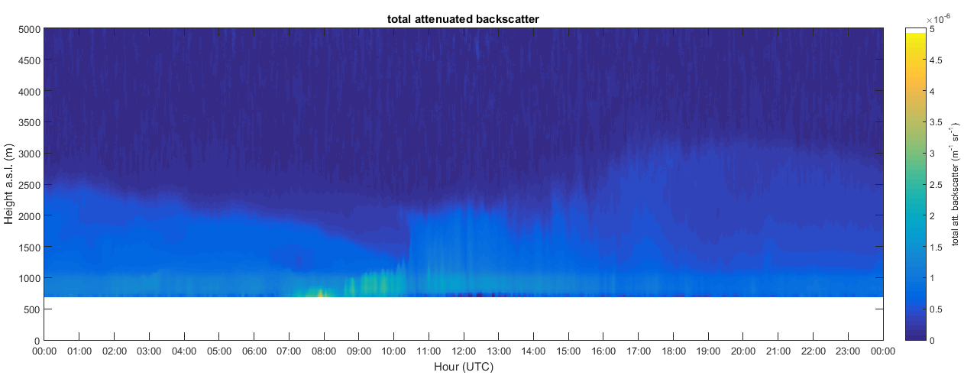
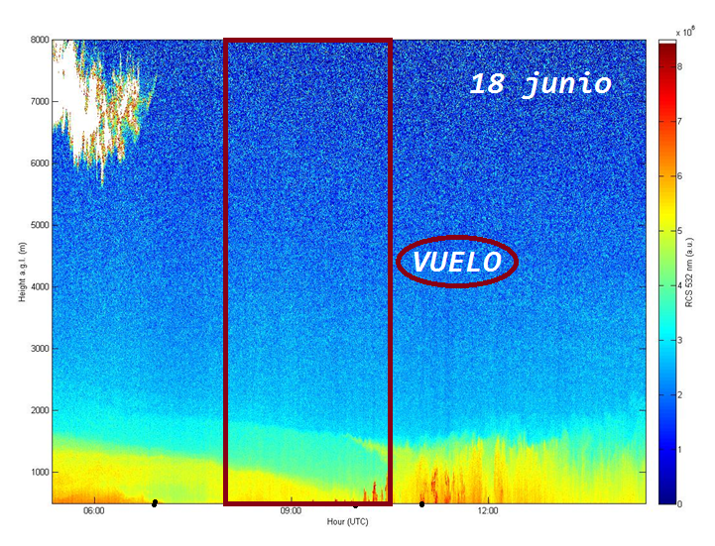
Flight 3
1 2

Slide 29
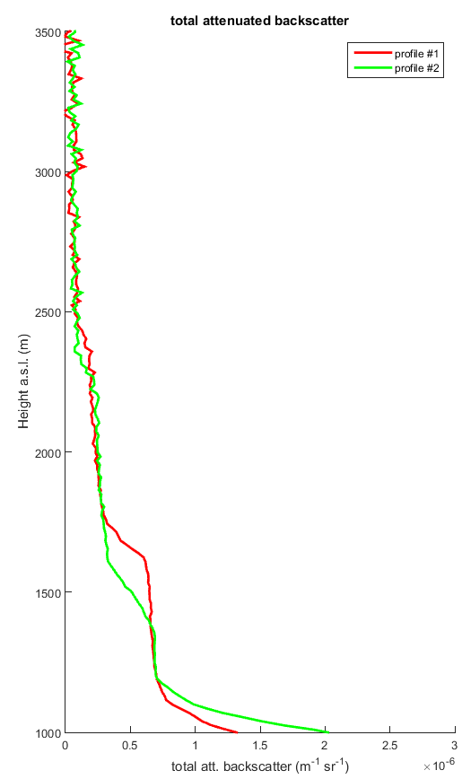
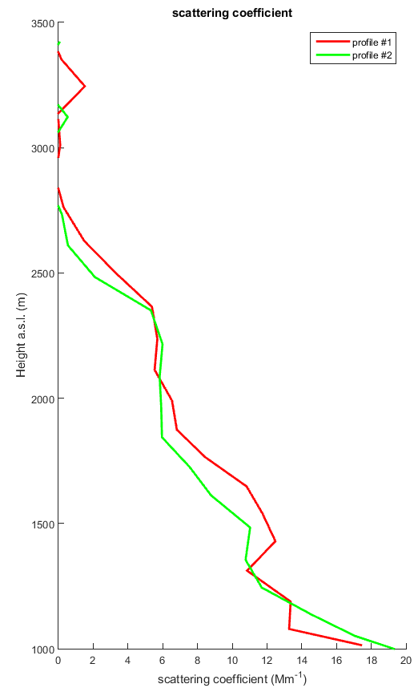
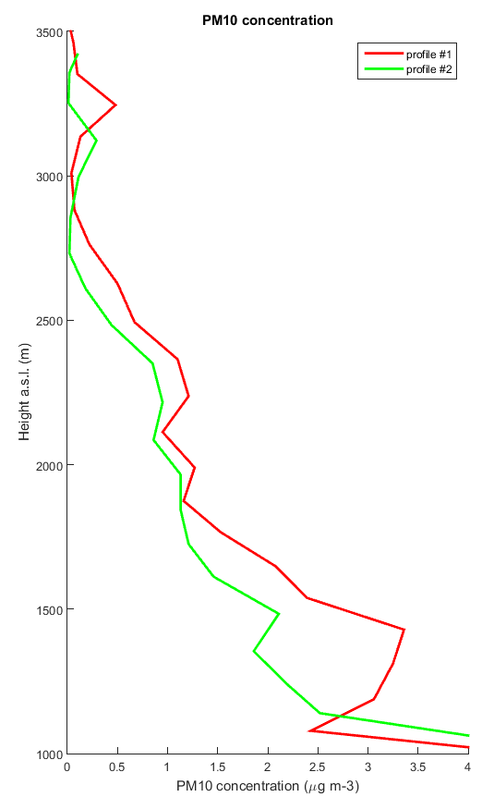
Flight 3

Slide 30
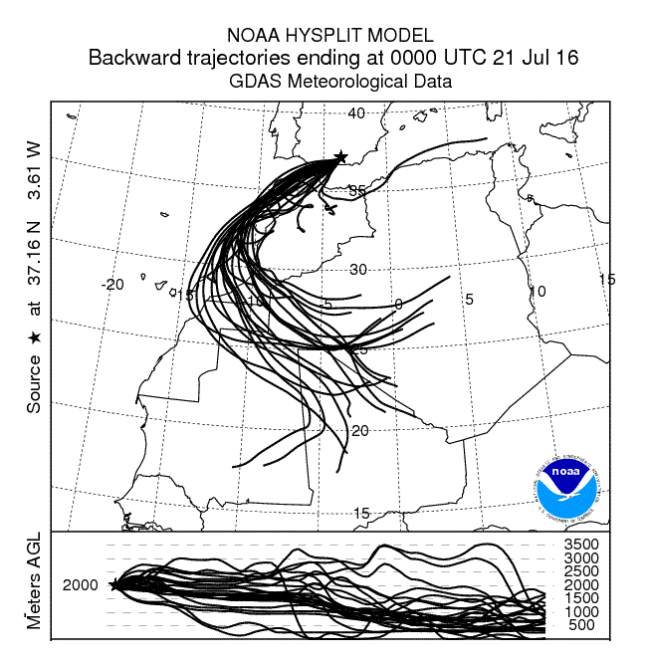
SPECIAL EVENTS 21st JULY

Slide 31
SPECIAL EVENTS
Intense Dust Outbreak

Slide 32
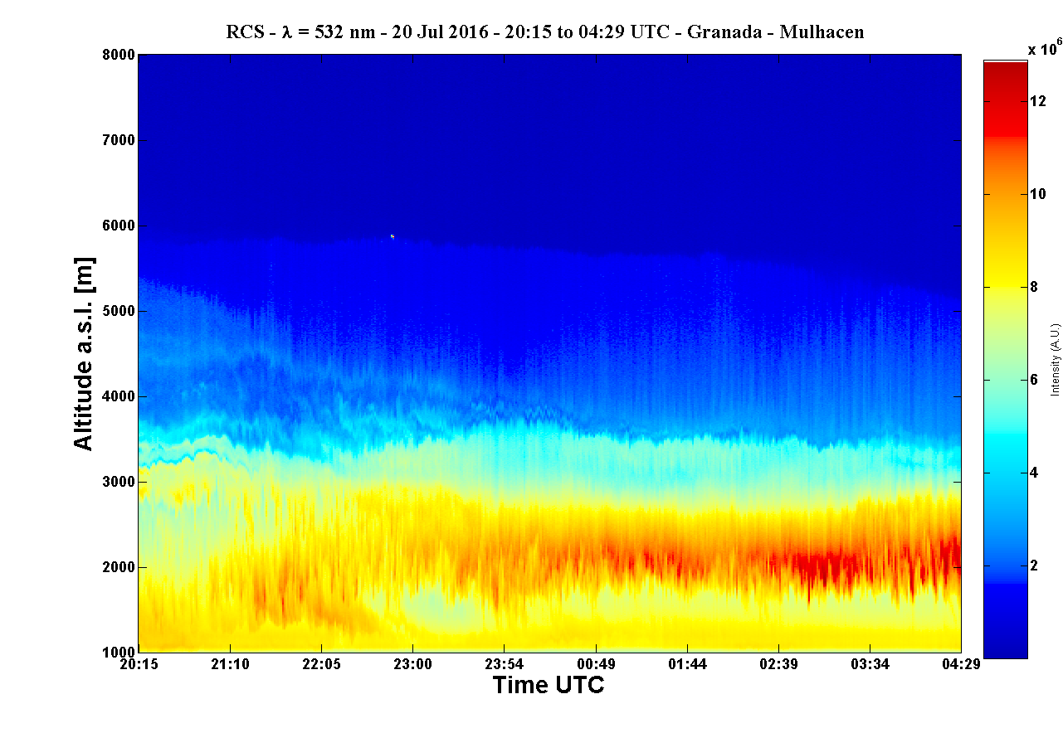
21st JULY

Slide 33
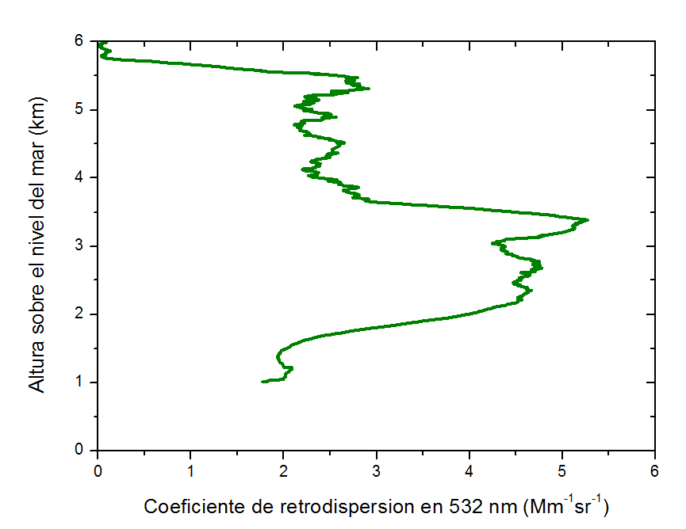
21st JULY

Slide 34
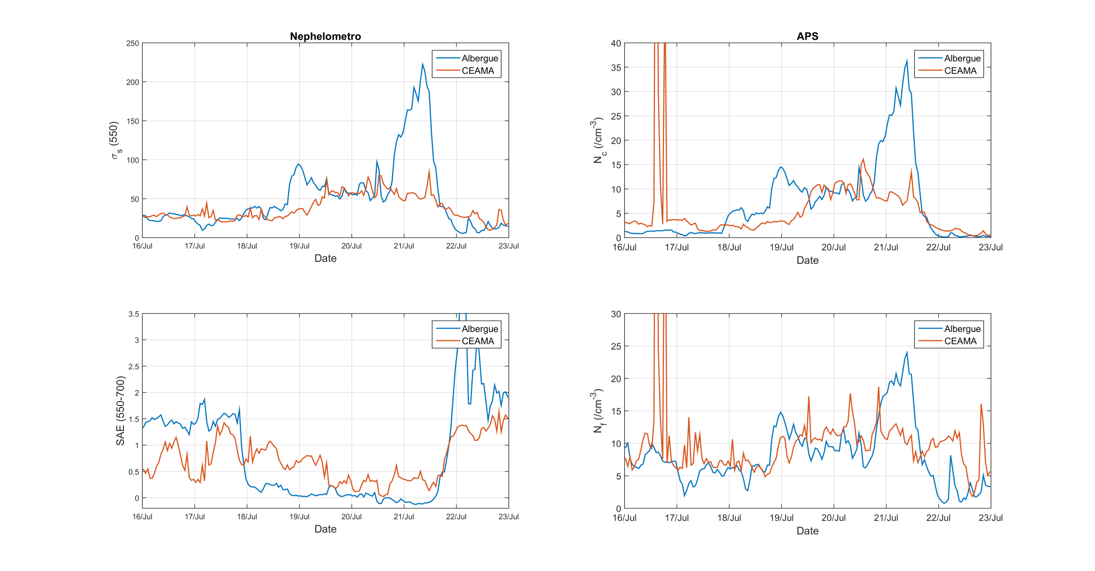
21st JULY
DUST

Slide 35
21st JULY
DUST

Slide 36



Atmospheric Physics Group
Andalusian Institute for Earth System Research. Andalusian Center for Environmental Research.
University of Granada
Spain

Slide 37

Acknowledgements
This work has been funded by:
Ministerio de Economia y Competitividad through Project CGL-2011-13580 and CGL2013_45410-R.
La Junta de Andalucía through project P12-RNM-2409.
European Union’s Horizon 2020 research and innovation programme under grant agreement No 654109, ACTRIS-2
Notes:
A sharp change can be appreciated also in the spectral dependence of AOD represented by the Angstrom exponent.

Slide 38
Thanks!!
Notes:
A sharp change can be appreciated also in the spectral dependence of AOD represented by the Angstrom exponent.

