Slide 1
Making Data Providers’ Contribution Count
Markus Fiebig, and the EBAS team NILU - Norwegian Institute for Air Research

Slide 2
The Case of Data Policies
Today:
Zoo of individually defined data policies, user often needs to contact every data provider when using a self-defined data collection.
Data policies ARE NOT legally binding – violations can’t really be sanctioned.
Data use is very difficult to quantify (beyond download statistics).
Future: Easier use of readily available data – a system similar to that for scientific articles:
A type of widely used license is attached to the data (e.g. Creative Commons)
License is easy to understand for user and legally binding – abuse has legal consequences.
Data are tagged with PIDs, i.e. DOIs
Quoting / Use of data DOIs is counted similar to scientific articles.

Slide 3
Existing Puzzle Pieces of Future: Creative Commons Licenses
Creative Commons Licenses General Features:
Copyright stays with originator
Allow non-commercial use.
Users have to credit originators for their work.
Users have to keep copyright notices intact.
Additional license components:
Attribution (CC BY): users may distribute / build upon work, but have to give credit for original work.
Attribution-Share Alike (CC BY-SA): as CC BY, but requires the same license for the product.
Attribution-NoDerivs (CC BY-ND): redistribution allowed, but work may not be changed / built upon.
Attribution-NonCommercial (CC BY-NC): users may build upon work, but only non-commercially
Attribution-NonCommercial-ShareAlike (CC BY-NC-SA): as CC BY-NC, but requires the same license for the product.
Attribution-NonCommercial-NoDerivs (CC BY-NC-ND): only download and sharing allowed

Slide 4
Existing Puzzle Pieces of Future: DOIs, Digital Object Identifiers
DOI: Digital identifier for objects.
Requires metadata to be registered when assigning DOI.
Metadata may change with time.
DIOs can be used on data in several ways:
Identification of whole primary repository with one DOI.
Identification of all data archived at fixed granularity (primary DOI)
provides quantifiable credit to data provider
clumsy to use
Identification of user selected data collections or products based on data collections (collection DOI)
Easy and flexible to use
Each originator is quoted only once independently of contribution magnitude to the collection
Potential zoo of cross-references and double DOIs

Slide 5
Existing Puzzle Pieces of Future: DOIs, Digital Object Identifiers
DOI: Digital identifier for objects.
Requires metadata to be registered when assigning DOI.
Metadata may change with time.
DIOs can be used on data in several ways:
Identification of whole primary repository with one DOI.
Identification of all data archived at fixed granularity (primary DOI)
provides quantifiable credit to data provider
clumsy to use
Identification of user selected data collections or products based on data collections (collection DOI)
Easy and flexible to use
Each originator is quoted only once independently of contribution magnitude to the collection
Potential zoo of cross-references and double DOIs

Slide 6
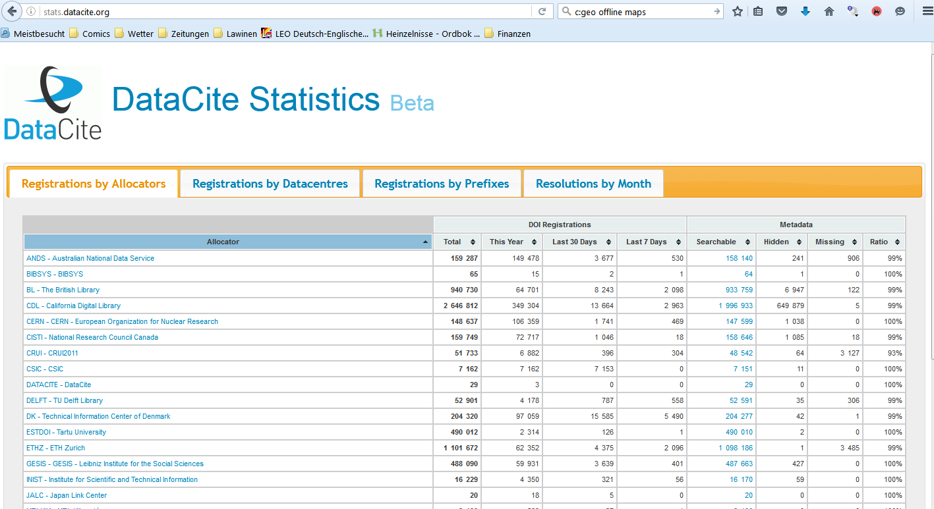
Existing Puzzle Pieces of Future: Qantification of DOI Use
http://stats.datacite.org/

Slide 7
Steps to be Taken to Reach Targeted Citation Service
Primary identification of all data archived in a primary data centre with suitable, but homogeneous granularity.
Enables correct quantification of data providers contribution.
Data collections / data products need to include references to the primary identifiers of all data contained in the collection
Facilitates that contributions can be counted correctly even when using collection DOIs.
Any services quantifying data use need to refer to the primary identifiers issued by the data’s primary data centre. References to identified data collections need to be resolved to the primary identifiers to facilitate correct quantification of data use.
Need for a corresponding recommendation has been transferred to RDA.

Slide 8
Steps to be Taken by ACTRIS Data Centre Nodes
All ACTRIS DC nodes need to identify DOI registrar for them to use, and clarify details around machine-based DOI assignment (API).
Figure out suitable granularity for issuing primary DOIs
Figure out how to include DOI assignment into your data curation workflow.
Example at EBAS:
Use newly established Norwegian DOI registration node.
Granularity: one DOI per 1 year of data per instrument at a station (1 DOI per submitted data file).
Assign DOI on import of data file into database.

