Slide 1

Recent updates from ACTRIS Data Centre Cathrine Lund Myhre, Markus Fiebig, Ann Mari Fjaeraa, Paul Eckhardt, Richard Olav Rud, Robert Logna NILU – Norwegian institute for air research
WP3 workshop in Bologna, Italy 11-13 October 2016

Slide 2
ACTRIS DC workshop in Utrecht 12-13 September
Strategy for collection, archiving and access to campaign data and data from JRA, including model data and results
Updates & news on the ACTRIS Data Portal
Where can I find our ACTRIS recommendations for the XX type of measurements?
Deliverables in progress on ACTRIS data provision and access
What is 1 ACTRIS data set?
Statistics and information on use of ACTRIS data in EBAS
DOI strategy within ACTRIS

Slide 3
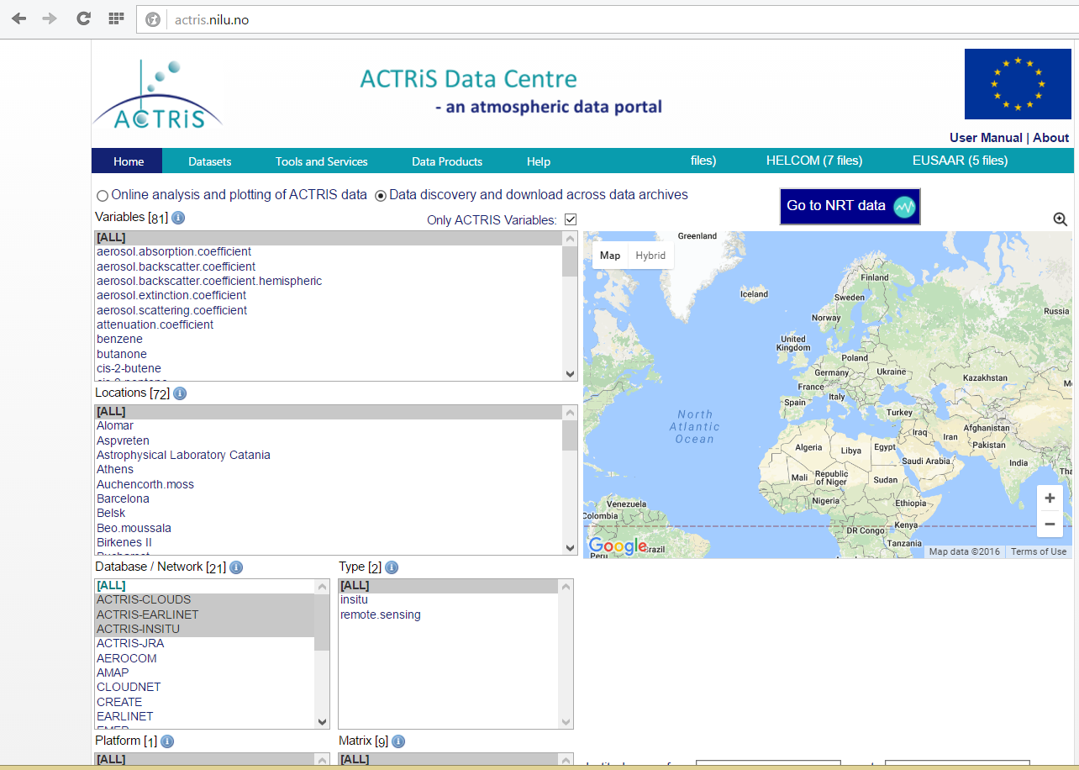
Updates in the ACTRIS Data Portal http://actris.nilu.no

Slide 4
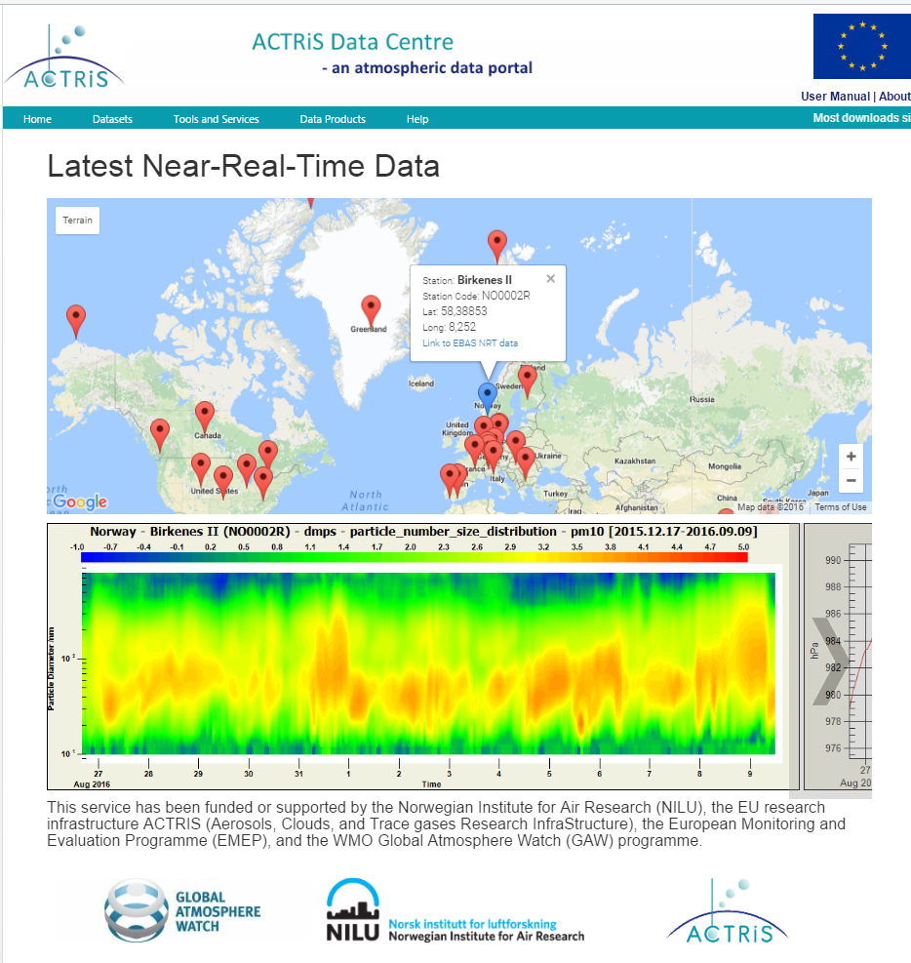
Updates in the ACTRIS Data Portal http://actris.nilu.no

Slide 5
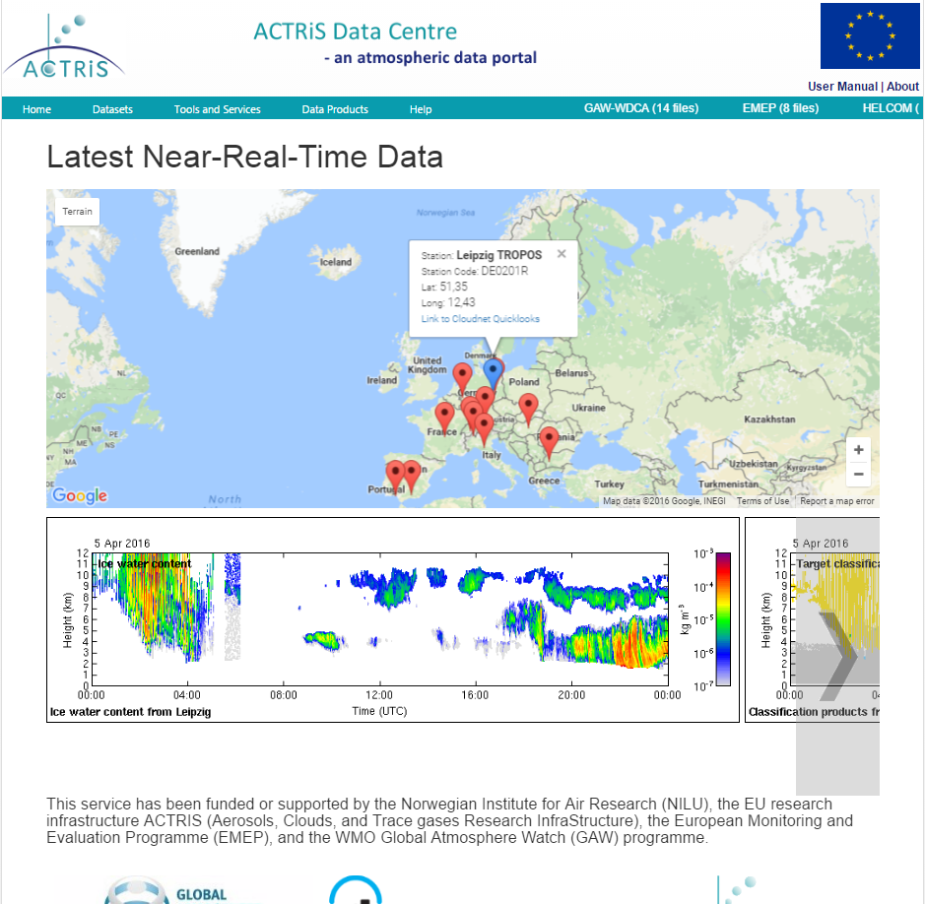

Slide 6
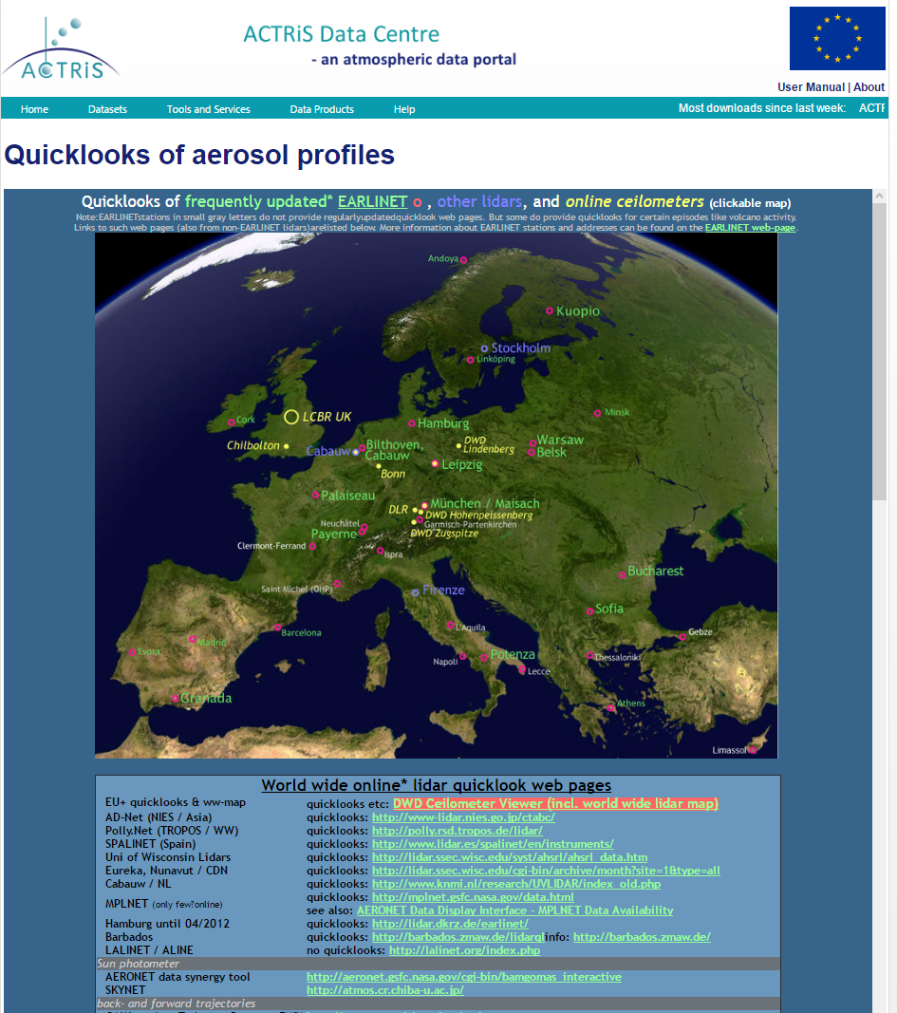
Updates in the ACTRIS Data Portal http://actris.nilu.no

Slide 7
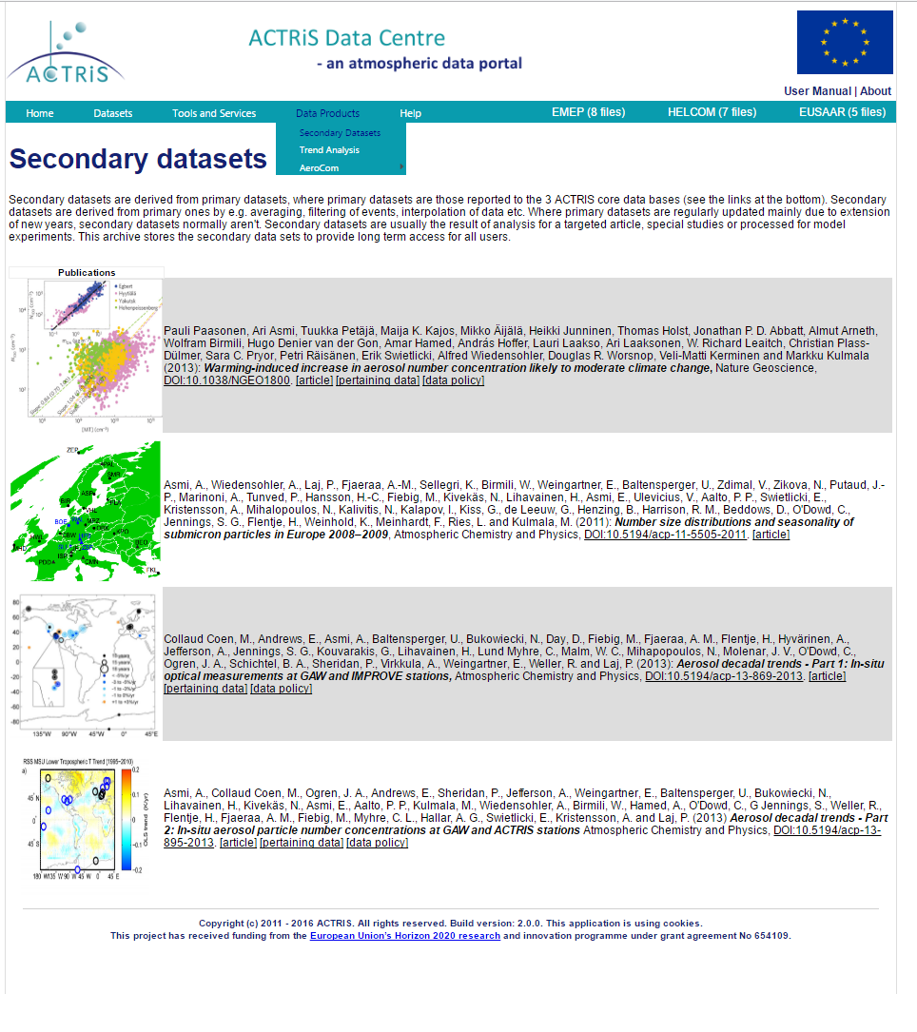

Slide 8
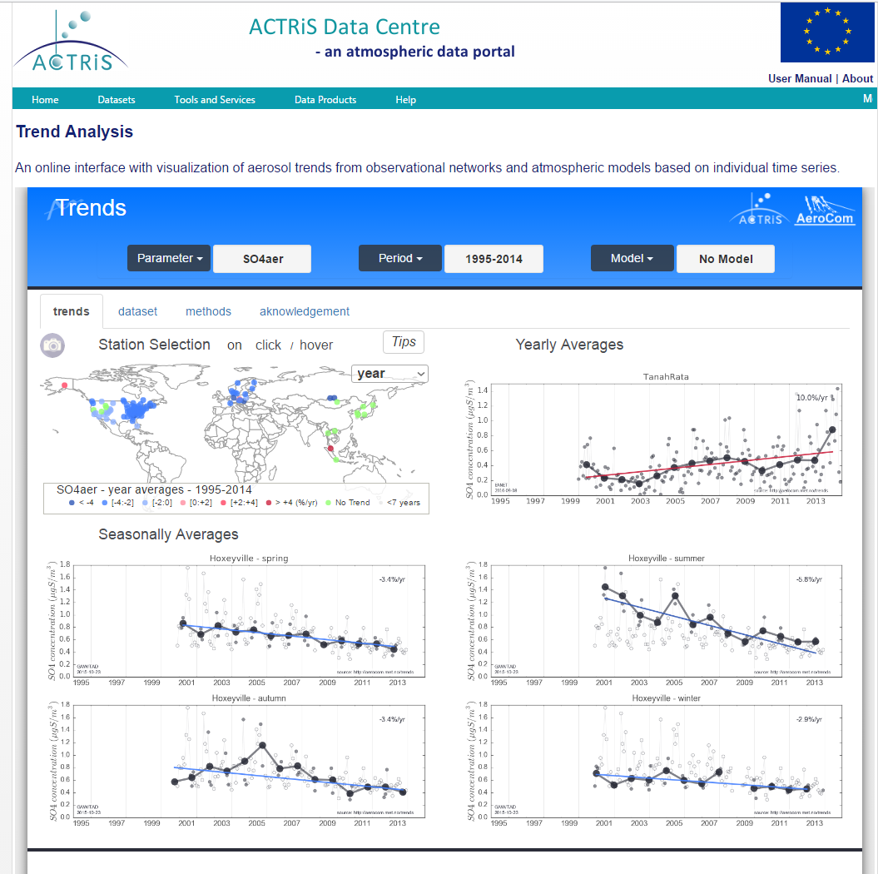

Slide 9
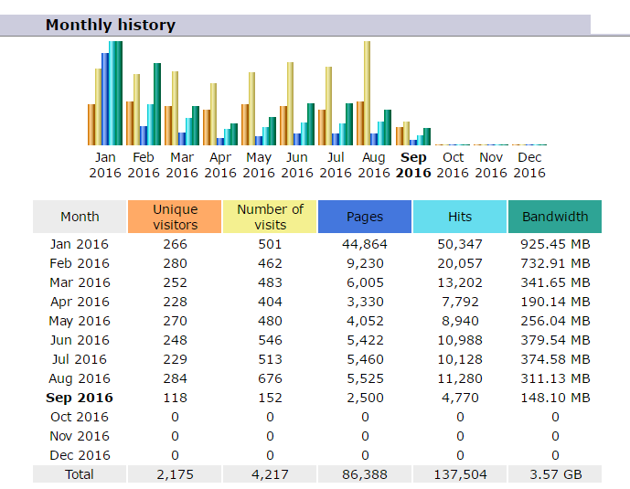
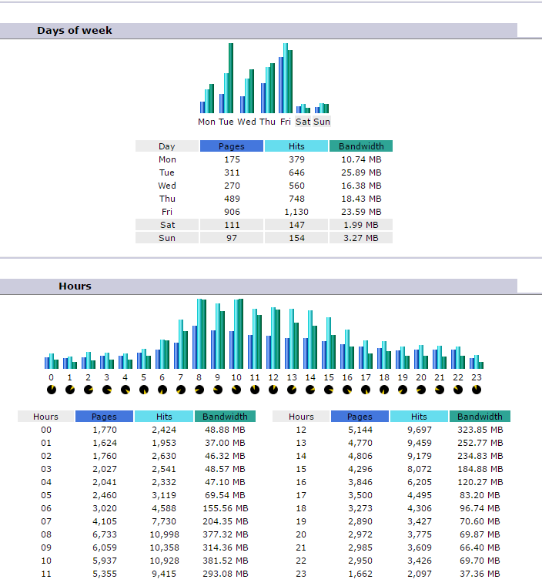
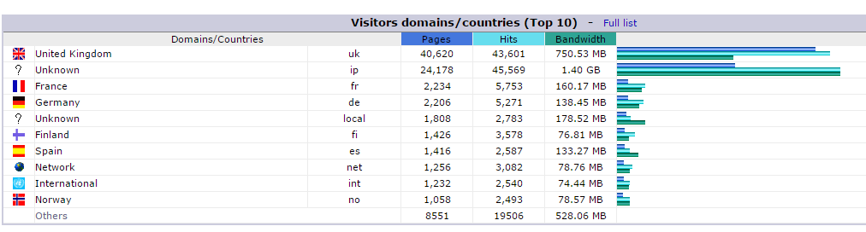
Web statistics as well for the portal

Slide 10
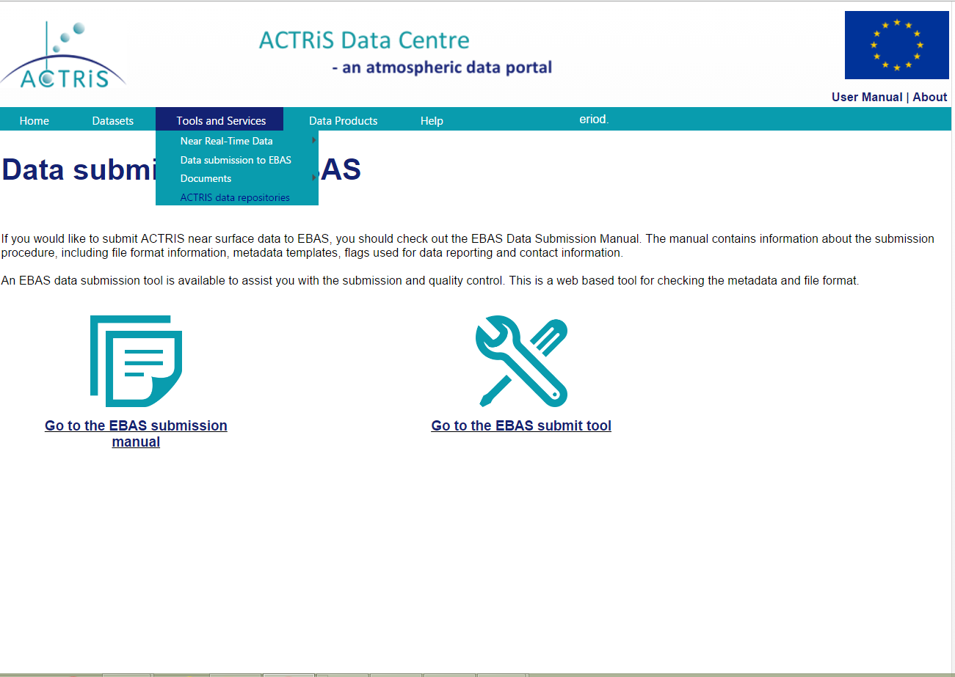
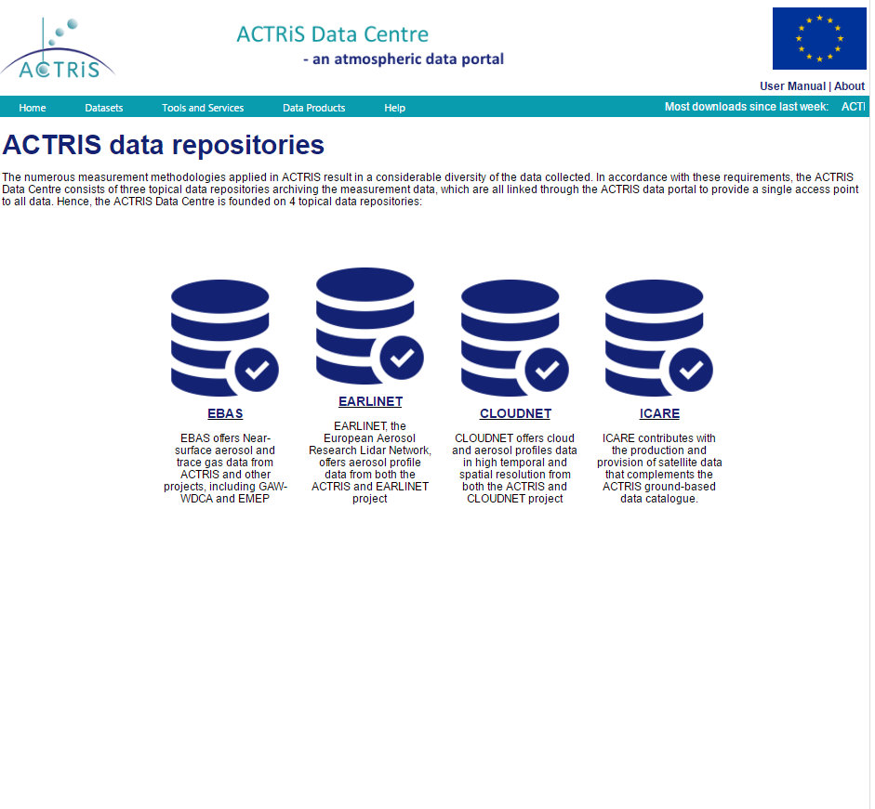

Slide 11
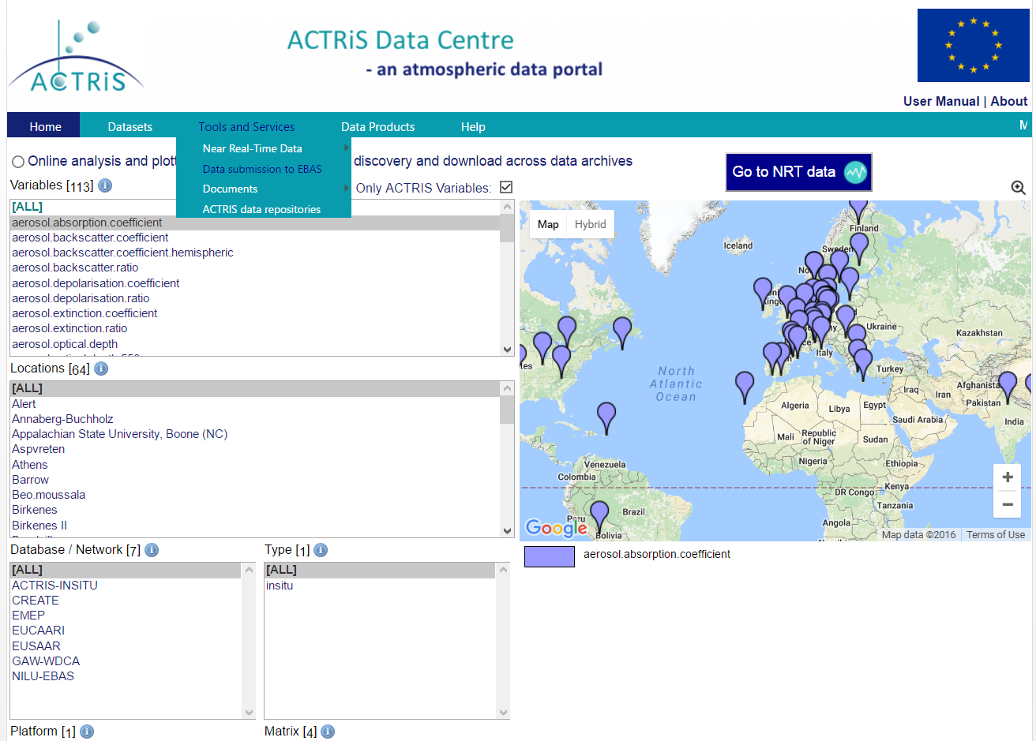
Where can I find our ACTRIS recommendations for the XX type of measurements?
Entry to overviews with:
Recommended methodologies for the determination of aerosol physical, chemical and optical properties from ground-based sites in ACTRIS
Recommended methodologies for measurements of trace gases from ground-based sites in ACTRIS
In progress, ready by end of 2016?

Slide 12
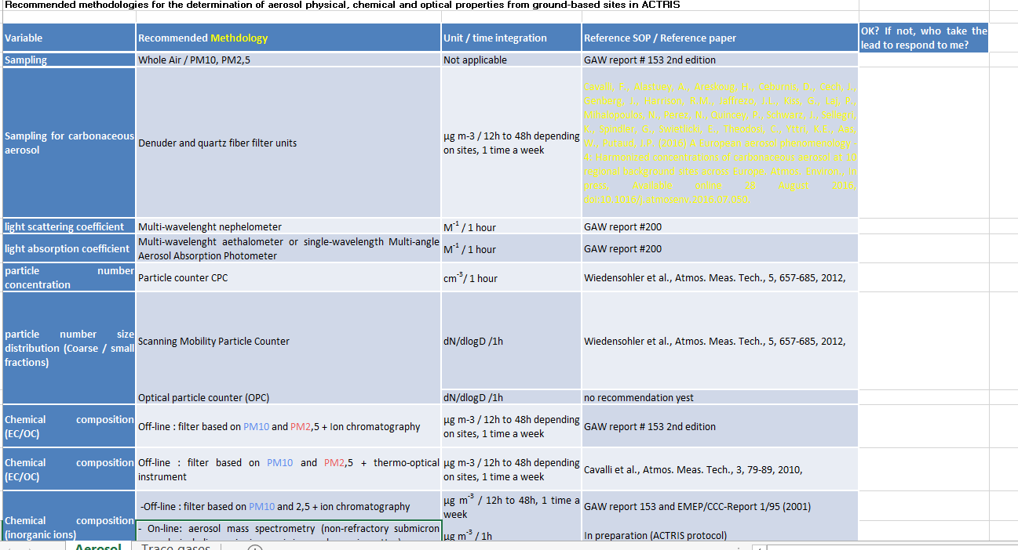
The e-mail from Paolo to Jean Philippe and others…

Slide 13
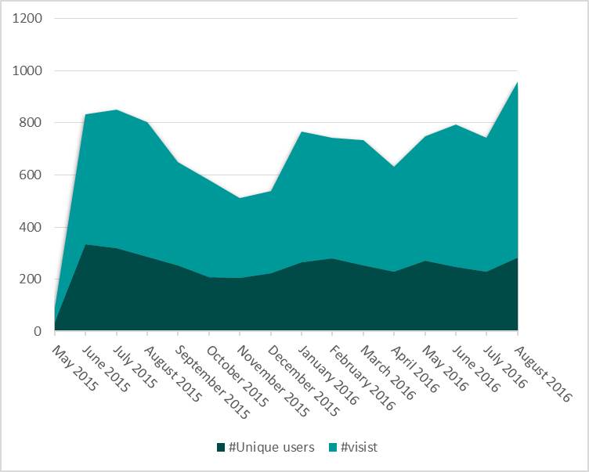
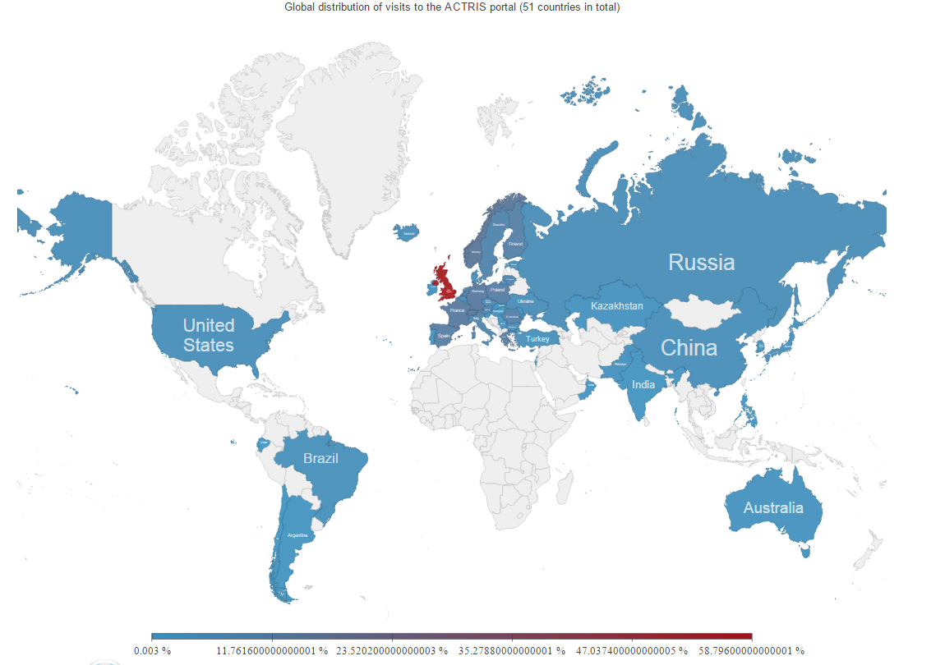
Does anyone visit the portal?
In total more than 7000 visit since May 2015 from more than 50 countries
On average ca 260 different users accessing the ACTRIS data portal each month
UK has used the portal extensively, more and the fractionated use is shown in Figure
A dynamic version of the map with more information is available from here: https://actris.github.io/actris-statistics/

Slide 14
Monitoring of ACTRIS DC, data provision and use
D10.2 First summary of the ACTRIS data offered by the ACTRIS Data Centre – delayed to M19
ACTRIS aerosol near surface data archived in the topic data base EBAS hosted by NILU (Norway)
ACTRIS trace gas near surface data archived in the topic data base EBAS hosted by NILU (Norway)
ACTRIS aerosol profile data archived in the topic data base EARLINET DB hosted by IMAA (Italy)
ACTRIS cloud profile data archived in the topic data base Cloudnet DB hosted by UREAD (United Kingdom)
Provision of ACTRIS NRT data
Provision of secondary ACTRIS data and products offered through the ACTRS data portal: http://actris.nilu.no
D10.3 First summary of the monitoring of access to ACTRIS data and user statistics – delayed to M19
Monitoring of access to ACTRIS aerosol near surface data
Monitoring of access to ACTRIS trace gas near surface data
Monitoring of access to ACTRIS aerosol profile data
Monitoring of access to ACTRIS cloud profile data
Monitoring of access to ACTRIS Data Portal and products offered through the ACTRIS data portal: http://actris.nilu.no

Slide 15
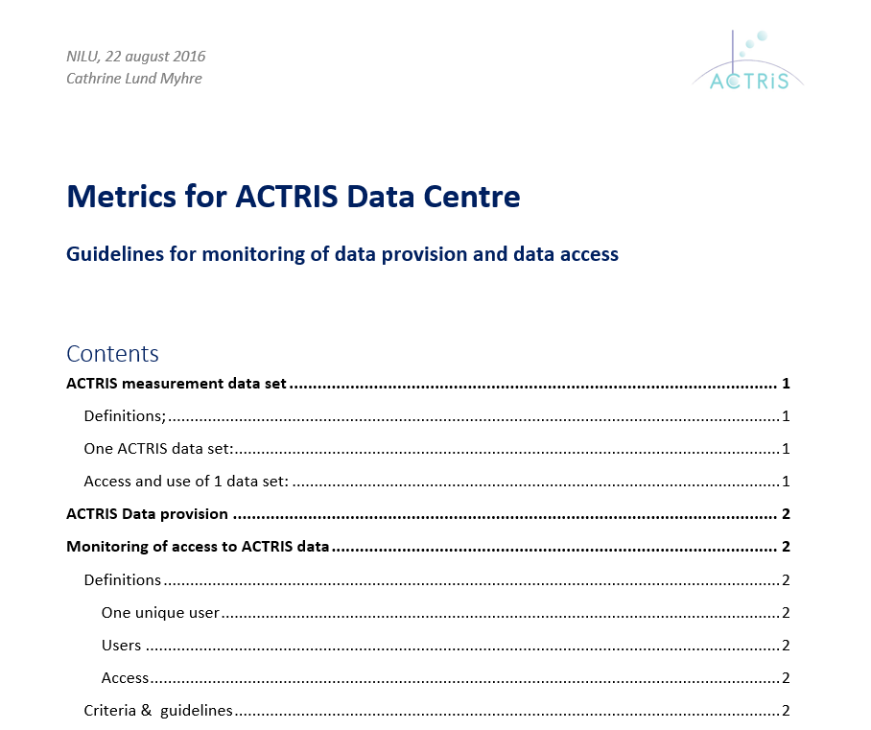
Metrics for ACTRIS Data Centre
We have set up common metrics across ACTRIS to be able to provide harmonised statistics
Monitoring of ACTRIS Data provision
What are the data provided by ACTRIS last year? How many sites are contributing with continues long-term measurement? How is this developing over time? How many sites and datasets are included in the NRT data provision?
Monitoring of access to ACTRIS data
What are the monthly download, plotting and inspection of data in the ACTRIS data centre? How is the geographical distribution of users? And where are data used most intensively?

Slide 16
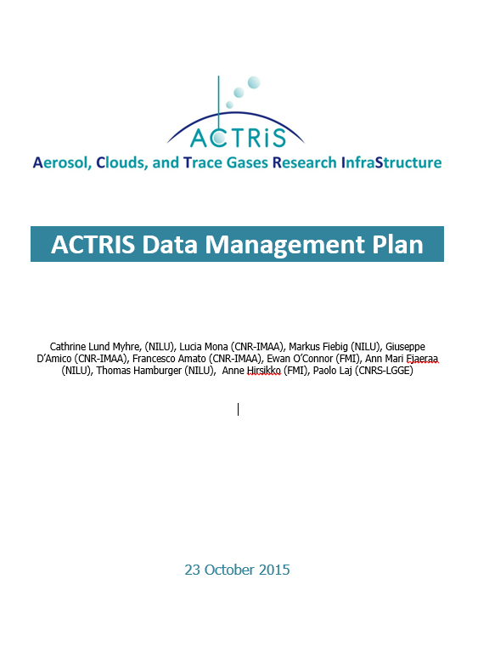
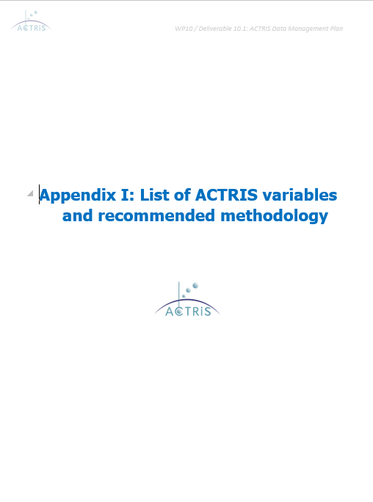
One ACTRIS data set
Harmonised definition across all ACTRIS topic data bases is established
One ACTRIS data set: is one variable per year of measurement data with time resolution as defined in appendix 1 in the ACTRIS data management plan. The instrument has to comply with the recommendations and provide data for at least 75% if the total time defined there, over 1 year.
Access and use of 1 data set: The access of one data set: follow the definition of the data set above. Access of full year of data is 1. If a user only plot or download part of the year, this is reflected.

Slide 17
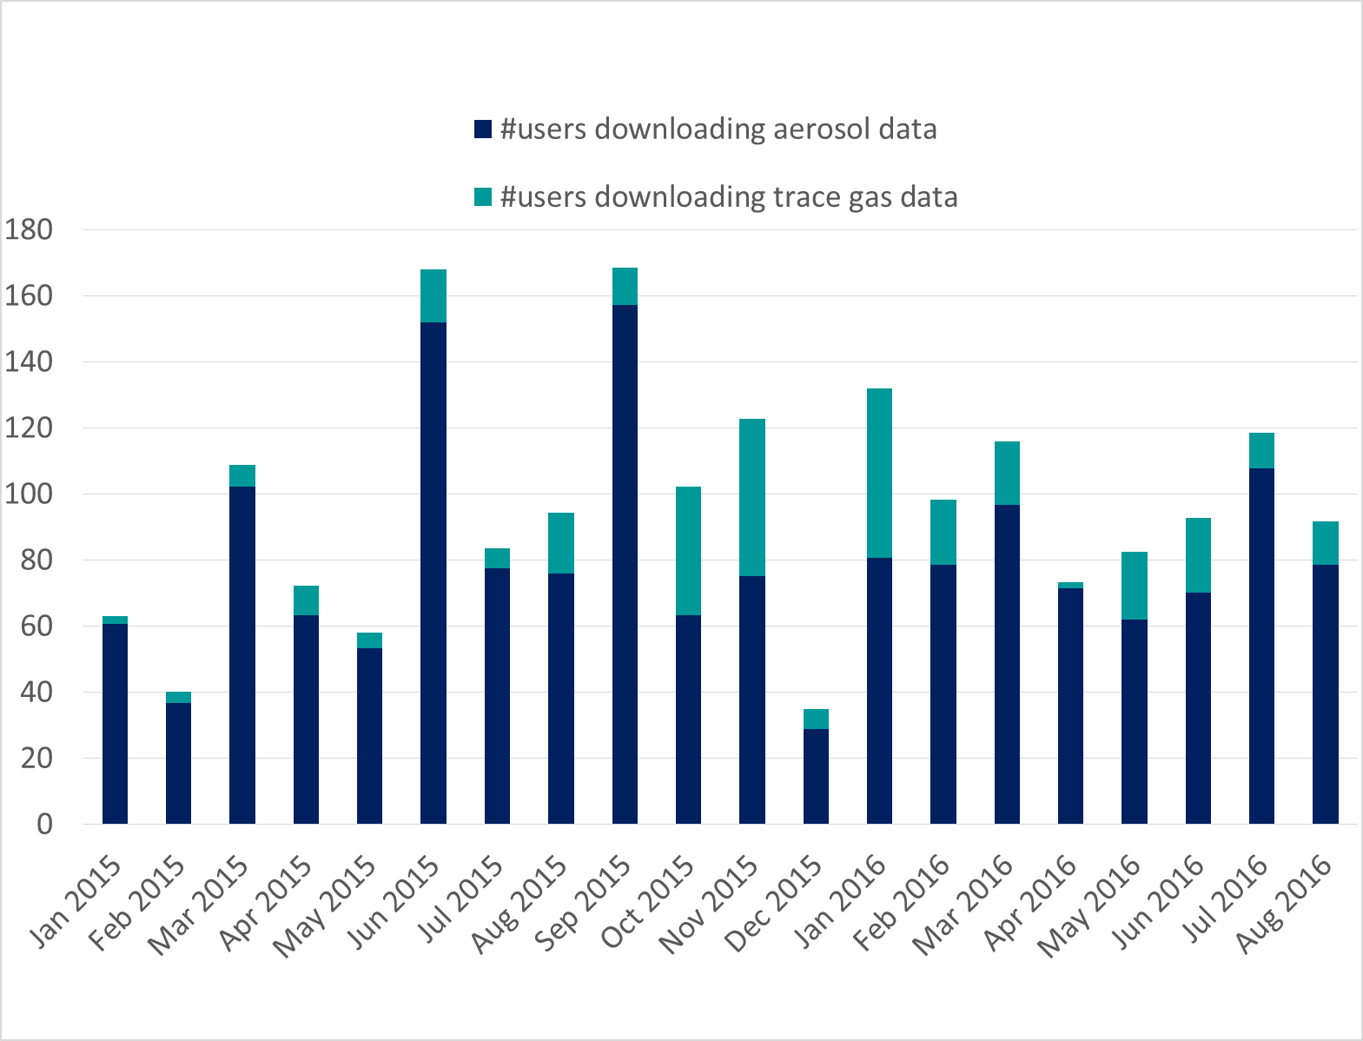
Access statistics of ACTRIS near surface data
Data from all years, back in time to CREATE -> EUSAAR -> ACTRIS-FP7-> ACTRIS-2, only included sites with European leading partner
Access and use of long time series back in time, hence comparing trace gases and aerosols is misleading, but still I will do this now also so we can follow this development at a later stage.
Since January 2015, ACTRIS-2 start:
near surface data are downloaded 1325 times by ca 450 different users, from 42 Countries
85% aerosol data
15 % trace gases

Slide 18
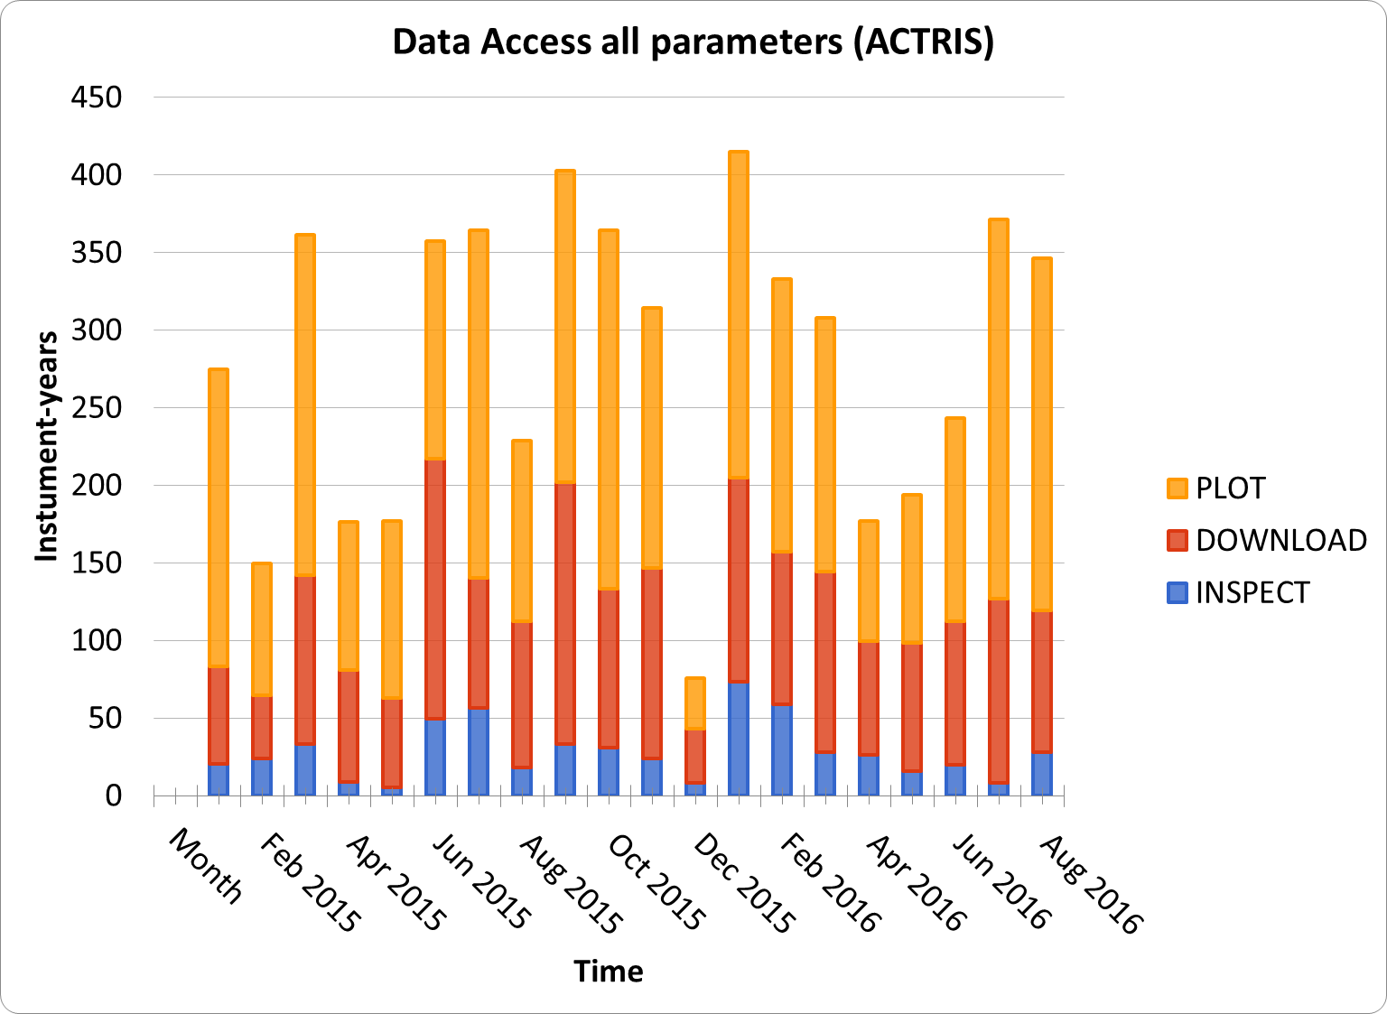
Overall: All ACTRIS near surface data
Total years of data downloaded: 1943
Total years of data plotted: 3144

Slide 19
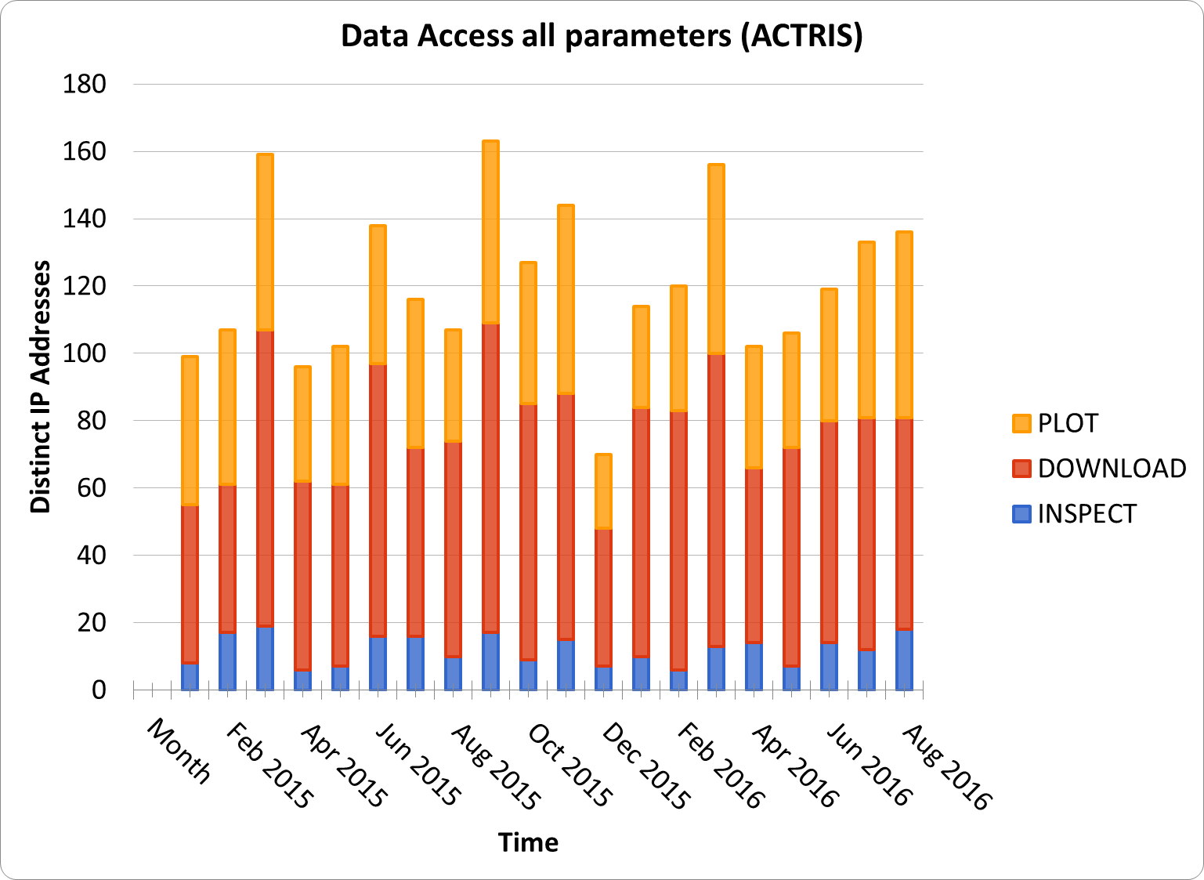
Overall: All ACTRIS near surface data
Total # of separate downloads: 1325
Total # of separate plotting: 848

Slide 20
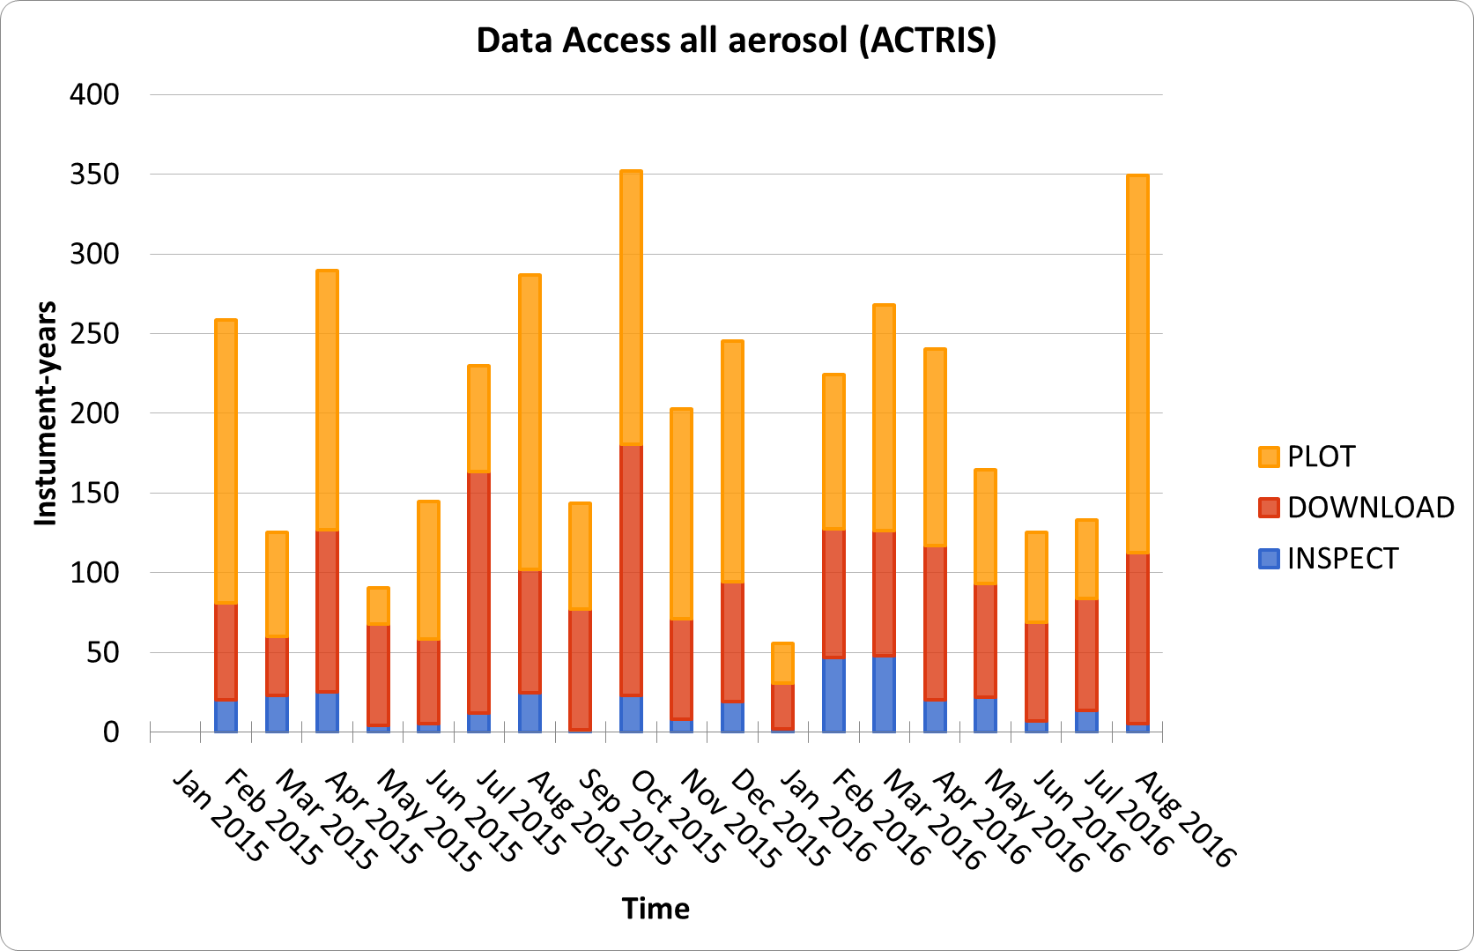
ACTRIS aerosol near surface data
Total years of data downloaded: 1591
Total years of data plotted: 2252

Slide 21
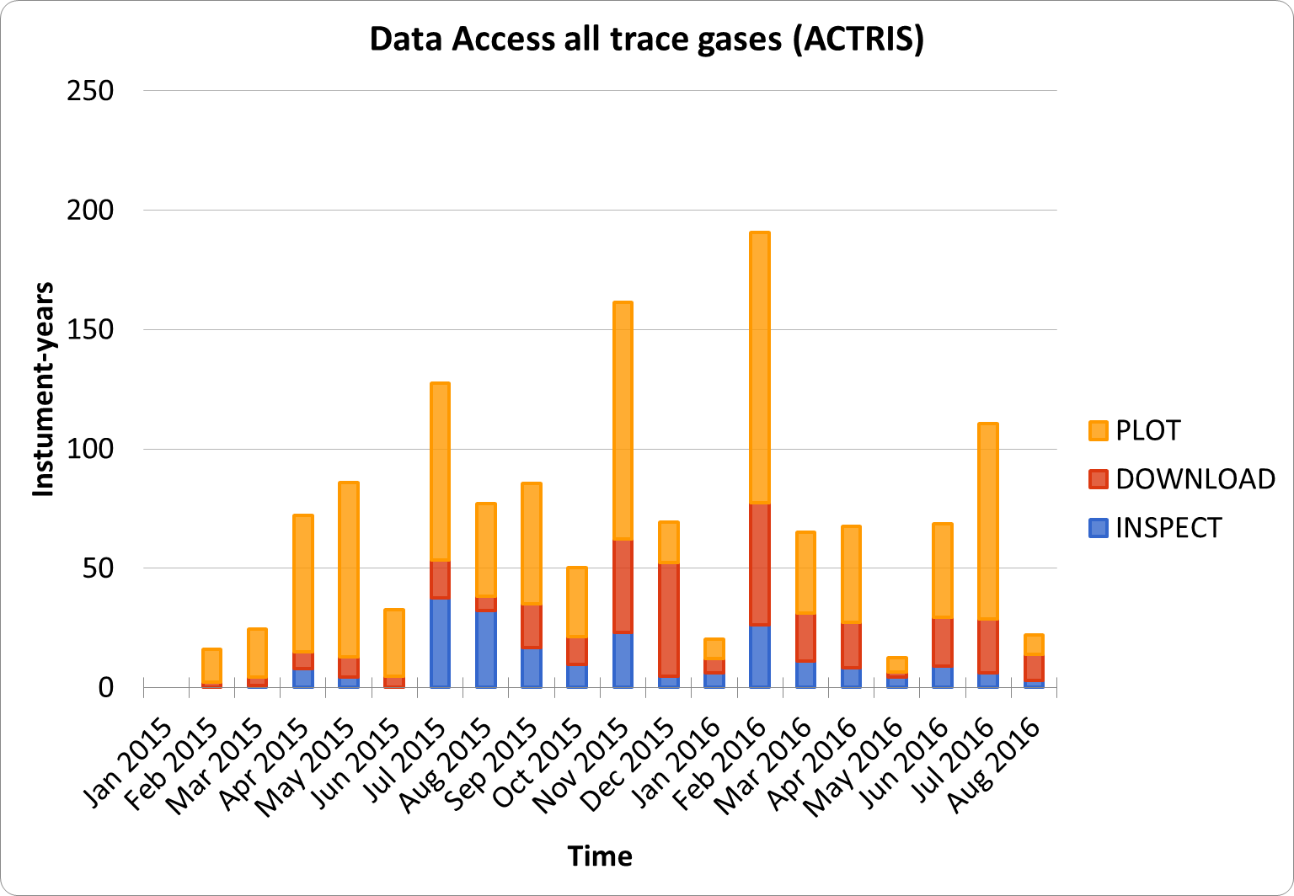
ACTRIS trace gas near surface data
Total years of data downloaded: 329
Total years of data plotted: 891

Slide 22
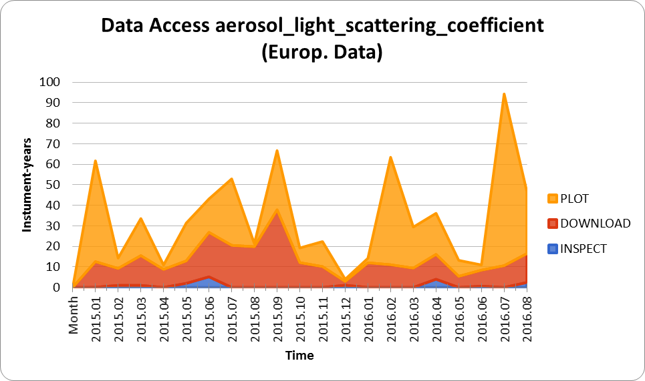
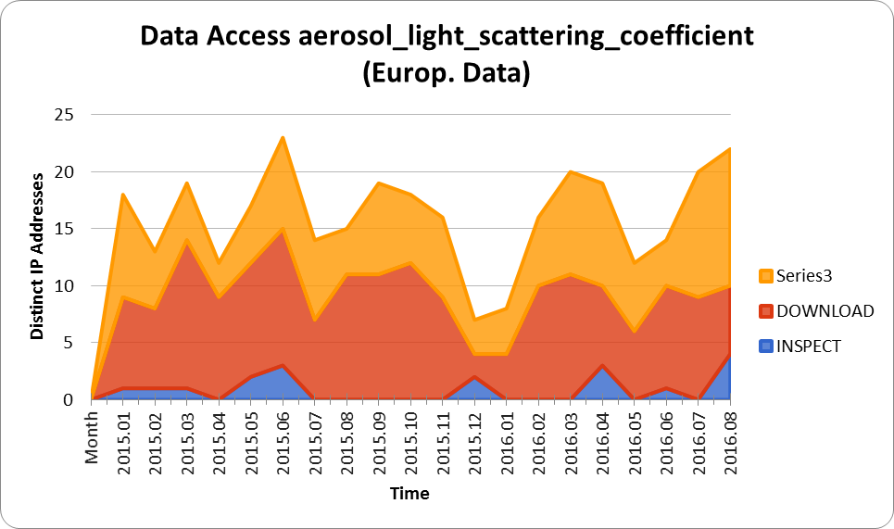
Access to particle scattering coefficient

Slide 23
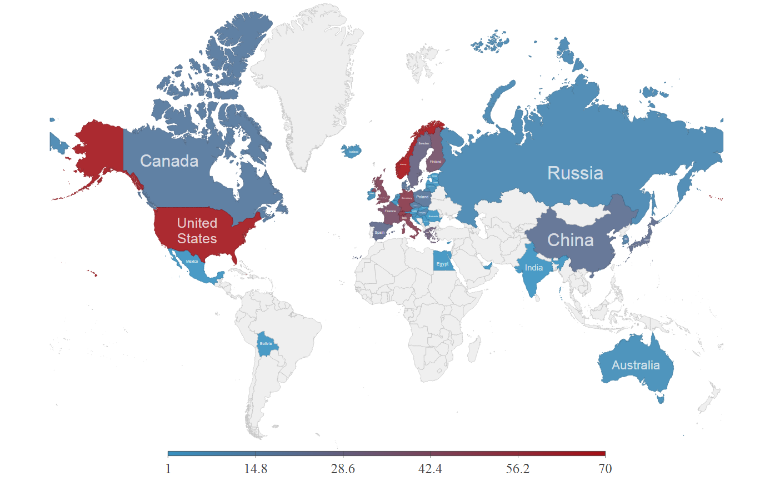
Summary; Since January 2015, ACTRIS-2 start All near surface data
https://actris.github.io/actris-statistics/
Near surface data are downloaded 1325 by ca 450 different users, from 42 Countries
85% aerosol data
15 % trace gases

Slide 24
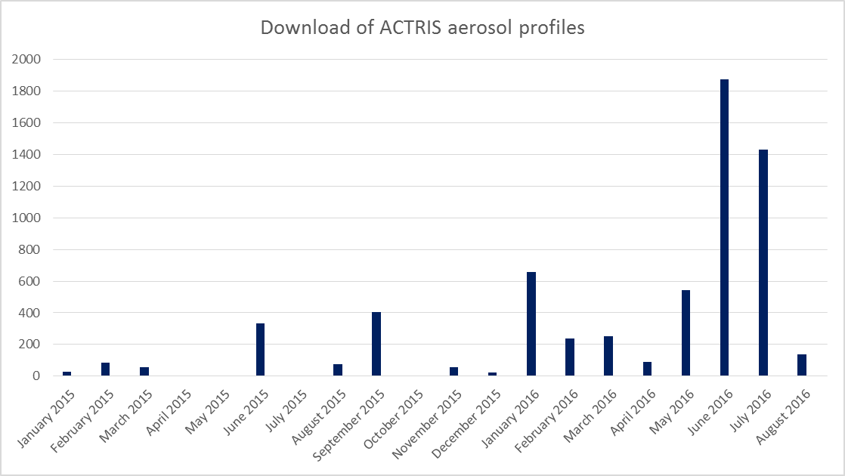
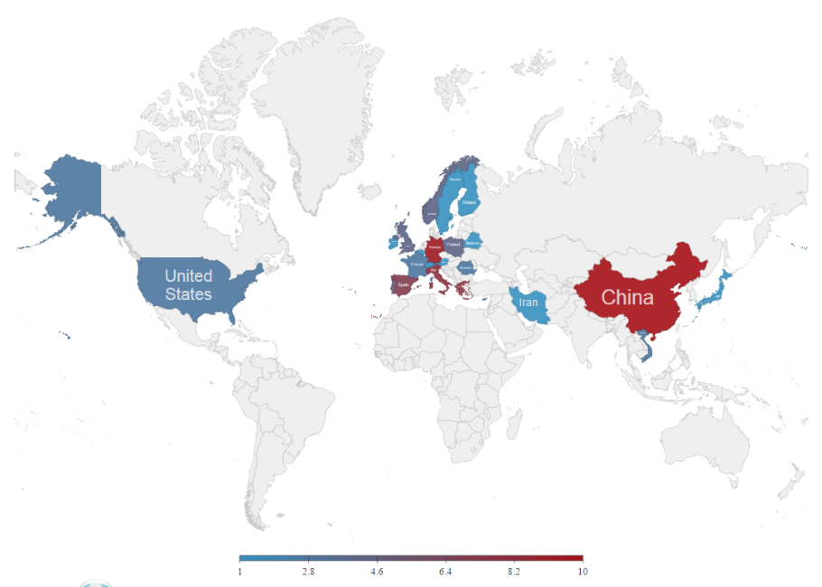
Summary; Since January 2015, ACTRIS-2 start Aerosol profiles
https://actris.github.io/actris-statistics/
There are 72 users from 24 countries downloading 6285 yearly data sets.

Slide 25
Who are the users, and how are the data used? How can we know more about the users, and ensure proper involvement, co-authorship and acknowledgment? The strategy is to implement DOI (Digital identifier for objects) across the research infrastructure

Slide 26
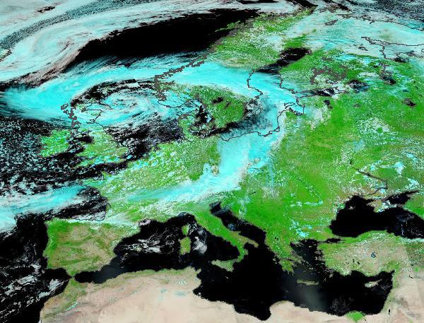
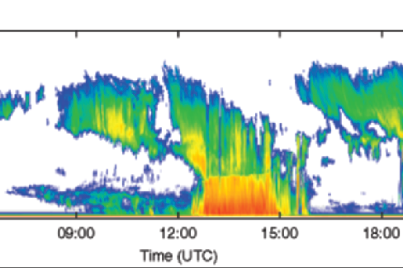
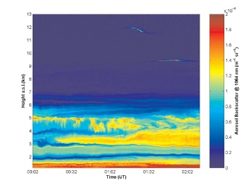
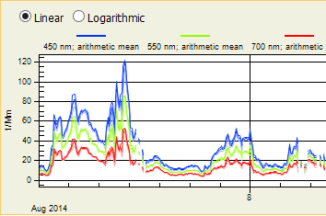
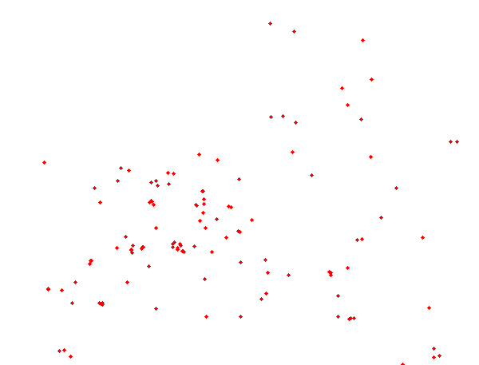
The main strategy of DOIs within ACTRIS Data Centre
The ACTRIS data portal is connecting topical data bases
DOI for secondary, higher level data request and service from the data centre, through the data portal.
FMI
CNR
NILU
CNRS
Cloud data CLOUDNET
Aerosol profiles EARLINET
Aerosol and trace gas near surface data EBAS
AERONET-Europe and
lidar-photometer products
In place, defined within EARLINET, might change based on their experiences.
In progress within EBAS, Markus Fiebig leads this, interact with ENVRI^{PLUS}
To be defined with in AERIS, for their products, or within portal for combined products
Interact with WP2, lead Ewan O’Connor

Slide 27
Publication with doi
What EARLINET published?
4 big dataset with ALL the stations data collected for “experiment” (categories accordingly to EARLINET nomenclature)
Authors?
The EARLINET publishing group 2000-2010,
Mariana Adam, Lucas Alados-Arboledas, Dietrich Althausen, V. Amiridis, Aldo Amodeo, Albert Ansmann, Arnoud Apituley, Yuri Arshinov, Dimitris Balis, Livio Belegante, Sergey Bobrovnikov, Antonella Boselli, Juan Antonio Bravo-Aranda, Jens Bösenberg, Emil Carstea, Anatoly Chaikovsky, Adolfo Comerón, Giuseppe D'Amico, David Daou, Tanja Dreischuh, Ronny Engelmann, Fanny Finger, Volker Freudenthaler, David Garcia-Vizcaino, Alfonso Javier Fernandez García, Alexander Geiß, Elina Giannakaki, Helmuth Giehl, Aldo Giunta, Martin de Graaf, Maria José Granados-Muñoz, Matthias Grein, Ivan Grigorov, Silke Groß, Carsten Gruening, Juan Luis Guerrero-Rascado, Martial Haeffelin, Theresa Hayek, Marco Iarlori, Thomas Kanitz, Panayotis Kokkalis, Holger Linné, Fabio Madonna, Rodanthi-Elisavet Mamouri, Volker Matthias, Ina Mattis, Francisco Molero Menéndez, Valentin Mitev, Lucia Mona, Yohann Morille, Constantino Muñoz, Anja Müller, Detlef Müller, Francisco Navas-Guzmán, Anca Nemuc, Doina Nicolae, Marco Pandolfi, Alex Papayannis, Gelsomina Pappalardo, Jacques Pelon, Maria Rita Perrone, Aleksander Pietruczuk, Gianluca Pisani, Charlos Potma, Jana Preißler, Manuel Pujadas, Jean Putaud, Cristian Radu, Francois Ravetta, Andrew Reigert, Vincenzo Rizi, Francesc Rocadenbosch, Alejandro Rodríguez, Laurent Sauvage, Jörg Schmidt, Franziska Schnell, Anja Schwarz, Patric Seifert, Ilya Serikov, Michaël Sicard, Ana Maria Silva, Valentin Simeonov, Nikos Siomos, Tobias Sirch, Nicola Spinelli, Dimitar Stoyanov, Camelia Talianu, Matthias Tesche, Ferdinando De Tomasi, Thomas Trickl, Geraint Vaughan, Hester Volten, Frank Wagner, Ulla Wandinger, Xuan Wang, Matthias Wiegner, Keith M. Wilson

Slide 28
Any questions now?
Ann Mari will present:
EBAS – ACTRIS 2015 Data Summary per 2 October 2016
Experiences from the first reporting period with the online data submission tool: a data centre perspective
Markus will pick up on
Data citation and use of DOIs in ACTRIS data centre
Issues around organizing the data processing workflow in a mature research infrastructure
Centralized/distributed?
Increasing the number of NRT stations and instruments
How to document QA measures in a generic way

Slide 29
News in the portal
Dynamic menu and content management system, enabling the portal managers to create their own menu items and pages.
Now possible to edit all menu elements except for the "Home" page containing the search functionality and "Datasets" menu item.
Aggregated results for identical data sets belonging to multiple frameworks.
Data sets are now displayed and downloaded as aggregates in order to avoid downloading of the same data set multiple times
New content and restructuring of content layout, including:
Divide old "Products" page in to separate menu-items and sub-pages under both "Tools and Services" and "Data Products".
Revised content of "Data Policy"
Embed of Near-Realtime data as separate page for both "Near surface and cloud data" and "Quicklooks for aerosol profiles"
​Linking to NRT data via front-page
Page linking to external resources regarding data submission to EBAS
Ability to add custom CSS for styling of HTML for the user-generated content
​URL alias for "Secondary datasets"
Removed "Browser Information" page
Direct links for menu items
In addition minor bug-fixes and refactoring of code has been done in order to support the new logic, both in terms of the user interface and to support the menu and content generation functionality.
New SQL templates in the "Reports" module (internal for the portal managers)
Minor code refactoring in same module. The templates are now stored as text files (UTF-8) instead of being hard coded.

