Slide 1

EBAS – ACTRIS 2015 Data Summary
Ann Mari Fjæraa – amf@nilu.no
NILU - Norsk Institutt for Luftforskning
Norwegian Institute for Air Research

Slide 2
Outline
Data requirements
Data submission status
Data submission tool

Slide 3
Requirements
Reporting deadline: 31.July 2016
Data: 2015, full year
Data Levels: Level 0 - 1 - 2 mandatory (with a few exceptions)
Templates: http://ebas-submit.nilu.no/
Data format: NASA Ames 1001 ascii
Submission: ftp or submission tool

Slide 4
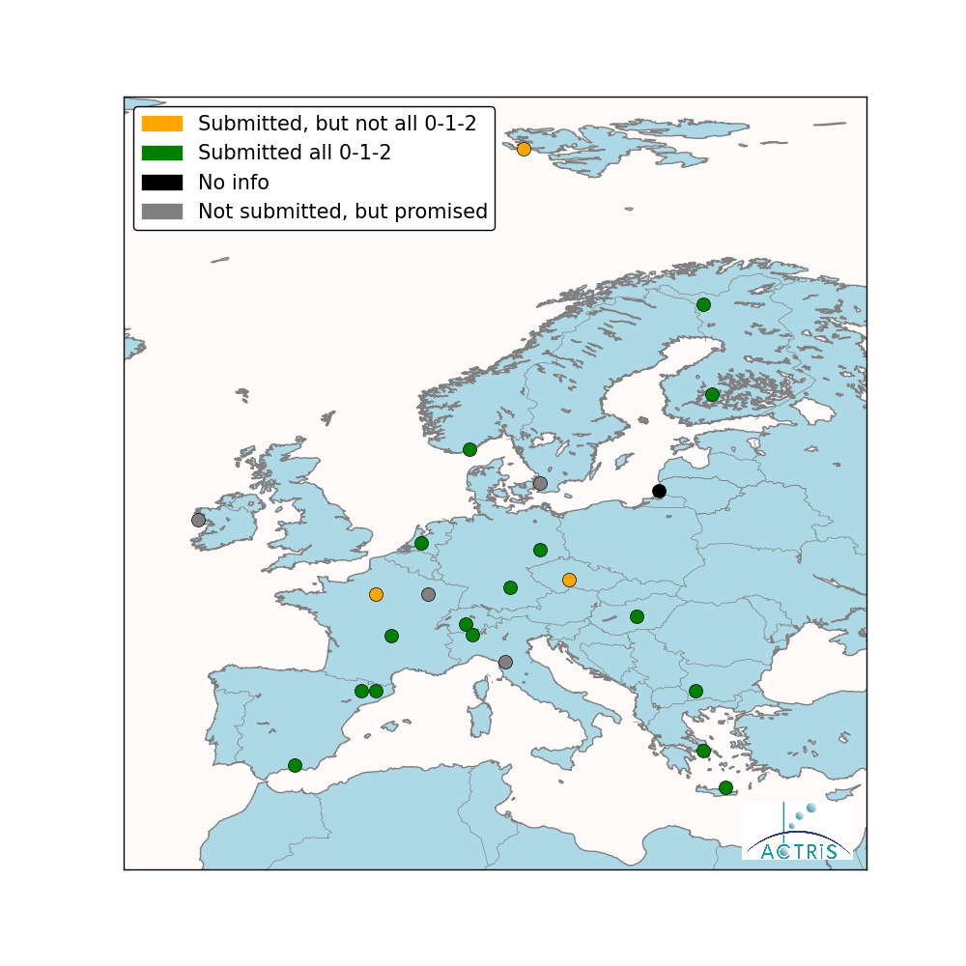
Nephelometer 2014
20 sites (partly) submitted

Slide 5

Nephelometer 2015
23 sites (partly) submitted
Submitted, Level 0-1-2 BEO Moussala, Chacaltaya (Bolivia, not shown), Jungfraucjoch, Hohenpeissenberg, Melpitz, Granada, Montsec, Montseny, El Arenosillo, Hyytiälä, Pallas, OPE, Puy de Dome, Finokalia, DEM Athens, K-puszta, Ispra, Mt.Cimone, Lecce, Birkenes, Trollhaugen (Antarctica, not shown)
Partly submitted, but not all Level 0-1-2 Kresin, SIRTA
Not submitted, but promised Vavihill (instrument broken)
No info Preila, Cabauw, Mace Head, Zeppelin

Slide 6
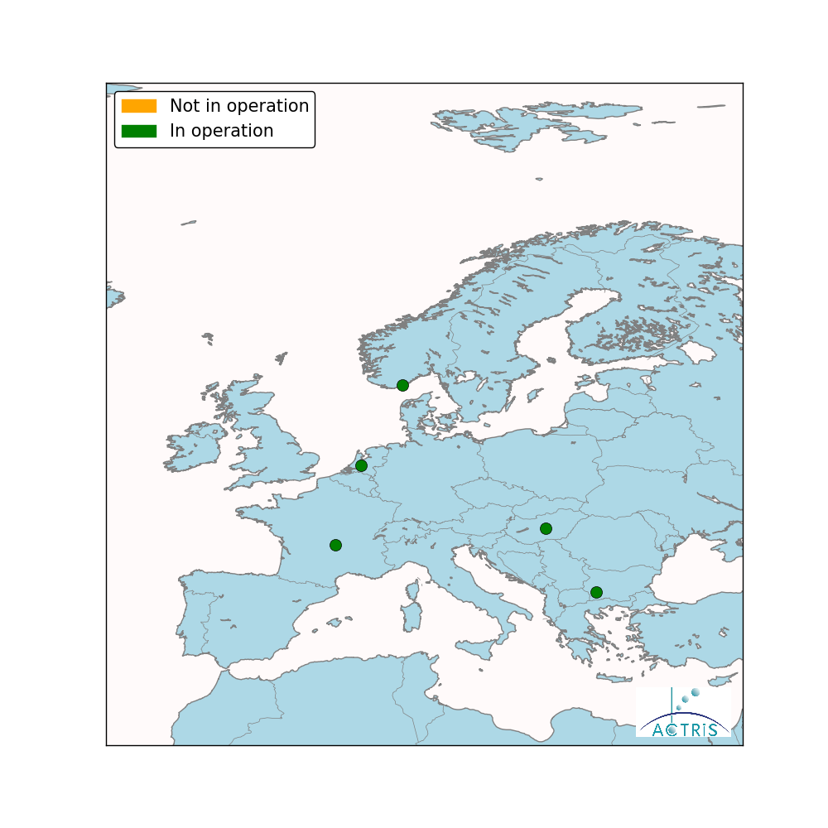
Nephelometer, NRT 2015
5 active sites

Slide 7
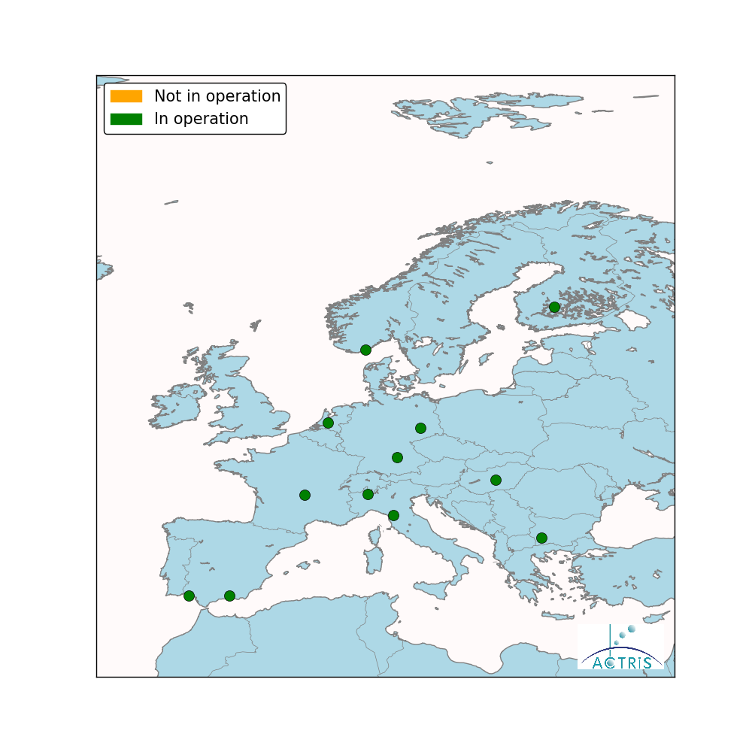
Nephelometer, NRT 2016
13 active sites
In operation September/October 2016 BEO Moussala, Hohenpeissenberg, Melpitz, Granada, El Arenosillo, Hyytiälä, Puy de Dome, K-Puszta, Ispra, Mt.Cimone, Cabauw, Birkenes, Trollhaugen
Not in operation September/October 2016, but set up

Slide 8
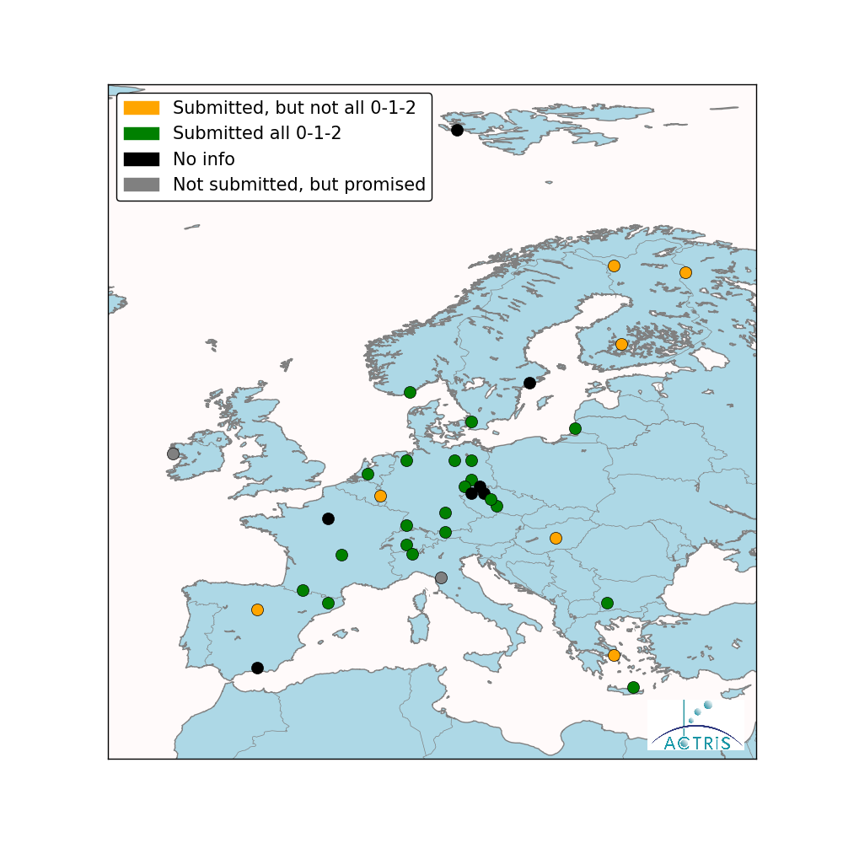
D/SMPS 2014
34 sites (partly) submitted

Slide 9

D/SMPS 2015
35 sites (partly) submitted
Submitted, Level 0-1-2 BEO Moussala, Jungfraucjoch, Kosetice, Suchdol, Hohenpeissenberg, Melpitz, Montseny, Pallas, Finokalia, DEM Athens, Ispra, Cabauw, Birkenes, Trollhaugen, Vavihill GUAN stations
Partly submitted, but not all Level 0-1-2 Vielsalm, Chacaltaya, Madrid, Varriö, Hyytiälä, SIRTA, Puy de Dome, K-Puszta
Not submitted, but promised
No info Usti, Granada, Mace Head, Mt.Cimone, Preila, Zeppelin, Pyramid, Aspvreten

Slide 10

D/SMPS, NRT 2015
2 active sites

Slide 11

D/SMPS, NRT 2016
4 active sites
In operation September/October 2016 Zeppelin, Cabauw, Birkenes, Trollhaugen
Not in operation September/October 2016, but set up

Slide 12

Aethalometer 2014
oppdateres
11 sites submitted

Slide 13

Aethalometer 2015
oppdateres
11 sites submitted
Submitted, Level 0 Jungfraucjoch, Chachaltaya, Kresin, Montsec, Montseny, Hyytiälä, Pallas, Pic du Midi, SIRTA, Finokalia, Ispra
Level 1-2 NA – central processing
Not submitted, but promised DEM Athens
No info OPE, Mace Head, Preila, Zeppelin

Slide 14

PSAP/MAAP 2014
21 sites (partly) submitted

Slide 15

PSAP/MAAP 2015
26 sites (partly) submitted
Submitted, Level 0-1-2 BEO Moussala, Jungfraucjoch,Hohenpeissenberg, Melpitz, Granada, Montsec, El Arenosillo, Montseny, Hyytiälä, Pallas, Puy de Dome, K-Puzsta, Ispra, Mt.Cimone, Cabauw, Birkenes, Trollhaugen, GUAN stations
Partly submitted, but not all Level 0-1-2 Chacaltaya
Not submitted, but promised
No info Usti, Zeppelin, Vavihill, Aspvreten. Pyramid

Slide 16

Filter absorption photometer NRT 2015
3 active sites

Slide 17

Filter absorption photometer NRT 2016
6 active sites
In operation September/October 2016 BEO Moussala, Melpitz, Granada, Hyytiälä, K-puszta, Pyu de Dome
Not in operation September/October 2016, but set up Birkenes

Slide 18

CPC 2014
7 sites (partly) submitted

Slide 19

CPC 2015
8 sites (partly) submitted
Submitted, Level 0-1-2 Jungfraucjoch, Hohenpeissenberg, Puy de Dome, Montseny, Pallas, Mt.Cimone
Partly submitted, but not all Level 0-1-2 Varriö, Hyytiälä
Not submitted, but promised
No info

Slide 20
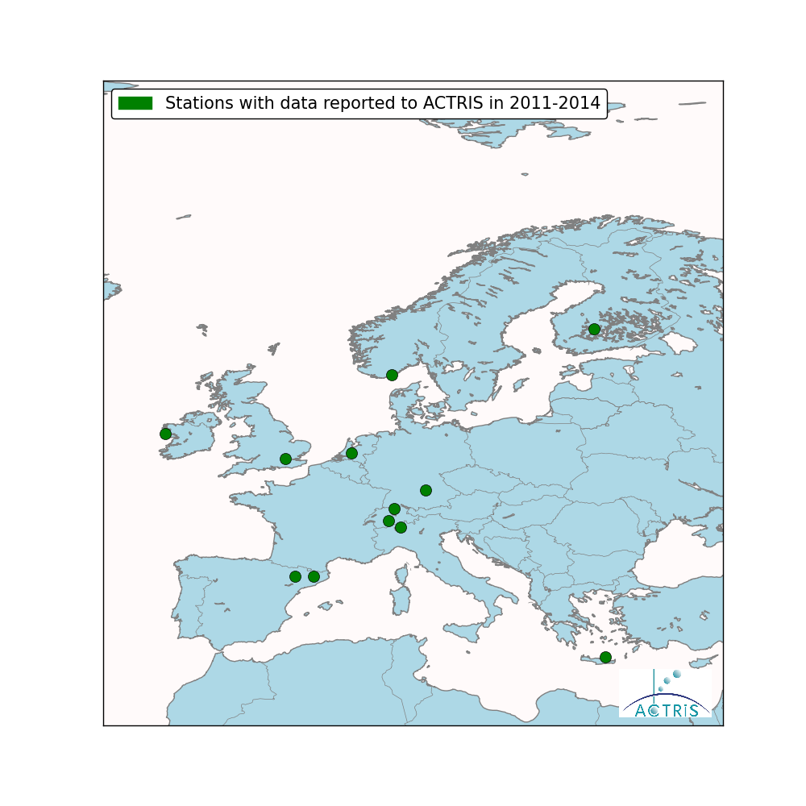
ACSM 2014
12 sites in 2011-2014

Slide 21
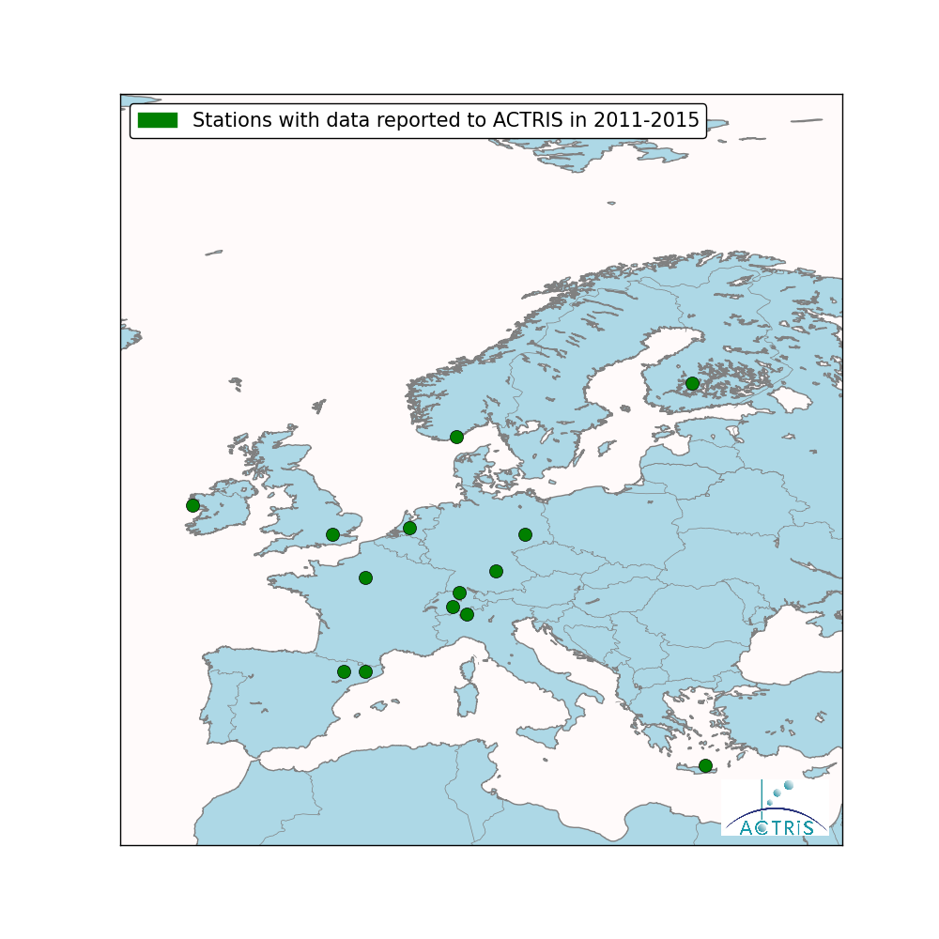
ACSM 2015
14 sites in 2011-2014
Submitted, Level 0+2 Jungfraucjoch, Zurich, Madadino, Mepitz, Hohenpeissenberg, Montsec, Montseny, Hyytiälä, SIRTA Kensington, Finokalia, Mace Head, Cabauw, Birkenes

Slide 22
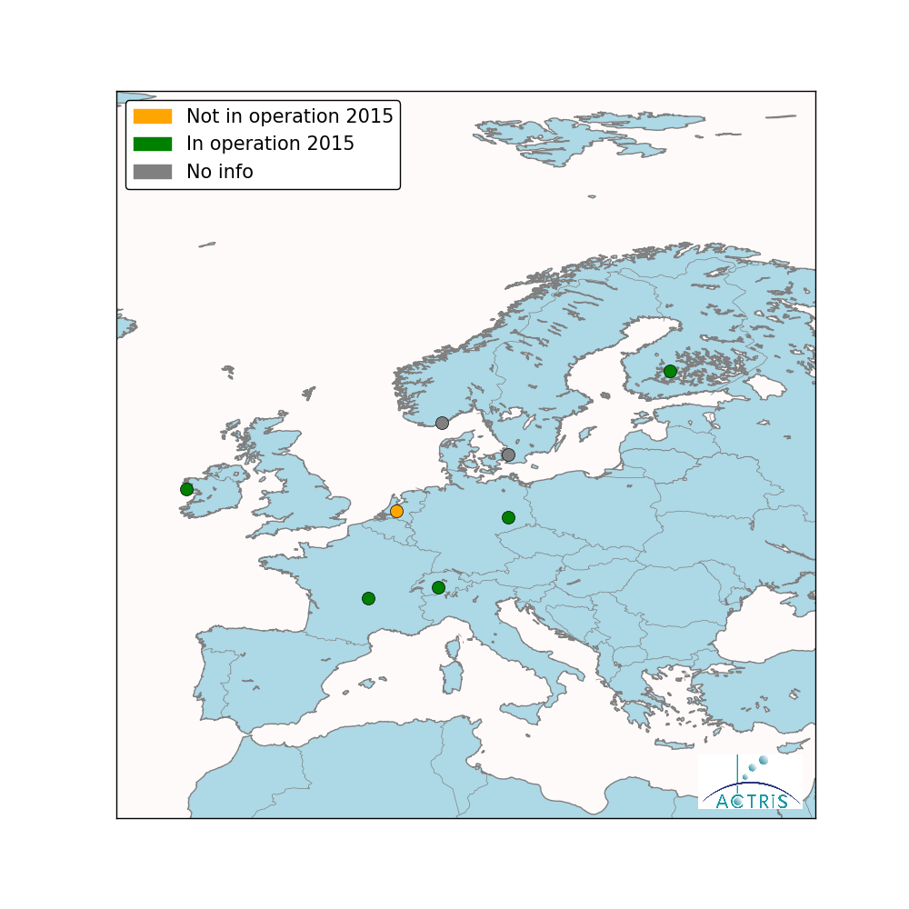
CCNC 2014
In operation 2015 Jungfraucjoch, Melpitz, Hyytiälä, Puy de Dome, Mace Head
Not in operation 2015 Cabauw
No info Vavihill, Birkenes

Slide 23
CCNC 2015
In operation 2016 Jungfraucjoch, Melpitz, Hyytiälä, Puy de Dome, Mace Head
Not in operation 2016 Cabauw
No info Vavihill, Birkenes

Slide 24
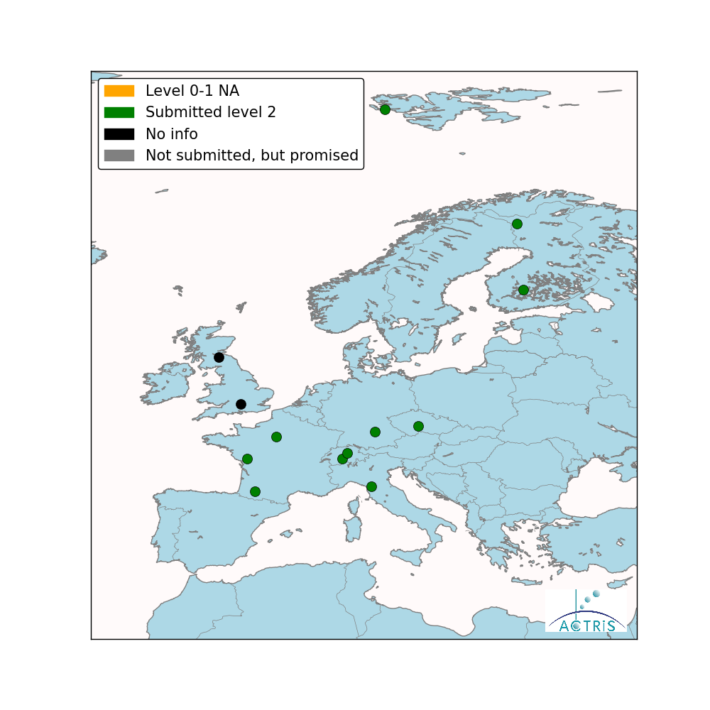
NMHC/VOC 2014
12 sites submitted

Slide 25

NMHC/VOC 2015
17 sites submitted
Submitted, Level 2 Jungfraujoch, Rigi, Kosetice, Cape Verde, Hohenpeissenberg, Hyytiälä, Pallas, Peyrusse Vieille, La Tardiere, SIRTA, Mt.Cimone, Zeppelin, UBA-stations (5).
Level 0-1 NA
Not submitted, but promised
No info, submitted to EMEP Harwell, Auchencort Moss

Slide 26

NOxy 2014
8 sites submitted

Slide 27

NOxy 2015
12 sites submitted
Submitted, Level 2 Cape Verde, Kosetice, Melpitz, Hohenpeissenberg, Hyytiäla, Pallas, La Tardiere, Peyrusse Vieille, Revin, SIRTA, Puy de Dome, Mt.Cimone
Level 1 Ispra
Not submitted, but promised
No info Harwell, K-puszta, Birkenes, Vavihill, Aspvreten reported to EMEP

Slide 28

Calibration workshops
Include information like this:
Example:
Nephelometers participated in workshops
Passed or not, useful information

Slide 29
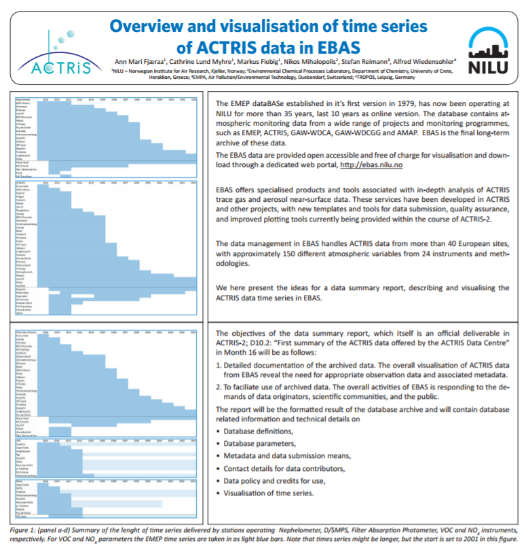

Slide 30
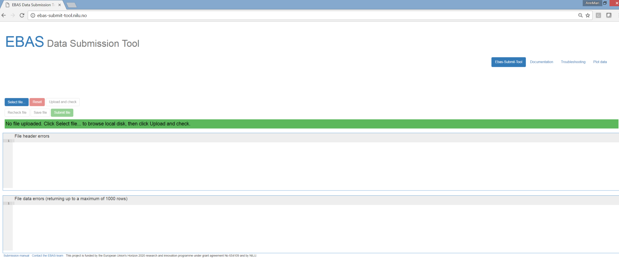
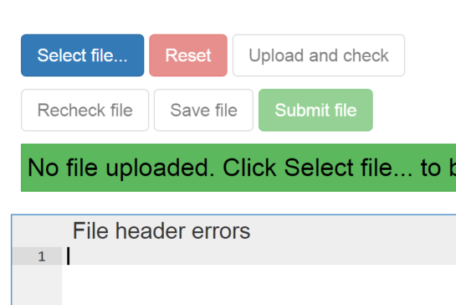
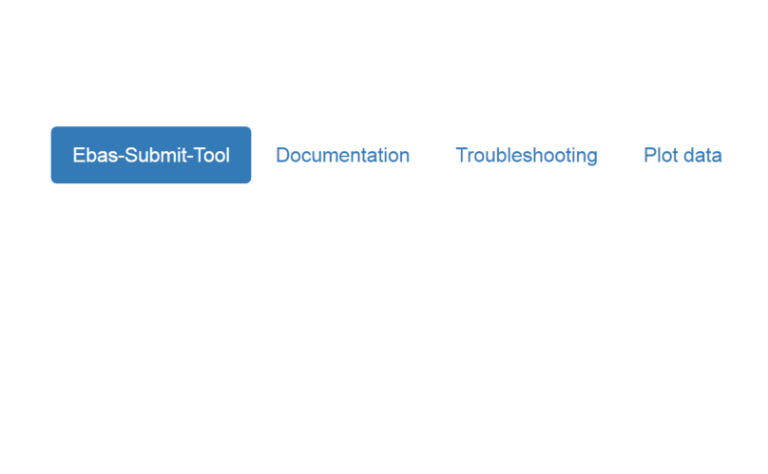
Data format checker and submission tool
A new format checker and submission tool was implemented and tested in 2015.
The tool was made available to the data submitters prior to the 2016 data submission.
Detailed format checker and direct feedback on level 2 data, connected to the templates.
http://ebas-submit-tool.nilu.no/

Slide 31
Data format checker and submission tool
Kommer:
noen punkter om erfaringer:
Enklere for bruker,
Hurtigere svar,
Kortere tid før data er inne i EBAS.
God kontakt med noen data submitters, andre ikke.
Viktig at også data submitters deltar på møter, eller kurs.
Dette er «våre» data, data submitters er også «vi»
Begynner å hjelpe med support men ellers fortsatt kø
Veldig dårlige på level 0 og level 1 feedback

Slide 32
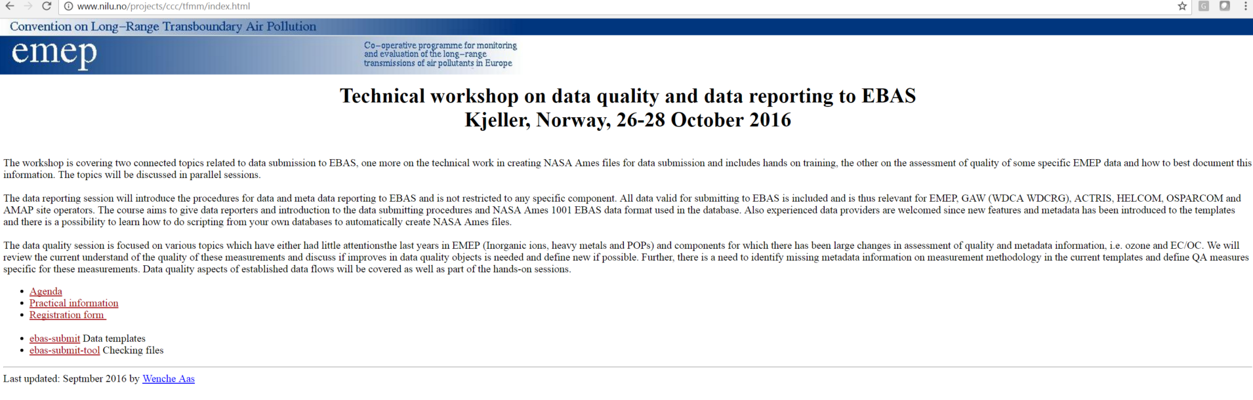
Data training course
A data training course will be held at NILU 26.-28 October
Participants from EMEP, ACTRIS, GAW-WDCRG, GAW-WDCA
Still possible to register
Next workshop?? (announced well in time before date)

