Slide 1
New Developments in ACTRIS Surface In-Situ Data Flow and Handling
M. Fiebig, C. Lund Myhre, A.M. Fjæraa, T. Hamburger
NILU - Norsk institutt for luftforskning
Norwegian Institute for Air Research

Slide 2
Proposed ACTRIS VOC Data Flow in a Nutshell
Data is quality assured at the station, including tools provided by ACTRIS
Data are submitted to ACTRIS DC / EBAS via submission portal (ensures homogeneous format low in errors), associated with project “ACTRIS_preliminary”.
Data are moved to a read-only FTP site at ACTRIS DC for download by the ACTRIS VOC QA group.
ACTRIS VOC QA group checks data, and either:
  logs issues found in issue tracker, and associates issue with responsible PI / submitter. Data are corrected by submitter, change documented in issue tracker. Back to 2.
  Finds the data to pass all QA tests, i.e. closes all issues on dataset (or creates a closed issue if pass at first submission). Go to 5.
Data are taken from FTP site, and imported into EBAS with project association “ACTRIS”.
    Note: for NOx, the whole QA procedure will be handled by NOx QA centre. Will NOx QA centre give feedback via issue tracker?

Slide 3
Requirements for Organising Data QA and Feedback
2 related requirements when organising data QA and data feedback:
  VOC:
  Issues found with submission of a station by QA group need to be recorded, station PI notified, correction followed up, DC notidied when issues are solved.
  Aerosol
  Issues are found when data are screened for larger studies (e.g. trend analysis, model inter-comparison). Issue needs to be documented, assigned to responsible PI, correction followed up, and corrected in archive.
→ Issue tracker at http://ebas-feedback.nilu.no. To be used for project / framework QA, but also general feedback on EBAS / ACTRIS system.

Slide 4
EBAS Feedback: Organising Quality Assurance and Feedback on Data
What is an issue tracker?
Web portal for organising and keeping track of issues and tasks in a project.
Issues are described in text, attachments allowed for illustration & documentation.
Issues can have 4 statuses reflecting work flow: open, assigned, resolved, closed.
All users need to have an account!
Each user has a “role” (set of rights): anybody can report issues or set issue to “resolved”
Only “managers” (members of QA group) can assign or close an issue.
HOMEWORK:
Every station / data PI & submitter to create account at ebas-feedback.nilu.no
Use syntax for login name: <First Name>_<Last Name>

Slide 5
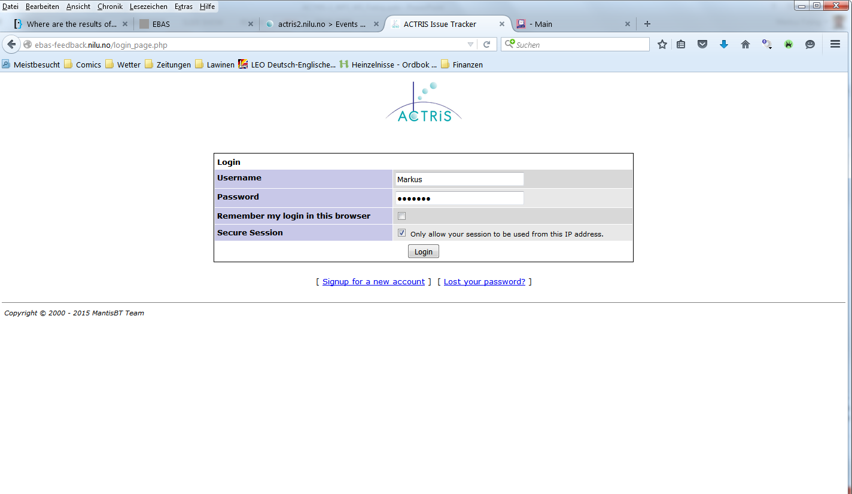
http://ebas-feedback.nilu.no: Organising QA and Feedback on Data

Slide 6
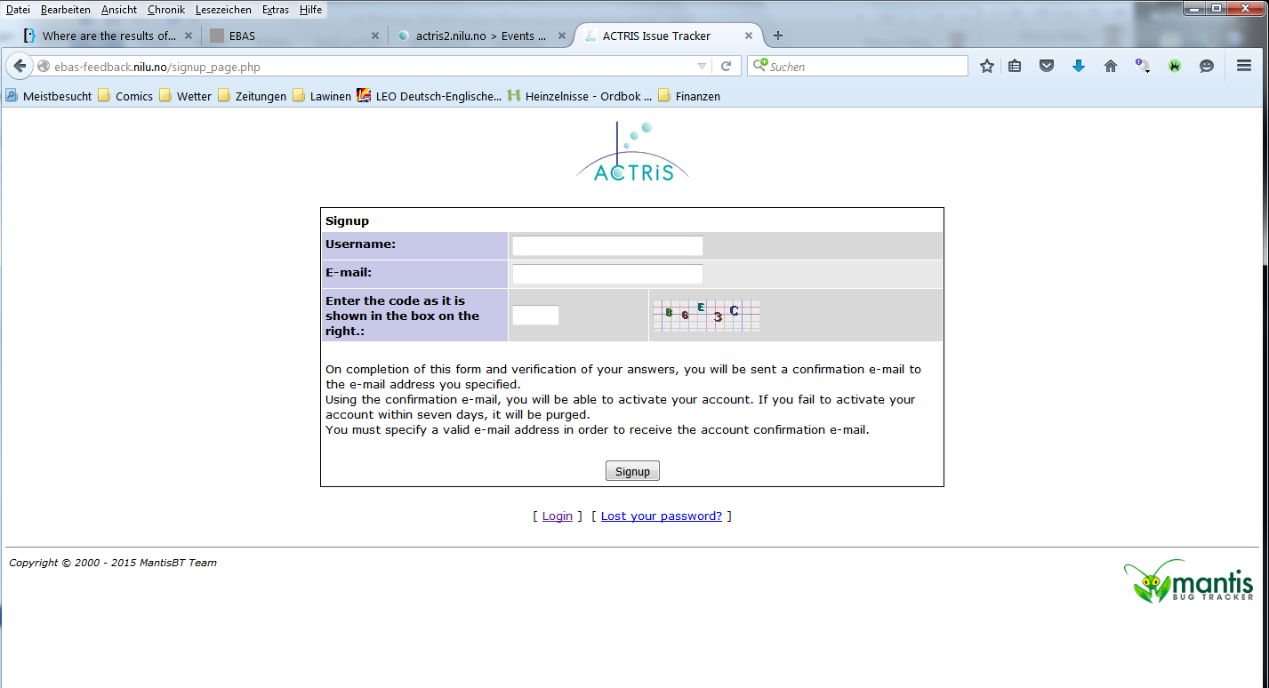
EBAS Feedback: Organising Quality Assurance and Feedback on Data

Slide 7
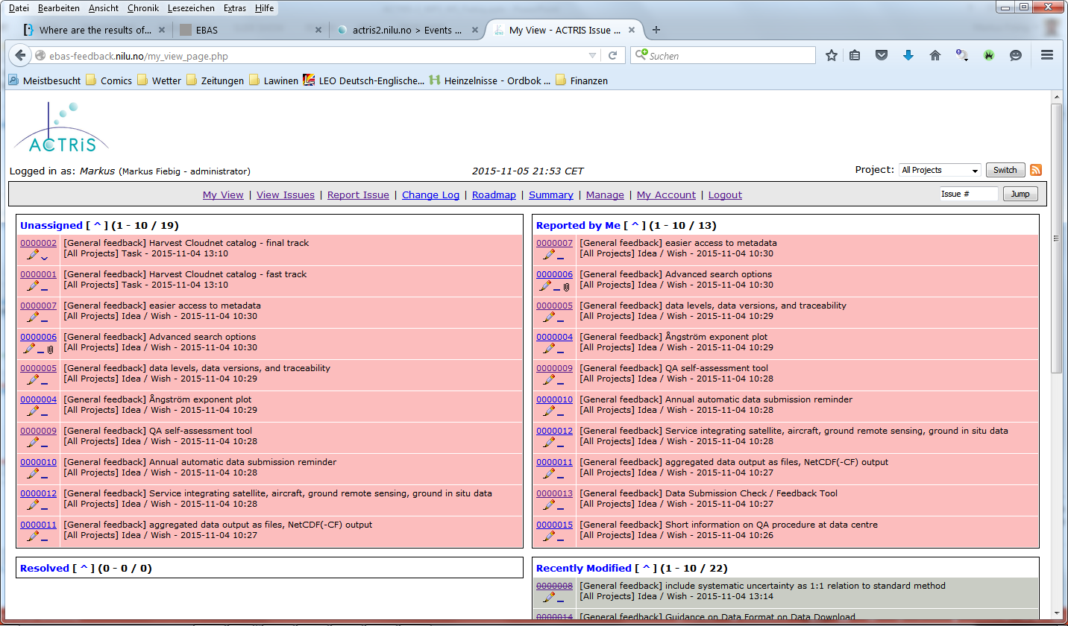
EBAS Feedback: Organising Quality Assurance and Feedback on Data

Slide 8
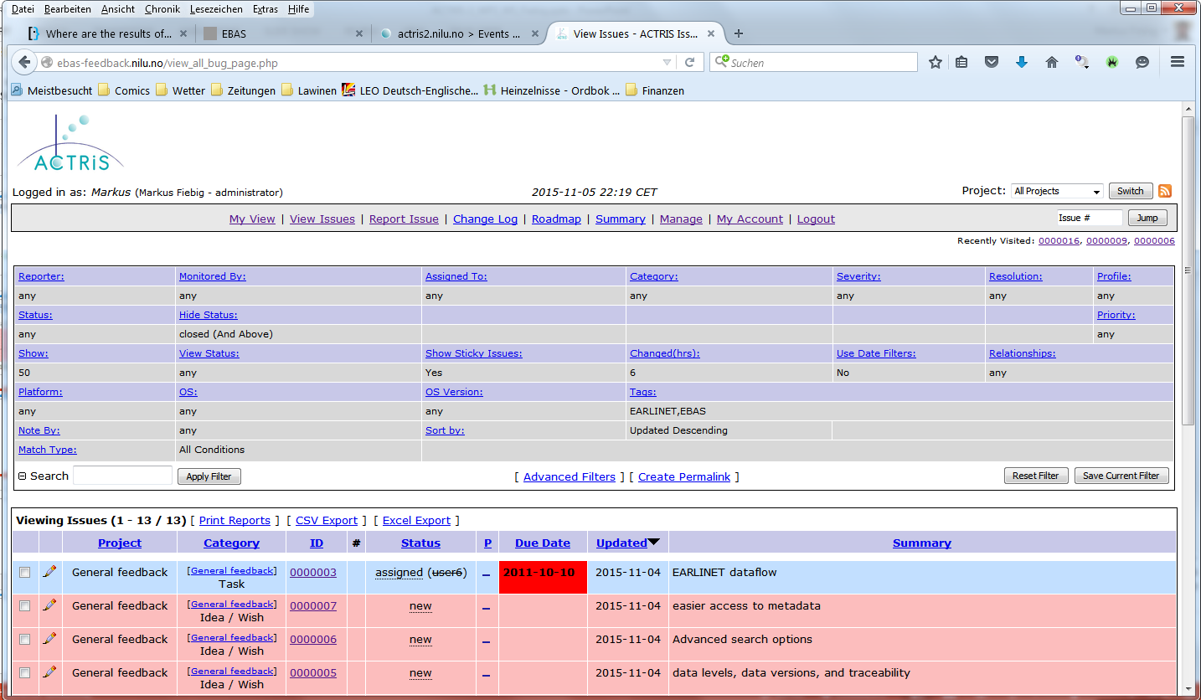
EBAS Feedback: Organising Quality Assurance and Feedback on Data

Slide 9
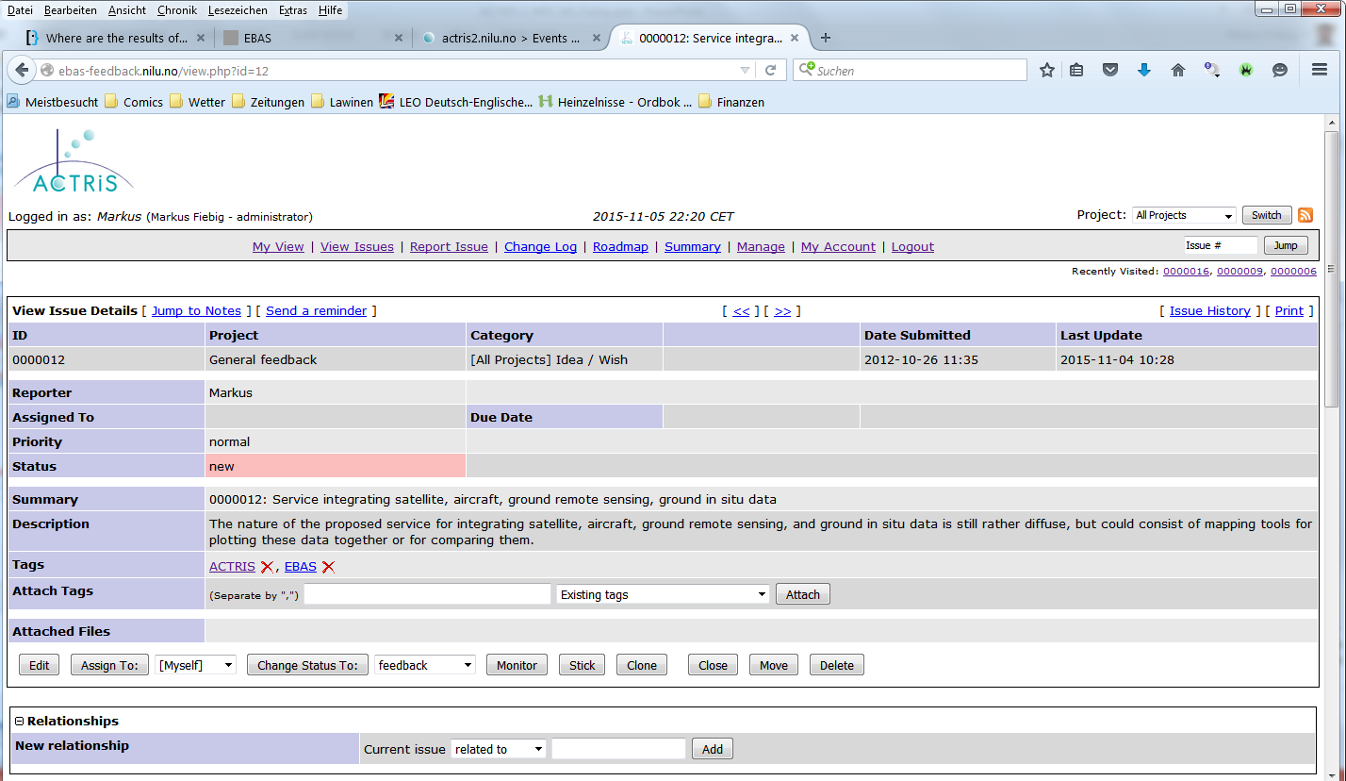
EBAS Feedback: Organising Quality Assurance and Feedback on Data

Slide 10
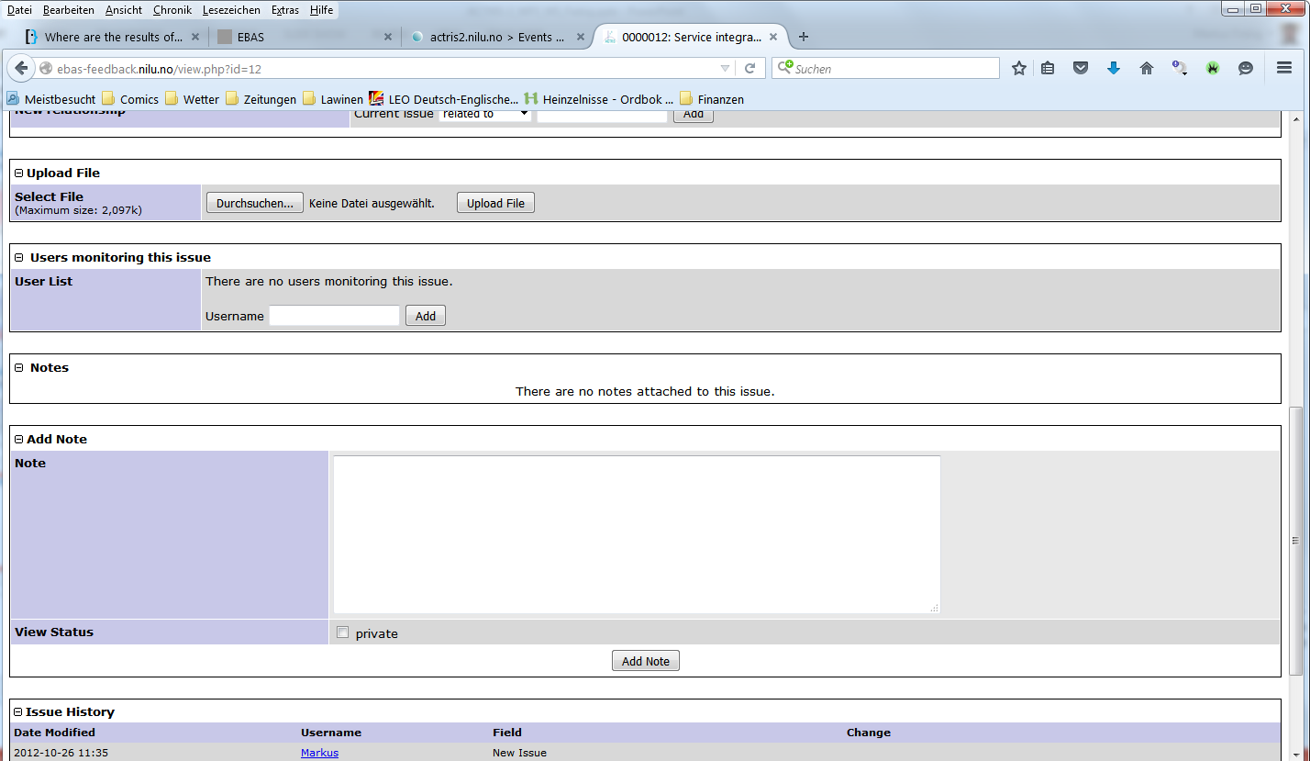
EBAS Feedback: Organising Quality Assurance and Feedback on Data

Slide 11
Quality Assurance Metadata: Why Do We Need That?
So far, quality metadata has focused on uncertainty of individual data points.
A huge fraction of ACTRIS’ work is around QA measures:
  inter-comparison workshops
  round-robin experiments
  on-site inter-comparison
  on-site audit
ACTRIS markets itself as RI for high-quality data – we need to “show-off” and document that.
Motivation for stations to participate in QA measures.

Slide 12
Metadata Documenting Quality Assurance
Measure master data:
  Unique ID of QA measure (issued by EBAS)
  Type of QA measure (on site intercomparison, off-site intercomparison, round-robin, on site audit)
  Entity issuing QA measure (name, address, URL)
  Date of QA measure
  Reference to test procedure used (title, URL).
Requested from data provider:
  Unique ID of QA measure (issued by EBAS)
  Date of QA measure
  Outcome:
    pass / no pass,
    uncertainty found (number, unit)
  reference document (title, date, URL)
  Will depend on component, at least for gases
Consistent with ISO19115 DQ metadata items.
To Do: Defined Interface between QA Centre and Data Centre:
Public documentation of QA measures and results at QA centre website.
Documentation in machine-readable format

Slide 13
Data Levels Defined in ACTRIS: Use for VOC & NOx?
Data Level | Description |  |  | Used for
0 | Annotated raw data format instrument specific all data / information for processing to final value. | contains all parameters provided by instrument as provided ”native” time resolution |  | NRT
1 | processed to final parameter invalid data removed | ”native” time resolution format property specific |  | intercom-parisons
1.5 | aggregated to hourly averages variability quantified format property specific STP correction if necessary |  | auto-processed | NRT
2 |  |  | manual QA | regular collection
SOP describes steps from one to the next level.
All levels use EBAS NASA-Ames format.

Slide 14
Why Do We Have Data Levels?
Traceability: Whole chain of data acquisition / processing / QA can be traced back to the time of measurement.
Allows to reprocess the data.
Separates DAQ / processing / QA chain into well defined steps, great tool for finding the cause of failing intercomparison.
Data is documented also for a user in 15 years from now.
Higher level frameworks are moving to requiring this feature.

Slide 15
How to Make Use of Data Levels for NOx & VOCs
NOx:
Similar to online aerosol observations: make use of all levels?
Draft templates exist, expert / stake holder overhaul needed.
VOCs:
Offline measurement, levels normally not used.
Calibration & target gas measurements should be documented, but may confuse end-user
Use level 0 & 2, almost identical templates, except:
  Level 0: contains all calibration / zero / target gas measurements, respective data points use respective flags.
  Level 2: same data, but excluding calibration / zero / target gas measurements
Level 0 archived offline, level 2 accessible in EBAS-web
Expert / stake holder input needed.

Slide 16
Use of Flags in Data Submission: The General Philosophy
So far, data archives are often single purpose – ACTRIS is multi-purpose:
Data are flagged invalid only with non-quantifiable instrument malfunction or severe local contamination (paint job on station, smoking under inlet) – non-representative even for close surroundings, can’t be corrected.
Other conditions of local influence are to be flagged with respective flag, but data are reported as valid, e.g.:
  Farming activity
  Dust storm
  Biomass burning episode
  Volcanic eruption

Slide 17
Comparison of Data Flags, 1/2
Flag | V/I/M | Description | VOC use | NOx use | Aerosol use
000 | V | Valid measurement | no obvious local influence or technical/instrumental problems
110 | V | Episode data checked and accepted by data originator. | ----- | ----- | Used to validate outlier
147 | V | Below theoretical detection limit or formal Q/A limit, but a value has been measured and reported and is considered valid |  |  | -----
185 | V | Possible local contamination indicated by wind direction or velocity | ----- | -----
186 | V | Possible local contamination indicated by single scattering albedo | ----- | -----
187 | V | Possible local contamination indicated by occurence of new particles. | ----- | ----- | Used in a setting where new particle formation indicates contamination)
188 | V | Possible local contamination indicated by low wind speed. | ----- | ----- | Used in case of auto-contamination by station
189 | V | Possible local contamination indicated by wind from contaminated sector. | ----- | ----- | Used if flag 185 is too unspecific.
390 | V | Data completeness less than 50% | Needed for averaged values, SOP uses 66%
392 | V | Data completeness less than 75%
394 | V | Data completeness less than 90%
410 | V | Saharan dust event | ----- | -----
459 | I | Extreme value, unspecified error | ----- | ----- | Unexplained extreme values, technical problem suspected.
Notes:
Need flag 110 to implement outlier check service.
How detailed should information coveyed to user be? Indicate possible reason for contamination?
Use detailed data completeness flags or just a few.
Allow flags that invalidate outliers for unspecified reason?

Slide 18
Comparison of Data Flags, 2/2
Flag | V/I/M | Description | VOC use | NOx use | Aerosol use
499 | V | Inconsistent with another unspecified measurement. | ----- | ----- | Inconsistent e.g scattering coefficient calculated from particle size distribution.
559 | V | Unspecified contamination or local influence, but considered valid | unexpected values, no instrumental or technical failure.
599 | I | Unspecified contamination or local influence | ----- | -----
640 | V | Instrument internal relative humidity above 40%. | ----- | ----- | Used to signal possible hygroscopic growth of aerosol particles (neph, MPSS)
652 | V | Construction / activity nearby. | ----- | ----- | Includes disturbance by other lab activity.
662 | V | Too high sampling flow, data considered valid. | ----- | ----- | E.g. aerosol flow rate out of range but considered valid.
676 | V | station inside cloud (visibility < 1000 m). | ----- | -----
677 | I | Icing or hoar frost in the intake. | ----- | -----
699 | I | Mechanical problem, unspecified reason. | ----- | ----- | E.g. problems with flow, leaks.
797 | V | Data element taken from co-located instrument |  |  | -----
980 | M | Missing due to calibration or zero/span check | ----- | ----- | e.g. neph zero checks
999 | M | Missing measurement, unspecified reason | missing measurements, outliers, technical problems, non-ambient contamination, definetly unusable for known reason (smoking, …)
??? | I | Missing due to zero/span check | Zero/span gas applied |  | -----
??? | I | Missing due to target gas check | Target gas applied |  | -----
??? | I | Missing due to calibration | Calibration gas applied |  | -----
Notes:
Discuss use of flag 797, Data taken from other instrument.
Discuss use of flags specific for zero, target gas, calibration

