Slide 1

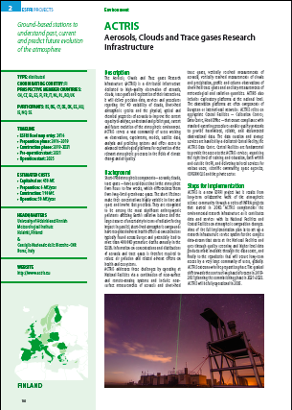
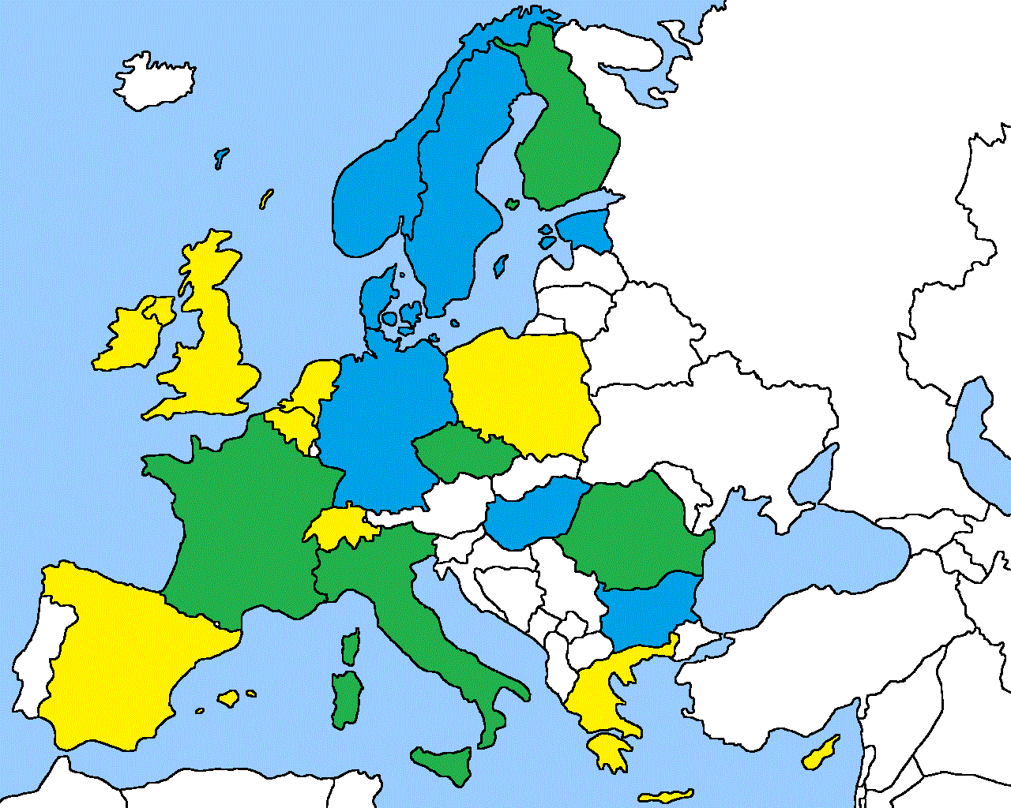
ACTRIS on the ESFRI Roadmap
Recognized as an added-value in the Atmospheric Research Arena
Recognized as sufficiently matured in its organization to be implemented as a legal-entity within 10 years
Strong commitment from EU countries to maintain their financial support to ACTRIS operations

Slide 2

ACTRIS on the ESFRI Roadmap
>>>>….....2016…..........Preparatory phase…..........2021.......>>>>>
Current Status
Short-term contractual agreement between EU ACTRIS-2 beneficiaries for Pan-European Activities
National support to ACTRIS operations not coordinated
Contribution of EC to access to Central Facilities (i.e. CC, Data Center) - TNA
ACTRIS represented by individuals on behalf of EU project coordination
Future Status
Long-Term European Research Infrastructure Consortium
Coordination of national and European ACTRIS activities under Head Office and ACTRIS Council
ACTRIS socio-economic model (no more EC support for operations)
ACTRIS represented by its General Director
INFRADEV2
ESFRI preparation
Deadline 22 June
Finland Coordination

Slide 3
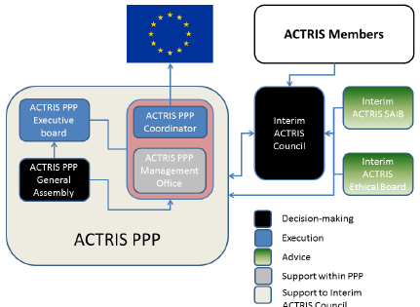
ACTRIS PPP
ACTRIS-PPP (INFRADEV-3) – 2017-2020
Coordination FMI (S. Sorvari). Coordination team (Sanna, Gelsomina, Paolo) – Management team (Sabine, Niku, Marjut, …)
28 beneficiaries (21 countries))
EU funding 4 M€
Kick-off January ?

Slide 4
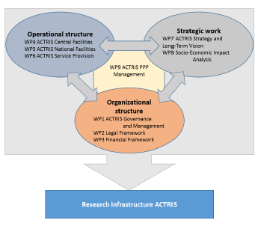
ACTRIS PPP structure

Slide 5

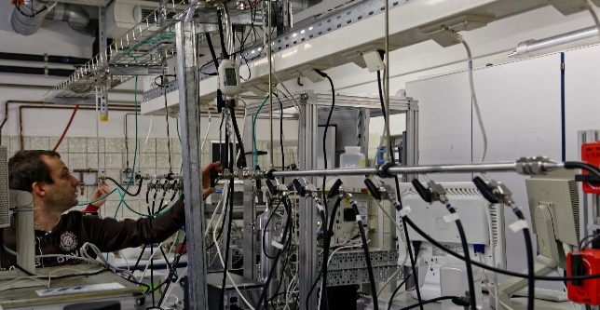
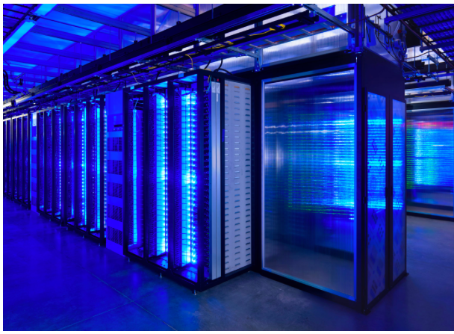
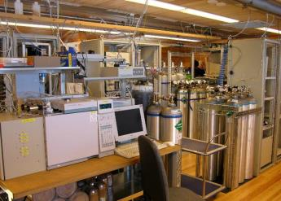
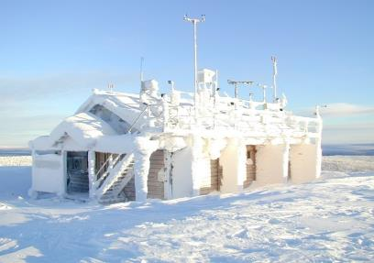
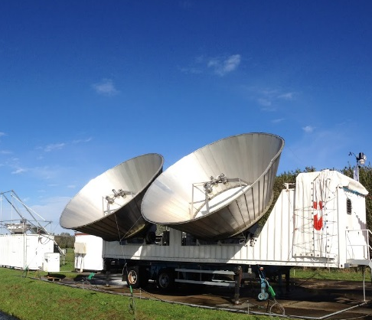
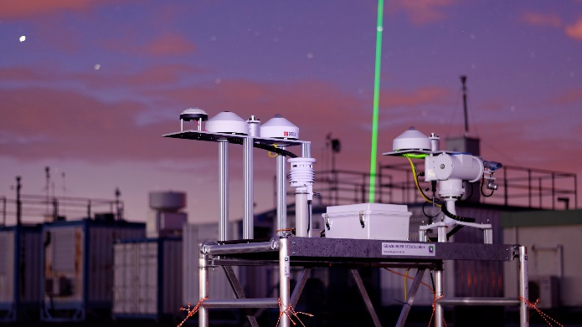
ACTRIS concept and design
ACTRIS Data services
ACTRIS data products
ACTRIS VRE for tools and computing
Calibration Centres
Data Centre
Data Center
Instrument calibration
NF aerosol, cloud and trace gas variables

Slide 6
ACTRIS concept and design
ACTRIS RI structure
Head Office
Coordination and Management
Central Facilities
National Facilities
Observations
Explorations
Service Access Management unit
Lidar, aerosol, radar, trace gas, aeronet Calibration Centres
ACTRIS Data Centre
Notes:
New graph from Markku

Slide 7
ACTRIS Preparatory phase
A 3-year plan under EU INFRADEV-3 for :
Identification of Legal contract (ERIC most likely)
Legal and financial agreements
Governance and RI architecture (structure)
Site identification and methodology compliance
Central facility identification
Service policies
Level of Contractual agreement with third parties (inc. EMEP)
Long-term strategy of the RI
Identification of funders and agreement

Slide 8
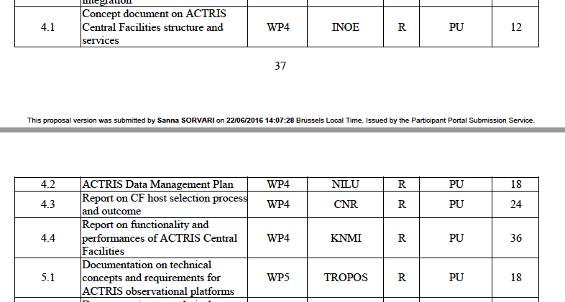
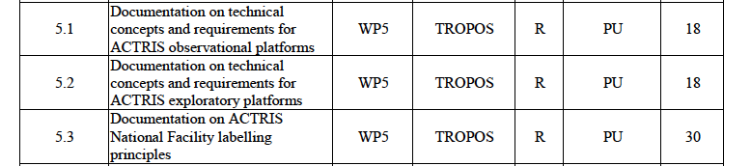
Some ACTRIS PPP deliverables
Audition ACTRIS-FR, Allenvi, , 20 Octobre, 2016

Slide 9
Work to do : CC
Concept : a clear and traceable quality control system, Terms of reference for the CC
Capacity: how many users ? Is there any major upgrade needed for responding to request of users
Cost : what is the cost of the CC in the construction phase (national investment) and operation phase
Criteria for eligibility: competition between CCs ?
Governance : multi-national consortium versus independent consortia
Who will apply ?
Audition ACTRIS-FR, Allenvi, , 20 Octobre, 2016

Slide 10
Work to do : CC
Concept : a clear and traceable quality control system, Terms of reference for the CC
Capacity: how many users ? Is there any major upgrade needed for responding to request of users
Cost : what is the cost of the CC in the construction phase (national investment) and operation phase
Criteria for eligibility: competition between CCs ?
Governance : multi-national consortium versus independent consortia
Selection: Who will apply ? Who will review applications ?
Audition ACTRIS-FR, Allenvi, , 20 Octobre, 2016

Slide 11
Work to do : NF
Concept : What does an ACTRIS label mean for a station ?
Cost : what is the cost of operation? What investment is needed in the construction phase (national investment)
Criteria for eligibility: Golden label for quality, access, availability of historical data, instruments, training, governance, what else ?
Access: can we maintain a TNA-like access program
Selection: Who will apply ? Who will review applications ?
Audition ACTRIS-FR, Allenvi, , 20 Octobre, 2016

Slide 12



ACTRIS concept and design

Slide 13
ACTRIS EUROCHAMP
EUROCHAMP-2020 (INFRAIA) – 2017-2021)
Coordination CNRS (J.F. Doussin)
ACTRIS: RI for Observation and EXPLORATION
WP5 EUROCHAMP-2020:
WP5 ACTRIS PPP
EUROCHAMP-DC in ACTRIS
Audition ACTRIS-FR, Allenvi, , 20 Octobre, 2016

Slide 14

ACTRIS is not a Network
ACTRIS
- Established by Research institutions
- Centralized governing board
- Limited number of platforms (15-25) in climate-relevant zones including discovery platforms
- High number of instrument in each site (near-surface, column, profiles)
- Operates advanced calibration centers (Lidar, in-situ aerosol, Clouds, Reactive gases)
- Sites operated by research institutions
- Develop advanced standards (ie. BC) and protocols
EMEP
-Established under political convention (CLRTAP)
- Distributed governing board (country level)
-High number of sites (150), high density
-Limited to near-surface regulatory variables
- Operate basic CC capacity
- Sites operated by research institution or EPAs
- Apply standards and protocols (limited development)

Slide 15
ACTRIS in the EMEP framework
Service to users
EMEP Data Center / EBAS
Advanced Research sites (level 3)
Core observation network (level ½)
ACTRIS in-situ Data Center / EBAS
ACTRIS National Facilities
ACTRIS Calibration Centers
ACTRIS is originally organized to support EMEP research dimension and should stay so

Slide 16

ACTRIS in the EARLINET framework
Service to users
Services to users
Advanced Lidar network
ACTRIS Lidar data Center
ACTRIS National Facilities
ACTRIS Lidar Calibration Centers

Slide 17
ACTRIS in the AERONET framework
Service to users
Services to users
Global sun-photometer instruments
European Sun-Photometer instruments
New Retrieval schemes
AERONET-EU CC

Slide 18
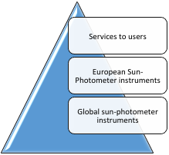
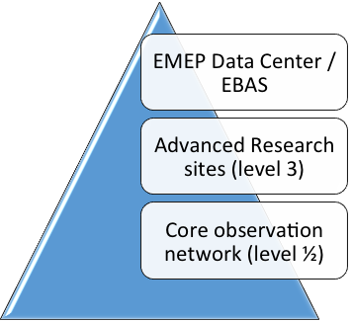
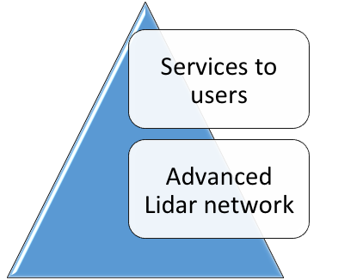

ACTRIS in the Earth observing framework
Service to users
ACTRIS Contribution

Slide 19
Open ACTRIS EMEP Questions
Site identification: a subset of EMEP stations, Global GAW ?
Methodology Compliance : how do we ensure relevant methodologies are identical – also GAW ?
Central facility identification: how are Central Facilities shared – also GAW ?
Service policies : How will user-access by organized and paid for ? How do we establish linkage with other organisations ?
Level of Contractual agreement with third parties: what do we need for effective EMEP-ACTRIS liaison ?
Long-term strategy of the RI: Shared vision for in-situ observation strategy in Europe

Slide 20
ACTRIS PPP / ACTRIS-2
ACTRIS-2 is the tool for constructing ACTRIS
What will not be constructed in 2019 (at least partially) will have difficulties to be included
Risk for WP3 activities not to be seen as an added value to Networks
Responsibility in WP3 to present clear plans for NF (DC +CCs) and participate to NF selection
Make sure you are well identify nationally

Slide 21

ENVRI week, Grenoble May 15-19, 2017

