Slide 1
WP3: Near-surface observations of aerosols, clouds and trace gases Task 3.1: Improvement of instrumentation, standardization and quality assessment of essential climate and air quality variables
Objective
To maintain and consolidate provision of high quality data for the variables addressed by ACTRIS in order to assure the quality and stability of the network composed of more than 40 ACTRIS labelled stations around Europe
Aims:
- increase the amount and quality of delivered data
- implement existing SOPs and propose revisions
ACTRIS-1 tools:
regular control exercises through round-robin tests and inter-calibration campaigns
ACTRIS-2 tools:
inter-laboratory comparison exercises (round-robin): will no longer be used
use of ACTRIS TNA (WP8): will no longer be used
or external calibration facilities
What is the status of the WCCs in Germany?
Frequency of the QA/QC activites for gaseous compounds:
At least one exercise in 2 different years

Slide 2
WP3: Near-surface observations of aerosols, clouds and trace gases Task 3.1: Improvement of instrumentation, standardization and quality assessment of essential climate and air quality variables
ACTRIS-2 tools:
target gases: monthly, all stations: a prerequisite for the ACTRIS label
➔ VOCs: spiked NPL+compressed air = commercial breathing air (DWD)
➔ NO: 100 ppb by synth. gases manufacturers (DWD)
practical issues to be solved: canister types/valves/shipment
travelling standards and calibration campaigns: on demand for:
- existing ACTRIS stations with quality issues for existing compounds,
- new stations
➔VOCs: re-use of round-robin canisters from ACTRIS-1 (stored at EMPA)
➔NO: re-use of round-robin canisters from ACTRIS-1 (stored at DWD)
Parallel sampling: biannual, all stations, a prerequisite for the ACTRIS label
➔ VOCs: flask sampling during measurements (EMPA)
NO: travelling instrument (DWD)
Station audits:
- existing ACTRIS stations with quality issues for existing compounds,
- new stations
➔WCCs for VOCs and NOx (under discussion)

Slide 3
ACTRIS-2: WP3: Near-surface observations of aerosols, clouds and trace gases
New control procedures to be implemented in ACTRIS-2 for:
New biogenic precursors and oxygenated VOCs
Additional oxygenated reactive NOx/NOy components
Additional activities:
Taylored campaigns at Hohenpeissenberg (biogenic VOCs/OVOCs and :
autumn 2016: NOx/NOy
autumn 2017: OVOC/terpenes
Budget for participants?

Slide 4
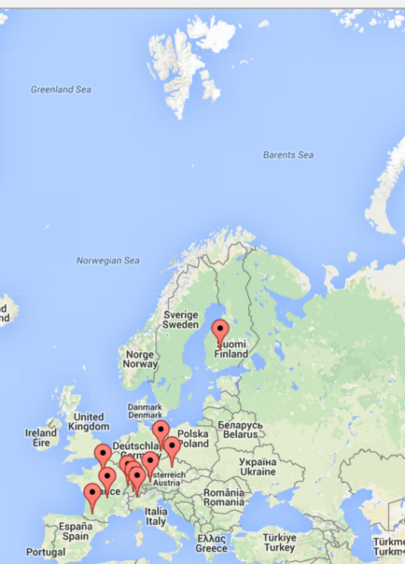
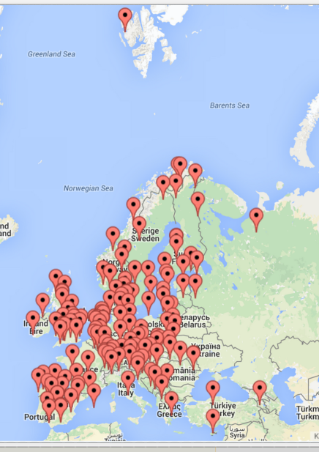
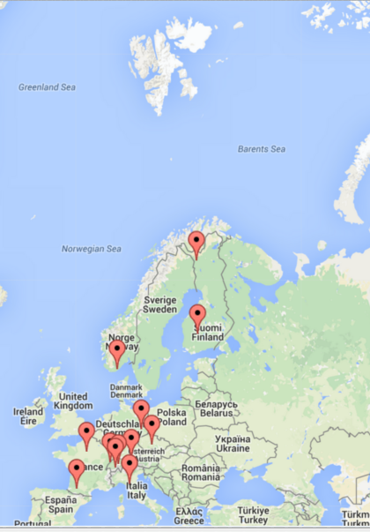
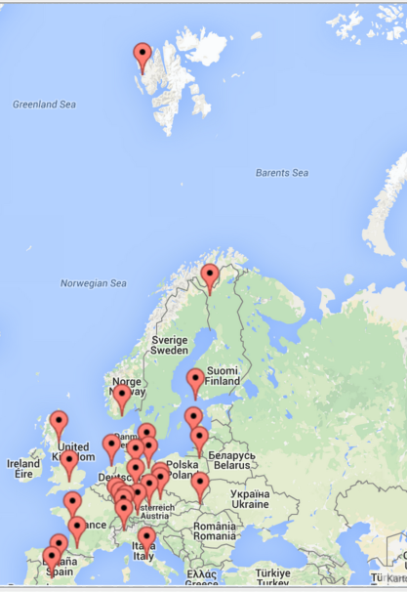
ACTRIS-2: Task 3.1 gases: improve the number of sites
NO₂
VOCs
ACTRIS
EMEP
ACTRIS
EMEP

Slide 5
NOx submission status
Status May 2016: VOC submission to EBAS under ACTRIS
Station | 2011 | 2012 | 2013 | 2014 | 2015 | Notes
CVO | NA | Subm. | Subm. | Subm. | Subm. | S.Punjabi/L.Carpenter, minor errors*
HPB | Subm. | Subm. | Subm. | Subm. | Subm. | A.Claude
HYY | Subm. | Subm. | Subm. | Subm. | Subm. | M.Kajos/P.Rantala
JFJ | Subm. | Subm. | Subm. | Subm. | Subm. | M.Hill
KOS | Subm. | Subm. | Subm. | Subm. | EMPA | J.Pekarek*
MEL
CMO | Subm. | Subm. | Subm. | Subm. | Subm. | J.Arduini
PAL | Subm. | Subm. | Subm. | Subm. | EMPA | M.Vestenius/H.Hakola*
PDD
PEY | Subm. | Subm. | Subm. | Subm. | Subm. | S.Sauvage, minor errors*
REV
RIG | Subm. | Subm. | Subm. | Subm. | Subm. | M.Hill
SIR |  |  |  |  | EMPA | N.Bonnaire*
TDA | Subm. | Subm. | Subm. | Subm. | Subm. | S.Sauvage, minor errors*
ZEP | Subm. | Subm. | Subm. | Subm. | Subm. | Lunder/Schmidbauer/Hermansen
GB |  |  |  |  |  | Data to EMEP*
Submission tool used
Submission tool not used

Slide 6
NOx submission status
Status October 2016: VOC submission to EBAS under ACTRIS

Slide 7
ACTRIS-2: Task 3.1 gases: improve the data quality
Yearly meeting in the process of data submission
VOC/NOx-1: November 2015
VOC/NOx-2: May 2016
VOC/NOx-1: May 2017
VOC/NOx-1: April 2018
→Feedback on data quality to the stations → action items
→revision of data
Discussion of data with CONTROL charts (Task 3.3)
Monthly means
xy-ratio plots
A clever way to do so has to be discussed in the 1st WP 3 meeting also
in conjunction with the WCCs.
Trackable revision process to be discussed at WP3 meeting with EBAS/EMEP

Slide 8
ACTRIS-2: Task 3.1 gases: sustain the quality
Implement control procedures for VOCs (Examples)
implementation of quality assurance tools for data submission
(in combination with EBAS/NILU)
1. Step visual inspection of data set
Time series (annual cycle) of C2-C4 alkanes measured at Hohenpeissenberg

Slide 9
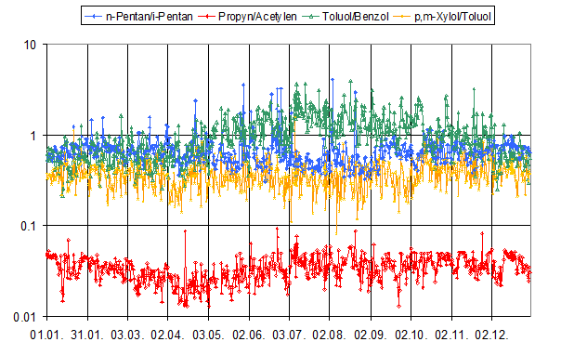
ACTRIS-2: Task 3.1 gases: sustain the quality
Implement control procedures for VOCs (Examples)
implementation of quality assurance tools for data submission
(in combination with EBAS/NILU)
2. Step visual inspection of ratios
Time ratio series of VOCs measured at Hohenpeissenberg

Slide 10
ACTRIS-2: Task 3.1 gases: sustain the quality
Implement control procedures for VOCs (Examples)
implementation of quality assurance tools for data submission
(in combination with EBAS/NILU)
2. Step visual inspection of MONTHLY MEANS
Rapid data delivery for selected station and checks
(2-3 stations to be decided at THIS meeting)

Slide 11
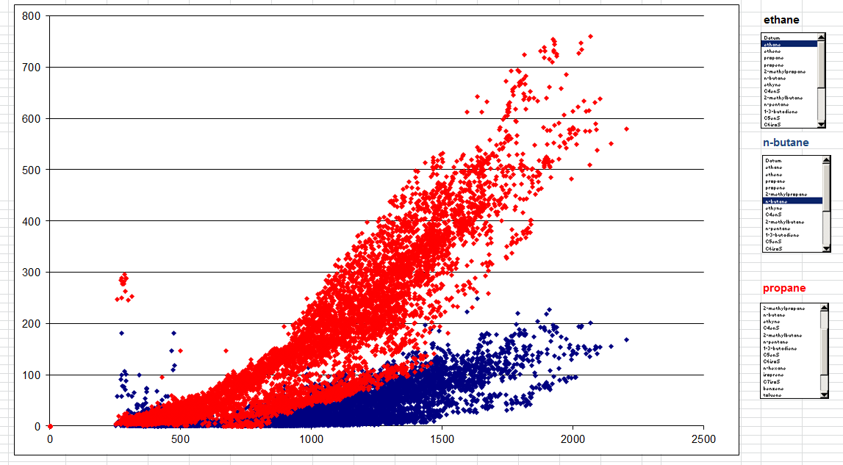
ACTRIS-2: Task 3.1 gases: sustain the quality
Implement control procedures for VOCs (Examples)
implementation of quality assurance tools for data submission
(in combination with EBAS/NILU)
3. Ratio plots against for inspection of outliers
Propane
n-Butane
?
Ethane

Slide 12
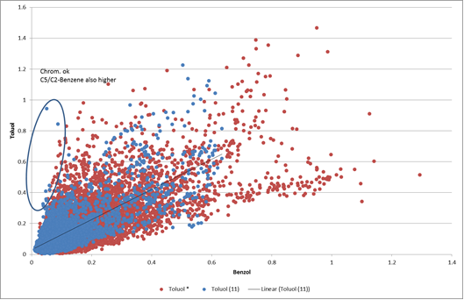
ACTRIS-2: Task 3.1 gases: sustain the quality
Implement control procedures for VOCs (Examples)
implementation of quality assurance tools for data submission
(in combination with EBAS/NILU)
4. Ratio plots against former years for inspection of outliers
Toluene vs Benzene ratio at Rigi, Switzerland (2011 and 2012)
Toluene
Benzene

Slide 13
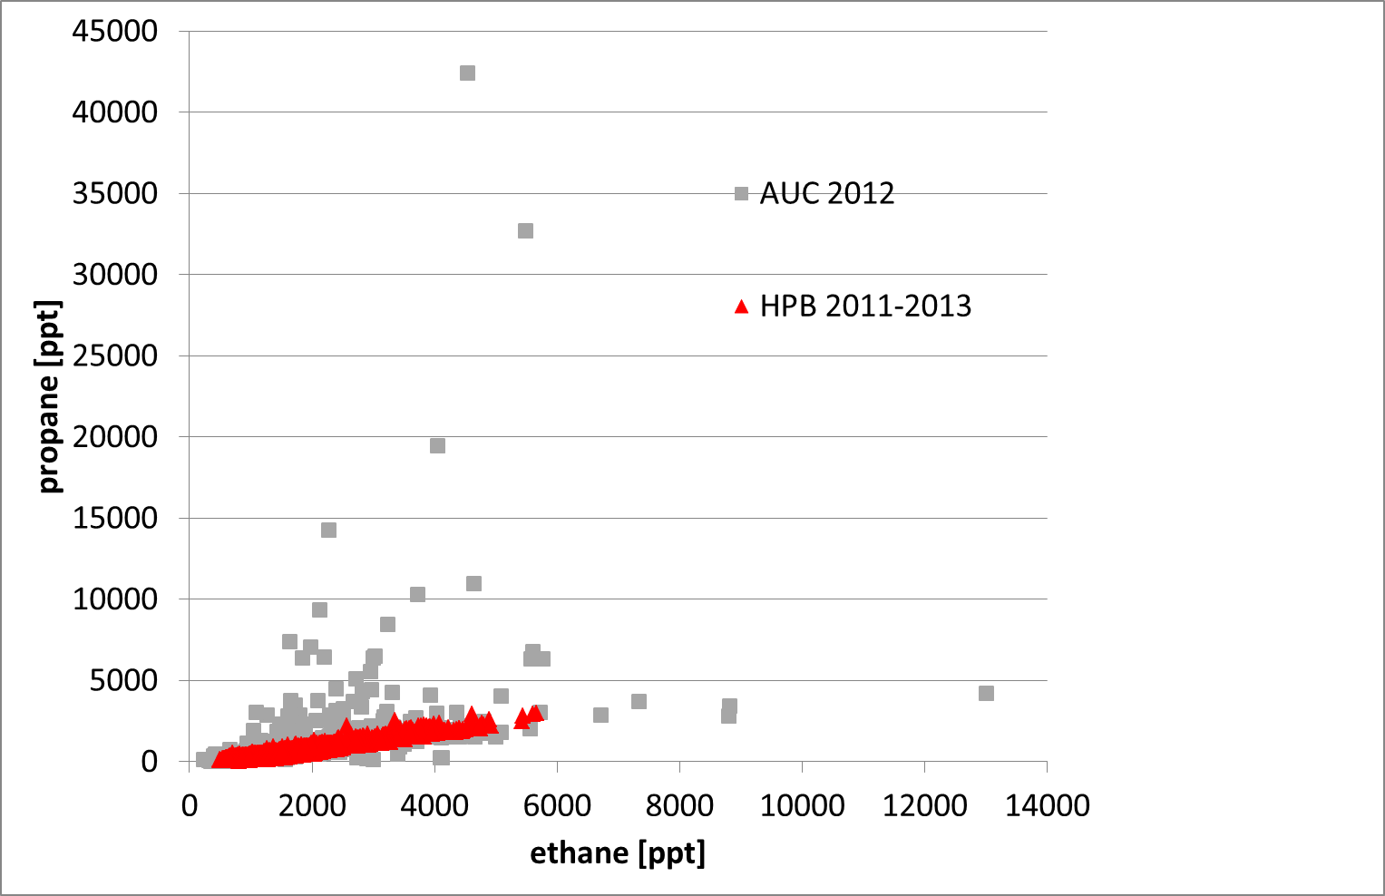
ACTRIS-2: Task 3.1 gases: sustain the quality
Implement control procedures for VOCs (Examples)
implementation of quality assurance tools for data submission
(in combination with EBAS/NILU)
5. Ratio plots for inspection against a "master station"

Slide 14
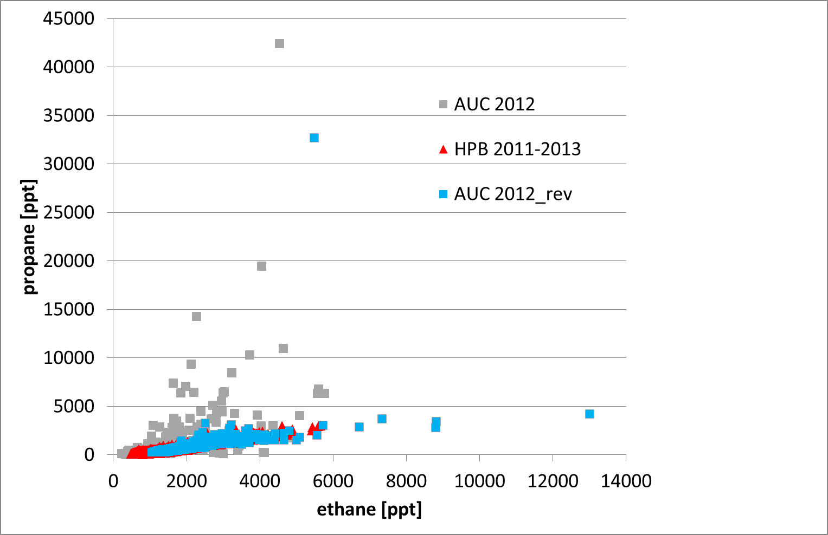
ACTRIS-2: Task 3.1 gases: sustain the quality
Implement control procedures for VOCs (Examples)
implementation of quality assurance tools for data submission
(in combination with EBAS/NILU)
5. Ratio plots for inspection against a "master station"

Slide 15
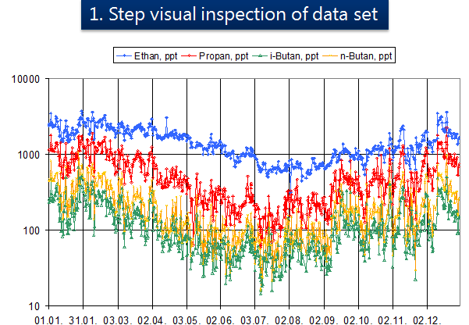
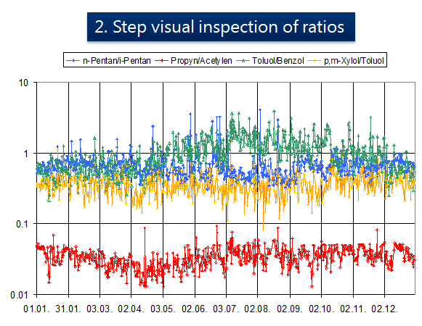
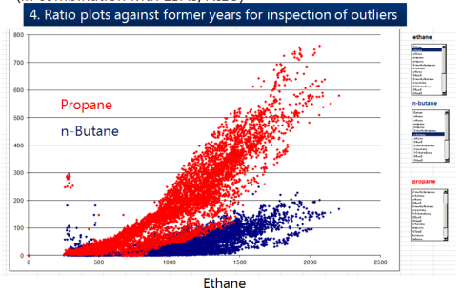
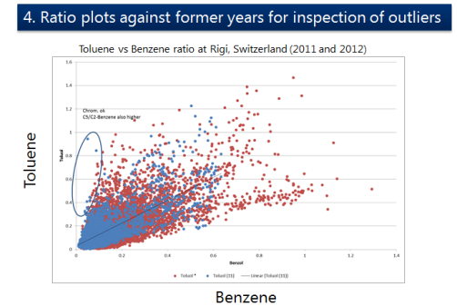
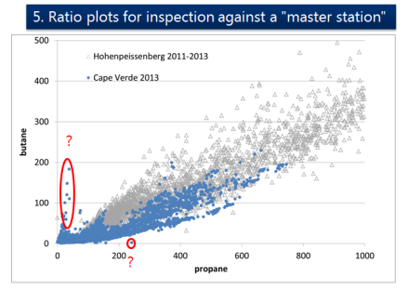
ACTRIS-2: Task 3.1 ➔ task. 3.3 : sustain the quality
Implement control procedures for VOCs (Examples)
implementation of quality assurance tools for data submission
(in combination with EBAS/NILU)
Implementation into EBAS (task 3.3)

Slide 16

ACTRIS-2: Task 3.1 (aerosol/cloud part)
Implement control procedures for
- Cloud Condensation Nuclei
- one additional organic tracer
Inter-laboratory comparison for selected organic aerosol (OA) tracers,
using synthetic/air standards for establishing SOPs for OA source apportionment :
ACTRIS calibration facilities:
For OC, EC and physical and optical aerosol variables, technical parts of the inter-comparison exercise (e.g. the pure calibration, intercomparison and hands-on training activities) will be performed at World Calibration Centre for Aerosol Physics (WCCAP, WP8) and European Laboratory for Air Pollution (ERLAP, WP8)

Slide 17
ACTRIS-2: Task 3.2.3 Development of a measurement standardization and a data submission protocol for VOCs based on PTRMS and TOF-MS measurements
CNRS/EMPA
Development of SOPs for PTR-MS and TOF-MS
In conjunction with ACSM intercomparison exercise, task .3.2.1. when/where?
No deliverables but will be included in VOC measurement guidelines
(Oct. 2018/D3.17/M4)
Status:
PTRMS (CNRS/Mines de Douai/UUtrecht/UHelsinki):
A first draft of a measurement standardization and a data submission protocol for PTRMS has been developed under ACTRIS but has not been delivered as such.
PTRMSs will take part at the OVOC/terpene side-by side intercomparison in 2017
TOFMS (EMPA/UUtrecht?): only a limited amount of instruments available in Europe. Mostly as Aerosol-TOFMS
GC-TOFMS being developed at EMPA (first results to be expected in 2016)

Slide 18
ACTRIS-2: Task 3.2.3 Development of a measurement standardization and a data submission protocol for VOCs based on PTRMS and TOF-MS measurements
Work plan for PTRMS and TOF-MS
Suggestion Rupert Holzinger (June 2015) (completed by Mines Douai)
0. Development of a sampling methodology (minimize sampling artifacts)
Development of an ACTRIS calibration method (gas standard) and a zeroing
method (background signal)
2. Procedure to manage humidity effects (signal normalization)
3. Method to measure specific compounds: methanol, acetonitrile, acetaldehyde, formic acid(?), acetone, MVK+MACR, isoprene, MEK, benzene, toluene, C8-C10 aromatics, phenol(?) and monoterpenes .
4. Other compounds? Especially using the new SRI method.
5. Total mass spectra products: total gas phase (oxygenated) organic carbon, O/C, H/C, N/C, carbon oxydation state etc (PTR-ToFMS only?)
6. Intercomparison between PTRMS, TOF-MS and other techniques (either round robin + target gas or side by side)

Slide 19
ACTRIS-2: Task 3.2.3 Development of a measurement standardization and a data submission protocol for VOCs based on PTRMS and TOF-MS measurements
Stations/instruments available in ACTRIS-2
site | institution | instrument | Data submission
Birkenes II | NILU | IONICON_PTR_TOF_8000 | yes
Hyytiälä | FMI |  | no
Field Campaigns | Mines de Douai | Kore 2sd generation PTR-ToFMS | no
 | Uni Utrecht |  | no
SIRTA | CNRS | IONICON_PTR | ?
Jungfraujoch | EMPA | GC-TOFMS (TOFWERK) | Installation in 2016/17

Slide 20
ACTRIS-2: task. 3.3 : Implementation of advanced control procedures for incoming VOCs/NOx
Implementation of advanced control procedures for incoming VOCs/NOx
(DWD/EMPA in combination with NILU/EBAS)
Implementation into EBAS (task 3.3)
M12: Apr 16 Workshop: development/implementation QC tools for data submission
M18: Okt 16 D3.6: tools for data submission developed

Slide 21
ACTRIS-2: task. 3.3 : Implementation of advanced control procedures for incoming VOCs/NOx
DWD/EMPA in combination with NILU/EBAS
task. 3.3.1 comparison of monthly means of different site for
VOC species and NOx
➔automatic check directly after submission of the data
Data from provider x is compared to data from all other provider for the
same period
To be done:
- Organization of a workshop when?
- Development of criteria for suggested action (flagging/recheck of data)
- Data base connection and automatization
- Potential for NRT and quick check

Slide 22
ACTRIS-2: task. 3.3 : Implementation of advanced control procedures for incoming VOCs/NOx
DWD/EMPA in combination with NILU/EBAS
task. 3.3.2 comparison of trace gas ratios for different site for
VOC species and NOx
➔automatic check directly after submission of the data
Data from provider x is compared to data from a master data set (e.g. Hohenpeissenberg/Rigi) for the period of one year
1st Step: Descriptive Plots (slope, inclination, r2)
2nd Step: Threshold definitions
To be developped:
Organization of a workshop when?
- Development of criteria for suggested action (flagging/recheck of data)
- Data base connection and automatization
- Preliminary data submission possible?

Slide 23
ACTRIS-2: Task 3.1 deliverables
deliverables
M6: Oct 15
M18: Oct 16
M18: Oct 16
M24: Apr 17
M36: Apr 18
M42: Oct 18
D 3.1: An expert workshop to determine the
targeted set of OA tracers
D 3.5: report on NO₂ side-by-side intercomp. (Lead DWD)
D3.6: tools for data submission (with Task 3.3) (Lead NILU)
D3.8: report on the QC tools for reactive gases (Lead EMPA)
D3.10: ILC studies for targeted sets of OA tracers
D3.15: SOPs for targeted sets of OA tracers
D3.17: Updated measurement guidelines for VOCs and NOx

Slide 24
ACTRIS-2: Task 3.1 additional milestones
Additional milestones
M12: Apr 16 Workshop: development/implementation QC tools for data submission
M15: Jul 16 NO₂ side-by-side intercomparison performed
M18: Oct 16 First QA/QC worskhop for VOC/NOx performed and data submitted
M27: Jul 17 OVOC/terpene side-by-side intercomparison performed
M30: Oct 17 Second QA/QC worskhop for VOC/NOx performed and data submitted
M42: Oct 18 Released updated measurement guidelines for VOCs and NOx
M42: Oct 18 Third QA/QC worskhop for VOC/NOx performed and data submitted

Slide 25
ACTRIS-2: Task 3.1 open questions
Rapid data delivery for VOCs
Near real-time? data delivery for NOx
Extended compound names
More stations
New data flow scheme?
Review of data submission flow (external, who?)
Papers: who? ESDD?

