Slide 1

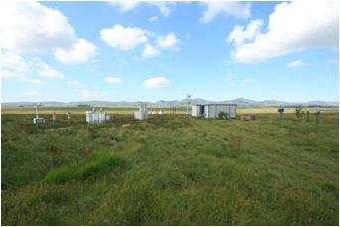
Auchencorth (UK): current status of station/instrument
NMHCs (cont. 2006ff.)
C2: ethane, ethene, ethyne
C3: propane, propene
C4: n-butane, isobutane, 1,3-butadiene, 1-butene, cis/trans-2-butene
C5: n-pentane, isopentane, cis-2-pentene, isoprene
C6: n-hexane, 2/3-methyl pentane
C7+: n-heptane, n-octane, isooctane
Arom: benzene, toluene, xylenes, trimethyl benzene, ethyl benzene
☹
Quality assurance:
Instrument: GC-FID
Preconcentration: PE TurboMatrix
Sample volume: 0.6 liter, trap at -30 °C, trap material CarbosorbB/Carbosieve SIII
Water removal: Nafion dryer
Scale: NPL, ppb standard, 30-components
Calibration interval: 4x 1h every 2 wk
Quality checks:
routine checks: daily chromatography
final checks: quarterly
Database: UKAIR, EMEP
Measurement instruction: no
Other issues: operated remotely by VNC

Slide 2

Harwell (UK): current status of station/instrument
NMHCs (cont. 2006ff.)
C2: ethane, ethene, ethyne
C3: propane, propene
C4: n-butane, isobutane, 1,3-butadiene, 1-butene, cis/trans-2-butene
C5: n-pentane, isopentane, cis-2-pentene, isoprene
C6: n-hexane, 2/3-methyl pentane
C7+: n-heptane, n-octane, isooctane
Arom: benzene, toluene, xylenes, trimethyl benzene, ethyl benzene
Quality assurance:
Instrument: GC-FID
Preconcentration: PE TurboMatrix
Sample volume: 0.6 liter, trap at -30 °C, trap material CarbosorbB/Carbosieve SIII
Water removal: Nafion dryer
Scale: NPL, ppb standard, 30-components
Calibration interval: 4x 1h every 2 wk
Quality checks:
routine checks: daily chromatography
final checks: quarterly
Database: UKAIR, EMEP
Measurement instruction: no
Other issues: operated remotely by VNC

Slide 3
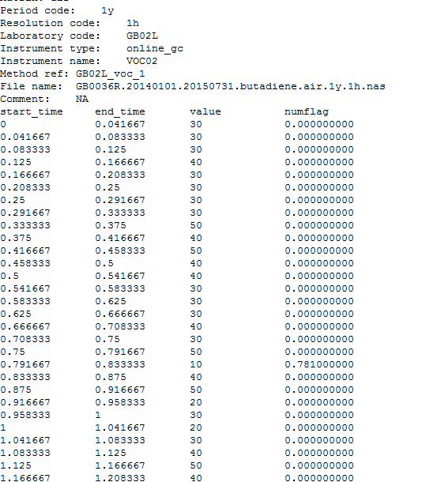
Harwell (UK): current status of station/instrument
☹

Slide 4
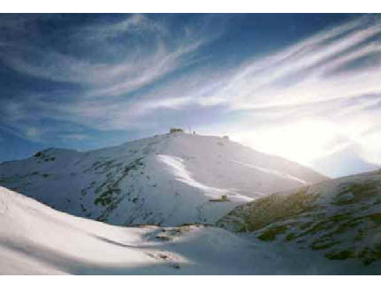

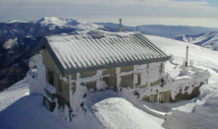
CMN Monte Cimone (Italy): current status of station/instrument
NMHCs (cont. 2004 /2008 ff.)
C3: propane, propene
C4: n-butane, isobutane, 1-butene, 2-butene, 1-3-butadiene
C5: n-pentane, isopentane, isoprene
C6: n-hexane, methyl-pentanes
C7: n-eptane,
C8: iso octane
Arom: benzene, toluene, xylenes, ethyl benzene;
Other VOCs could be added to the list after a deep investigation of the retention time of every compound: typical ions (m/z 41, 43, 51, 54, 56, 57) are detected along the chromatogram. Performance test has not been performed for the VOCs, but we are quite confident of the linearity of the trapping system as reported by the manufacturer (same system is sold as US-EPA TO14/15 and O-17 compliant)
Quality assurance:
Instrument: GCMS
Preconcentration: Markes – Unity2
Sample volume: 1 liter, trap at -30 °C, multibed trap: Carbograph/CarosieveS3/Carboxen1003
Water removal: Nafion dryer
Scale: not calibrated! Working std are traceble back to 2007; additional information for some compounds (C4, C5, and aromatics) might be available back to 2004
Calibration interval: every 2 hours
Quality checks:
routine checks: daily
final checks: yearly
Database: AGAGE but not for VOCs
Measurement instruction: no

Slide 5
Monte Cimone (Italy):
Current Issues Related to Substances:
High butane peaks
Restart issues
Butane/2-methylpropane/propane too high vs pentane
19.02.2015 20:12 | 20.02.2015 10:12 | all peaks | very low concentrations. Delete first days after the restart
19.03.2015 17:19 |  | n-butane | vs 2-methylpropane
20.03.2015 11:15 |  | n-butane | vs 2-methylpropane
11.07.2015 | 28.07.2015 | n-butane | high concentrations, unusual trend
11.07.2015 | 28.07.2015 | 2-methylpropane | high concentrations, unusual trend
11.07.2015 | 28.07.2015 | propane | high concentrations, unusual trend
19. 07. 2015, 21:26 |  | m-propane vs. Methylbutane wrong?
07.08.2015 | 15.08.2015 | benzene
27.10.2015 | 16.11.2015 | my-xylene | very low concentrations vs toluene and somehow it looks wrong anyway
07.11.2015 11:41 | 12.11.2015 18:23 | n-octane | high concentrations, unusual trend
08.11.2015 14:40 |  | n-hexane | very high. Local?
08.11.2015 |  | hexane and heptane???
07.12.2015 | 10:00-14:00 | mp-xylene too high
24. 12. 2015, 12:19 |  | m-propane vs. Methylbutane wrong? Also n-butane

Slide 6
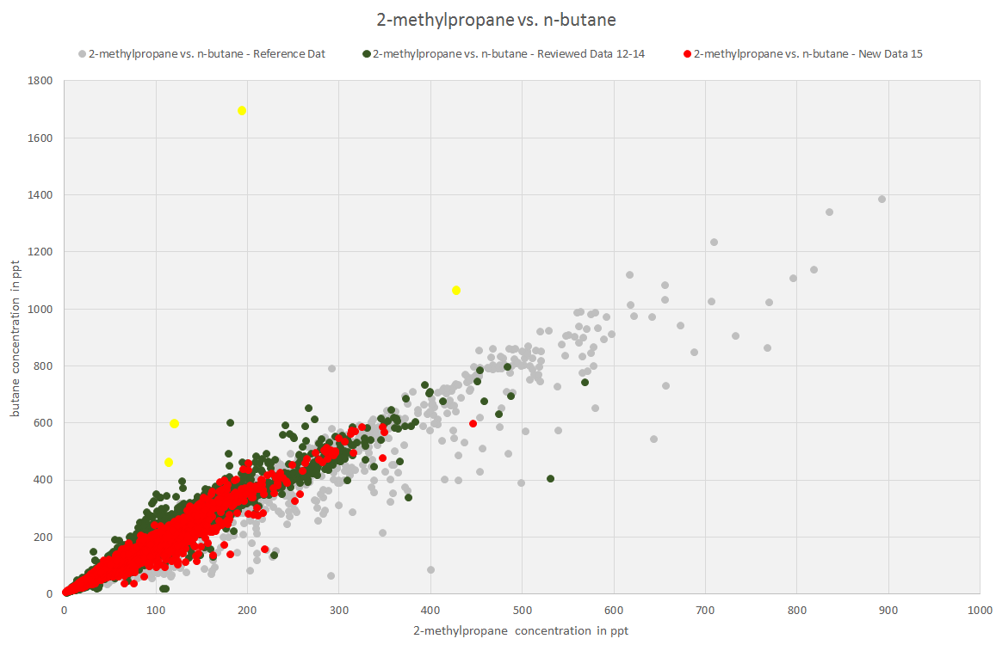
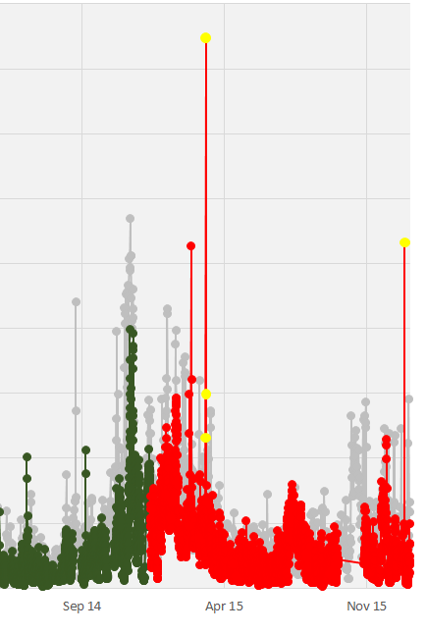
Monte Cimone (Italy):
Issue: high n-butane peaks

Slide 7
Monte Cimone (Italy):
Current Issues Related to Substances:
High butane peaks
Restart issues
Butane/2-methylpropane/propane too high vs pentane
19.02.2015 20:12 | 20.02.2015 10:12 | all peaks | very low concentrations. Delete first days after the restart
19.03.2015 17:19 |  | n-butane | vs 2-methylpropane
20.03.2015 11:15 |  | n-butane | vs 2-methylpropane
11.07.2015 | 28.07.2015 | n-butane | high concentrations, unusual trend
11.07.2015 | 28.07.2015 | 2-methylpropane | high concentrations, unusual trend
11.07.2015 | 28.07.2015 | propane | high concentrations, unusual trend
19. 07. 2015, 21:26 |  | m-propane vs. Methylbutane wrong?
07.08.2015 | 15.08.2015 | benzene
27.10.2015 | 16.11.2015 | my-xylene | very low concentrations vs toluene and somehow it looks wrong anyway
07.11.2015 11:41 | 12.11.2015 18:23 | n-octane | high concentrations, unusual trend
08.11.2015 14:40 |  | n-hexane | very high. Local?
08.11.2015 |  | hexane and heptane???
07.12.2015 | 10:00-14:00 | mp-xylene too high
24. 12. 2015, 12:19 |  | m-propane vs. Methylbutane wrong? Also n-butane

Slide 8
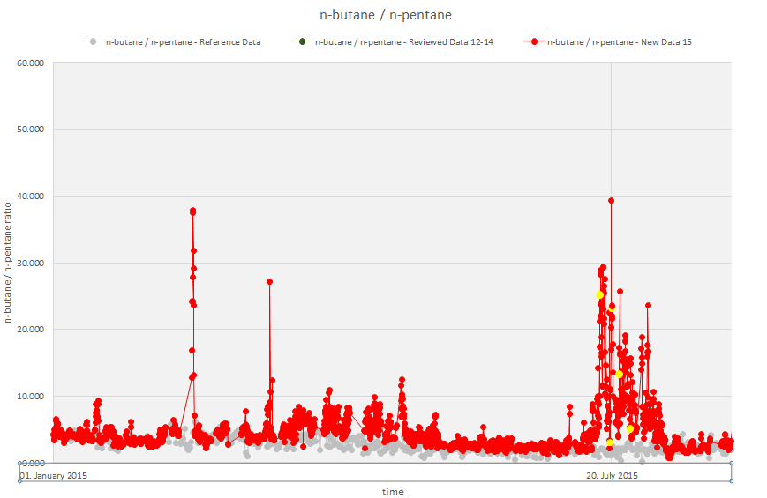
Monte Cimone (Italy):
Restart issues
Butane/2-methylpropane/propane too high vs pentane

Slide 9
Monte Cimone (Italy):
Current Issues Related to Substances:
4. Benzene vs ethyne in August
19.02.2015 20:12 | 20.02.2015 10:12 | all peaks | very low concentrations. Delete first days after the restart
19.03.2015 17:19 |  | n-butane | vs 2-methylpropane
20.03.2015 11:15 |  | n-butane | vs 2-methylpropane
11.07.2015 | 28.07.2015 | n-butane | high concentrations, unusual trend
11.07.2015 | 28.07.2015 | 2-methylpropane | high concentrations, unusual trend
11.07.2015 | 28.07.2015 | propane | high concentrations, unusual trend
19. 07. 2015, 21:26 |  | m-propane vs. Methylbutane wrong?
07.08.2015 | 15.08.2015 | benzene
27.10.2015 | 16.11.2015 | my-xylene | very low concentrations vs toluene and somehow it looks wrong anyway
07.11.2015 11:41 | 12.11.2015 18:23 | n-octane | high concentrations, unusual trend
08.11.2015 14:40 |  | n-hexane | very high. Local?
08.11.2015 |  | hexane and heptane???
07.12.2015 | 10:00-14:00 | mp-xylene too high
24. 12. 2015, 12:19 |  | m-propane vs. Methylbutane wrong? Also n-butane

Slide 10
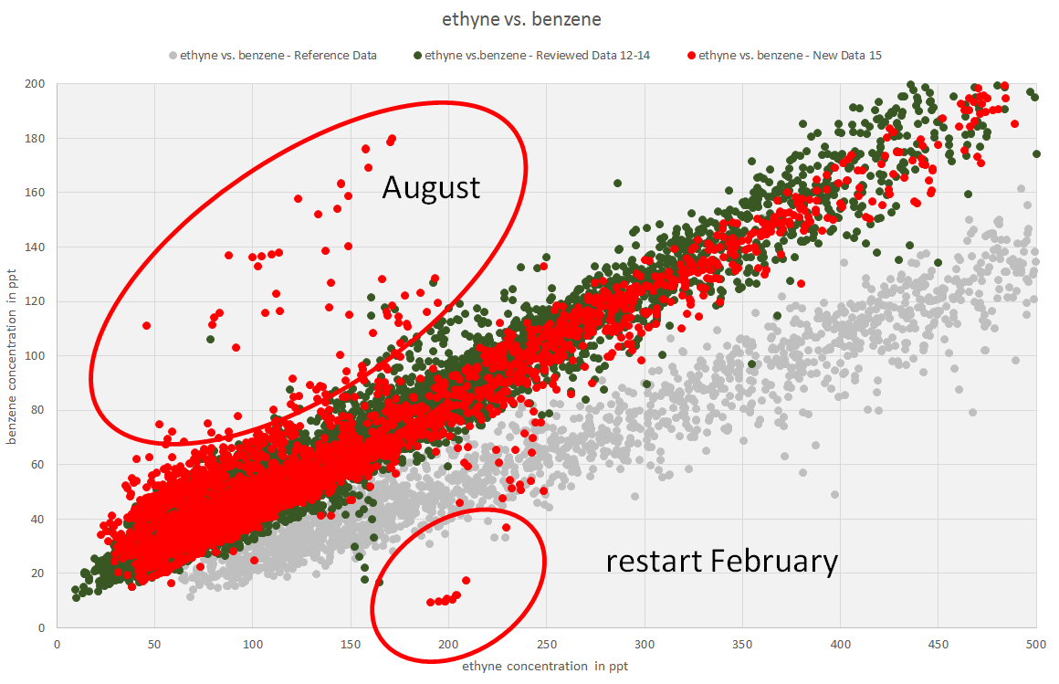
Monte Cimone (Italy):
4. Benzene vs ethyne in August

Slide 11
Monte Cimone (Italy):
Current Issues Related to Substances:
4. Benzene vs ethyne in August
19.02.2015 20:12 | 20.02.2015 10:12 | all peaks | very low concentrations. Delete first days after the restart
19.03.2015 17:19 |  | n-butane | vs 2-methylpropane
20.03.2015 11:15 |  | n-butane | vs 2-methylpropane
11.07.2015 | 28.07.2015 | n-butane | high concentrations, unusual trend
11.07.2015 | 28.07.2015 | 2-methylpropane | high concentrations, unusual trend
11.07.2015 | 28.07.2015 | propane | high concentrations, unusual trend
19. 07. 2015, 21:26 |  | m-propane vs. Methylbutane wrong?
07.08.2015 | 15.08.2015 | benzene
27.10.2015 | 16.11.2015 | my-xylene | very low concentrations vs toluene and somehow it looks wrong anyway
07.11.2015 11:41 | 12.11.2015 18:23 | n-octane | high concentrations, unusual trend
08.11.2015 14:40 |  | n-hexane | very high. Local?
08.11.2015 |  | hexane and heptane???
07.12.2015 | 10:00-14:00 | mp-xylene too high
24. 12. 2015, 12:19 |  | m-propane vs. Methylbutane wrong? Also n-butane

Slide 12
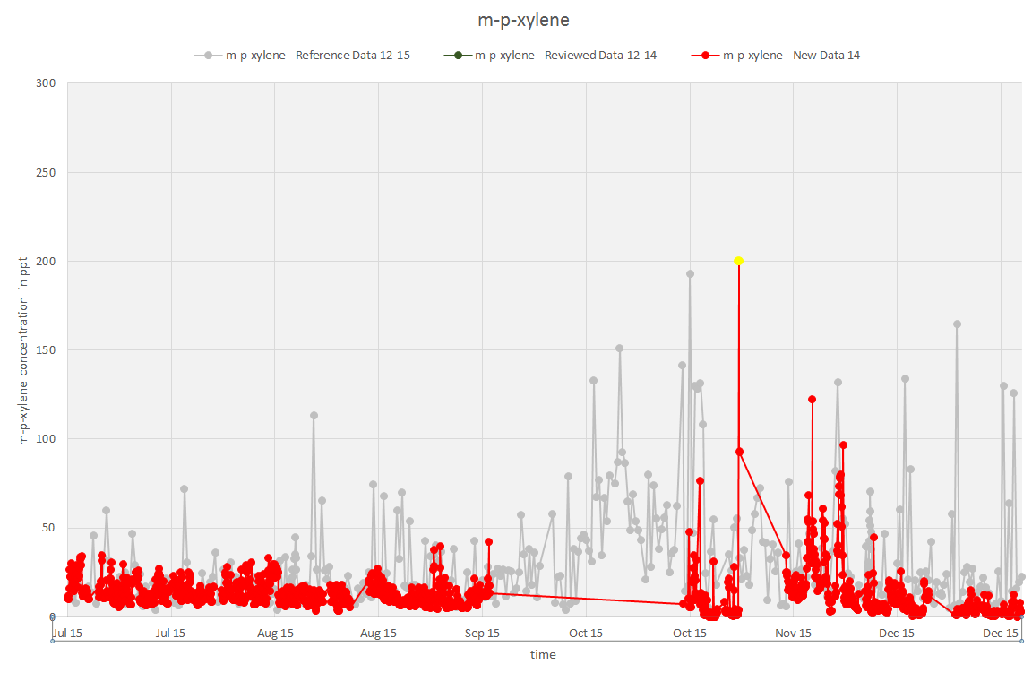
Monte Cimone (Italy):
4. Benzene vs ethyne in August
mp-xylene in autumn

Slide 13
Monte Cimone (Italy):
Current Issues Related to Substances:
4. Benzene vs ethyne in August
19.02.2015 20:12 | 20.02.2015 10:12 | all peaks | very low concentrations. Delete first days after the restart
19.03.2015 17:19 |  | n-butane | vs 2-methylpropane
20.03.2015 11:15 |  | n-butane | vs 2-methylpropane
11.07.2015 | 28.07.2015 | n-butane | high concentrations, unusual trend
11.07.2015 | 28.07.2015 | 2-methylpropane | high concentrations, unusual trend
11.07.2015 | 28.07.2015 | propane | high concentrations, unusual trend
19. 07. 2015, 21:26 |  | m-propane vs. Methylbutane wrong?
07.08.2015 | 15.08.2015 | benzene
27.10.2015 | 16.11.2015 | my-xylene | very low concentrations vs toluene and somehow it looks wrong anyway
07.11.2015 11:41 | 12.11.2015 18:23 | n-octane | high concentrations, unusual trend
08.11.2015 14:40 |  | n-hexane | very high. Local?
08.11.2015 |  | hexane and heptane???
07.12.2015 | 10:00-14:00 | mp-xylene too high
24. 12. 2015, 12:19 |  | m-propane vs. Methylbutane wrong? Also n-butane

Slide 14
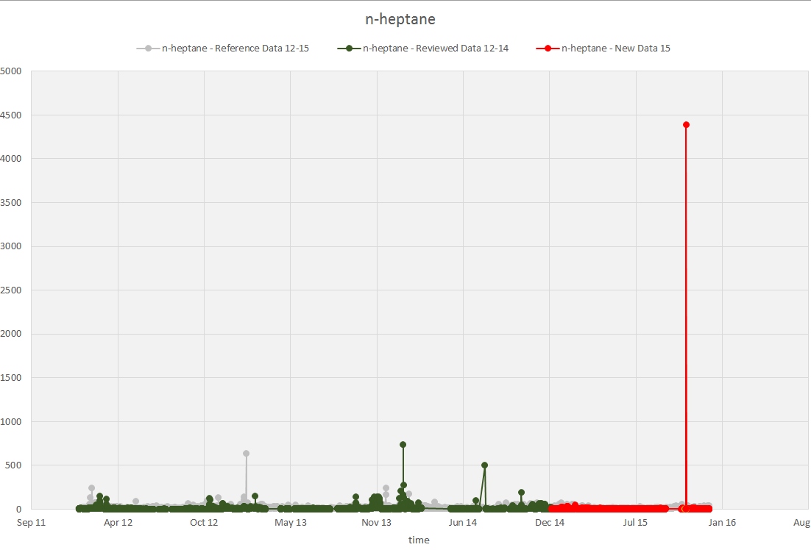
Monte Cimone (Italy):
4. Benzene vs ethyne in August
5. mp-xylene in autumn
6. 7./8. Nov, high for certain compounds (local contamination?)

Slide 15
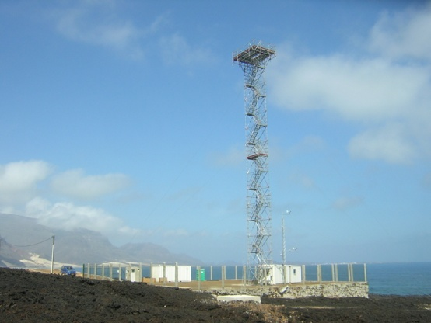
CVO Cape Verde: current status of station/instrument
NMHCs (cont. 2007)
C2: ethane, ethene, acetylene
C3: propane, propene
C4: n-butane, isobutane, 1-butene, cis-2-butene, iso-butene, trans-2-butene, 1,3-butadiene
C5: n-pentane, isopentane, cyclopentane, isoprene
C6: n-hexane, 2+3-methylpentane
C7+: n-heptane
Arom: benzene, toluene, ethylbenzene, m+p xylene, o-xylene
Quality assurance:
Instrument: dual channel GC-FID
Preconcentration: OPTIC (Ai Qualitek)
Sample volume: 1 litre, trap at -20 °C, trap material: Carboxen 100 and carbotrap B
Water removal: glass cold finger (-30 °C)
Scale: NPL, 4ppb standard, 30-components
Calibration interval: fortnightly
Quality checks:
routine checks: daily
final checks: yearly
Database: WDCGG, BADC
Measurement instruction: yes/no
Other issues:

Slide 16
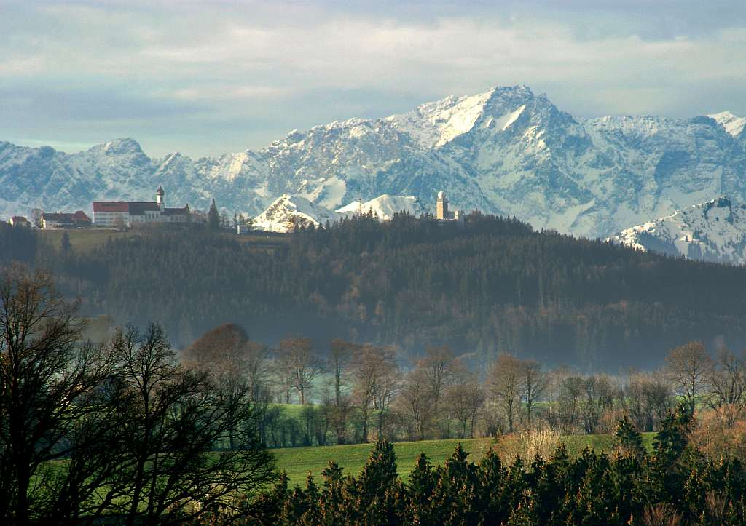
HPB Hohenpeißenberg (Germany): current status of station/instrument
C2-C8 HC (Sep 1998 ongoing)
Daily 1:00 + 13:00 CET
C2: Ethane, Ethene, Acetylene
C3: Propane, Propene, Propyne
C4: i-Butane, n-Butane, 1-Butene, i-Butene, c-2-Butene, 1,3-Butadien
C5: i-Pentane, n-Pentane, t-2-Pentene, 1-Pentene, c-2-Pentene, Isoprene
C6: n-Hexane, 2-M-Pentane, 3-M-Pentane, 2,3-DiM-Butane, M-Cyclopentane+2,2-DiM-Butane
C7: n-Heptane, M-Cyclohexan+2,2,3-TriM-Butan
C8: n-Octane
Aromatics: Benzene, Toluene, ethylbenzene, p,m-Xylene
Quality assurance:
Instrument: GC-FID
Preconcentration: glass beeds in 1/8“ SS, custom built, trap at -185 °C
Sample volume: 0.75 liter
Water removal: 1/8“ Silcosteel cold trap -40°C
Scale: NPL, 2ppb standard, 30-components +
Calibration interval: monthly: station standard, after each sample: synth. Reference gas
Quality checks: daily: GC param. + chromatogr., weekly: zero, monthly: cal. + 1st data evaluation, yearly: final data evaluation
Database: WDCGG, EBAS
Measurement instruction: yes
Other issues: compar.: other GC + flasks Helmig

Slide 17

JFJ Jungfraujoch (Switzerland): in EBAS current status of station/instrument
NMHCs (cont. 2008ff.)
C2: ethane,
C3: propane,
C4: n-butane, isobutane,
C5: n-pentane, isopentane
C6:
C7+:
Arom: benzene, toluene
Quality assurance:
Instrument: GCMS
Preconcentration: MEDUSA
Sample volume: 2 liter, trap at -170 °C, trap material Hayesep D
Water removal: Nafion dryer
Scale: NPL, 4ppb standard, 30-components
Calibration interval: 3-hourly
Quality checks:
routine checks: daily
final checks: yearly
Database: WDCGG, AGAGE
Measurement instruction: yes/no
Other issues: xxx

Slide 18
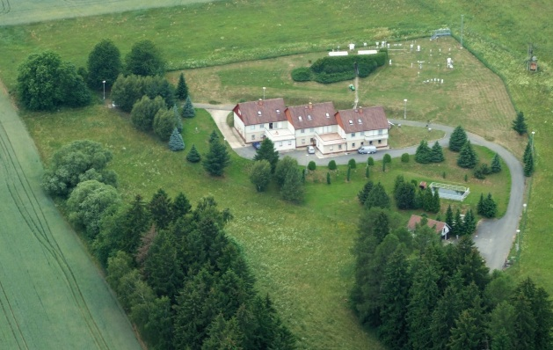
Kosetice (Czech Republic): current status of station/instrument
NMHCs (1993 up to now)
ethane
ethene,
propane
propene
i-butane
n-butane
acethylene
total butanes
i-pentane
n-pentane
total pentenes,
i-hexane
n-hexane
isoprene
i-heptane
n-heptane
benzene
toluene
etylbenzene
m,p-xylene
o-xylene
Quality assurance:
Instrument: steel canister
Preconcentration: UNITY - Thermal Desorber, oven temperature 120 °C, trap temperature -20 °C, transfer line temperature 120 °C, gas type air, trap flow 40 ml/min, split 20 ml/min
Water removal: No
Scale: detection and determinableness limits are specified for each measured compound
Calibration interval: 3 months
Quality checks:
routine checks: daily
final checks: yearly
Database: EMEP, CHMI
Measurement instruction: yes
☹

Slide 19
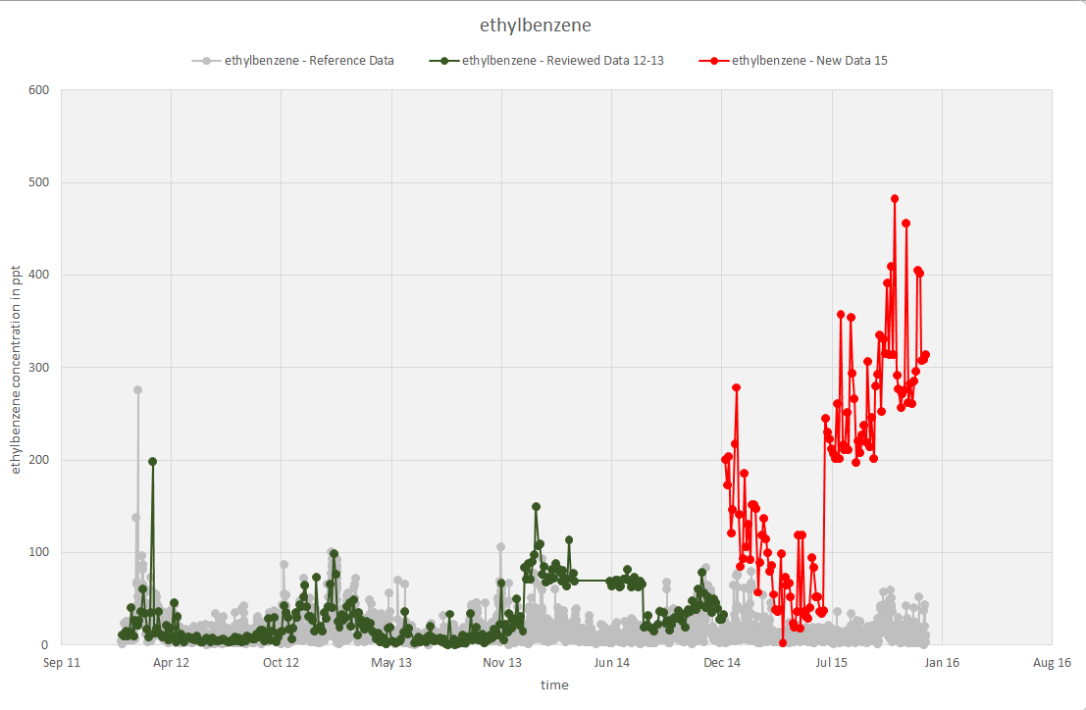
KOS Kosetice (Czech Republic):
Current Issues Related to Time Periods:
l)ethylbenzene: much higher than the years before
m) ethylbenzene: DL very high >200ppt

Slide 20
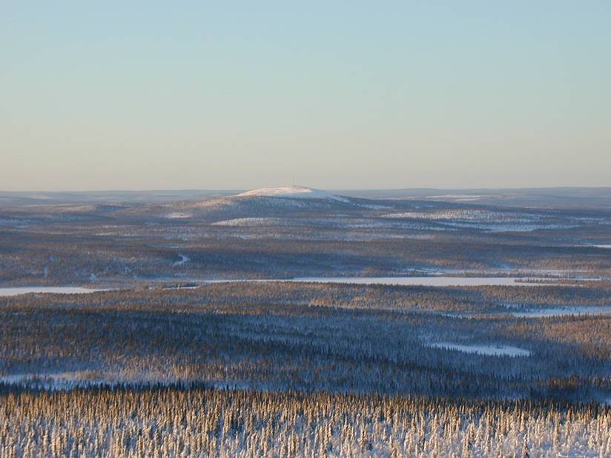
PAL Pallas-Sodankylä (Finland): current status of station/instrument
NMHCs
C2: ethane,
C3: propane,
C4: n-butane, isobutane,
C5: n-pentane, isopentane
C6:
Arom: benzene, toluene
FMI
Hannele Hakkola
Quality assurance:
Instrument: GCFID
Preconcentration: Adsorbent trap
Sample volume: 1.2 liter, trap at -40 °C, trap material Perkin Elmer air monitoring trap, mixed bed carbon
Water removal: Nafion dryer
Scale: NPL, 4ppb standard, 30-components
Calibration interval: weekly
Quality checks:
routine checks: weekly
final checks: yearly
Database: EMEP
Measurement instruction: no

Slide 21
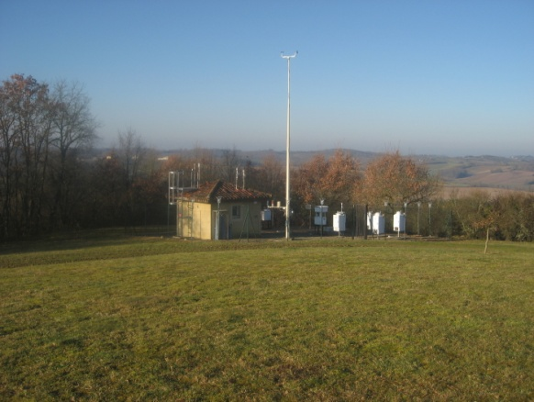
PEY Peyrusse/TAR La Tardiere
NMHCs (off-line cont.)
C2: ethane, ethene, ethyne
C3: propane, propene
C4: n-butane, isobutane, butenes
C5: n-pentane, isopentane, dimethylpropane, pentenes, isoprene
C6: hexane, cyclohexane, hexene, dimethylbutane, methylbutane
C7+: n-heptane, isoheptane, dimethylpentane, octane
Arom: benzene, toluene, xylenes, ethylbenzene, trimethylbenzenes
Stephane Sauvage
Peyrusse Vieille
Quality assurance:
Sampling system : stainless steel canister + AVOCS andersen, volume 6 liters, 2/week
Instrument: GC/2FID Chrompak CP9001
Preconcentration: ENTEC P7100
homemade traps trap1 glass+tenax -120 °C, trap2 tenax -50°C, capillary -50°C
Water removal: yes
Scale: NPL, 4ppb standard,
Calibration interval: weekly
Quality checks: Canister cleaning check
Quality control/dual sampling : 2/year
routine checks: monthly final checks: yearly
Database: EMEP
Measurement instruction: yes (for sampling)

Slide 22
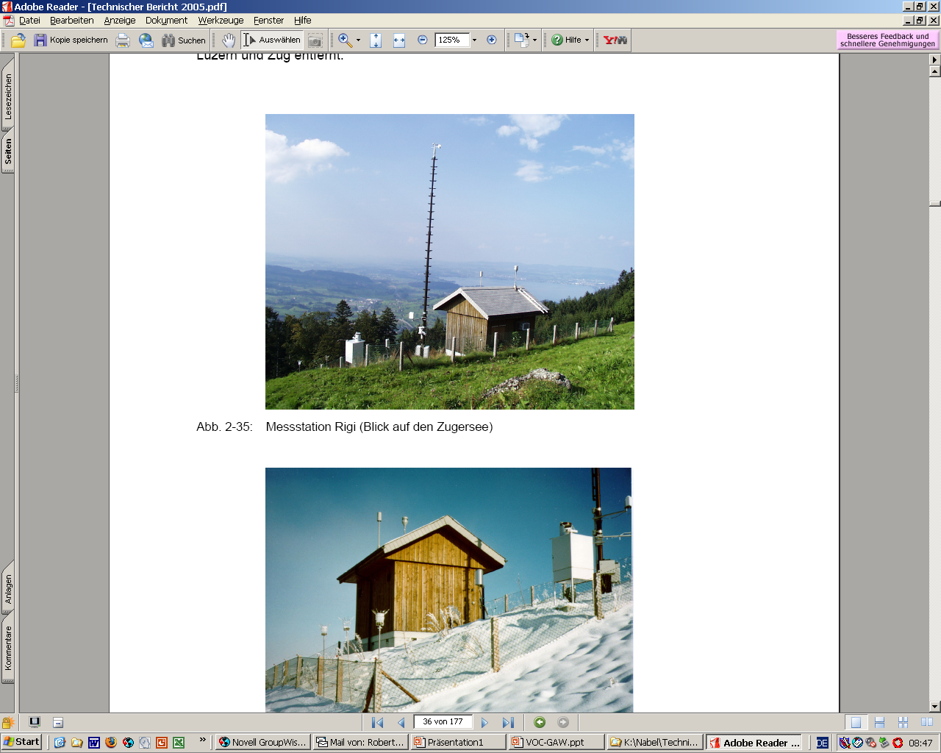
Rigi (Switzerland): current status of station/instrument
C2-C8 HC (2003 ongoing)
Hourly (continuous)
C2: Ethane, Ethene, Acetylene
C3: Propane, Propene
C4: i-Butane, n-Butane, sum of Butenes, 1,3-Butadien
C5: i-Pentane, n-Pentane, sum of Pentenes, Isoprene
C6: n-Hexane, sum of Isohexanes
C7: sum of Isoheptanes
C8:
Aromatics: Benzene, Toluene, ethylbenzene, p,m-Xylene, o-xylene
Quality assurance:
Instrument: GC-FID
Preconcentration: 3-stage trap, -44 °C
Sample volume: 1 liter
Water removal: Nafion Dryer
Scale: NPL, 4ppb standard, 30-components
Calibration interval: monthly: station standard, Quality checks: daily: GC param. + chromatogr., yearly: final data evaluation
Database: WDCGG,
Measurement instruction: yes
Other issues:

Slide 23
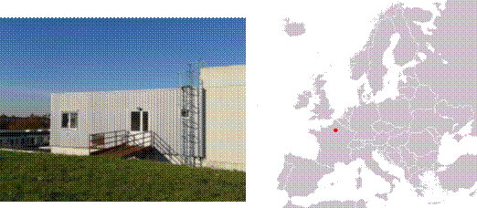
SIR SIRTA (France): 2 samples a week
NMHCs
C2:
C3:
C4: Isobutane,
C5: 2-Pentene, (Z)-, 1-Pentene,
C6: Pentane, 2-methyl-,
C7+: Heptane, Octane, Pentane, 2,2,4-trimethyl-,
Arom: benzene, toluene, p & m-Xylene, o-Xylene, 1,3,5-TMB, 1,2,4-TMB, 1,2,3-TMB, Benzene 1,3-dimethyl, Ethylbenzene,
Quality assurance:
Instrument: GCMS
Sampling system : SASS Autosampler, trap material TENAX TA, Volume : 0.7 L
Preconcentration: ATD 300, TurboMatrix thermal Desorbers, Cold trap at 0°C with Carbosieve SIII (C2 to C6) and Carpopack B (C5 to C12)
Water removal: No
Scale: NPL, 4ppb standard, 30-components
Calibration interval: before cartridge analysis
Quality checks: Autotune, each week for Air/Water Check and calibration in mass
Database: ? (NILU)
Measurement instruction: yes
Other issues: xxx

Slide 24
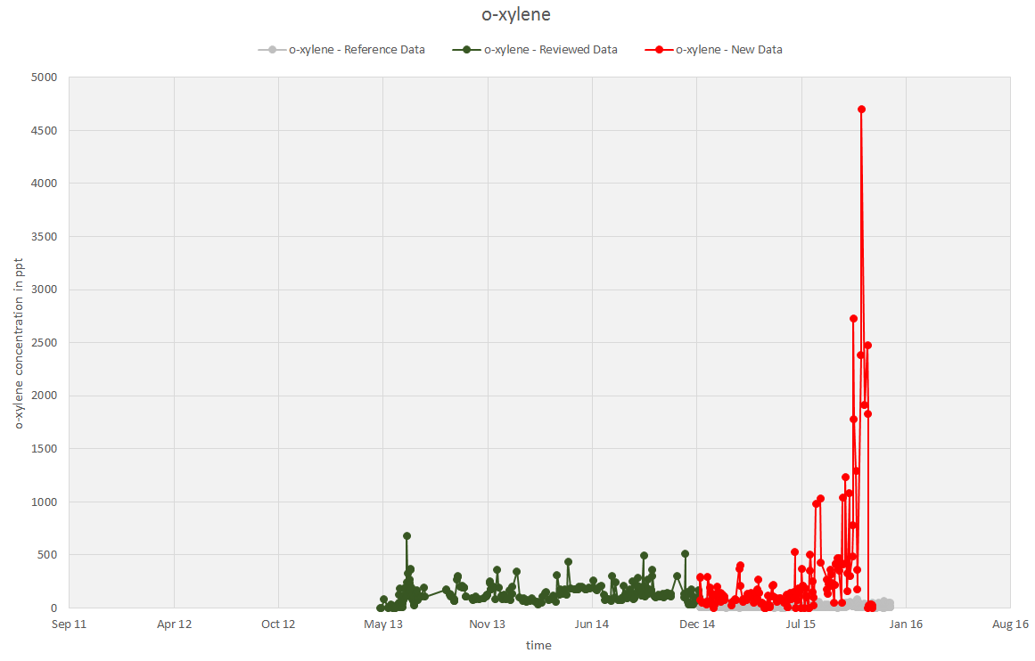
SIR SIRTA (France):
Current Issues Related to Time Periods:
July Nov very high concentrations for
Xylenes, Ethylbenzene, benzene, toluene

Slide 25
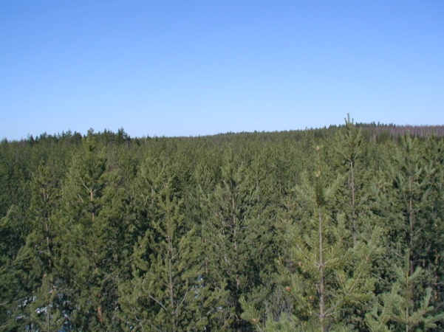
SMR Hyytiälä (Finland): current status of station/instrument
Isoprene,
benzene,
toluene
University of Helsinki
Quality assurance:
Instrument: PTRMS
Preconcentration: no
Water removal: dry purge
Scale: liquid standards in adsorbent tubes
Calibration interval: weekly
Quality checks:
routine checks: weekly
final checks: yearly
Database:
Measurement instruction: yes (in Finnish)
Other issues:

Slide 26
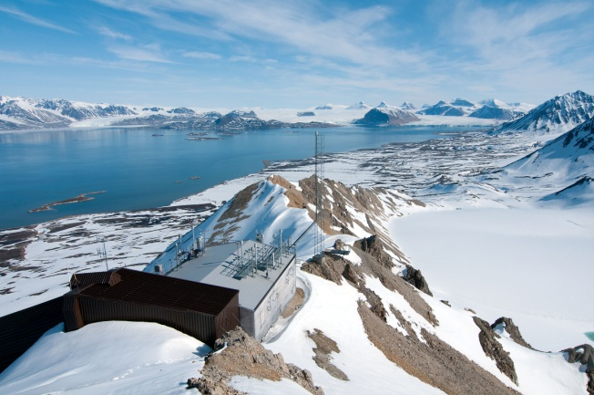
ZEP Zeppelin Norway, Spitsbergen
NMHCs (cont. 2010 ff.)
ethane,
propane,
n-butane, isobutane,
n-pentane, isopentane
benzene
toluene
ethylbenzene
m + p –xylenes
o-xylene
Quality assurance:
Instrument: GCMS
Preconcentration: MEDUSA
Sample volume: 2 liter, trap at -170 °C, trap material Hayesep D
Water removal: Nafion dryer
Scale: EMPA/SIO/NPL, 4ppb standard, 30-components
Calibration interval: 3-hourly
Quality checks:
routine checks: daily - weekly
final checks: yearly
Database: WDCGG, AGAGE
Measurement instruction: yes/no
TAR La Tardière

Slide 27
4 German EMEP sites
NMHCs (cont. 2010 ff.)
ethane,
propane,
n-butane, isobutane,
n-pentane, isopentane
benzene
toluene
ethylbenzene
m + p –xylenes
o-xylene
Quality assurance:
Instrument: GC-FID
Preconcentration:
Water removal:
Scale: NPL, 4ppb standard, 30-components
Calibration interval:
Quality checks:
routine checks: daily - weekly
final checks: yearly
Database: WDCGG,
Measurement instruction: yes/no

Slide 28

Puy de Dôme (France): current status of station/instrument
NMHCs (campaigns 2010, 2011 and from 2012 : 2 samples/weeks)
N-butane
Iso-butane
1-pentene
Isopentane
N-pentane
T2-pentene
C2-pentene
1-hexene
N-hexane
Benzene
Isooctane
N-heptane
Toluene
N-octane
Ethlbenzene
M+p xylene
O-xylène
1.3.5 trimethylbenzene
1.2.4 trimethylbenzene
1.2.3 trimethylbenzene
For ACTRIS:
Twice a week (to be discussed)
1 sample/day at 10:00 UTC;
1 sample/night 22:00 UTC;.
No data submitted
Quality assurance:
Instrument: GCMS
Preconcentration: Adsorbent-tube sampling
(250 mg of Tenax TA 60-80 mesh, 150 mg of Carsieve III). . Sampling during 3 hours at 100mL/min,
Tube Conditionning: 4h at 300°C with pure nitrogen.
Water removal: none
Scale: NPL, 4ppb standard, 30-components
Calibration interval: 1 standard/every 10 samples
Quality checks: flow, leak, repetability, blanks
Database: no
Measurement instruction: no
Other issues: xxx
☹

Slide 29
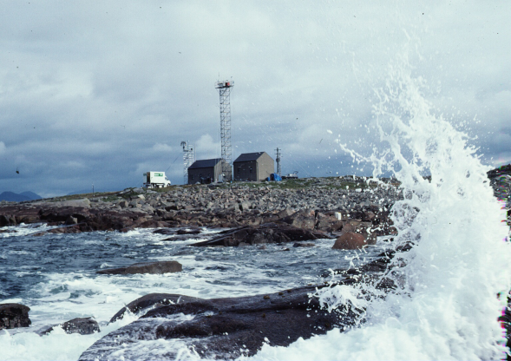
Mace Head (Ireland): current status of station/instrument
NMHCs (continous-2005)
C2: ethane,
C3: propane,
C4: n-butane, isobutane,
C5: n-pentane, isopentane
C6:
C7+:
Arom: benzene, toluene
No data submitted
Quality assurance:
Instrument: GCMS
Preconcentration: MEDUSA
Sample volume: 2 litre, trap at -170 °C, trap material Hayesep D
Water removal: Nafion dryer
Scale: NPL (D45 7238D45) 7238
Calibration interval: 3-hourly
Quality checks:
Routine checks: daily
Final checks: yearly QA
Database: AGAGE
Measurement instruction: yes
Other issues:
☹

