Slide 1

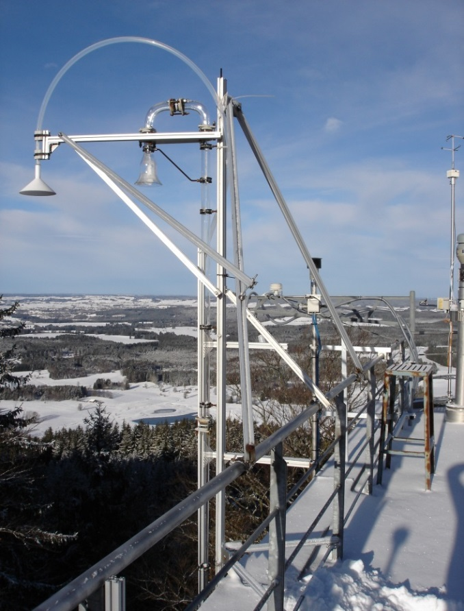

Side by side-Intercomparison NOx
10. – 21. Oktober 2016
Hohenpeissenberg Observatory (DWD)

Slide 2
OBJECTIVES:
Ambient air comparison
Dry or humid calibration – What’s better?
NO and NO₂ offset determination
Linearity of converters
NOx dependence on humidity
NOx dependence on laboratory temperature
Identifying drifts
Impact of HNO₂ (HONO)/(HNO₃) on NOx
NOx interferences by Alkenes
Characterization of possible differences between CLD and other techniques

Slide 3
Site | Institution | Short cut | Device | Method
Hohenpeissenberg (D) | DWD | HPB | TEI 42 CTL | CLD / BLC
 |  |  | Ecophys. 770 AL ppt | CLD / PLC
 |  |  | Aerodyne CAPS | Cavity attenu-ated phase shift
Košetice / Prague (CZ) | CHMI | CHMI | TEI 42C | CLD / Mo converter
Leipzig (D) | TROPOS | TROPOS | TEI 42 iTL | CLD / BLC
WCC/FZJ (D) | GAW WCC NOx | FZJ | modified Eco-physics 780 TR | CLD / BLC
FZJ (D) | Research Center Juelich | IAGOS | IAGOS | CLD / BLC
Ispra (I) | JRC | IPR | CAPS | Cavity attenuated phase shift
 |  |  | TE 42iTL | CLD / Mo converter
Pallas-Sodankylä (FIN) | FMI | FMI | TEI 42 iTLE | CLD / BLC
Monte Cimone (I) | CNR - ISAC | ISAC | TEI 42 iTL | CLD / BLC
SIRTA (F) | LSCE - CNRS | Sirta | Teledyne T200U | CLD / BLC
French EMEP sites: La Tardière, Peyrusse-Vieille (F) | Mines Douai | MD | AS 32M (CAPS) | Cavity attenuated phase shift
 |  |  | Los Gatos Research | Cavity enhanced laser absorption spectroscopy (CEAS)
 |  |  | TEI 42 iTL | CLD / BLC
Heidelberg (D) | University of Heidelberg, IUP | DOAS | ICAD NO2 1.0 / ICAD-NOx 1.1 | ICAD (Iterative Cavity DOAS)

Slide 4
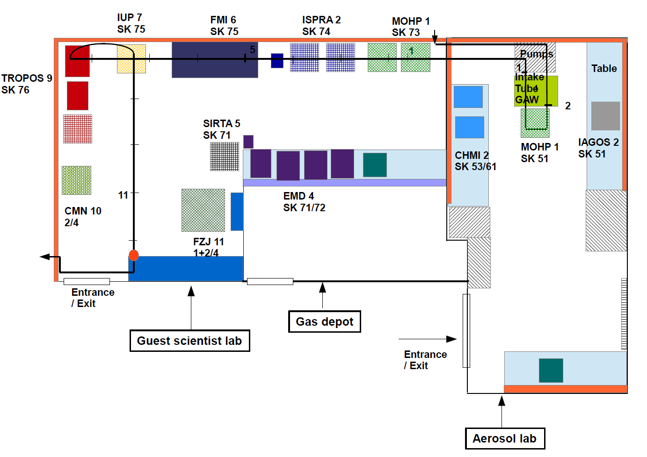
Laboratory plan

Slide 5
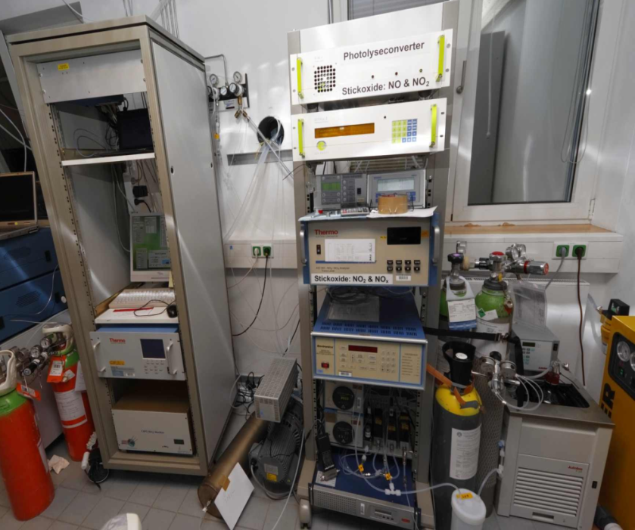
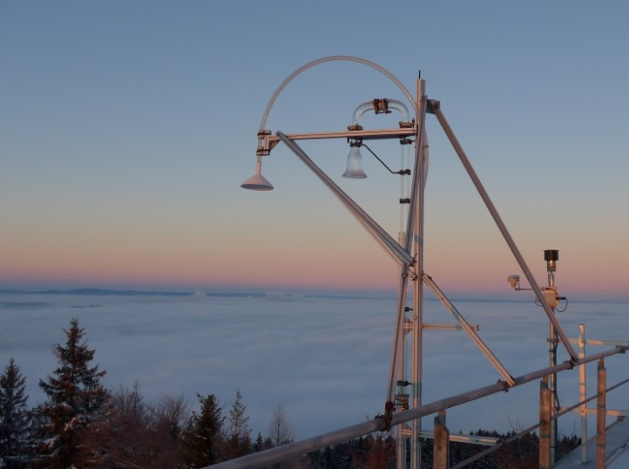
Analytical Set Up

Slide 6
Time schedule +++first week+++
Day | date | activity
1 | Monday 10/10 | Instrument Setup First Briefing Purging manifold with humid air enriched with ozone
2 | Tuesday 10/11 | Purging manifold with humid air enriched with ozone Diurnal variation of zero air or time buffer Individual calibrations using stations calibration equipment, calibration gases are provided by MOHp
3 | Wednesday 10/12 | Calibrations using the manifold (Zero, Span, Converter Efficiency) Steps of NO, NO₂, different ratios: NO+NO₂ = NOx ? diurnal variation of zero air
4 | Thursday 10/13 | Ambient air Discussion on calibration results/checks
5 | Friday 10/14 | HNO₂ (HONO) interference noon: Calibration using manifold afternoon: Alkenes (and HNO3)
6 | Saturday 10/15 | Spiking of ambient air
7 | Sunday 10/16 | Spiking of ambient air

Slide 7
Time schedule +++second week+++
Day | date | activity
8 | Monday 10/17 | Converter linearity: Does humidity- and ozone correction reduce splitting of individual devices?
9 | Tuesday 10/18 | constant NO, NO₂ -> varying humidity
10 | Wednesday 10/19 | Glyoxal, temperature dependence
11 | Thursday 10/20 | calibrations using the manifold (Zero, Span, Converter Efficiency)
12 | Friday 10/21 | Dismantling manifold remains active End: Individual calibrations

Slide 8
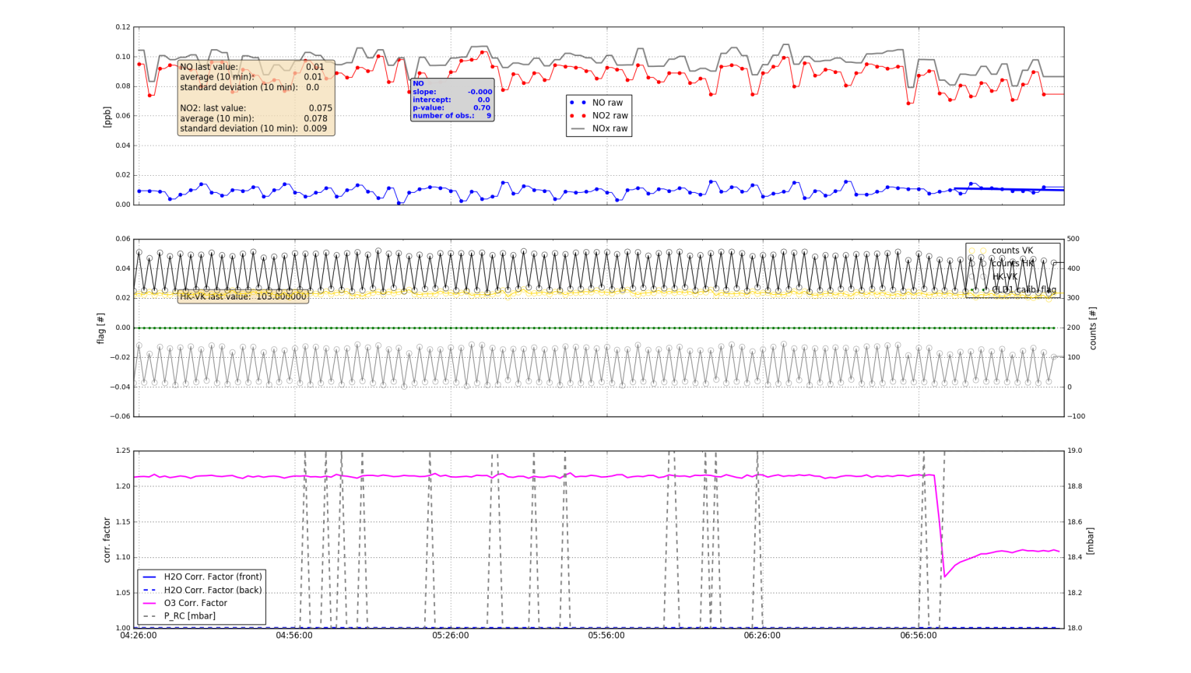
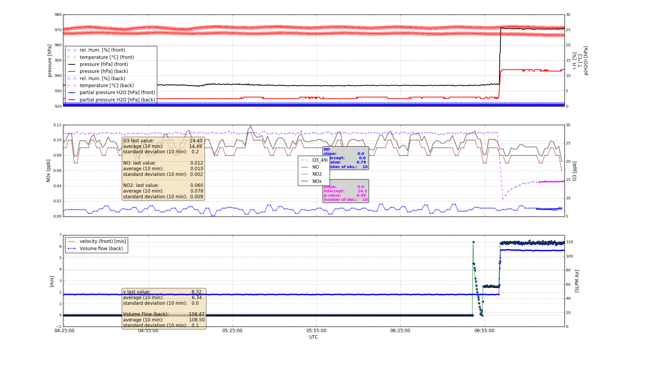
Houskeepingdaten „live“
https://1drv.ms/f/s!ApTP35txctnviNsoV0Gi8UwEDlbYKQ

Slide 9
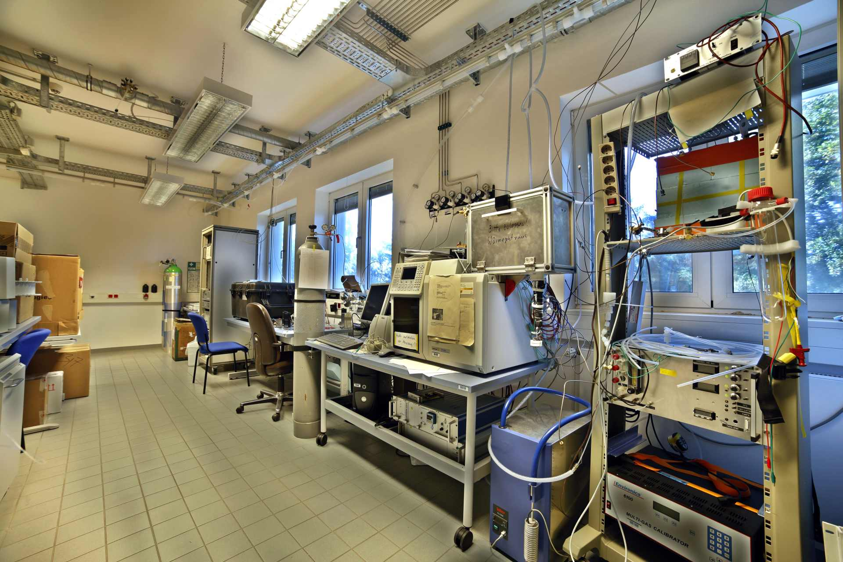
Finally, let us take a glimpse into the lab….

