Slide 1


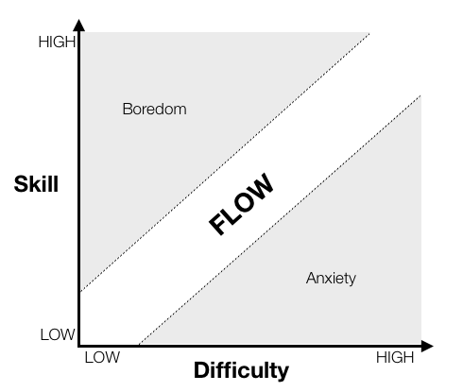
Data flow ACTRIS-2

Slide 2
Data flow ACTRIS-2 for NOx
level 0: raw data
level 1: corrected*¹ data
level 2: 1-hourly corrected*¹ data
(for all levels: EBAS format with optional columns containing metadata to check corrections) *²
Data meeting to discuss problems and progress
(regular?)
First Submission to EBAS
http://ebas-submit-tool.nilu.no/
WCC-NOx
Data Processing/Consistency Checks
Feedback to stations:
open issues in the issue tracker
http://ebas-feedback.nilu.no/my_view_page.php
QA process under lead by WCC-NOx
Re-
submission
second revision or approval
problems / questions have to be addressed by the data provider;
this will be tracked until a decision maker (WCC-NOx) closes the issue (successful).
Stations
WCC-Cloud
https://fz-juelich.sciebo.de/
Re-
submission
Final Submission to EBAS
«ACTRIS» data
http://ebas-submit-tool.nilu.no/
*¹ according to GAW Measurement Guidelines
*² final format will be developed (Rohrer, EBAS), see http://ebas-submit.nilu.no/

Slide 3
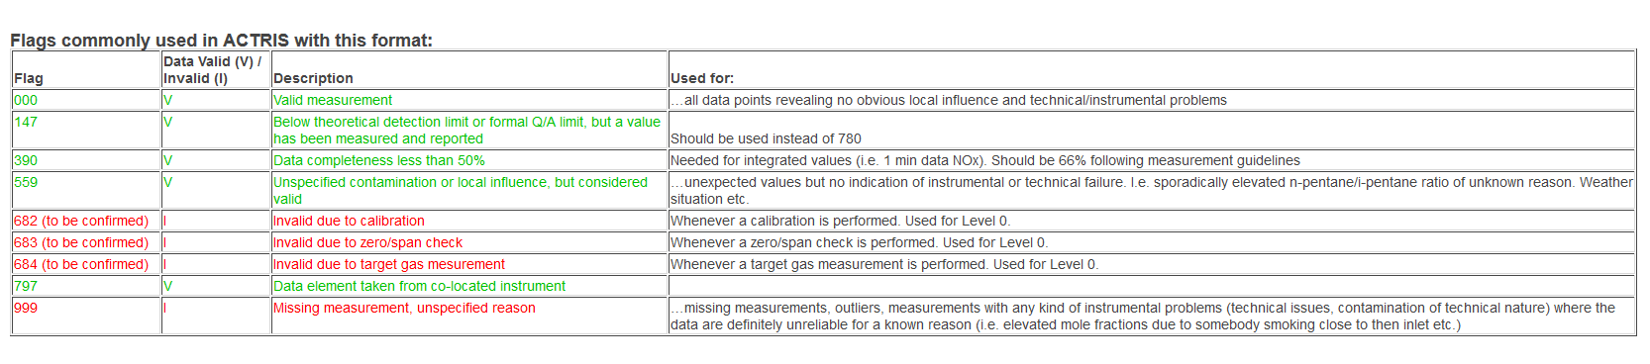
NOx submission levels and flags
Level 0 "Native" time resolution, mixing ratios
Level 1 corrected data, "Native" time resolution
Level 2 corrected data, 1-hour averages
Confirmation of flags???
Are templates ok? Yes, all infomation is captured but some technical problems during submission (is discussed offline with EBAS)
Status of WCC NOx: first priority Side-by-Side intercomparison (preparation and participation), correction/data checks on-going.

Slide 4
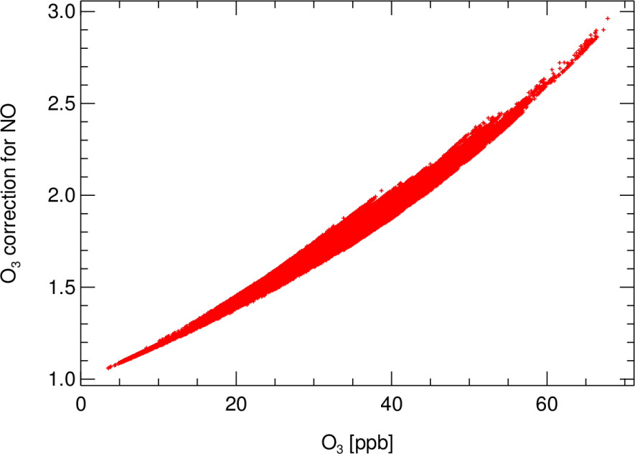
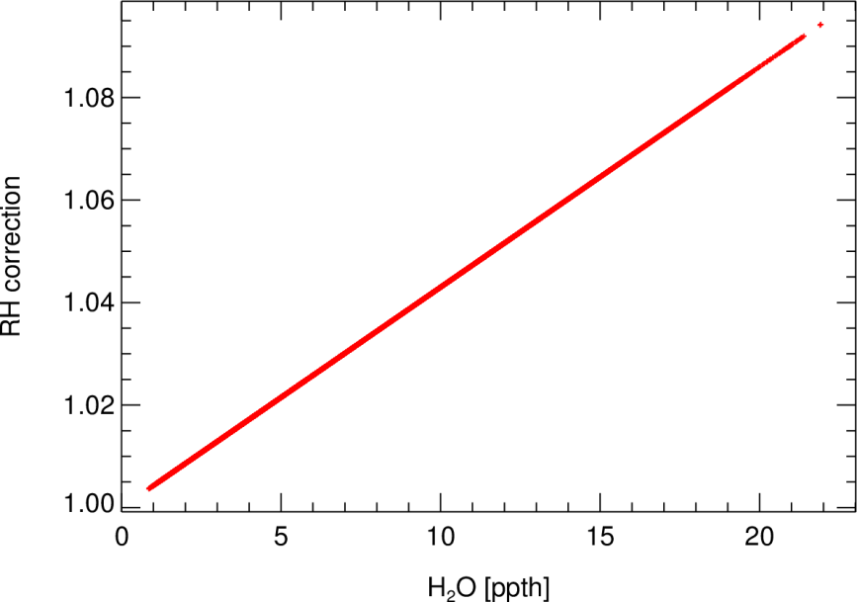
NO_{x} Correction
F. Rohrer WCC-NO_{x}
1) Dark reaction with ambient O₃ in inlet line :
NO+O₃ (hν = 0)
  O₃ measurements required
2) H₂O quenching:
NO₂* + H₂O → NO₂ + H₂O
  H₂O measurements required
  (or alternatively adequate drying)
3) Offset correction: nighttime data when O₃ > 20 ppb
Notes:
Dark reaction depends on residence time in the inlet line,temperature, and pressure
Example taken from station with a long inlet line → most servere effect. If possible short line with high diameter to reduce the pressure gradient.
@30 ppb O3 5s entspricht 5%

Slide 5
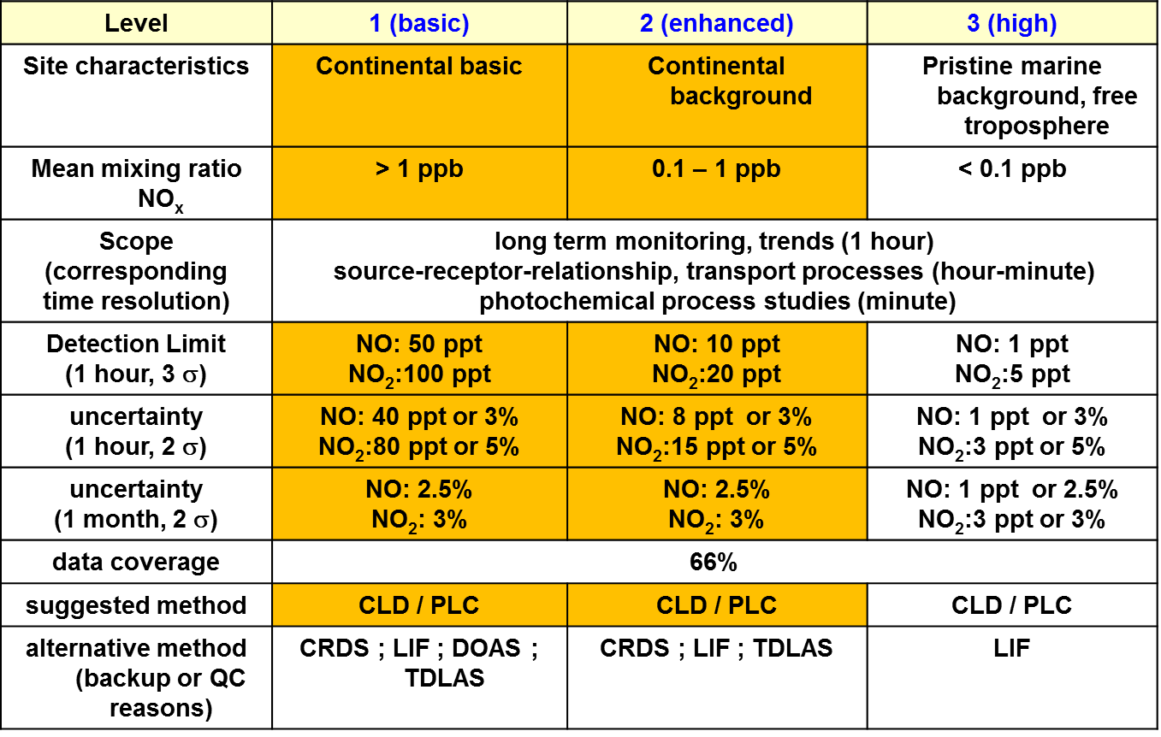
data quality objectives (DQO‘s) for NO & NO₂

Slide 6
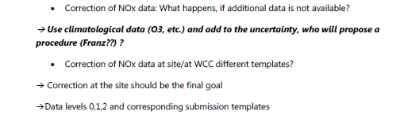


Open questions NOx
NOx rapid data delivery? → WHO will act as pilot?

Slide 7
Data flow ACTRIS-2 for VOCs
Issue tracker: request to submit data
1. Submission level 0 (incl.target, zero) and/or Level 2 to EBAS via http://ebas-submit-tool.nilu.no/
March 31st
Consistency checks ACTRIS QA(EMPA) and EMEP QA (NILU)
Issue tracker: Feedback to stations
April 30th
Not approved
Issue tracker: Stations answer open issues
Data workshop – Discussion of data
~2nd half of May
approval
approval
Issue tracker: re-submit data
Re-submission
to EBAS via submission tool
Deadline: 30st June
Publication of final data at EBAS:
«ACTRIS» data
Notes:
Yellow boxes require action from the data submitter!
Short description:
EMPA/NILU (WHO?) will open an Issue to start the data submission (1st March)
Submission to the database – it is mandatory to use the submission tool!
Consistency checks are performed by NILU (Sverre) and EMPA (Stefan and Matz)
NILU/EMPA : Problems/ issues are defined in the issue tracker and assigned to the respective stations
These issues are discussed at the data workshop
Issues have to be answered by the stations –
if ok (approval), issues are closed and a new issue is opened to initiate the re-submission of revised data.
As long as the issues are not solved (no approval), the discussion is on-going and the data will not be published (????)
If no revisison is necessary the data set submitted in the first submission process will be published.

Slide 8
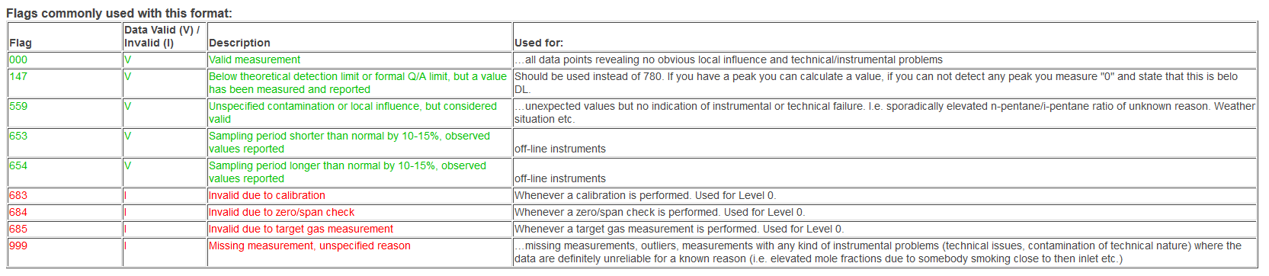
VOC submission levels and flags
Level 0 (with target gas and zero data → HPB pilot station for target gas )
Level 2 same as Level 0 but without target gas and zero gas infromation
NEW Submission template VOCs (July 2016):
http://ebas-submit.nilu.no/Submit-Data/Regular-Annual-Data-Reporting/VOC/NMHC-VOC-OVOC-on-line

Slide 9
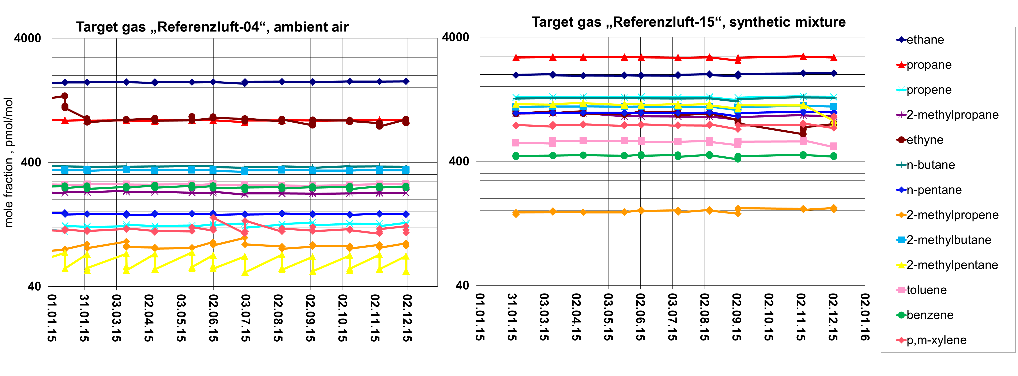
First VOC target gas data submitted for 2015
Target gas measurements monitor…
…the reproducibility of the instrument, the uncertainty of the measurement (deviation from expected values),the quality of the calibration procedure on a monthly and long-term scale.
Target gas for NOx (pilot station HPB) postboned → technical issues

Slide 10
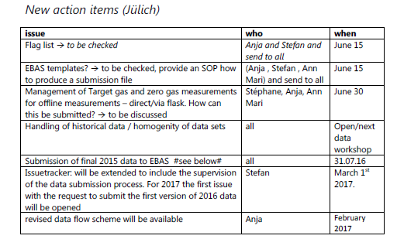
Open questions VOCs
VOC rapid data delivery? → WHO will act as pilot?
Automated QA measures → task 3.3
RR Cylinders → are station interested in intercomparison?

Slide 11
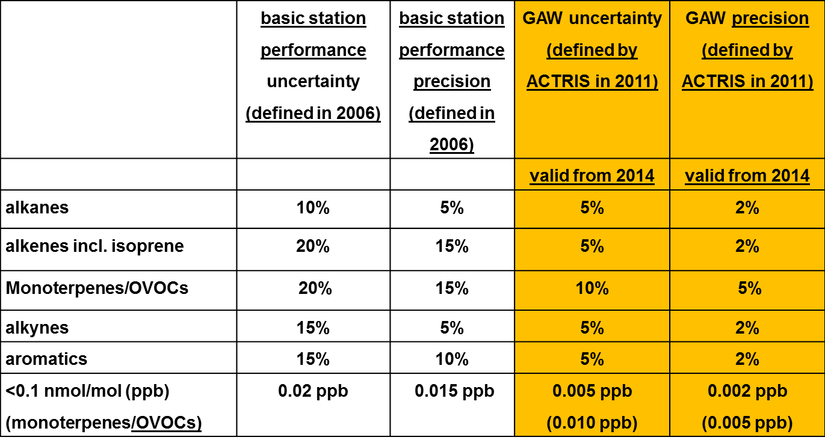
data quality objectives (DQO‘s) for VOCs

Slide 12


Open questions VOCs
Automated QA measures:
EMEP QA checks (Sverre Solberg)
Plot of target gas data with average stdv and comparison to previous years.
X/y plots and ratios
→ workshop for discussion – date? Location ?
DWD Met. Observatorium Hohenpeißenberg, Oktober 16 Seite 12

Slide 13
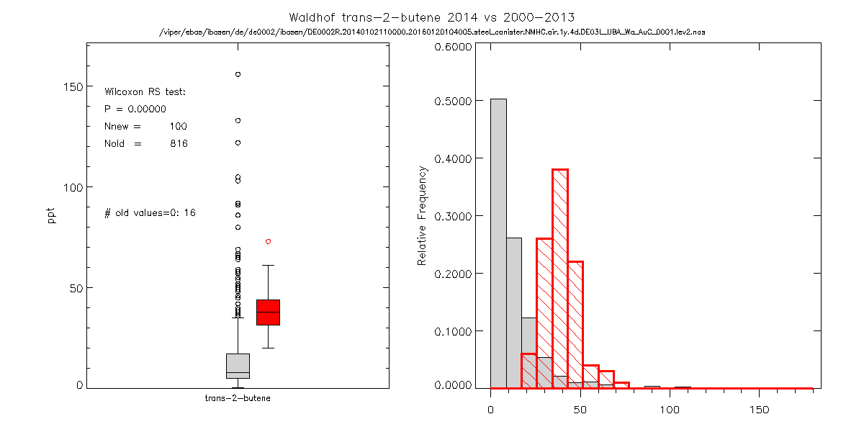

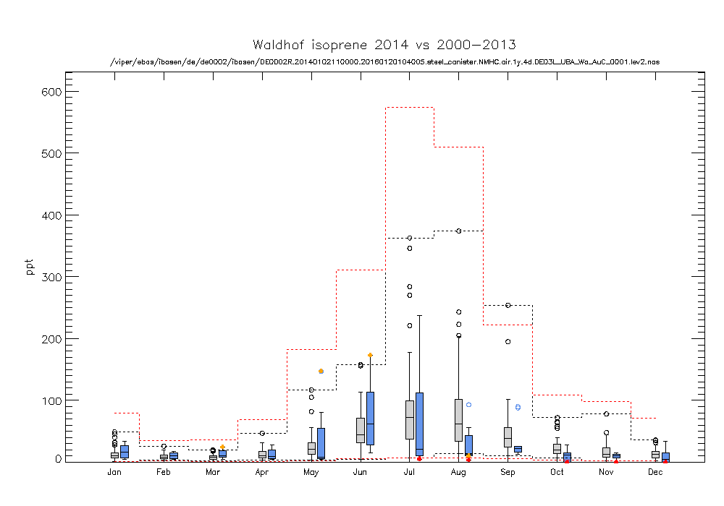
NILU consistency checks of new VOC data (colored) receieved through EBAS-submit compared to existing data in EBAS (grey) by S. Solberg
red color: data rejected/outlier
blue: data ok
grey: historical data
DWD Met. Observatorium Hohenpeißenberg, Oktober 16 Seite 13

