Slide 1
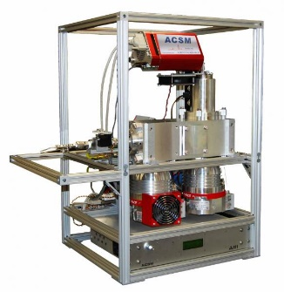

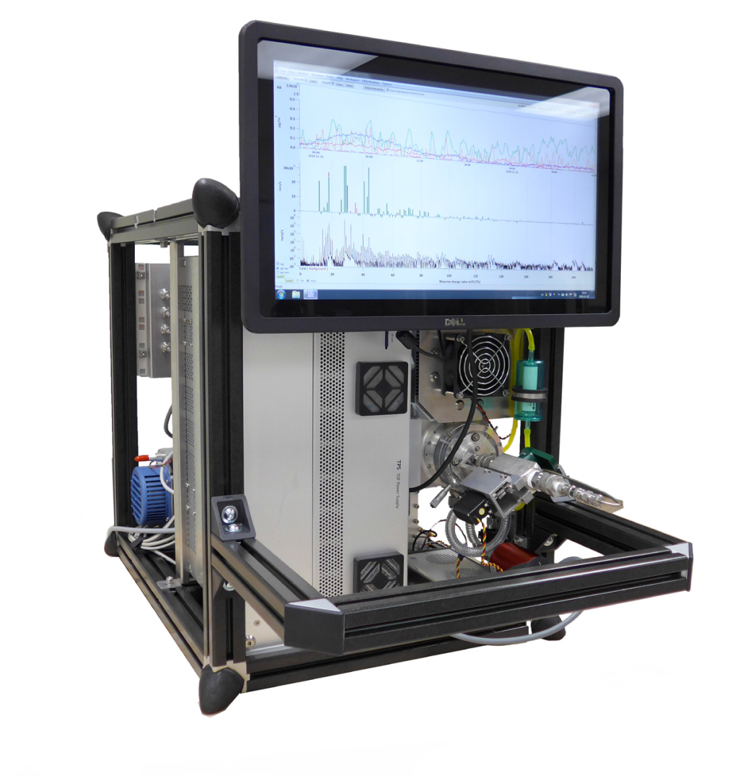



WP3.2.1: Development of a measurement standardization and data submission protocol for aerosol particle mass spectroscopy based on Aerosol Chemical Speciation Monitor
Bologna, Italy. October 2016
Evelyn Freney, Olivier Favez, Valerie Gros, Jean Sciare, Andre Prevot, Jay Slowik, Francesco Canonaco
Deliverables
To provide homogeneous quality-controlled ACSM datasets at a European scale
To homogenize calibration and data processing and in particular the source apportionment of organic aerosol data.
To assure the precision and accuracy of these measurements through comparison with various co-located instruments e.g TEOM-FDMS, SMPS, OC-EC etc.
With the help of

Slide 2

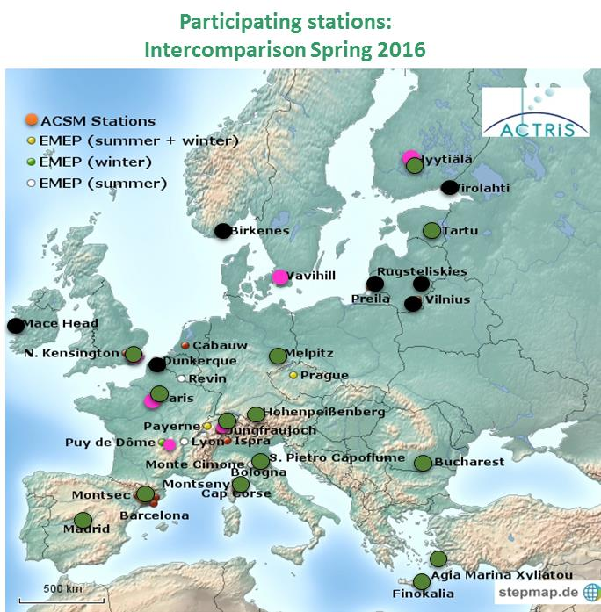
WP3: Development of a measurement standardization and data submission protocol for aerosol particle mass spectroscopy based on Aerosol Chemical Speciation Monitor
Task 3.2.1
2016 ACTRIS-2 ACSM intercomparison exercise at the ACMCC
1. Homogenous quality-controlled ACSM datasets at a European scale
  Intercomparison campaign took place March/April 2016. A total of 22 instruments within the ACTRIS network participated.
  In order to accommodate all applications to the intercomparison exercise, two separate calibration exercises were organised.
Site | Intercomparison Q-ACSM ToF-ACSM
Hohenpeissenberg
FMI –Hyytiala
Cyprus
Melpitz
Finokalia
London
Bologna
Madrid
Vavihill
SMEAR (UHEL)
Zurich
JFJ
Bucharest
Barcelona
PUY
SIRTA
CapCorse
Tartu
ToFwerk
Quad-ACSM: 4th to 14th of March
(15 instruments)
ToF-ACSM: 21st of March to 18th of April
(12 instruments (6 ToF-ACSM))
Calib: Quad –ACSM
Calib: ToF-ACSM
DNA

Slide 3



WP3: Development of a measurement standardization and data submission protocol for aerosol particle mass spectroscopy based on Aerosol Chemical Speciation Monitor
Task 3.2.1
2016 ACTRIS-2 ACSM intercomparison exercise at the ACMCC
2. To homogenize calibration and …..
  Organisation:
  Three to four days pre-calibration intercomparison.
  Calibration using single and mixed inorganic solutions
  Three to four days post-calibration intercomparison (extended for ToF-ACSM).
Quad-ACSM
arrival
Ambient measurements
Calibration,
IE NO₃, IE SO₄
Ambient measurements
4th to 7 th of March
11th to 14 th of March
3rd March
7th to 10 th of March
Phase 2:
ToF-ACSM
Research Intercomparison
21st March
Calibration/PAM experiments
Ambient measurements
24th to 27th of March
Ambient measurements
21st to 24th of March
27th of March to 18th of April
acmcc@lsce.ipsl.fr

Slide 4
WP3: Development of a measurement standardization and data submission protocol for aerosol particle mass spectroscopy based on Aerosol Chemical Speciation Monitor
Task 3.2.1
2016 ACTRIS-2 ACSM intercomparison exercice at the ACMCC
3. Precision and accuracy of these measurements were evaluated with various co-located instruments from such as TEOM-FDMS, SMPS, OC-EC Sunset Field analyzer, PILS-IC, filter sampling …).
1. Instrument falls within ± 30% of the « reference » instrument
2. Instrument performance evaluated against the Median using the Z-score method
  Organic, sulphate, nitrate, Ammonia
PM1 SIRTA (REF)
  PM1 of all instrument compared with PM1 of SIRTA instruments.
  Dotted line indicates ± 30% error
  light points represent TEOM-FDMS, black points represent ACSM data
More discussion of the intercomparison results and evaluation
Thursday 09:30-11:15: WP8 (A. Wiedensohler) European Centre for Aerosol Calibration

Slide 5
WP3: Development of a measurement standardization and data submission protocol for aerosol particle mass spectroscopy based on Aerosol Chemical Speciation Monitor
Task 3.2.1
2016 ACTRIS-2 ACSM intercomparison exercise at the ACMCC
  Deliverables
  21/25 of the ACTRIS ACSM instruments were successfully evaluated.
  New operating and calibration procedures were put in place.
  Instruments were compared with external reference instruments as well as with the SIRTA reference instrument.
  Workshop with the ACTRIS community for training/discussion and improvement
  Actions:
  Calibration reports need to be distributed to each of the instruments PIs.
  New SOPs need to be implemented
  Announcement of new inter-laboratory exercise (Oct 2018 )
Work in process
Introduction of new calibration procedures into SOP
Autumn 2017:
For new instruments or those unable to attend first intercomparison,
A smaller calibration exercise will be annonced.

Slide 6
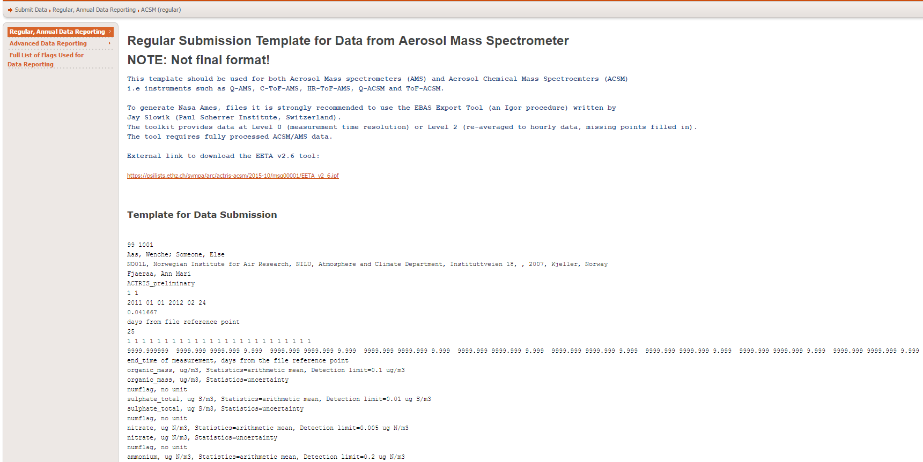
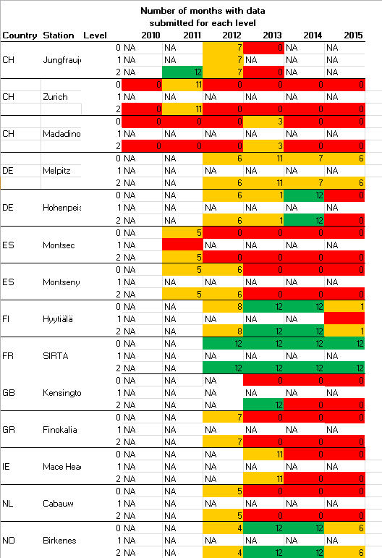
WP3: Development of a measurement standardization and data submission protocol for aerosol particle mass spectroscopy based on Aerosol Chemical Speciation Monitor
Task 3.2.1
2a. Data submission protocol:
Current data submission format is outlined on the NILU page

Slide 7
WP3: Development of a measurement standardization and data submission protocol for aerosol particle mass spectroscopy based on Aerosol Chemical Speciation Monitor
Task 3.2.1
2a. Data submission protocol:
Current format is outlined on the NILU page
Common template for all ACSM (Quad/ToF)/(HR/C/-ToF/Quad) and AMS instruments
The measurement principle of all these instruments remains the same.
Metdata allows for instrument type to be disquished.
Particle concentrations are expressed as hourly averaged μg m⁻³
In order to quantify the atmospheric variability on an hourly basis, the standard
deviation is also reported alongside the hourly average.
Missing data is represented as -99999

Slide 8
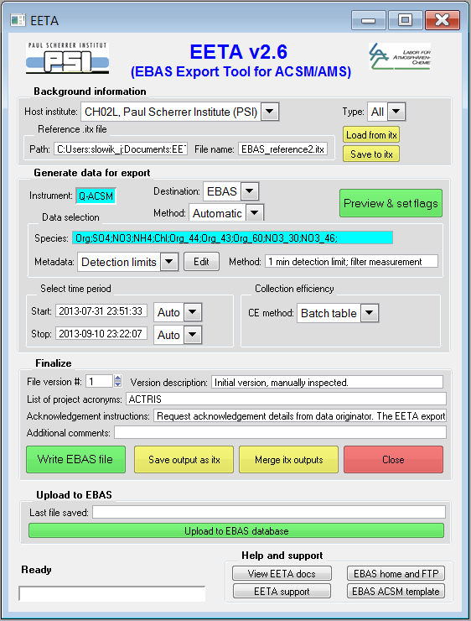
WP3: Development of a measurement standardization and data submission protocol for aerosol particle mass spectroscopy based on Aerosol Chemical Speciation Monitor
Task 3.2.1
2a. Data submission protocol:
What is EETA?
→ Utility for exporting ACSM/AMS data to external databases
Output files use EBAS format
Handles reporting of “standard” outputs and PMF matrices
Distributed through ACTRIS-ACSM mailing list.
Current version: 2.6
→ Q-ACSM fully supported
Partial support for other instruments
Still a few stability issues, but no known calculation problems
ACTIONS
Goal of “final” version by mid-2017
Support for all types of aerosol mass spectrometry instruments
Source apportionment analysis

Slide 9
WP3: Development of a measurement standardization and data submission protocol for aerosol particle mass spectroscopy based on Aerosol Chemical Speciation Monitor
Task 3.2.1
2a. Data submission protocol:
ACTIONS
To increase the amount of data being submitted from ACSM instruments to the database.
NRT submission of level 0 data.

Slide 10
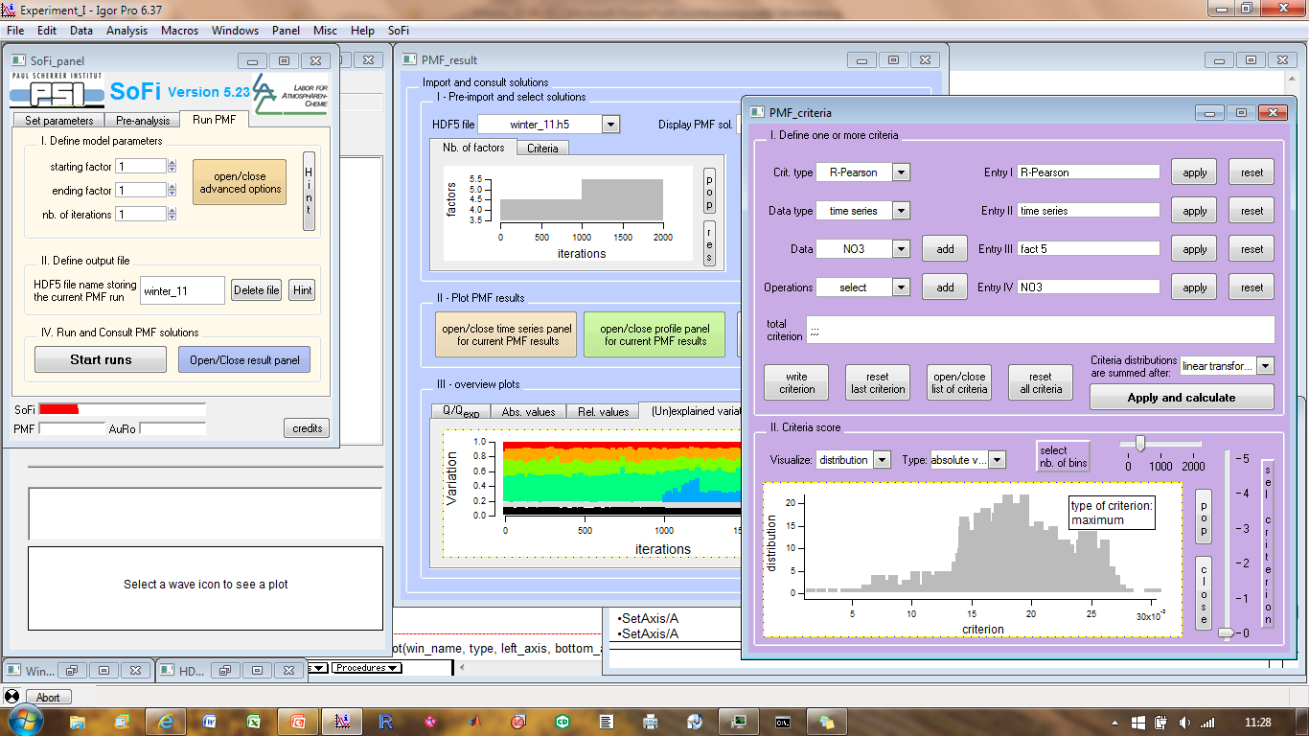
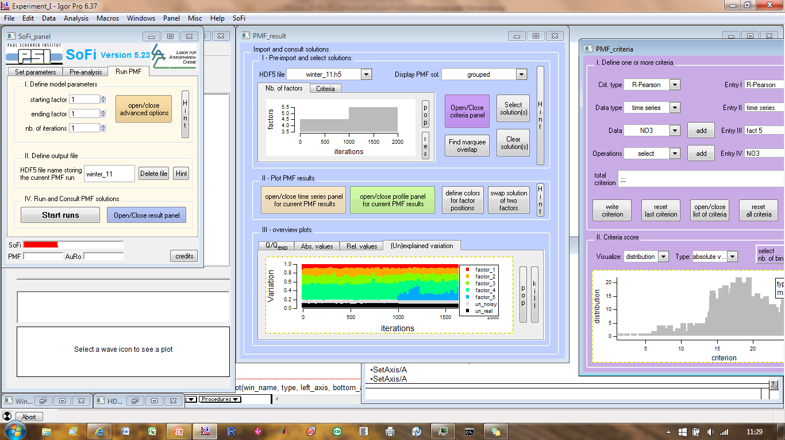
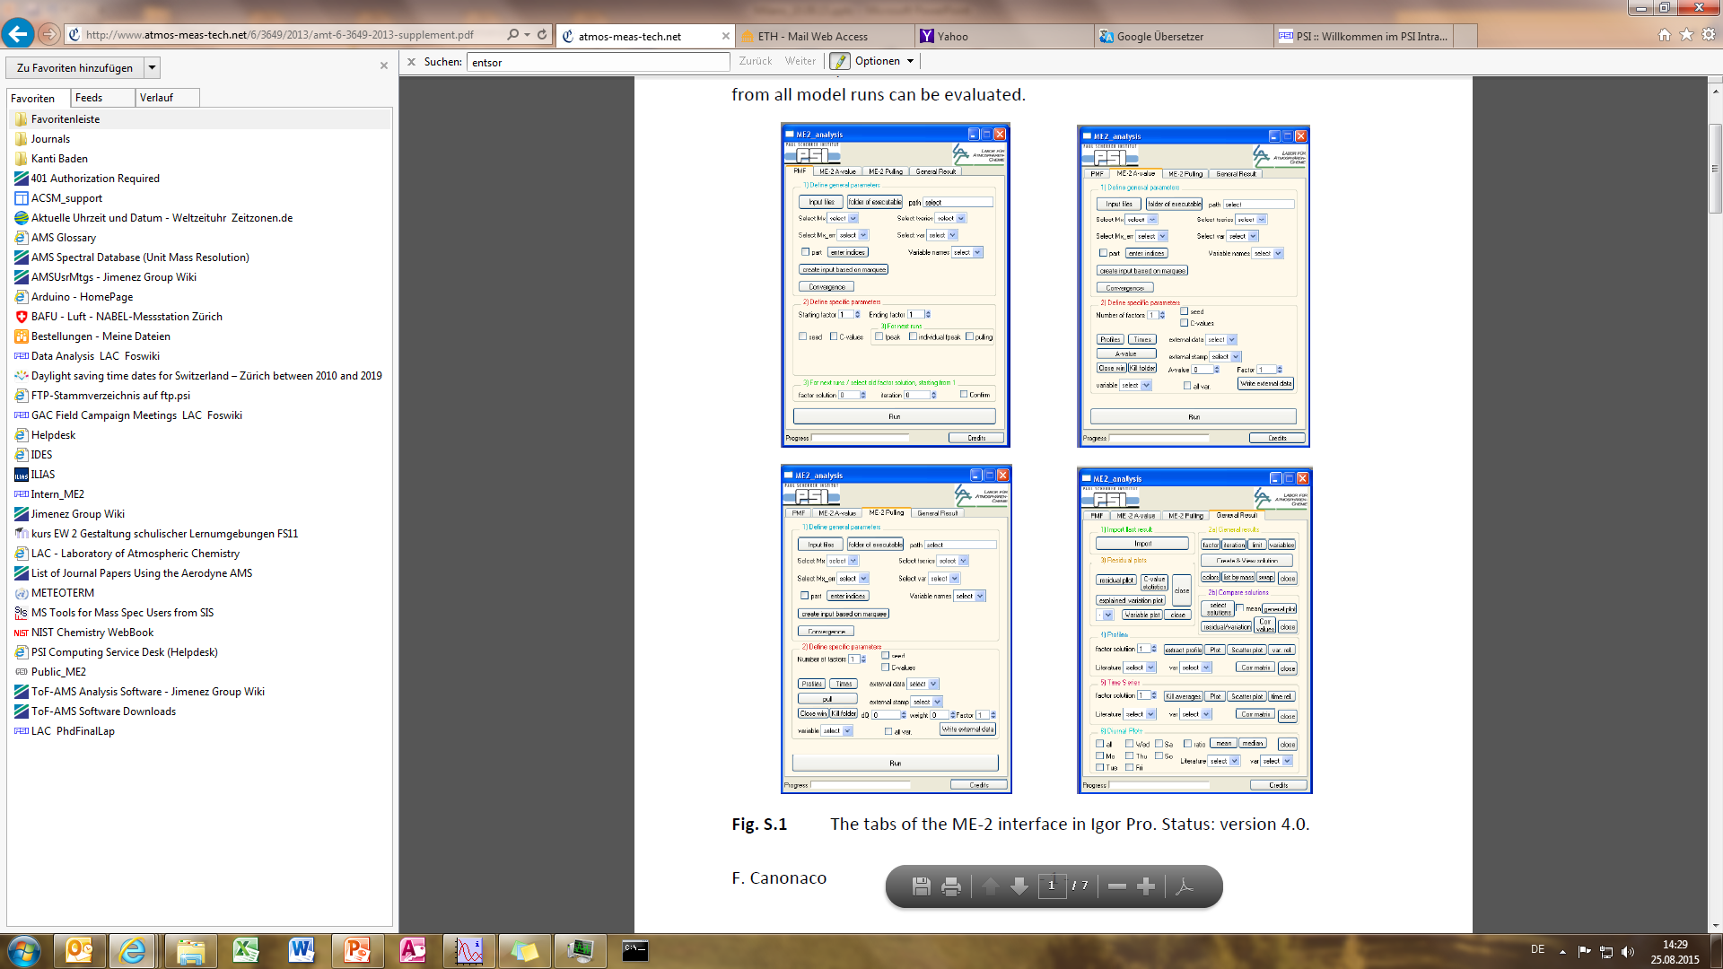
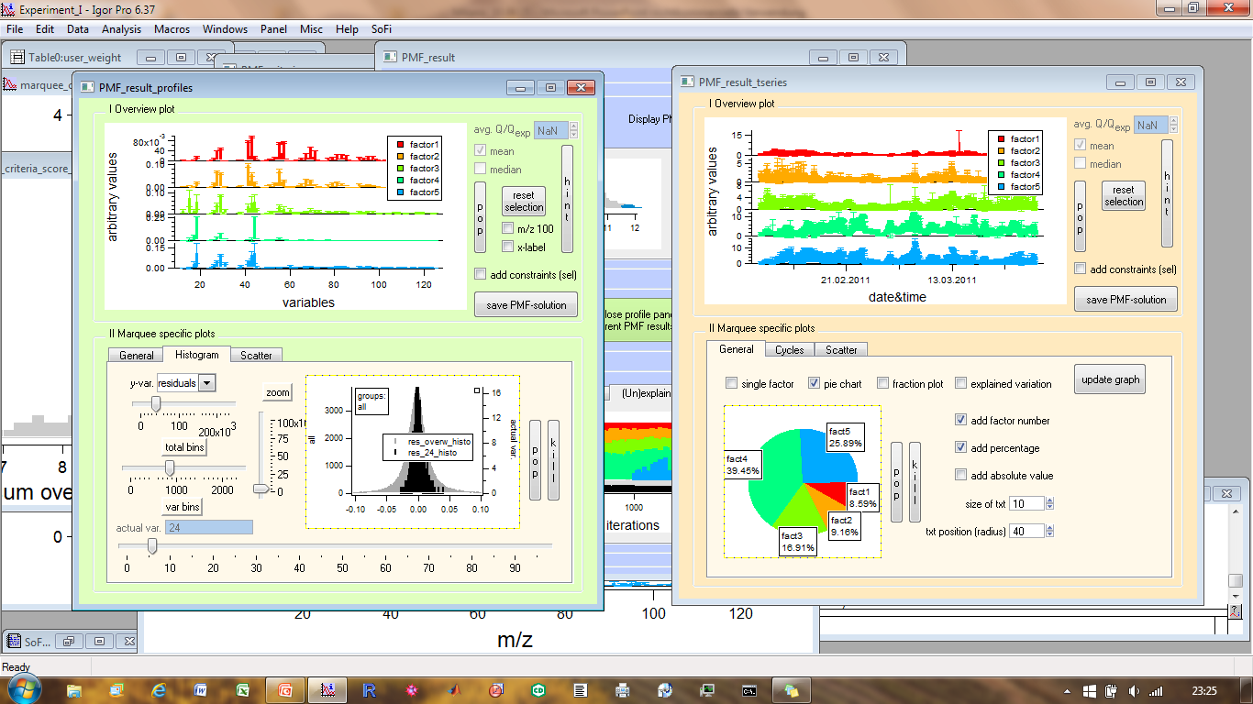
WP3: Development of a measurement standardization and data submission protocol for aerosol particle mass spectroscopy based on Aerosol Chemical Speciation Monitor
Task 3.2.1
2a. Data processing and source apportionment → SoFi – The interface in Igor Wavemetrics Pro
Current SoFi version
user-friendly
fast (exploits multiprocessors for PMF calculations and during data analysis)
smart storage using HDF technology
Current state
Canonaco et al., 2013
Email to: francesco.canonaco@psi.ch
Notes:
¹⁰

Slide 11
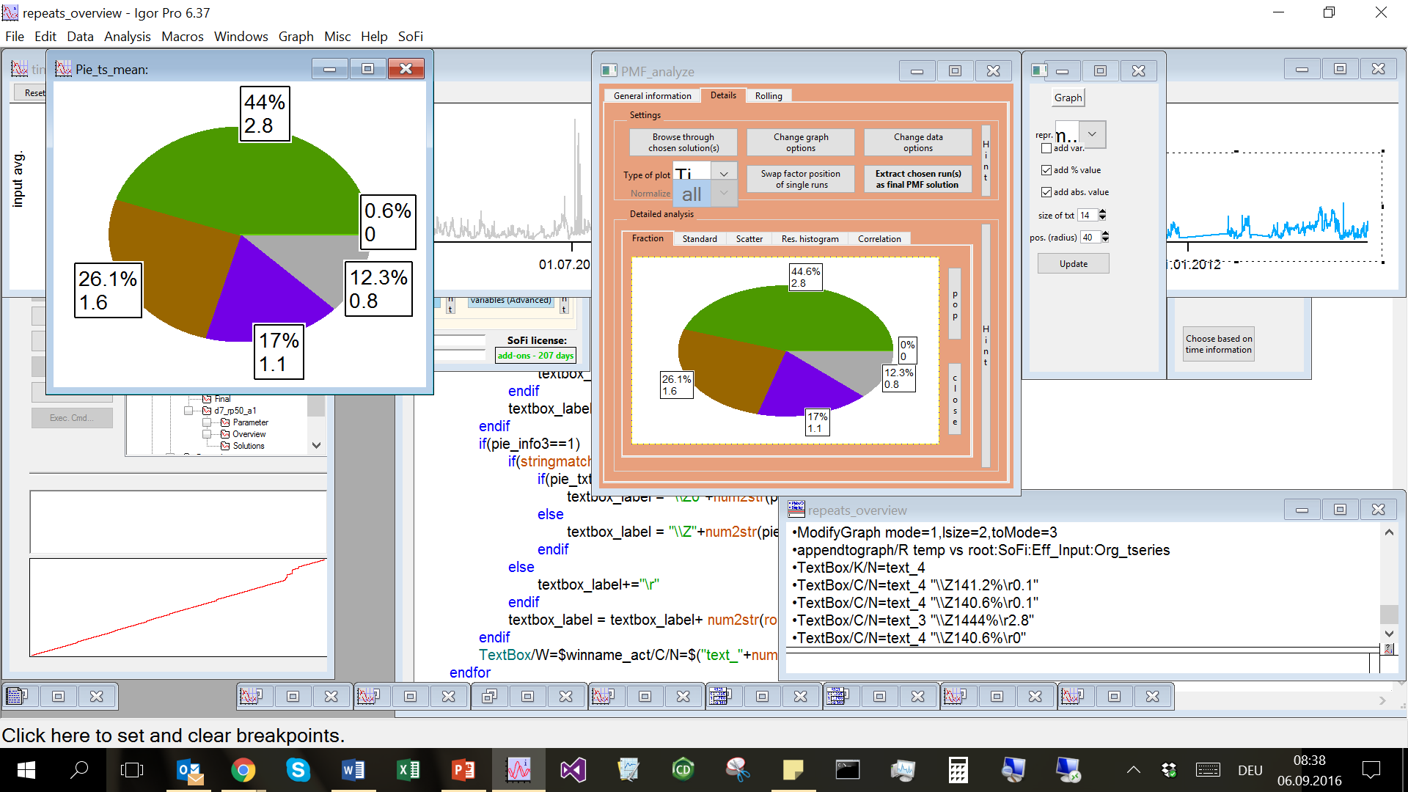
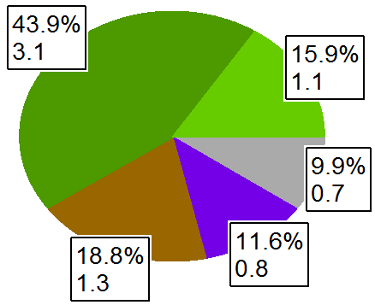
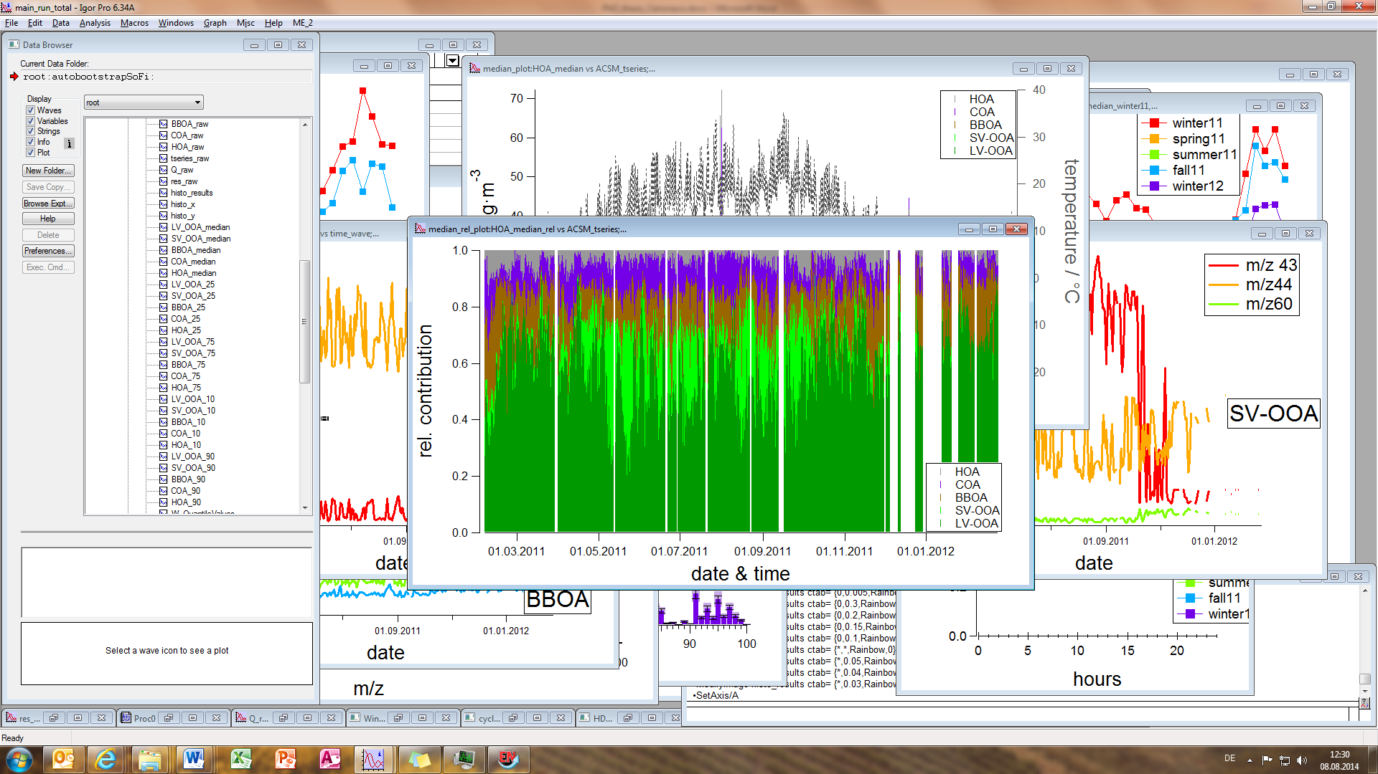
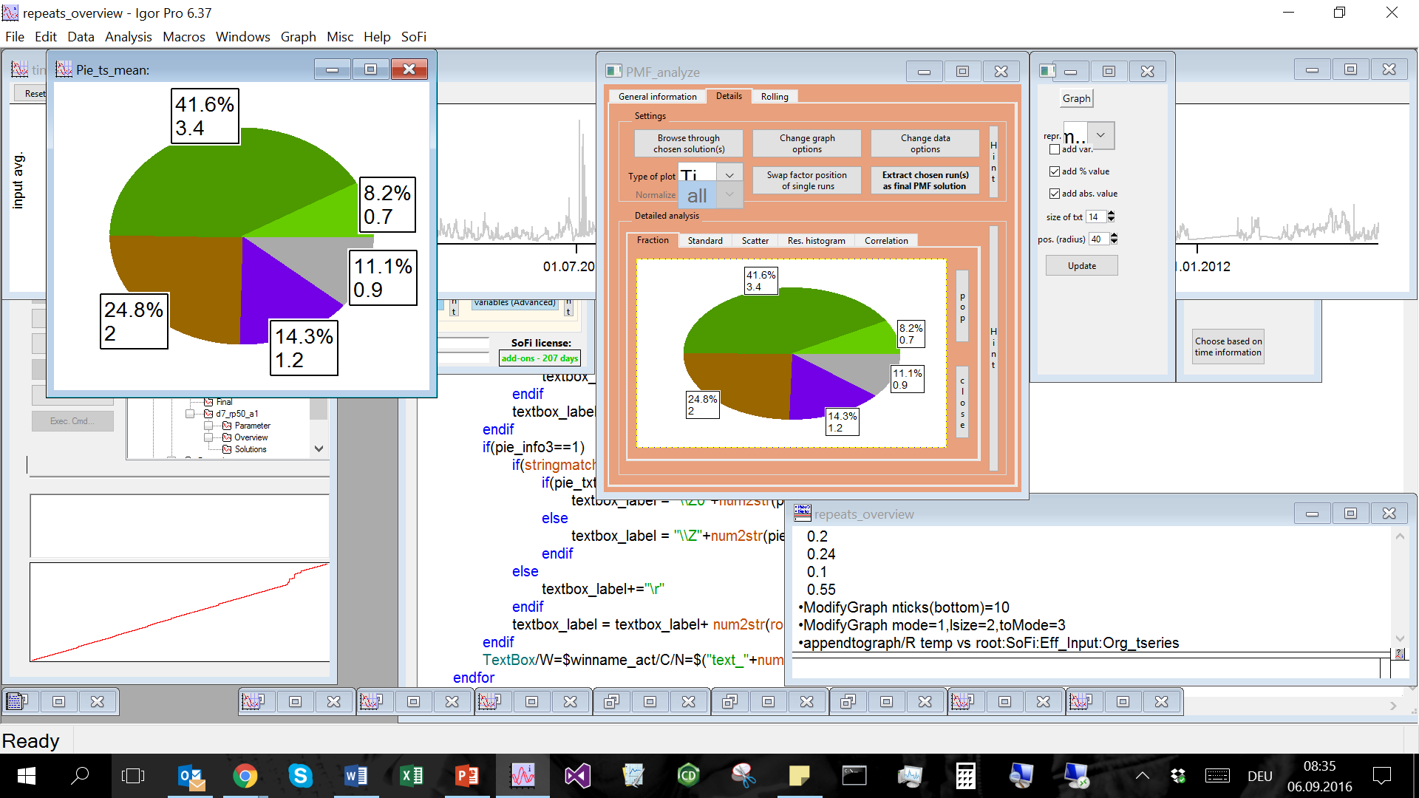
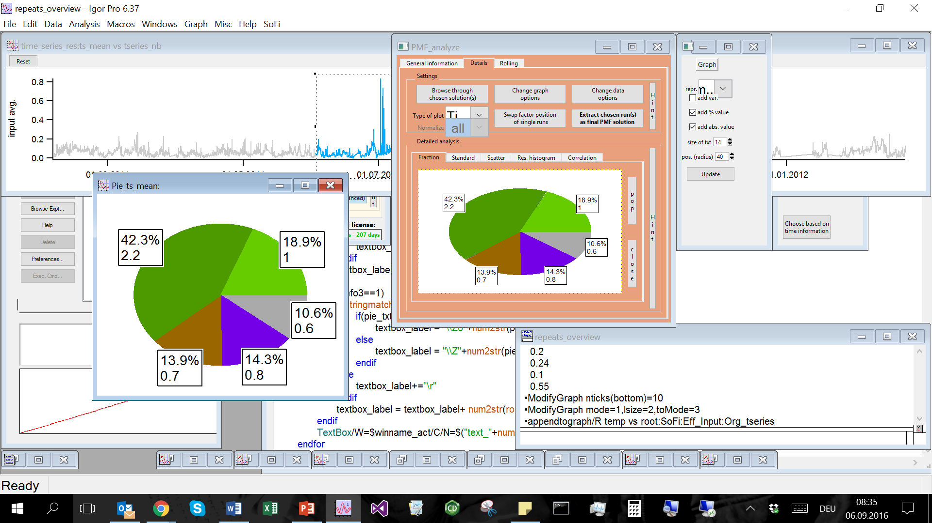
WP3: Development of a measurement standardization and data submission protocol for aerosol particle mass spectroscopy based on Aerosol Chemical Speciation Monitor
Task 3.2.1
2a.Data processing and source apportionment → SoFi – The interface in Igor Wavemetrics Pro
Actions:
finalize/test automatic selection of the sources
Test on other data sets
build/test on-line source apportionment (Automated Rolling ➔ AuRo SoFi)
Notes:
¹¹

Slide 12
WP3: Development of a measurement standardization and data submission protocol for aerosol particle mass spectroscopy based on Aerosol Chemical Speciation Monitor
Task 3.2.1
  ACTIONS:
  1. ACMCC:
  Calibration reports need to be distributed to each of the instruments PIs. (Dec 2016)
  Announcement of new inter-laboratory exercise
  - basic calibration exercise 2017 (new and/or uncalibrated instruments),
  - larger (research) intercomparison 2018
  2. ACMCC + PSI : Implementation of existing and new SOPs
    In current SOPs calibrations are recommended every two months. We aim to request groups to send their calibration results every 6 months as a means to follow instrument performance.
  All: Data submission
    Increase the amount of submitted data. Set up of NRT of level0 data

