Slide 1
WP3-Task 2.2 Measurement standardization and data submission protocol for cloud relevant products: Liquid Water Content (LWC) and droplet effective radius (Re)
K. Sellegri, J. Nicolas, C. Gourbeyre, B. Laurent, O. Jourdan, G. Febvre, JF Fournol (LaMP)
PSI, CNRS-SIRTA

Slide 2
Task 2.2. Objectives and milestones
To evaluate performances of existing probes for the measurement of Liquid Water Content (LWC) and Droplet effective Radius (Re)
Intercomparison field campaign with all cloud microphysical probes existing in the ACTRIS community, in order to determine de detection limit, robustness, advantages and drawbacks (M12)
Report on intercomparison campaign (Deliverable on M18)
To harmonize the standard operation procedures for the bulk probes (PVM, PWD)
Workshop on cloud microphysical measurements (M24)
provide to the community recommendations and standard operating procedures (Delivrable on M24).
To develop a new PVM probe prototype according to the identified drawback (M36)

Slide 3
Task 2.2. – Evaluate performances of existing probes for LWC and Re
Cloud probes intercomparison campaign at puy de Dôme (Oct 2016)
Objectives:
- To evaluate intervariability of probes for cloud characterization
- To qualify critical operating conditions for data quality (dependance on external wind conditions speed and direction/probe orientation)
Test robustness and reliability of new probes/instruments for monitoring activity

Slide 4
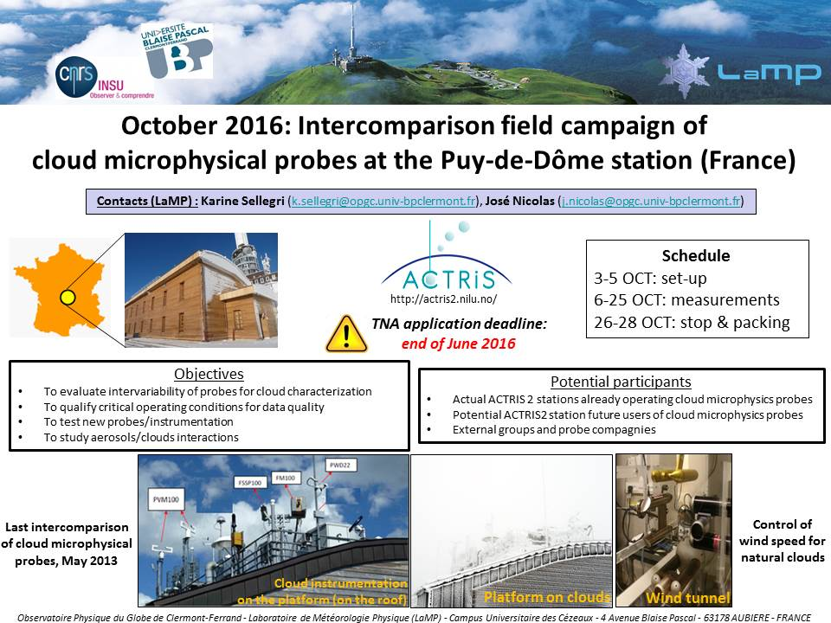
Task 2.2. – Evaluate performances of existing probes for LWC and Re
Cloud probes intercomparison campaign at puy de Dôme (Oct 2016)
-Advertisement within the ACTRIS2 community
-Evaluation of existing probe models -> advertisement outside the ACTRIS2 community

Slide 5
Task 2.2. – Evaluate performances of existing probes for LWC and Re
PLATFORM
Instrument | Team
4 Gerber PVM-100 | LaMP, PSI, CNR-ISAC, IFT
2 OPC Welas | LaMP, PSI
SPP-100 FSSP-100 | LaMP (SPP-100), FMI (on a rotating platform)
DMT Fog Monitor | SIRTA (on swivel), ETHZ (on a rotor)
Diffusometer Degreanne DF20+ | SIRTA
Holographic imager HOLIMO | ETHZ
Polar nephelometer | LaMP
2 FIDAS (dry, wet) | ADDAIR/PALAS
PVM-IP | LaMP
LOAC | SIRTA
2 UCASS instruments | Univ. Hertfordshire
DMT-CAPS | FMI
Dew-point mirror/WAI | PSI
20 probes
5 ACTRIS groups
3 non ACTRIS groups
1 company

Slide 6
Task 2.2. – Evaluate performances of existing probes for LWC and Re
Wind Tunnel
Instrument | Team
CDP-2 PbP | LaMP
2 airborne Gerber PVM-100A | IFT
DMT CDP-2 PbP | IFT
DMT LWC-300 (King probe) | IFT
BCPD | DMT
2 UCASS sondes | Univ. Hertfordshire
DMT LWC-100 (MAJ 300) | LaMP
9 probes
1 additionnal company

Slide 7
Task 2.2. – Evaluate performances of existing probes for LWC and Re
Instrument | Team
sonic anemometer | ETHZ
sonic anemometer | LaMP (2)
thermometer & pitot (wind tunnel) | IFT

Slide 8
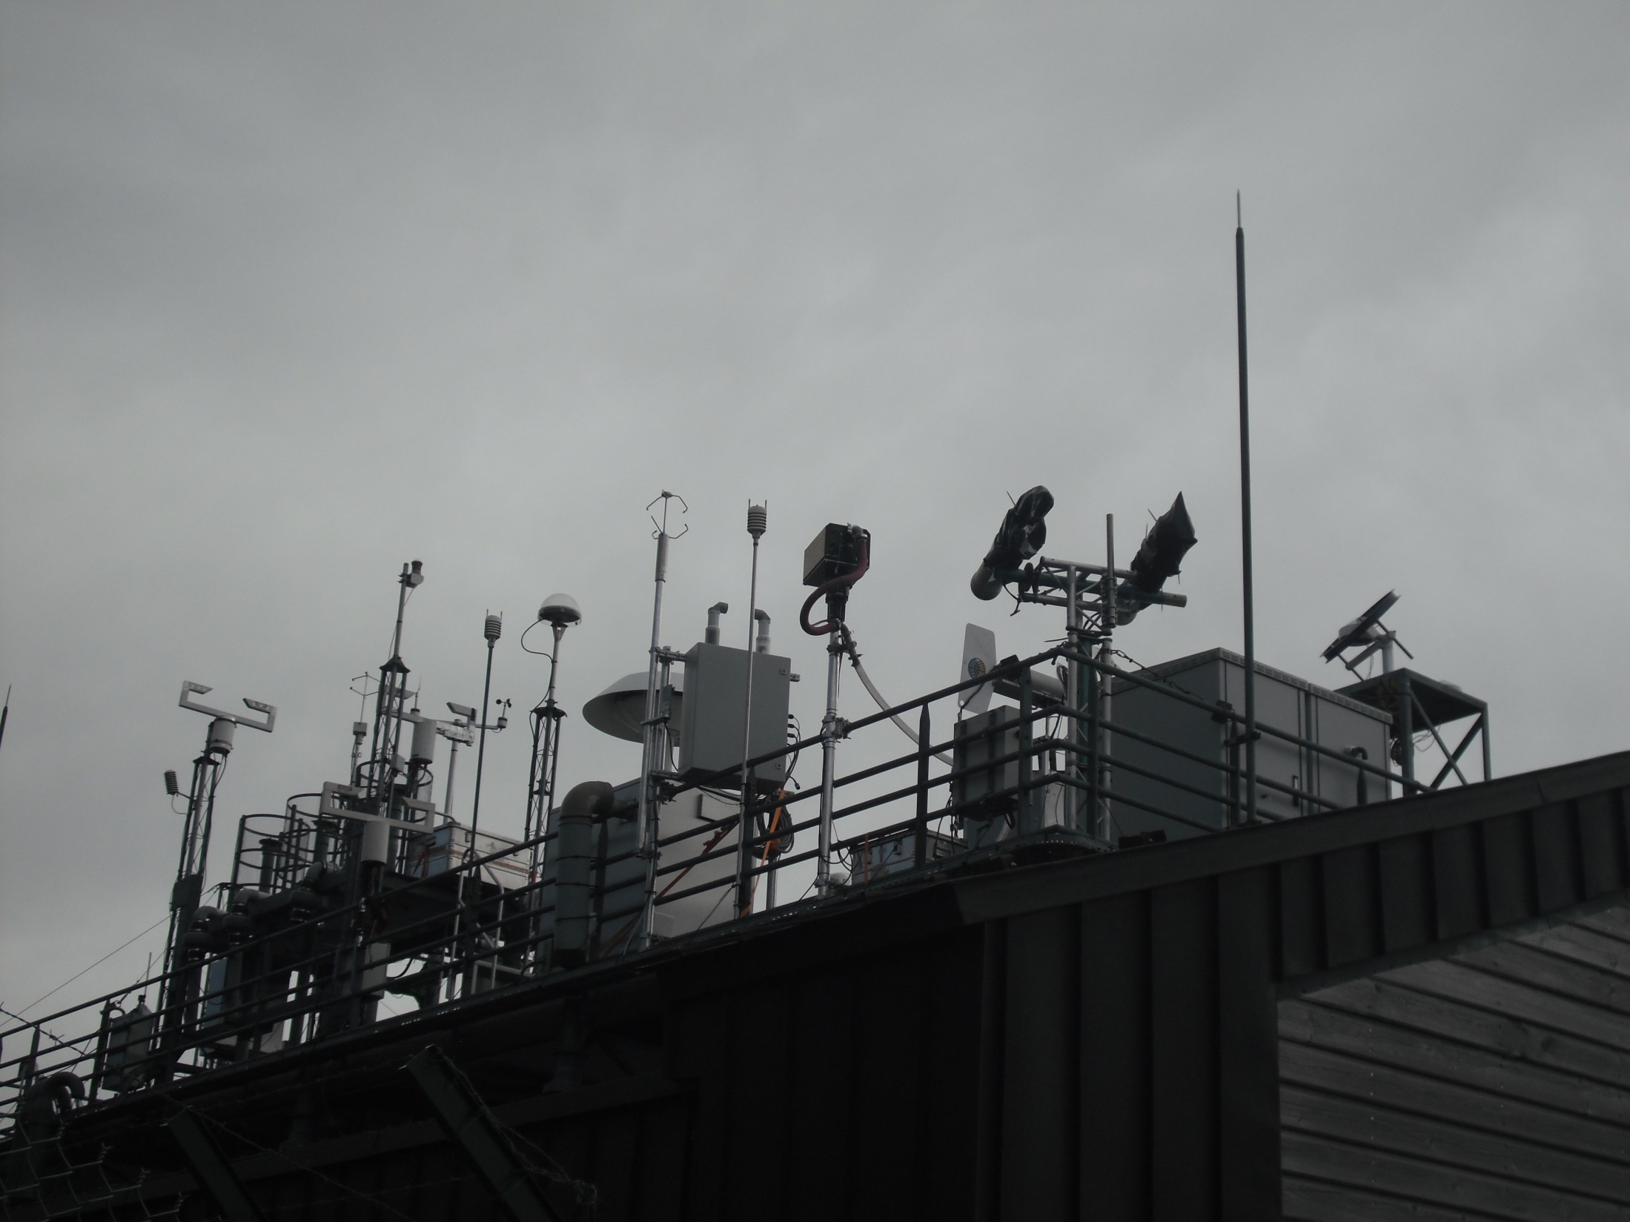
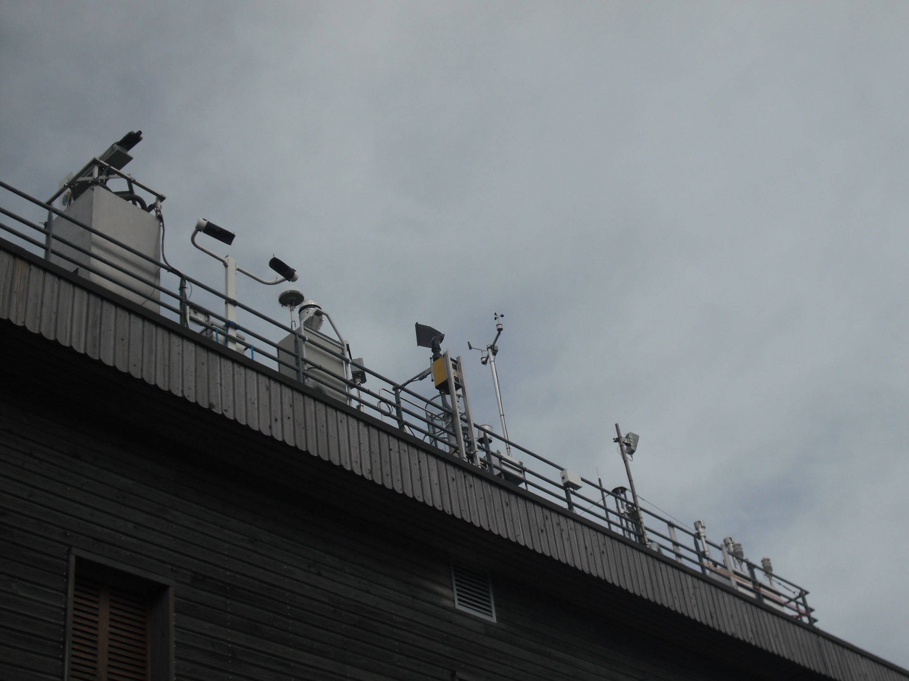
Task 2.2. – Evaluate performances of existing probes for LWC and Re
ACTRIS2 intercomparison campaign at puy de Dôme: To evaluate intervariability of probes for cloud characterization 1) as a function of environemental conditions after calibration
FSSP FMI
Diffusometer SIRTA
Fog Monitor
ETHZ
SPP100, Polar
nephelometer
LaMP
Welas PSI
For Monitor SIRTA
3 Gerber
LaMP, PSI, CNR-ISAC
HOLIMO
ETHZ
LOAC
SIRTA
2 FIDAS
PALAS/ADDAIR

Slide 9
Task 2.2. – Evaluate performances of existing probes for LWC and Re
ACTRIS2 intercomparison campaign at puy de Dôme: To evaluate intervariability of probes for cloud characterization 2) measure the drift after calibration
FSSP FMI
Diffusometer SIRTA
Fog Monitor
ETHZ
SPP100, Polar
nephelometer
LaMP
Welas PSI
For Monitor SIRTA
3 Gerber
LaMP, PSI, CNR-ISAC
HOLIMO
ETHZ
LOAC
SIRTA
2 FIDAS
PALAS/ADDAIR

Slide 10
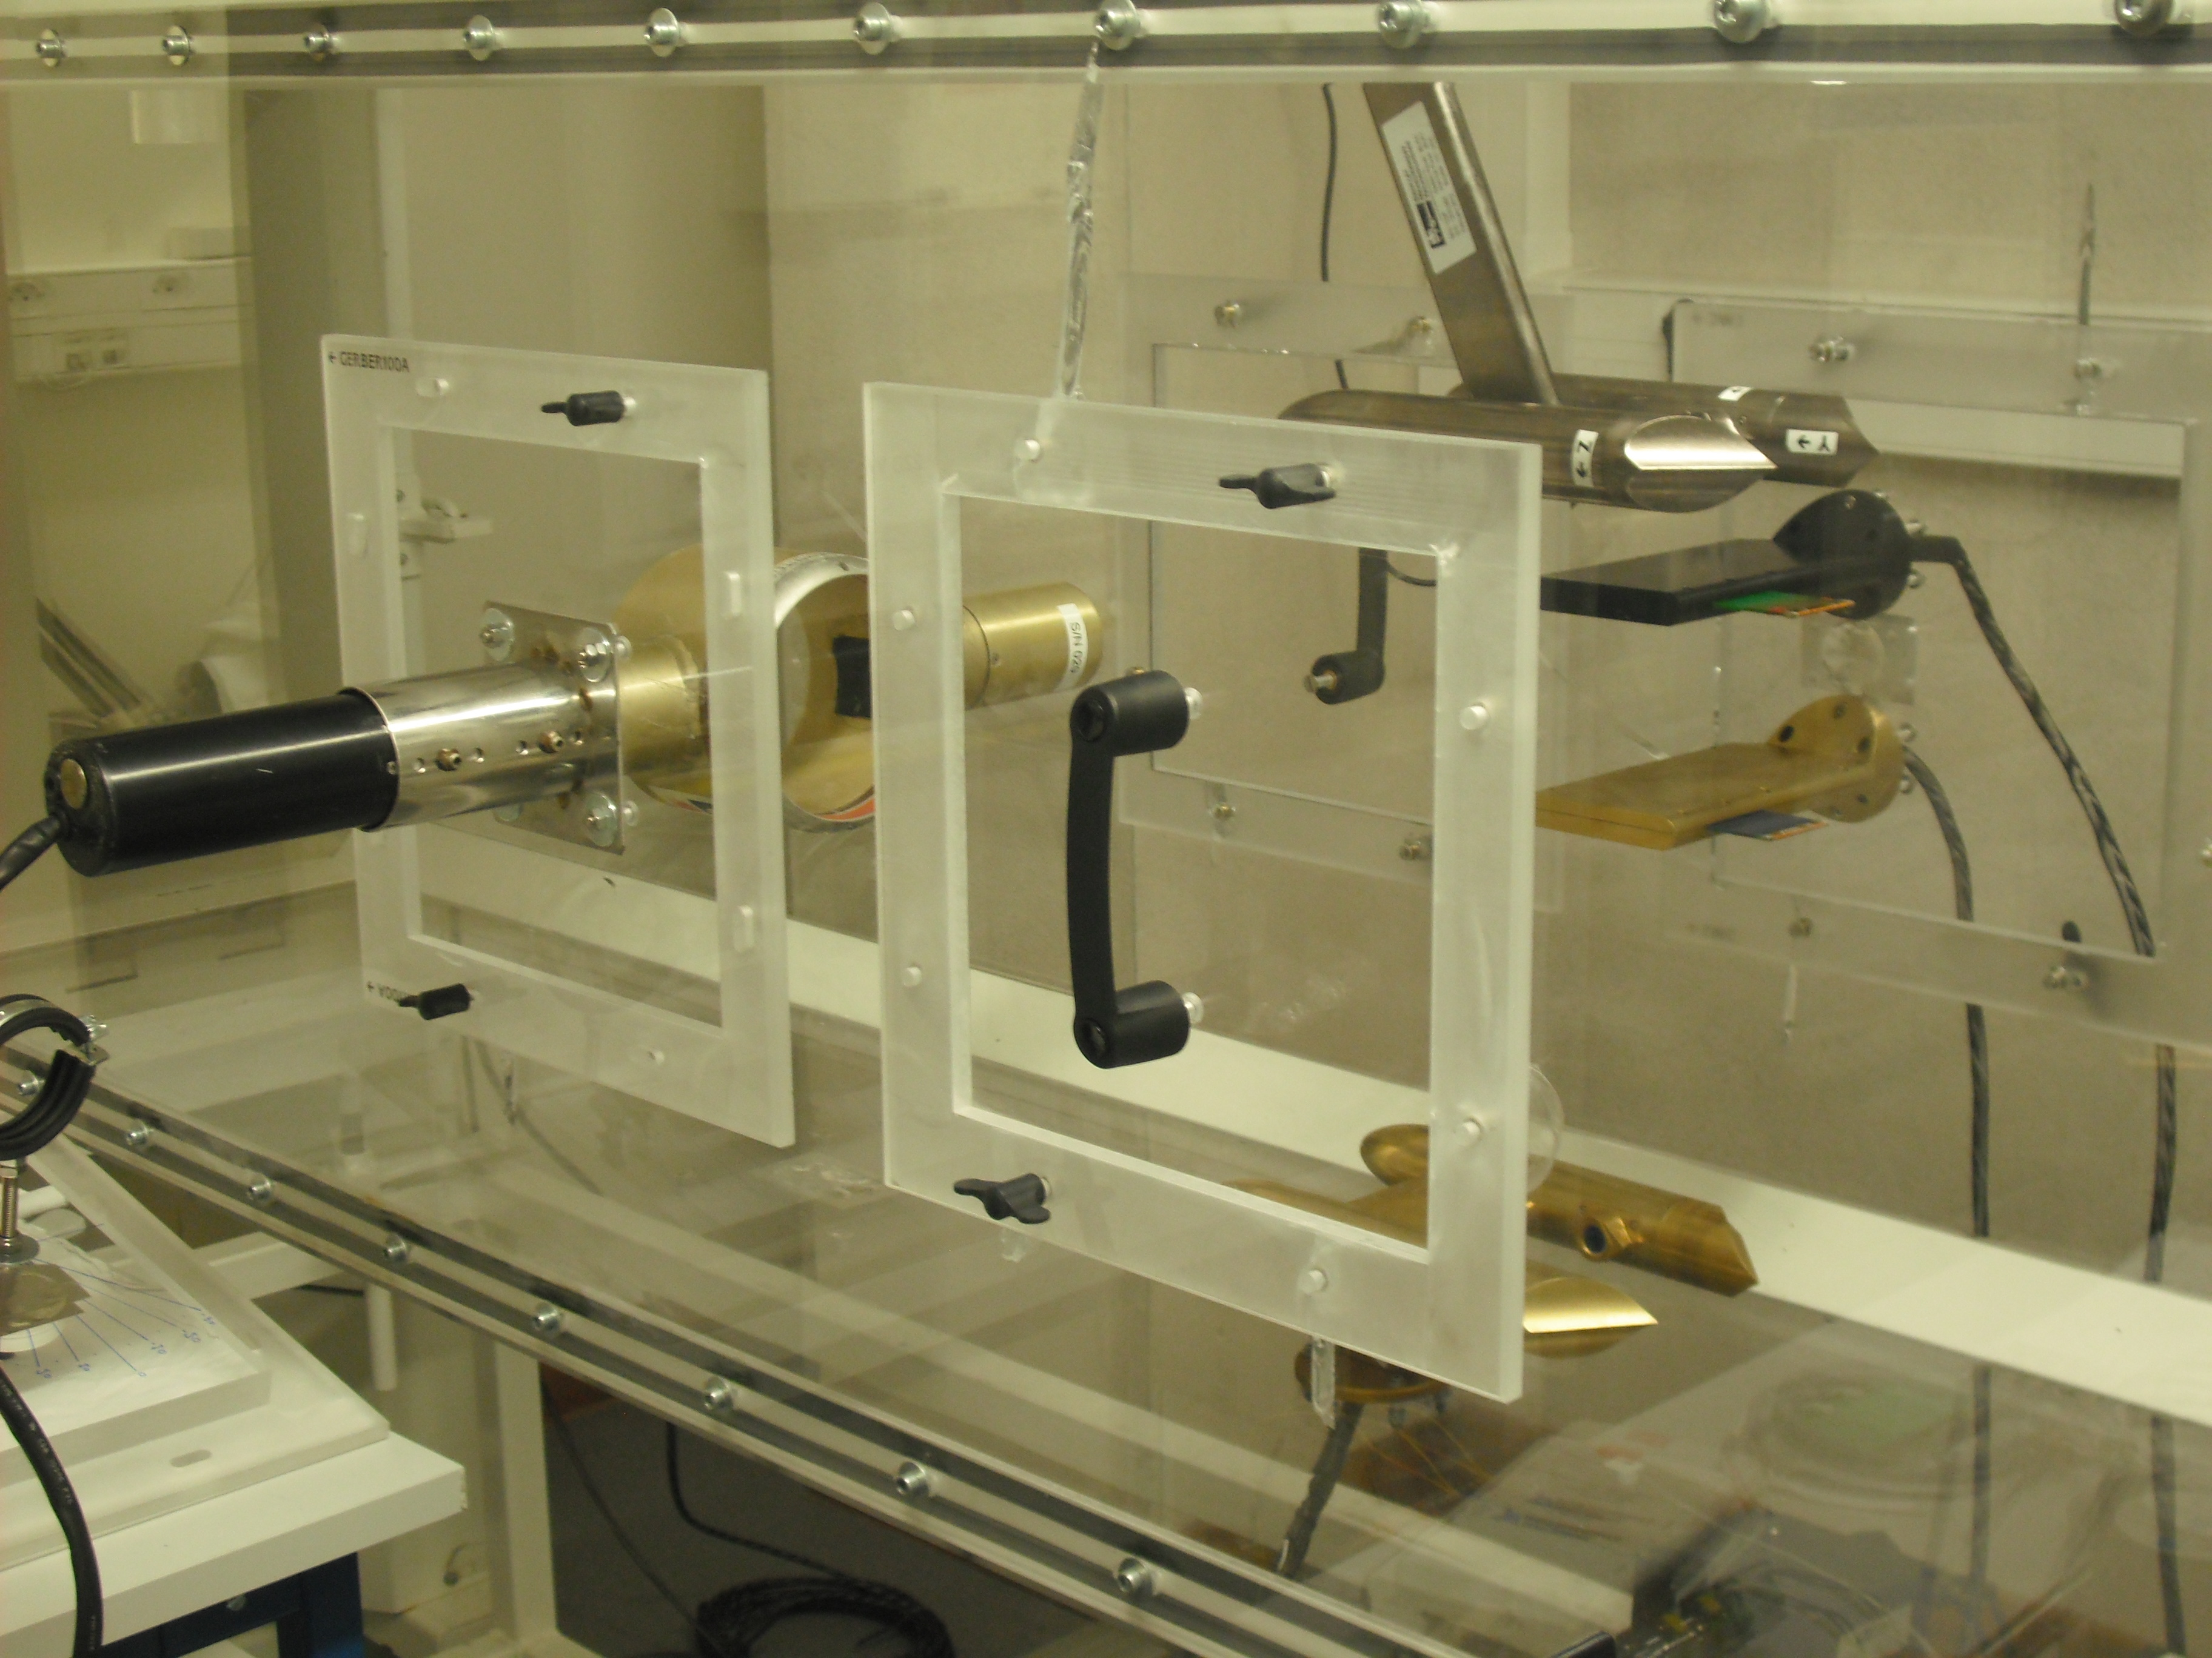
Task 2.2. – Evaluate performances of existing probes for LWC and Re
ACTRIS2 intercomparison campaign at puy de Dôme: To qualify critical operating conditions for data quality (dependance on external wind conditions speed and direction/probe orientation)
CDP-2
DMT LWC-100
Airborne-PVM
DMT LWC-300
CDP-2

Slide 11
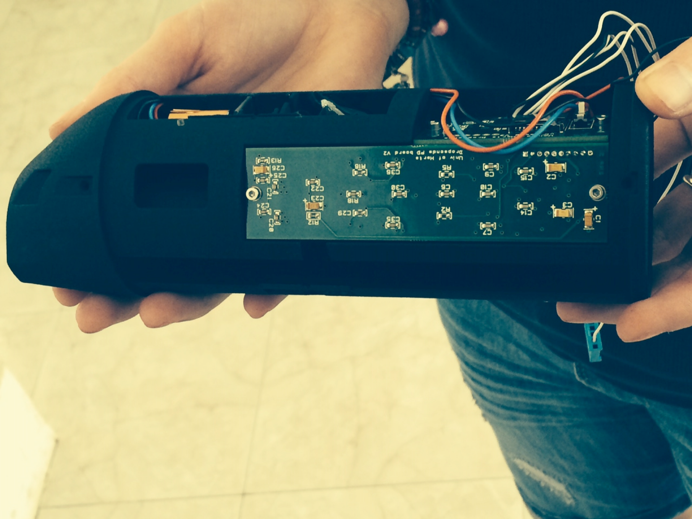
Task 2.2. – Evaluate performances of existing probes for LWC and Re
ACTRIS2 intercomparison campaign at puy de Dôme: Test robustness and reliability of new probes/instruments for monitoring activity
U. Hertfordshire UCAAS probe: adapt for ground-based measurements
/comparison with wind tunnel measurements

Slide 12
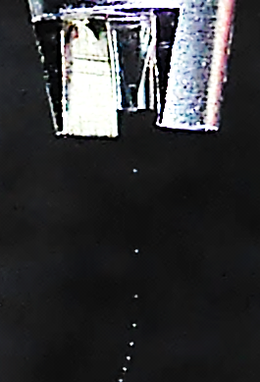
Task 2.2. – Evaluate performances of existing probes for LWC and Re
ACTRIS2 intercomparison campaign at puy de Dôme: Test robustness and reliability of new probes/instruments for monitoring activity
U. Hertfordshire UCAAS probe: calibrate for cloud droplet size and concentration
(generation of droplets of known size and concentration)

Slide 13
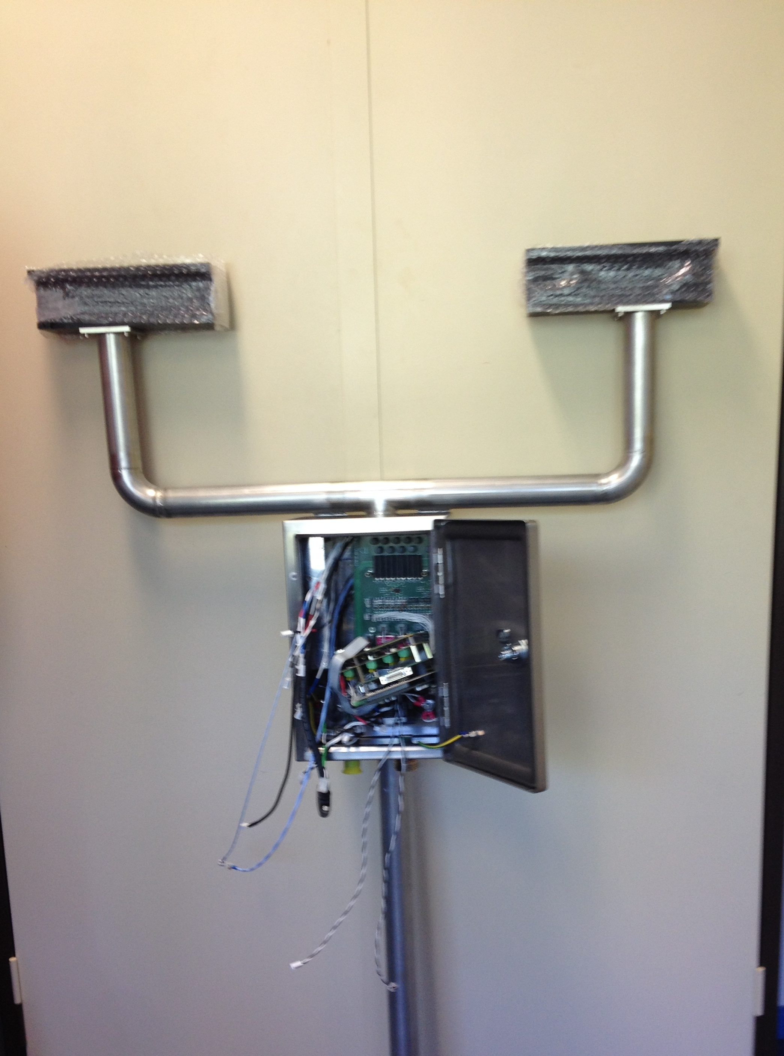
Task 2.2. Develop a new PVM prototype
Advantages:
-heated arms to avoid freezing during winter (identified limitation for continuous measurements at JFJ station)
-water-proof electonic box (identified frequent problem of loss of data during winter at PUY station)
-recording of raw data (may enable a more elaborated analysis than LWC/Re in the future)
-data continuously sent via internet

Slide 14
Task 2.2. timeline & planned actions
Campaign data analysis (until April 2017)
Report on calibration campaign (April 2017)
Organization of expert workshop for discussing campaign results (October 2017)
> deliverable: recommendations for SOP and data submission

Slide 15
Task 2.2. Objectives and milestones
To evaluate performances of existing probes for the measurement of Liquid Water Content (LWC) and Droplet effective Radius (Re)
Intercomparison field campaign with all cloud microphysical probes existing in the ACTRIS community, in order to determine de detection limit, robustness, advantages and drawbacks (M12) ✔
Report on intercomparison campaign (Deliverable on M18->M24)
To harmonize the standard operation procedures for the bulk probes (PVM, PWD)
Workshop on cloud microphysical measurements (M24->M30)
provide to the community recommendations and standard operating procedures (Delivrable on M24->M30).
To develop a new PVM probe prototype according to the identified drawback (M36) ✔

