Slide 1
WP3.2.3: Development of a measurement standardization and a data submission protocol for VOCs based on PTRMS and TOF-MS measurements
Truman Wright and Rupert Holzinger, Utrecht University , the Netherlands
Sebastien Dusanter and Stephan Sauvage, Ecole Nationale Superieure des Mines de Douai;
Anja Claude, DWD;
Stephan Reimann, EMPA

Slide 2
Content
1. Current state of the art (without standard operation protocol, SOP)
1.1 PTR-TOF-MS in a nut-shell
1.2 The kinetic method and its issues
1.3 The calibration method
2. The SOP (so far…)
2.1 Recommended settings
2.2 Merging of the two methods for the mutual benefit
2.3 In-situ gas-standard additions for data quality assurance (QA)
3. Quality control (QC) tools (exploiting the gas-standard additions)
3.1 PTR parameters (O₂⁺/H₃O⁺, E/N, sample flow, sample humidity)
3.2 TOF-MS parameters (transmission, peak shape, baseline signal)
4. QA/QC protocol
5. Next steps

Slide 3
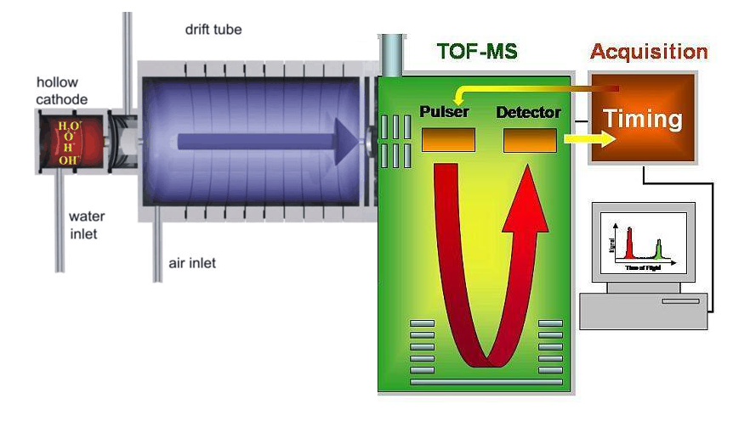




1.1 PTR-TOF-MS in a nut-shell
…
Proton transfer reactions (PTR):
H₃O⁺ + R → H₂O + RH⁺
… occur at the collisional rate for almost all VOCs.
Hansel et al., 1995:

Slide 4
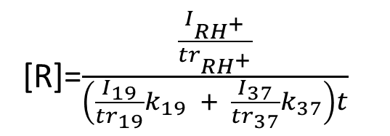
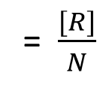
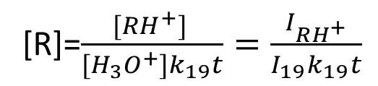
1.2 The kinetic method and its issues
Issues
H₃O⁺ not the only primary ion, also ~10-50% water dimer (H₂O H₃O⁺),
transmission through the mass spectrometer depends on ion mass,
uncertain reaction rate constant, k, (20-30%),
fragmentation for some compounds.
Hansel et al., 1995:
[R]=$\frac{[RH^{+}] }{[H_{3}O^{+}]k_{19}t}=\frac{I_{RH^{+}}}{I_{19}k_{19}t}$
VMR_{R}
= $\frac{[R]}{N}$
[R] concentration of VOC [molec cm⁻³]
VMR_{R} volume mixing ratio of compound [mol/mol]
N number concentration of gas in drift tube [molec cm⁻³]
t reaction time (residence time in drift tube) [s]
Primary ions:
[H₃O⁺] concentration [ions cm⁻³]
I₁₉ measured intensity [counts per second]
k₁₉ reaction rate constant with H₃O⁺ [cm³s ⁻¹molecule⁻¹ ]
Product ions:
[RH⁺] concentration [ions cm⁻³]
I_{RH+} measured intensity [counts per second]
Holzinger et al., 2010:
[R]=$\frac{\frac{I_{RH^{+}}}{{tr}_{RH^{+}}}}{\left(\frac{I_{19}}{{tr}_{19}}k_{19} + \frac{I_{37}}{{tr}_{37}}k_{37}\right)t}$
Water dimer (H₂OH₃O⁺, second primary ion):
[H₂OH₃O⁺] concentration [ions cm⁻³]
I₃₇ measured intensity [counts per second]
k₃₇ reaction rate constant with H₂OH₃O⁺ [cm³s ⁻¹molecule⁻¹ ]

Slide 5
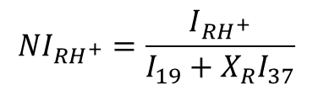
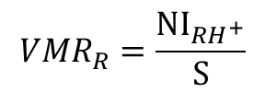
1.3 The calibration method
De Gouw and Warneke, 2007:
S determined through frequent in-situ gas standard additions:
“Measure NI_{RH+} for a known volume mixing ratio.”
$${NI}_{RH^{+}}=\frac{I_{{RH}^{+}}}{I_{19}+X_{R}I_{37}}$$
$${VMR}_{R}=\frac{{NI}_{RH^{+}}}{S}$$
NI_{RH+} normalized measured intensity [normalized counts]
X_{R} unitless compound specific humidity factor (experimentally determined)
S compound specific sensitivity
[normalized counts per ppb]
Advantages/disadvantages:
Straightforward
Accurate for calibrated compounds
No worries about transmission, fragmentation, and rate constant
Humidity factor remains an issue
Uncalibrated signals are often not reported or very inaccurate

Slide 6
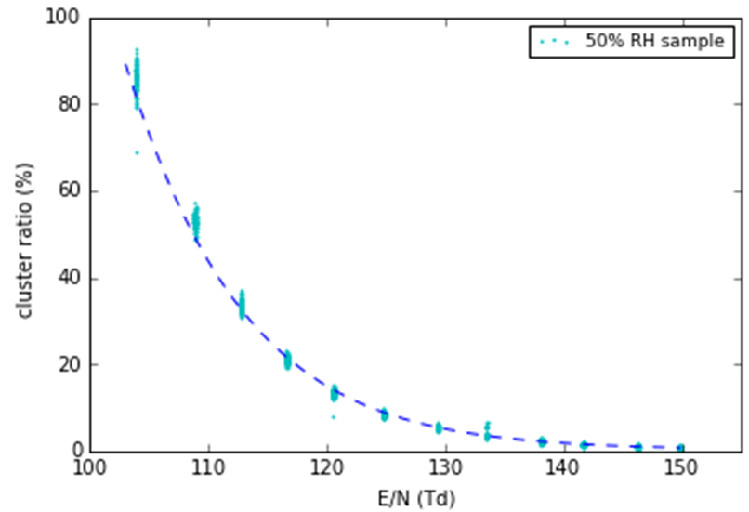
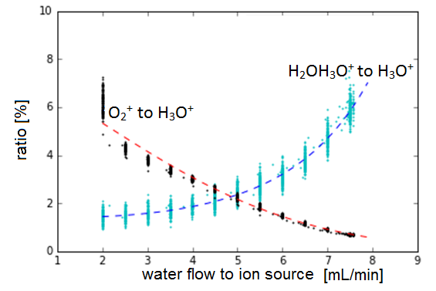
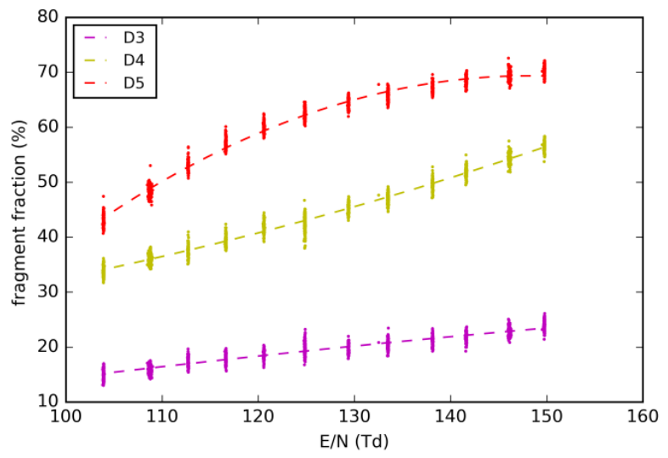
2.1 Recommended settings
Compromise between
low H₂O H₃O⁺/H₃O⁺ ,
fragmentation of VOCs,
and O₂⁺/H₃O⁺.

Slide 7
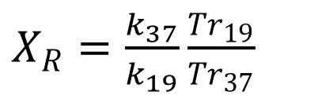
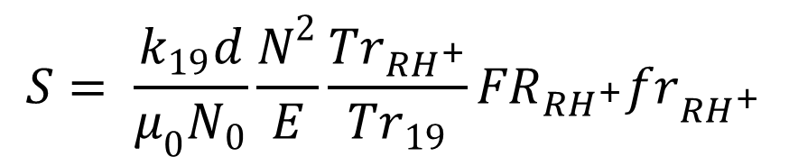
2.2 Merging of the two methods for the mutual benefit
$$S= \frac{k_{19}d}{μ_{0}N_{0}}\frac{N^{2}}{E}\frac{{Tr}_{{RH}^{+}}}{{Tr}_{19}}{FR}_{{RH}^{+}}{fr}_{{RH}^{+}}$$
The benefit:
S can be easily measured with a gas standard.
Physical parameters (E/N, k₁₉, k₃₇, transmission, and X_{R} ) can be retrieved from simple measurements of S, humidity, and fragmentation.
$X_{R}=\frac{k_{37}}{k_{19}}\frac{{Tr}_{19}}{{Tr}_{37}}$

Slide 8
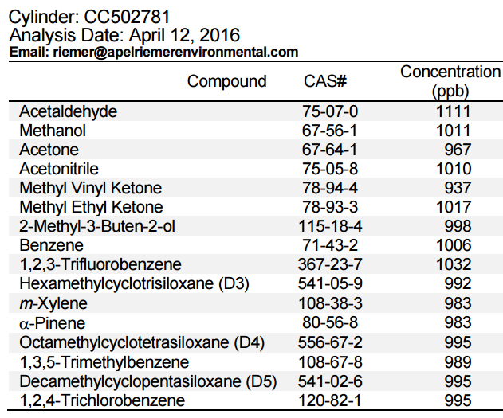
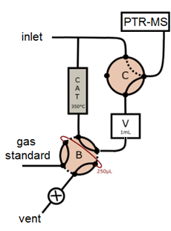
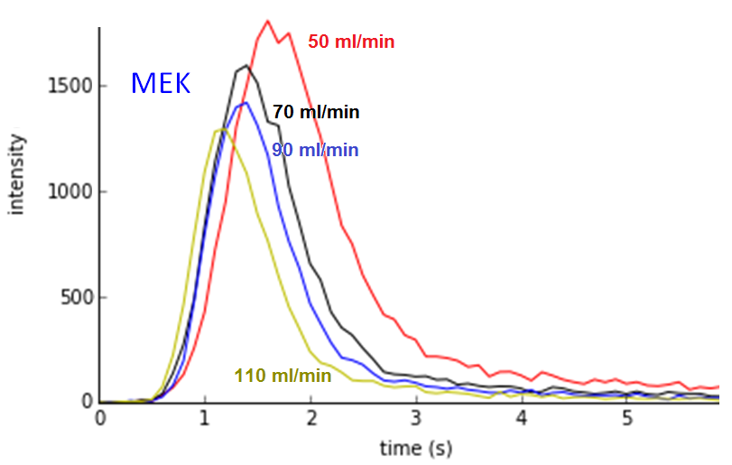
2.3 In-situ gas-standard additions for data quality assurance (QA)
16 compounds
Covered mass range 33-373 Da
Some compounds fragment
Range of X_{R} values
No overlapping signals

Slide 9
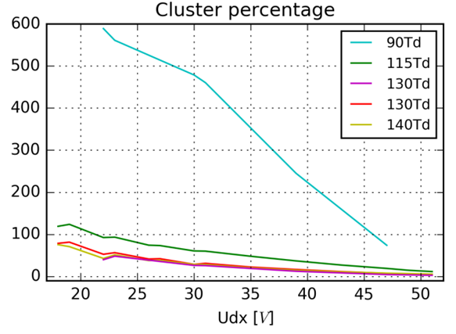
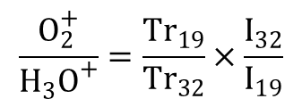
3.1 Quality control: PTR parameters
Extraction to TOF region
Ratio O₂⁺/H₃O⁺
$$\frac{O_{2}^{+}}{H_{3}O^{+}}=\frac{{Tr}_{19}}{Tr_{32}}×\frac{I_{32}}{I_{19}}$$

Slide 10
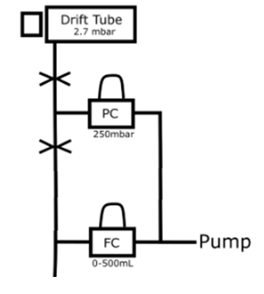

3.1 Quality control: PTR parameters
Flow into PTR-MS
??
Inlet
flow

Slide 11
3.1 Quality control: PTR parameters
E/N
…
E/N (Td) = a(fr_{x})² + b(fr_{x}) + c (fr_{x} given as a percentage (%))
m/z of parent compound | m/z of fragment | A | b | c
137.132 | 81.070 | 0.00587 | 0.210 | 82.7
223.064 | 207.032 | 0.0417 | -1.37 | 114.6
371.101 | 355.070 | 0.00110 | 0.0641 | 97.1

Slide 12
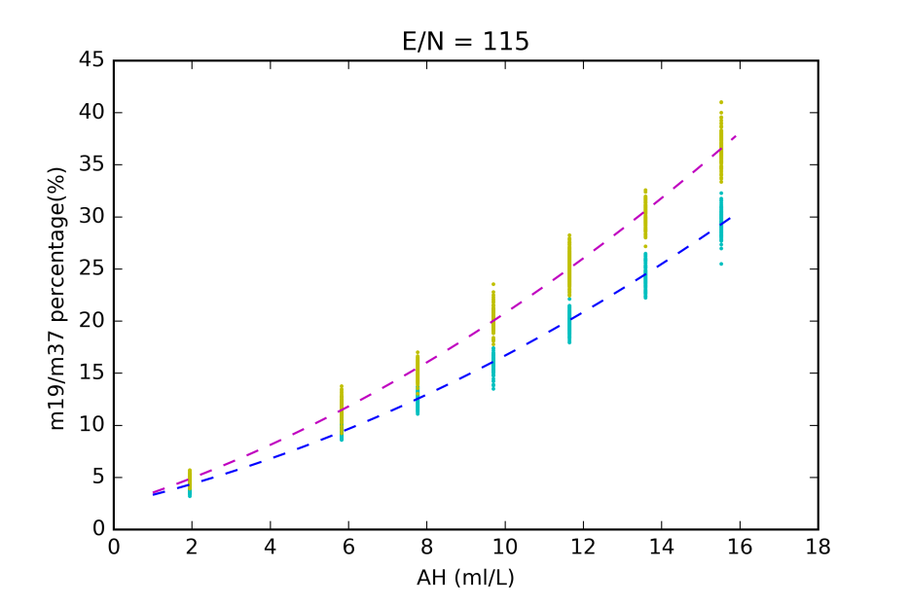
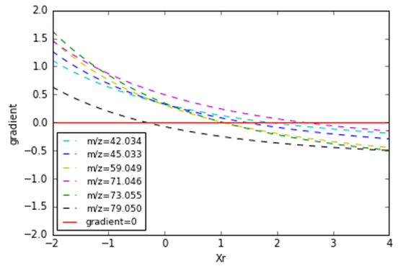
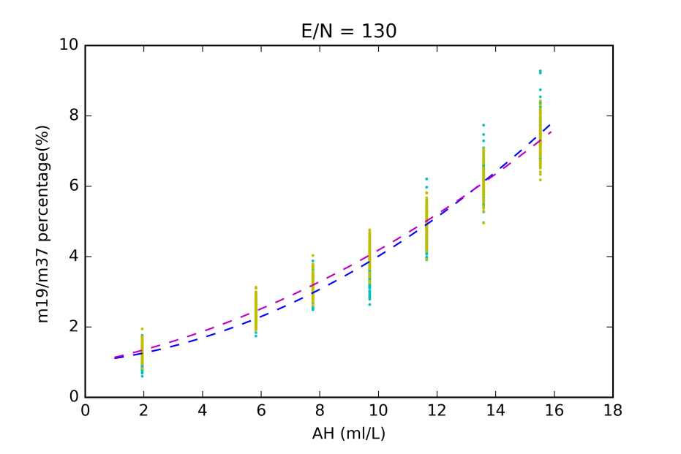
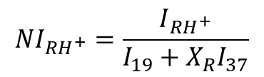
3.1 Quality control: PTR parameters
Sample humidity & H₂O leak from ion source
Humidity factor, Xr
$${NI}_{RH^{+}}=\frac{I_{{RH}^{+}}}{I_{19}+X_{R}I_{37}}$$

Slide 13
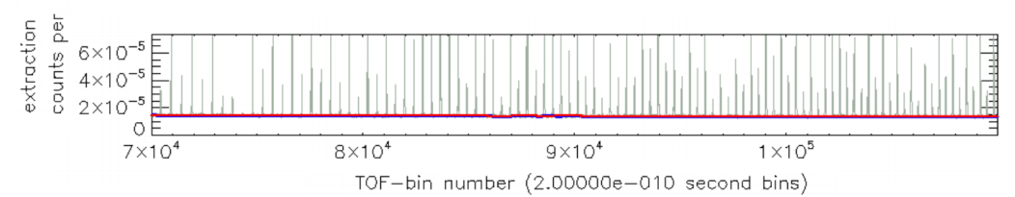
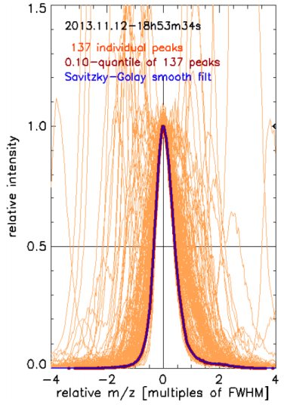
3.2 Quality control: TOF-MS parameters
Baseline signal
Peak shape
R. Holzinger: PTRwid: A new widget-tool for processing PTR-TOF-MS data
http://www.atmos-meas-tech.net/8/3903/2015/amt-8-3903-2015.pdf

Slide 14
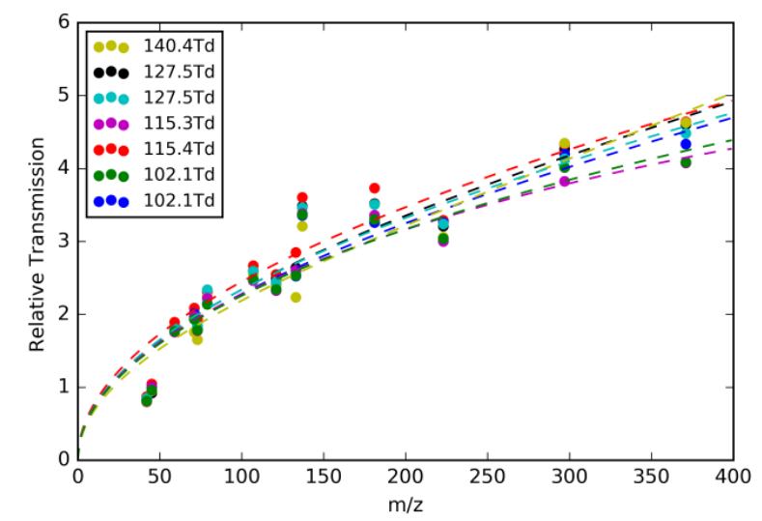
3.2 Quality control: TOF-MS parameters
Transmission

Slide 15
4. QA/QC protocol
Preliminary Protocol:
30s: F_{H2O} low, dry air
30s: F_{H2O} low, humid air
30s: F_{H2O} normal, humid air
40s: F_{inlet}=20sccm, 2 Std injections
40s: F_{inlet}=40sccm, 2 Std injections
40s: F_{inlet}=60sccm, 2 Std injections
40s: F_{H2O} low, dry air, E/N=100Td, 2 Std injections
40s: F_{H2O} normal, dry air, E/N=100Td, 2 Std injections
40s: F_{H2O} high, dry air, E/N=100Td, 2 Std injections
Retrievals:
Inlet flow (4,5,6)
O₂⁺/H₃O⁺ (3)
Extraction to TOF good? (1,2)
H₂O leak from ion source (2,3)
E/N (4,5,6)
Transmission (4 thr 9)
Sensitivity, S (4,5,6)
X_{R} (7,8,9)
Baseline signal (1 thr 9)
Peak shape (1 thr 9)
General output:
accuracy, precision, inconsistency alerts

Slide 16
5. Next steps
Get the community involved
Construct a stand-alone standard addition device that can be shipped to PTR-MS users for testing our SOP and QA/QC protocols.
Develop a simple measurement protocol for full QA (in ~5 minutes in automated systems)
Data submission protocol
Publications

