Slide 1



Development of correction factors for Aethalometers
AE31 and AE33
Thomas Müller
Leibniz Institute for Tropospheric Research, Leipzig
ACTRIS-2 WP3 Workshop, Bologna, October 2016

Slide 2
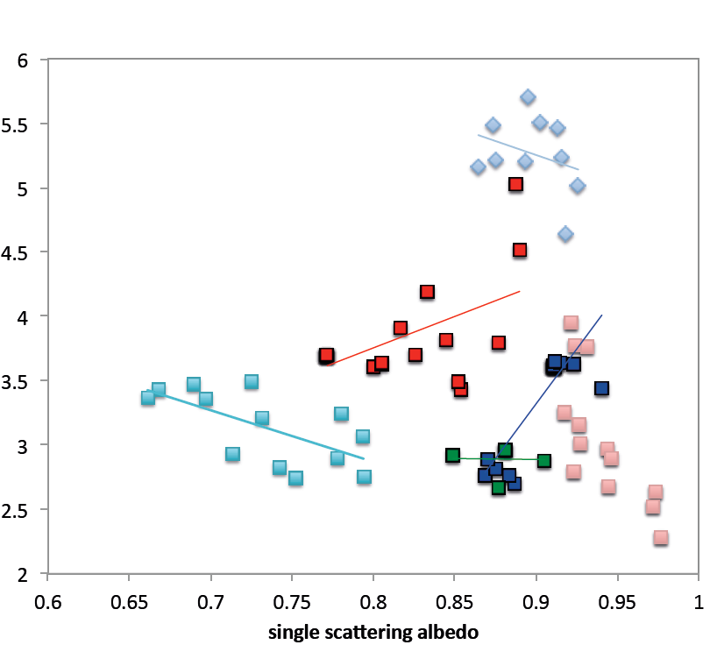
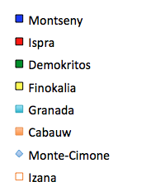
Average AE31 correction factor (Status Oct. 2015)
C₀
*
attenuation Ångström exponent
single scattering albedo
Recommended value: C₀=3.5 ± 0.875 (25%)
(not used for deriving C₀)
ACTRIS-2 WP3 Workshop, Bologna, October 2016

Slide 3
Database for C₀-Climatology for AE31
Cabauw: May to Oct 2013
Demokritos: Aug to Dec 2011
Finnokalia: Aug to Sep 2011
Granada: Sep 2012 to Sep 2013
Ispra: Jan to Dec 2012
Izana: July 2012 to Aug 2013
Monte Cimone: Jan to Dec 2014
Montseny: July 2012 to Dec 2013
TROPOS will search through EBAS database for more data.
Data not submitted to EBAS can be send to TROPOS until end of October
ACTRIS-2 WP3 Workshop, Bologna, October 2016

Slide 4
C₀ AE33 correction
Stations with AE33 & MAAP
(list from last years WP3 meeting in Athens)
Vavihill, Birkenes, Jungfraujoch, Granada, Ispra, Cabauw, Montseny, Puy de Dome, Finokalia, Athens
TROPOS will scan EBAS for more data.
Data not submitted to EBAS can be send to TROPOS until end of October
ACTRIS-2 WP3 Workshop, Bologna, October 2016

Slide 5
Timeline for publication
Sending data to TROPOS by end of October
Screening EBAS data base by end of October
Data evaluation (final plots) by end of November
Draft manuscript by end of November
Submission of manuscript end of December 2016
Co-Authorship
Significant contribution to manuscript (text etc.)
All data originators
ACTRIS-2 WP3 Workshop, Bologna, October 2016

