Slide 1
Increasing the number of NRT stations and instruments
Markus Fiebig, and the EBAS team
NILU - Norwegian Institute for Air Research

Slide 2
The Big Picture: The EC Digital Agenda
“Quite simply, knowledge is the engine of our economy. And data is its fuel.”
(Neelie Kroes, former European Commission Vice President in charge of the Digital Agenda)
EU Commission’s Digital Agenda:
Digital technologies are to be used for generating economic growth (next Facebook, Google, Air BnB, …)
Data has to flow as freely as possible to be available for new products and services.
A whole General Directorate is working on this!
Every project funded has to demonstrate how it fits into digital agenda (section on socio-economic impact).

Slide 3
Source: Copernicus.eu

Slide 4
Implementing the Digital Agenda: Copernicus
Source: Alessandro Annoni, JRC

Slide 5
Source: Vincent-Henri Peuch, ECMWF

Slide 6
Operational Services: What’s In It For The Station?
Success for ACTRIS-ESFRI:
ACTRIS-ESFRI will establish ACTRIS (stations & facilities) as permanent infrastructure.
Will be successful only if relevant (for digital agenda / Copernicus)
Funding & Visibility at national level:
Your national funding agency can demonstrate they are contributing to Copernicus (with your station)
Increased chances of getting national funding on ACTRIS ticket.
Visibility:
Work towards visibility of network and station in final product.

Slide 7
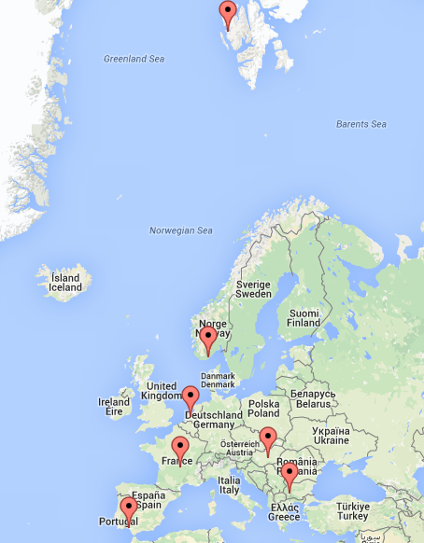
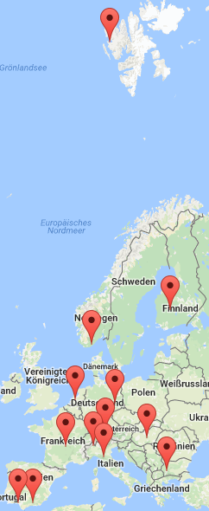
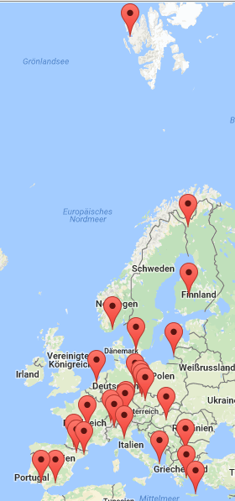
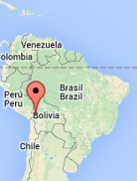
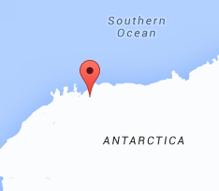
Task: Increase Number of NRT Stations and Instruments
Partners: NILU, all NA3
Relevant operational services are key criterion for project success → JRA3
ACTRIS-2 start:
7 stations, 10 instruments
Current NRT system:
14 stations, 23 instruments
Potential NRT system:
29 stations, 71 instruments

Slide 8
Increasing the number of NRT stations and instruments
NRT service is based on hourly uploads of last hours data in properly formatted level 0 to NILU.
Volunteers for writing / maintaining DAQ software displaying / logging / NRT uploading data at stations:
Instrument | Responsible
TSI 3563 nephelometer | NILU (ready!)
ECOTECH nephelometer | U. Crete (delayed)
MAAP | TROPOS (ready!)
Magee AE31 | NILU (soon ready)
Magee AE33 | NILU
Radiance Res. PSAP | NILU (little demand)
TROPOS SMPS | TROPOS (soon ready)
Custom DMPS / SMPS | Stations themselves

Slide 9
Focus On Getting Nephelometers Online
Station | Type | Solution | Station | Type | Solution
Mt. Cimone | TSI | custom | Pallas | TSI
Puy de Dôme | TSI | custom (!) | Preila | TSI
Birkenes | TSI | NILU | El Arenosillo | TSI | NOAA
Trollhaugen | TSI | NILU | Agia Marina | TSI
Zeppelin | TSI/ECOTECH |  | SIRTA | ECOTECH
Hyytiälä | TSI | custom | Pic du Midi | ECOTECH
Cabauw | TSI | custom (!) | Madrid | ECOTECH
Jungfraujoch | TSI | NOAA | Hyltemossa | ECOTECH
Melpitz | TSI | NILU | Montseny | ECOTECH
Granada | TSI | NOAA | Finokalia | Rad.Res.?
Izaña | TSI |  | Demokritos | ECOTECH
Mace Head | TSI | NILU | Navarino | Rad.Res.?
Ispra | TSI | custom (?) | Aspvreten | ECOTECH
Hohenpeissenberg | TSI | NILU | Mt. Chacaltaya | ECOTECH
BEO Moussala | TSI | NOAA | Montsec | ECOTECH
Kosetice | TSI |  | Lecce | ECOTECH
K-puszta | TSI | NOAA

Slide 10
Next Focus: Getting Filter Absorption Photometers Online
Station | Type | Solution | Station | Type | Solution
Agia Marina | AE31 |  | Jungfraujoch | AE31 / AE33 / MAAP | NOAA / NOAA
Annaberg | MAAP |  | K-puszta | PSAP | NOAA
Aspvreten | custom |  | Kosetice | AE31
Auchencorth Moss | AE?? |  | Lecce
BEO Moussala | PSAP | NOAA | London-Kensington | AE??
Birkenes | PSAP | NILU | Mace Head | AE31 / MAAP
Cabauw | MAAP |  | Madrid | AE33
Mt. Chacaltaya | AE31 / MAAP |  | Melpitz | MAAP | TROPOS
Mt. Cimone | AE31 / MAAP |  | Montsec | MAAP
Demokritos | AE31 |  | Montseny | AE33 / MAAP
Dresden | MAAP |  | Navarino | AE31
El Arenosillo | PSAP | NOAA | Pallas | AE31 / MAAP
Finokalia | AE33 |  | Pic du Midi | AE16
Granada | AE33 / MAAP/ PSAP | ? / ? / NOAA | Preila | AE31
Harwell | AE?? |  | Puy de Dôme | MAAP | custom
Hohenpeissenberg | AE31 / MAAP |  | SIRTA | AE33
Hyltemossa | AE31 / MAAP |  | Trollhaugen | PSAP | NILU
Hyytiälä | AE31/MAAP/PSAP | ? / Custom / ? | Vielsalm | AE??
Ispra | AE31 / MAAP |  | Zeppelin | AE31/AE33/MAAP | NILU / NILU / ?
Izaña | AE31 / MAAP

Slide 11
Next Focus: Getting Mobility Spectrometers Online
Station | Type | Solution | Station | Type | Solution
Agia Marina | --- |  | Lecce | ---
Annaberg | TROPOS |  | Leipzig-Eisenbahnstr. | TROPOS
Aspvreten | SU |  | Leipzig-Mitte | TROPOS
Auchencorth Moss | TSI 3080 |  | Leipzig-West | TROPOS
Barrow | TROPOS |  | Leipzig-TROPOS | TROPOS
BEO Moussala | TROPOS |  | London-Kensington | TSI 3080
Birkenes | NILU | NILU | Mace Head | custom
Cabauw | TSI / TROPOS | custom | Madrid | TSI 3080
Cape San Juan | TSI 3080 |  | Melpitz | TROPOS | TROPOS
Mt. Chacaltaya | TROPOS |  | Montsec | ---
Mt. Cimone | custom |  | Montseny | TROPOS
Demokritos | TSI / TROPOS |  | Neuglobsow | TROPOS
Dresden | TROPOS |  | Navarino | SU
El Arenosillo | TSI 3080 |  | Pallas | FMI
Finokalia | TROPOS |  | Pic du Midi | ---
Granada | TSI |  | Prague | TROPOS
Harwell | TSI 3080 |  | Preila | TROPOS
Hohenpeissenberg | TROPOS |  | Puy de Dôme | custom | custom
Hyltemossa | custom |  | Schauinsland | TROPOS
Hyytiälä | UHEL |  | SIRTA | GRIMM
Ispra | custom |  | Trollhaugen | NILU | NILU
Izaña | TSI |  | Vielsalm | TROPOS
Jungfraujoch | custom |  | Waldhof | TROPOS
K-puszta | UHEL |  | Zeppelin | NILU | NILU
Kosetice | TROPOS |  | Zugspitze | TSI / TROPOS

Slide 12
Action Items for Increasing Number of NRT Instruments
Stations with offline TSI nephs
Bring instruments online before end of year, i.e. with DAQ software provided by NILU. Refer to e-mail of spring for instructions and download location
MAAPs and AE31s
DAQ software with integrated NRT upload available next week on WDCA homepage, panel “Software”. Go ahead and install before end of year.
TROPOS MPSS systems
Software will be available early next year on WDCA homepage. Install and take into use before summer 2017.
U Crete: Finish ECOTECH NRT DAQ software before end of Nov. 2016
AE33
  Iterate level 0 template by February 2017.
  Provide software by April 2017.

Slide 13
Take Your TSI 3563 NRT Now!
Software runs on LabView 2014, needs LabView 2014 Run-time driver and LabView VISA driver (for COM ports). Both are bulky, but free of charge.
Go to ftp://ftp.nilu.no/Pub/mf/, download the respective downloaders to your DAQ PC, download the drivers, and install them on your DAQ PC.
From ftp://ftp.nilu.no/Pub/mf/, download the whole “TSI_3563_log_v0.0.1” folder, and place it in that folder containing the DAQ software on your PC.
From the “TSI_3563_log_v0.0.1” folder, take the “NILU_TSI_3563_control_v0.0.1.config.Example.20151030.ini” file, rename it “NILU_TSI_3563_control_v0.0.1.config.<station name>.<date>.ini”, and move it to “C:\NILU_DAQ\NILU_TSI_3563_log_v0.0.1\”. Open the file, and adapt it to the configuration at your station and your metadata.
In “C:\NILU_DAQ\NILU_TSI_3563_log_v0.0.1\”, make a copy of the edited file, and name it “TSI_3563_control_v0.0.1.config.current.ini”.
Run the program, and add it as scheduled task at system boot for auto-start after power failure.

