Slide 1


Quality assurance / closure studies for particle number concentration measured by mobility spectrometers
Alfred Wiedensohler & Kay Weinhold
+ PSI, CNRS, NILU, UHEL

Slide 2
Onsite Intercomparison with an additional CPC
TSI CPCs model 3772 are provided by following institutes:
  PSI
  UHEL
  CNRS (still missing)
  NILU
  TROPOS
The CPCs will be circulates in a regional sub-network to be compared to the MPSS
After each circulation, the CPCs will be checked and calibrated at the WCCAP
Time series of particle number concentrations and size distributions are sent to TROPOS for evaluation.

Slide 3
CPC Calibration – adjustment to 10 nm

Slide 4
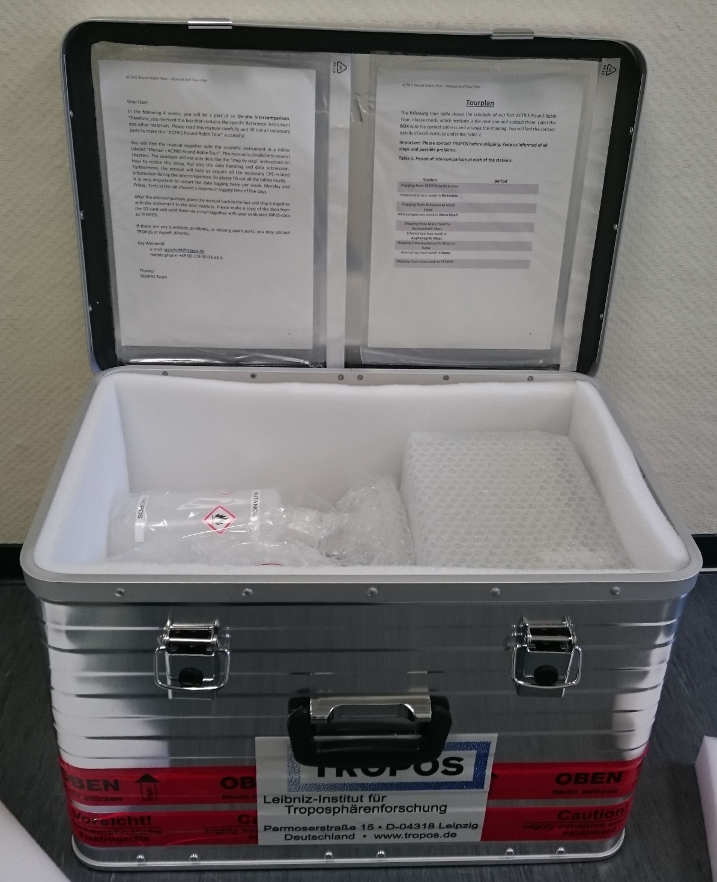

Slide 5
Country | Station
BE | Vielsalm
BG | BEO Moussala
BO | Chacaltaya | Not reachable
CH | Jungfraujoch | Non-EU
CZ | Kosetice
CZ | Usti | OdCOM
CZ | Prague Suchdol
DE | Waldhof | UBA
DE | Schauinsland | UBA
DE | Neuglobsow | UBA
DE | Zugspitze | UBA
DE | Hohenpeissenberg | DWD
DE | Melpitz | TROPOS
DE | Leipzig TROPOS | TROPOS
DE | Leipzig Eisenbahnstr. | TROPOS
DE | Leipzig Mitte | BfUL/TROPOS
DE | Leipzig West | BfUL/TROPOS
DE | Annaberg | BfUL
DE | Dresden - Nord | BfUL
DE | Dresden - West | BfUL
ES | Granada
ES | Madrid
ES | Montseny
FI | Varriö
FI | Hyytiälä
FI | Pallas
FR | SIRTA/Gif
FR | Puy de Dome
GB | Kensington | ???
GB | Auchencorth Moss | ???
GR | Finokalia
GR | DEM Athens
HU | K-Pustza
IE | Mace Head | ???
IT | JRC Ispra
IT | Mt.Cimone
LT | Preila
NL | Cabauw
NO | Birkenes | Non-EU
NO | Zeppelin | Not reachable
NP | Pyramid | Not reachable
SE | Hyltemossa
SE | Norunda

Slide 6
BOX1 NILU CPC
IE | Mace Head
UK | Auchencorth Moss | Christine Braban | chri2@ceh.ac.uk
FR | SIRTA/Gif | Valérie Gros | valerie.gros@lsce.ipsl.fr
BE | Vielsalm | Benjamin Bergmans | b.bergmans@issep.be
NL | Cabauw | Bas Henzing | bas.henzing@tno.nl
NO | Birkenes | Chris Lunder | Chris.Lunder@nilu.no
BOX2 - UHEL CPC
FI | Hyytiälä | Pasi Aaalto | pasi.p.aalto@helsinki.fi
FI | Pallas | Asmi Eija | Asmi.Eija@fmi.fi
SE | Hyltemossa | Adam Kristenson | adam.kristensson@nuclear.lu.se
SE | Norunda | Radovan Krejci | Radovan.Krejci@aces.su.se

Slide 7
BOX3 - CNRS CPC, still missing
Cy | Agia Marina Xyliatou | Jean Sciare | j.sciare@cyi.ac.cy
GR | Finokalia | Nikolaos Mihalopoulos | mihalo@uoc.gr
GR | DEM Athens | Eleftheriadis Konstantinos | elefther@ipta.demokritos.gr
HU | K-Pustza | András Hoffer | hofferandras@gmail.com
BG | BEO Moussala | Ivo Kalapov | ivokalapov@gmail.com
BOX4 - TROPOS CPC
ES | Granada | Esther Coz | esther.coz@ciemat.es
ES | Arenosillo | Mar Sorribas Panero | sorribas@inta.es
ES | Montseny | Noemi Perez | n.perezlozano@gmail.com
ES | Madrid | Esther Coz | esther.coz@ciemat.es
DE | Hohenpeissenberg | Harald Flentje | flentje@dwd.de
DE | Melpitz | Alfred Wiedensohler | ali@tropos.de

Slide 8
BOX5 - PSI CPC
CZ | Kosetice | Vladimir Zdimal | Zdimal@icpf.cas.cz
CZ | Prague Suchdol | Vladimir Zdimal | Zdimal@icpf.cas.cz
FR | Puy de Dome | Karine Sellegri | K.Sellegri@opgc.univ-bpclermont.fr
IT | Mt.Cimone | Angela Marinoni | a.marinoni@isac.cnr.it
IT | JRC Ispra | JP Putaud | jean.putaud@jrc.ec.europa.eu
CH | Jungfraujoch | Martin Gysel | matin.gysel@psi.ch

