Slide 1
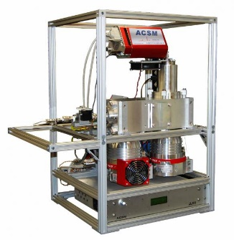

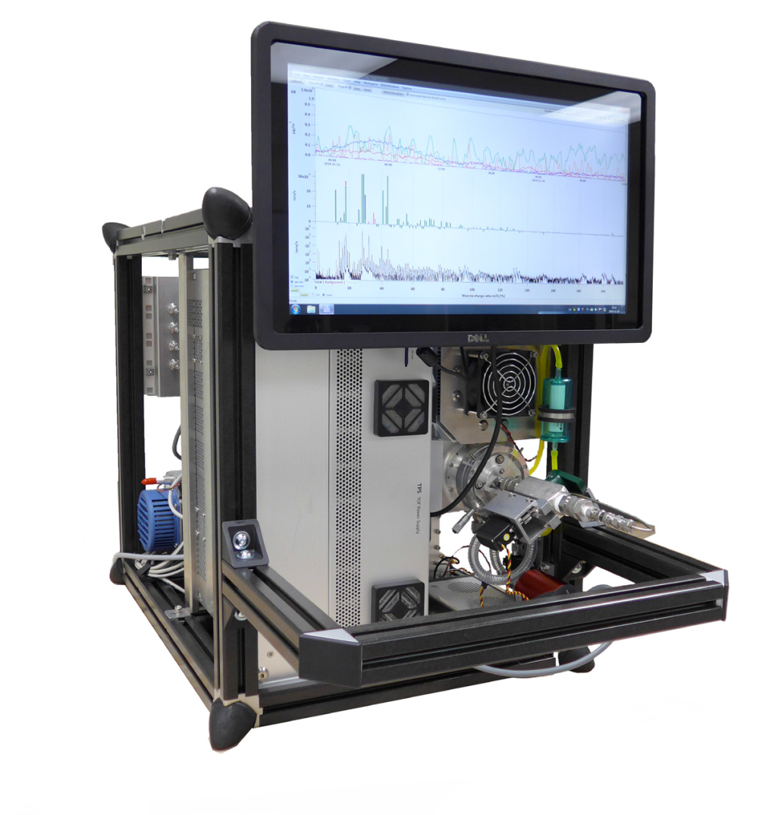


WP8: Calibration facilities, Aerosol Chemical Monitor Calibration Centre Evaluation protocol
Bologna, Italy. October 2016
Evelyn Freney, Olivier Favez, Valerie Gros, Jean Sciare
Yunjiang ZHANG, Tanguy AMODEO
It’s complicated!

Slide 2

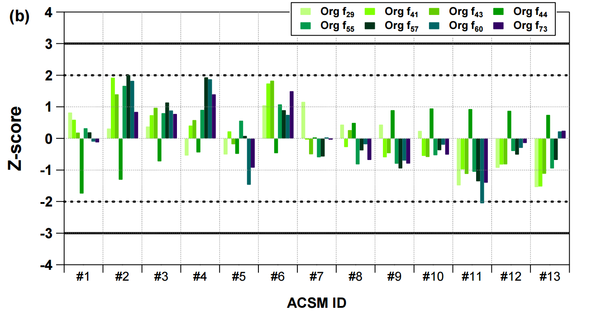
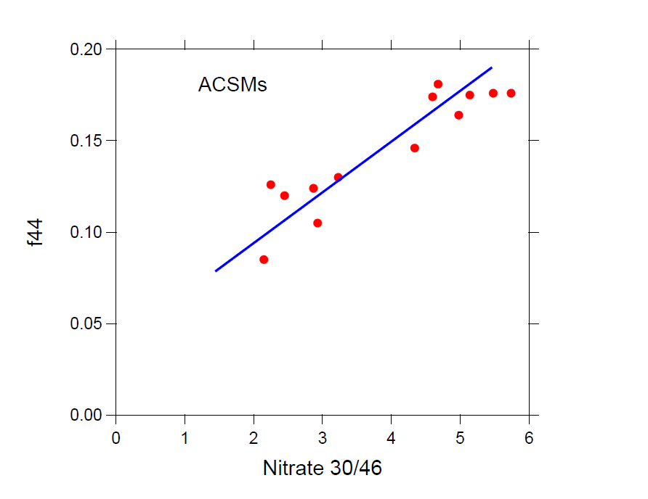
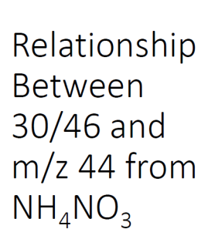
It’s complicated! : some examples
ACSM measurement artefacts
Observed for the first time after the ACTRIS-1 ACSM intercomparison (2013)
Discrepancies within organic mass fractions from one instrument to another
Seemed to be linked to NO₃ contents
Crenn et al., 2015 + Frohlich et al., 2015

Slide 3
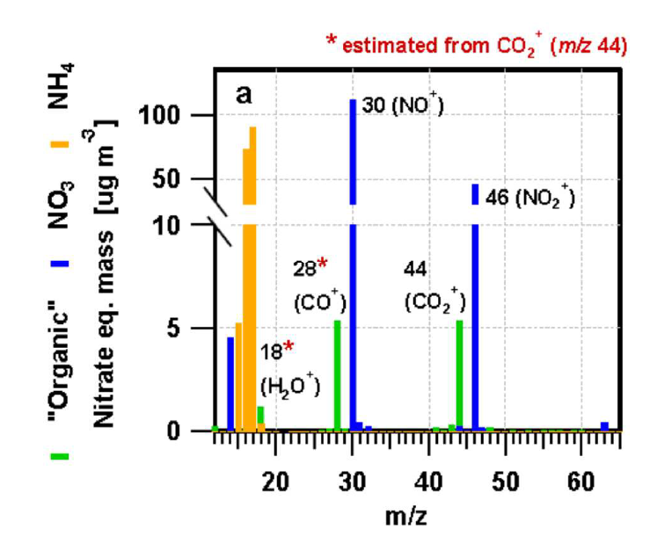
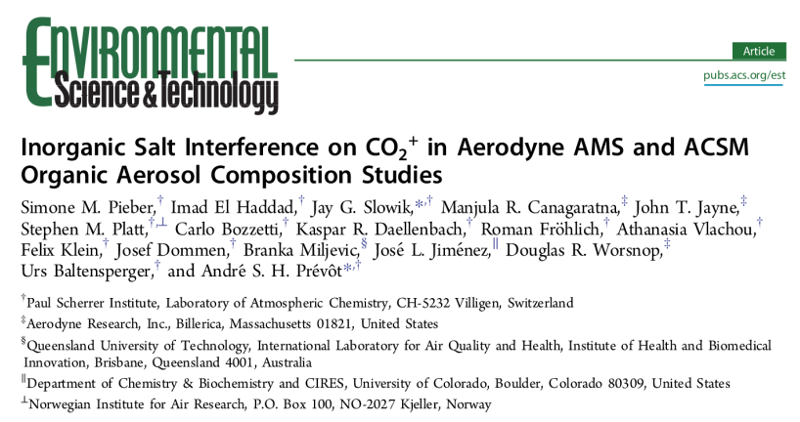
It’s complicated! : some examples
ACSM measurement artefacts
Can be observed during direct injection of ammonium nitrate (in acquisition mode)
Recent study conducted on the various PSI AMS and ACSM’s
Published Sept. 2016

Slide 4

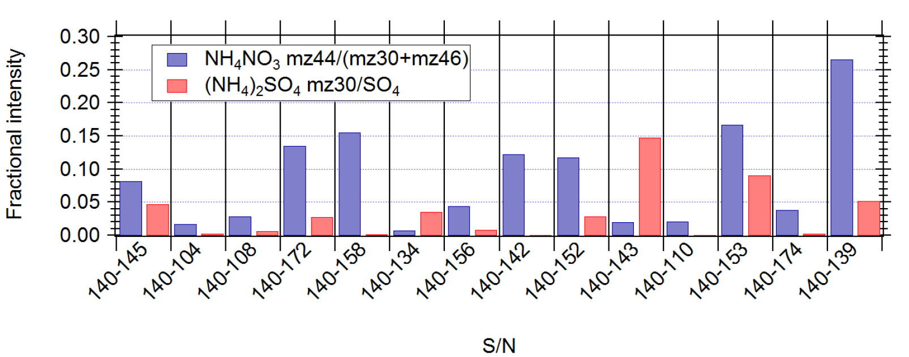
It’s complicated! : some examples
ACSM measurement artefacts
Can be observed during direct injection of ammonium nitrate (in acquisition mode)
Recent study conducted on the various PSI AMS and ACSM’s
Published Sept. 2016
ACTRIS-2: this relationship appears to be dependant on vapourizer dirtiness
2013 intercomparison
ACTRIS-2 2016 intercomparison

Slide 5
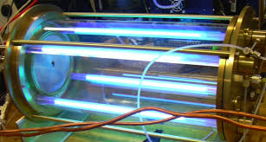
It’s complicated! : some examples
ACSM measurement artefacts
Organic fragments show significant variation between instruments - especially for m/z 44.
A second « research » thematic that was adressed during the 2016 intercomparison
Can we define harmonized correction protocols (when needed) ?
Need for a better « calibration » of organic mass spectra
Secondary organic aerosol generated from know compounds and from different UV exposures

Slide 6
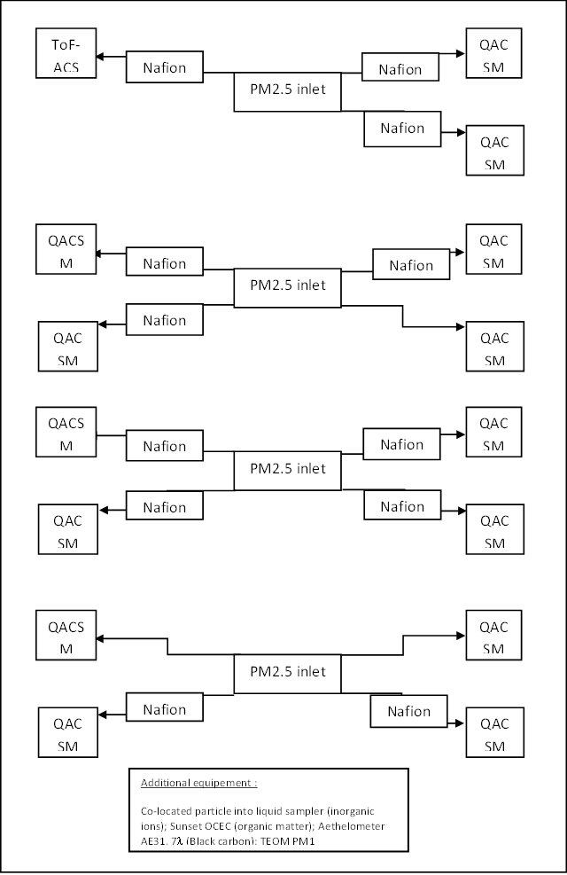

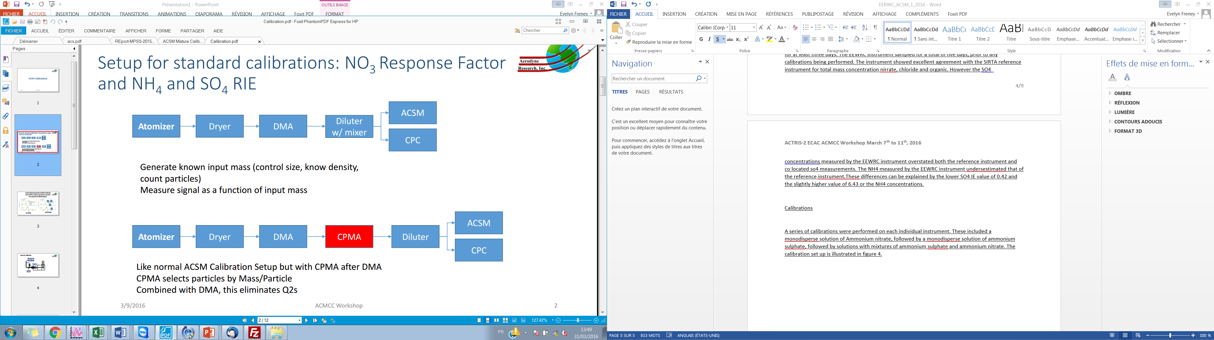
ACMCC: ACTRIS2_First intercomparison analysis and reporting
Ambient measurements
Calibration,
IE NO₃, IE SO₄
11th to 14 th of March
Quad-ACSM
arrival
4th to 7 th of March
Ambient measurements
7th to 10 th of March
Calibration/PAM experiments
Ambient measurements
Phase 2:
ToF-ACSM
Ambient measurements
24th to 27th of March
21st to 24th of March
27th March to 18th April
Calibration set-up

Slide 7
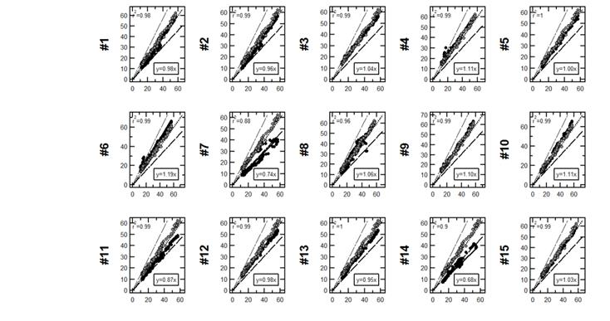
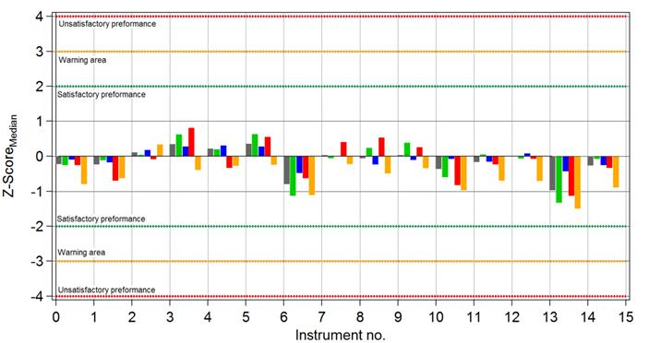
ACMCC: ACTRIS2_First intercomparison analysis and reporting
2016 ACTRIS-2 ACSM intercomparison exercice at the ACMCC: Evaluation of instruments preformance
1. Instrument falls within ± 30% of the « reference » instrument
2. Instrument performance evaluated against the Median using the Z-score method
Organic, sulphate, nitrate, Ammonia
PM1 SIRTA (REF)
PM1 of all instrument compared with PM1 of SIRTA instruments.
Dotted line indicates ± 30% error
light points represent TEOM-FDMS, black points represent ACSM data

Slide 8
ACMCC: ACTRIS2_First intercomparison analysis and reporting
2016 ACTRIS-2 ACSM intercomparison exercice at the ACMCC: Evaluation of instruments preformance
1. Instrument falls within ± 30% of the « reference » instrument
2. Instrument performance evaluated against the Median using the Z-score method
Organic, sulphate, nitrate, Ammonia
PM1 SIRTA (REF)
PM1 of all instrument compared with PM1 of SIRTA instruments.
Dotted line indicates ± 30% error
light points represent TEOM-FDMS, black points represent ACSM data

Slide 9
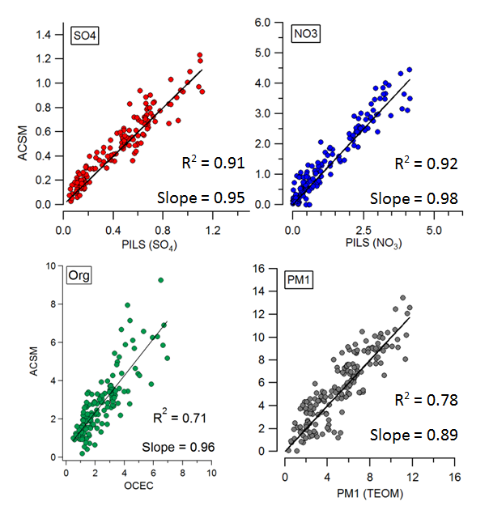
ACMCC: ACTRIS2_First intercomparison analysis and reporting
Validation of reference instrument
SIRTA instrument was identified as reference instrument
Instrument has been sampling at SIRTA since 2011. The longest existing ACSM data set.
It is regularily calibrated and maintained by experienced SIRTA staff.
Comparison with external reference methods

Slide 10
ACMCC: ACTRIS2_First intercomparison analysis and reporting
Evalulation criteria (List of some of potential errors)
Calibration error
Transmission efficiency
Collection efficiency
Detection limit (Zero measurements)
Instrument artefacts

Slide 11
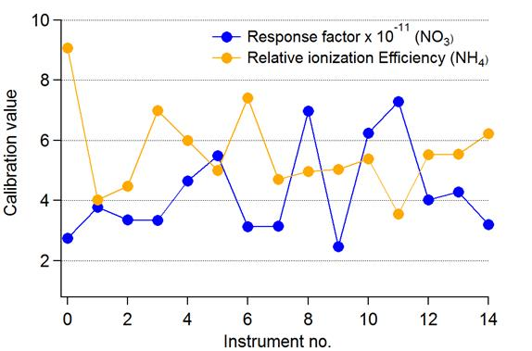
ACMCC: ACTRIS2_First intercomparison analysis and reporting
Evalulation criteria (Error associated with calibration)
As expected, high variability within response factors from one instrument to the next → Each instrument has is own response factor
But, less expected, for a given instrument:
Calibration repeatability: Variation in calibration values (up to 3 calibrations were performed on each instrument)
Discrepancies between average values from user’s reported calibration and those obtained at the ACMCC:
Deviation = 24%
Same person using same calibration set-up at ACMCC:
Deviation = up to 14% , partly due to different particle concentration reading directly from CPC vs. from the ACSM instrument

Slide 12
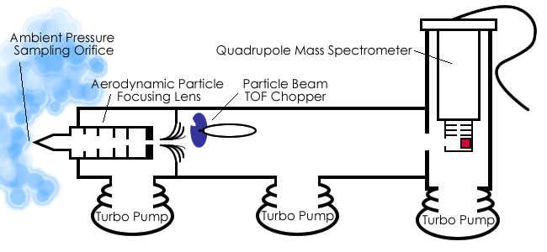
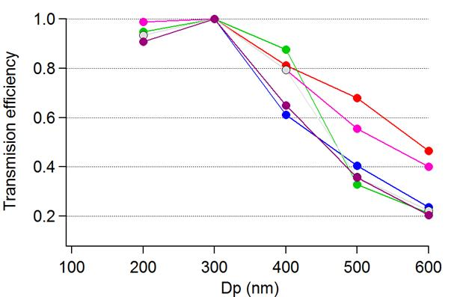
ACMCC: ACTRIS2_First intercomparison analysis and reporting
Evalulation criteria (Error associated with instrument transmission and collection)
TE: Transmission efficiency.. The Lens TE varies depending on the particle size measured (25%).
Error in TE

Slide 13
ACMCC: ACTRIS2_First intercomparison analysis and reporting
Evalulation criteria (Error associated with instrument transmission and collection)
TE: Transmission efficiency.. The Lens TE varies depending on the particle size measured (25%).
Error in TE
Error in CE
CE: Correction for collection efficiency of indiviual instruments depends on composition and phase
Instruments are then corrected using a chemical dependant collection efficiency (CDCE).
Assuming that when particles contain a high fraction of ammonium nitrate that they are more efficiency sampled (more liquid)
The instrument to instrument variation in the CDCE =5%

Slide 14
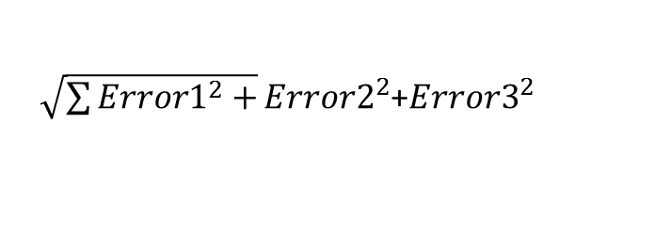
ACMCC: ACTRIS2_First intercomparison analysis and reporting
Evalulation criteria (Conclusion)
Propagation of errors
Calibration repeatability : Variation in calibration value (3 to 4 calibrations were performed on each instrument)
Error = 14%
$\sqrt{\sum{{Error1}^{2}+}}{Error2}^{2}$+${Error3}^{2}$
Error1
TE: Transmission efficiency error.. Depending on the particle size measured the lens TE varies..
(25%)
Error2
29%
CE: Collection efficiency correction.
Depending on the particle chemical composition and morphology..
Error in CDCE based on chemical composition
5%
Error3

Slide 15
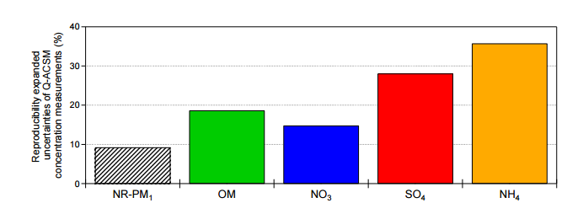
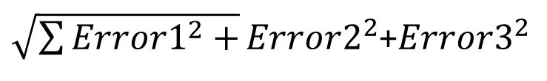
ACMCC: ACTRIS2_First intercomparison analysis and reporting
Evalulation criteria (Conclusion)
Propagation of errors
$\sqrt{\sum{{Error1}^{2}+}}{Error2}^{2}$+${Error3}^{2}$
Calibration repeatability : Variation in calibration value (3 to 4 calibrations were performed on each instrument)
Deviation = 14%
Error1
29%
Error2
TE: Transmission efficiency. Depending on the particle size measured the lens TE varies.. (Deviation = 25%)
** This is a first estimate of instrument errors.
ACTIONS
TE: Use longterm ILC data to determine TE error on ambient data (comparing with external FIDAS instrument).
Species by species uncertainties will be determined for all instruments.
Instrument detection limits will be detected from zero measurements.
CE: Collection efficiency correction.
Depending on the particle chemical composition and morphology.. (30% from literature)
Error in CDCE based on chemical composition
5%
Error3
Species by species uncertainties (Crenn et al., 2016).

Slide 16
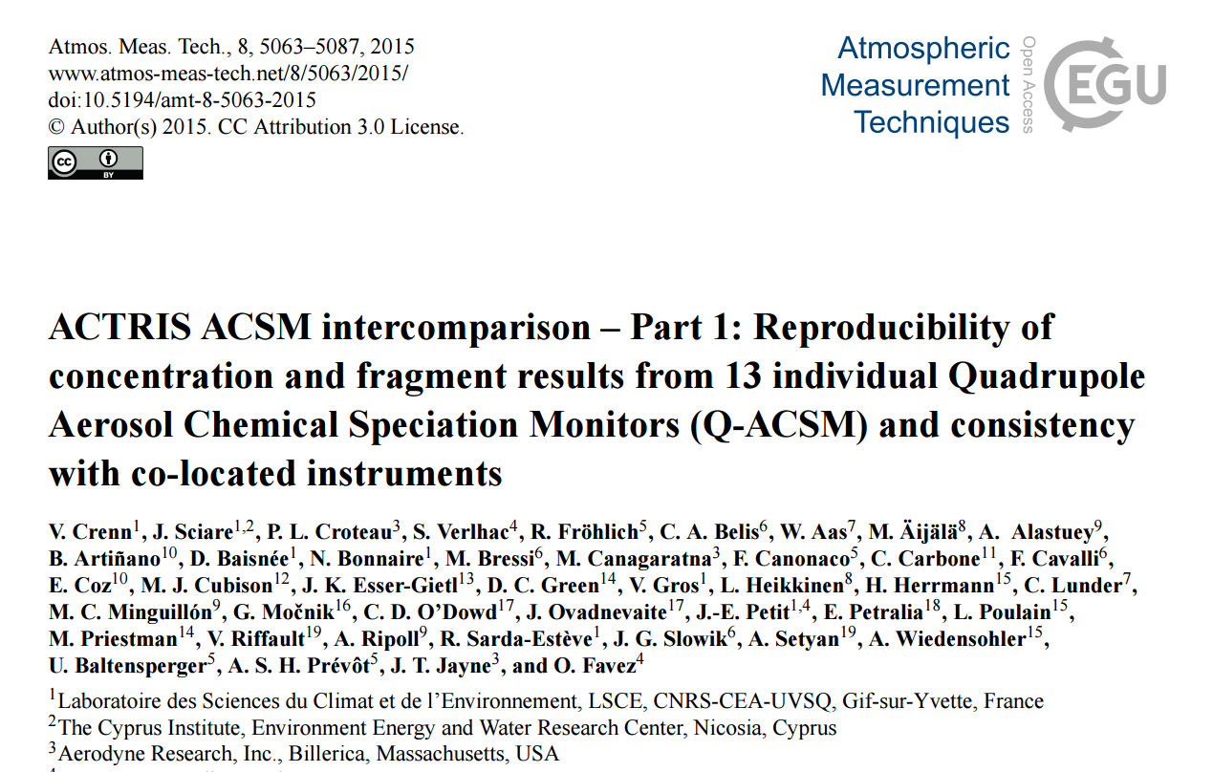
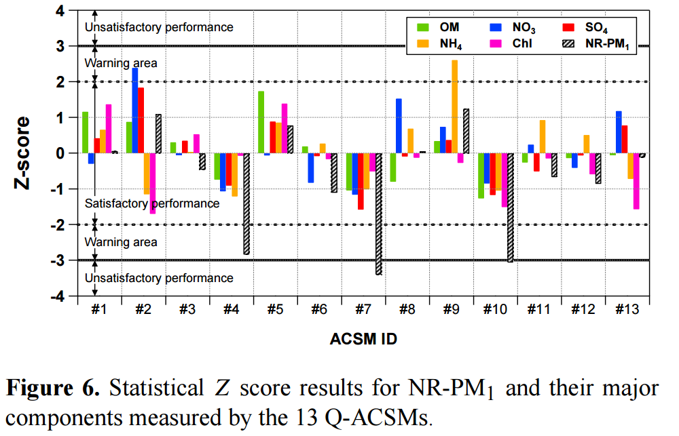
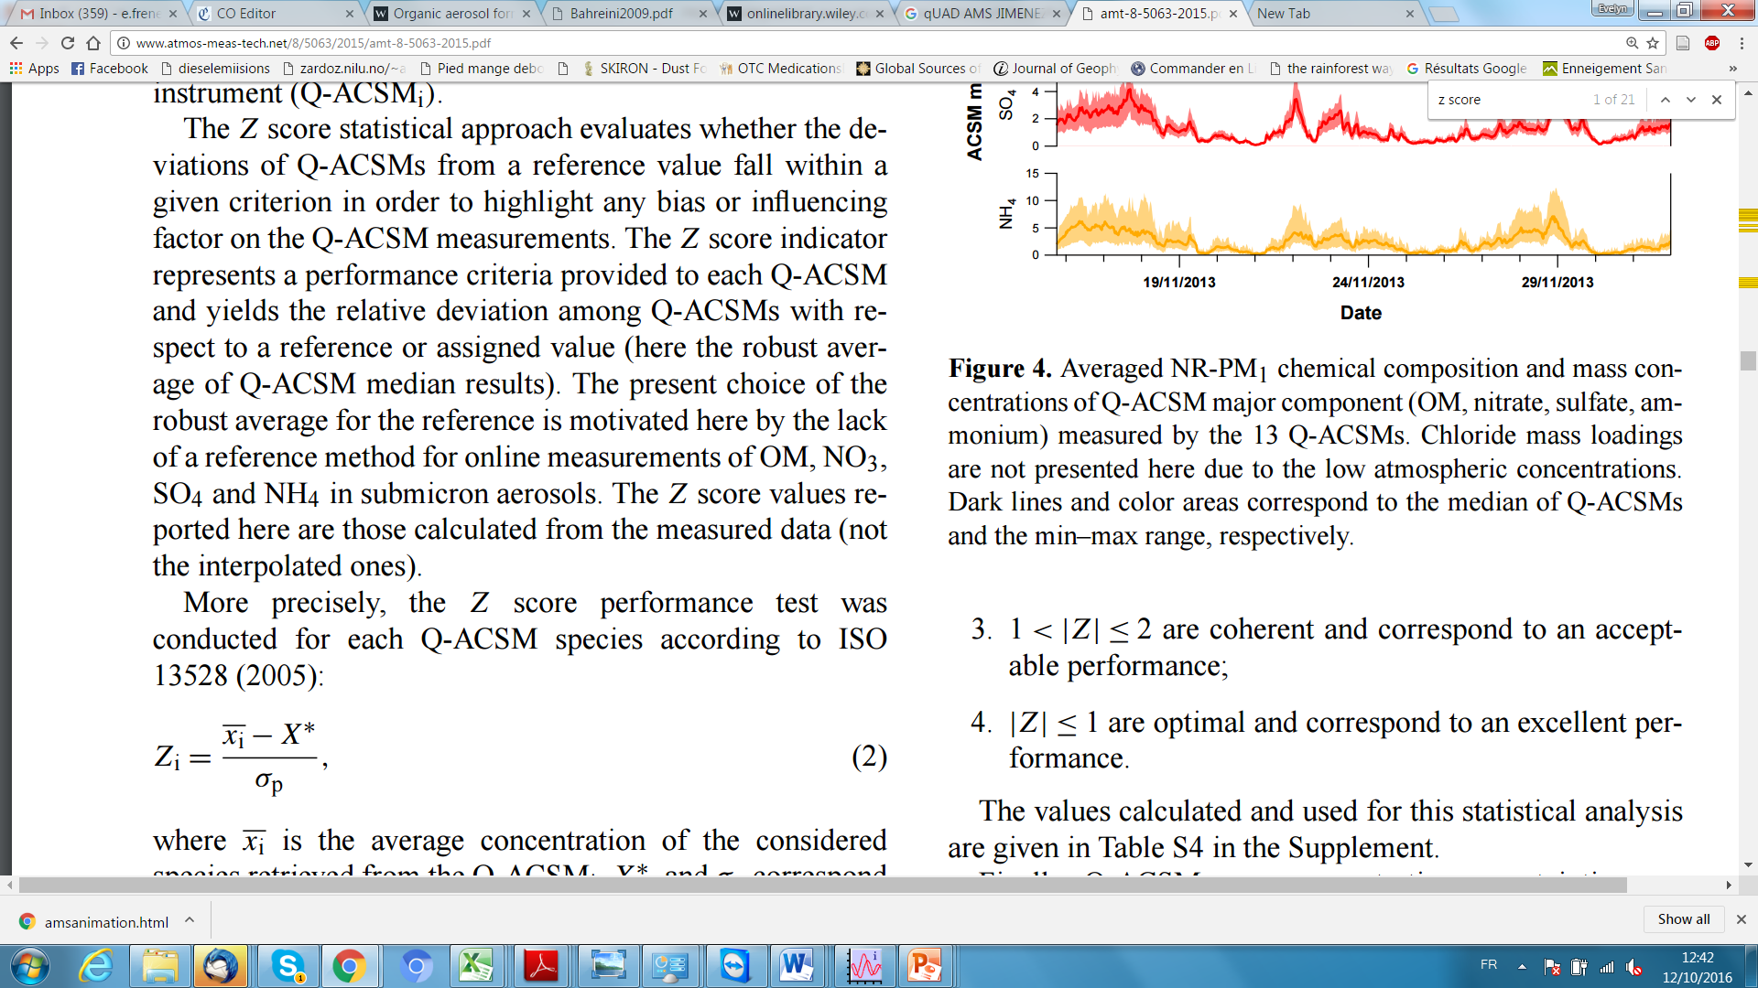
ACMCC: ACTRIS2_First intercomparison analysis and reporting
Method 2
Instrument performance evaluated against the Median using the Z-score method (ISO 13528 (2005))
Organic, sulphate, nitrate, Ammonia
Average concentration of instrument i
Median concentration
Standard deviation

Slide 17
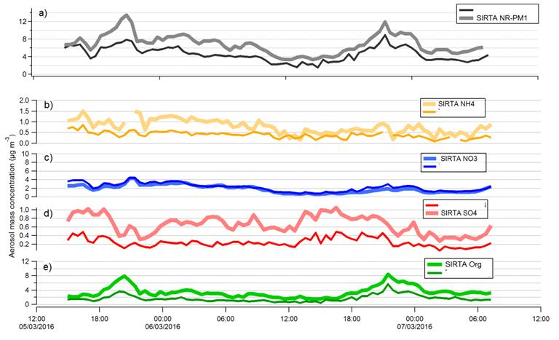
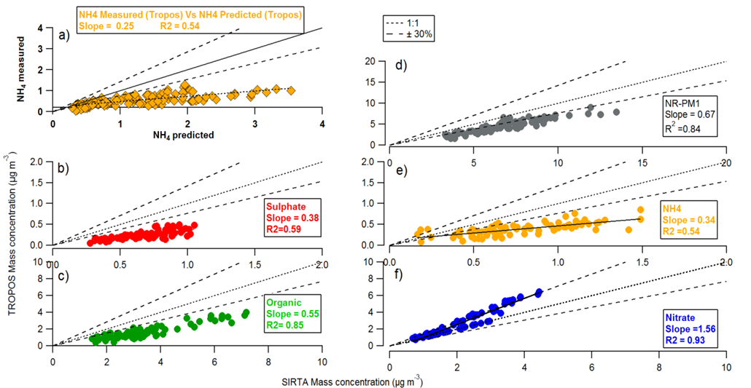
ACMCC: ACTRIS2_First intercomparison analysis and reporting
Some examples of individual instrument comparisons
*** All settings did not load up correctly when instrument arrived at station
Pre-calibration intercomparison. Comparison with reference instrument
BEFORE
Internal instrument reference
This can be compared with values of the instrument prior to the instrument coming to the centre
Serial # | RFNO₃ | RIENH4 STD | RIESO4 STD | RIESO4 MIX | RIENH4 MIX
Original | 5.20e-11 | 9.57 | 0.54 | - | -
Calibrated | 6.24e-11 | 5.38 | 0.32 | 0.70 | 3.50

Slide 18
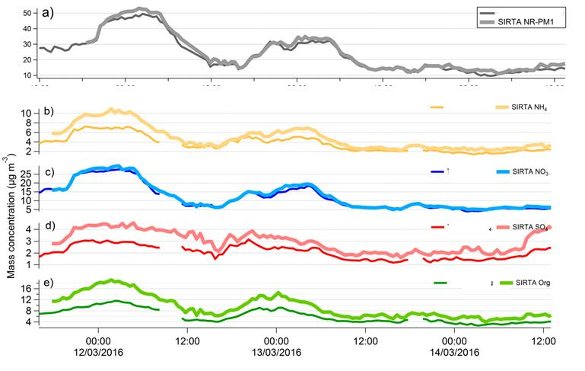
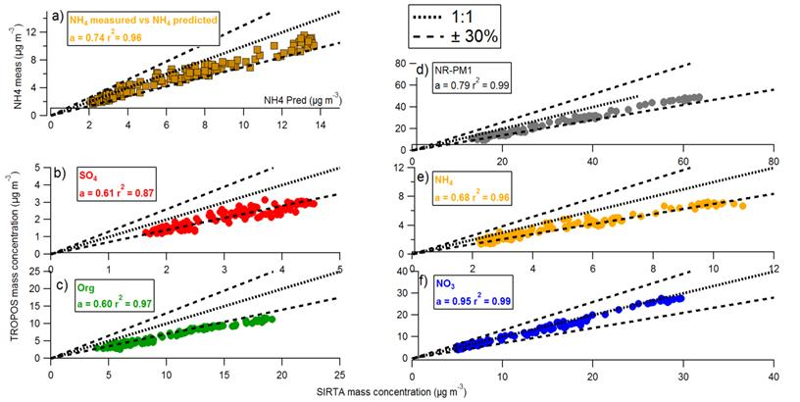
ACMCC: ACTRIS2_First intercomparison analysis and reporting
Some examples of individual instrument comparisons
Post-calibration intercomparison. Comparison with reference instrument
AFTER
Internal instrument reference
This can be compared with values of the instrument after the instrument goes back to the centre
Serial # | RFNO₃ | RIENH4 STD | RIESO4 STD | RIESO4 MIX | RIENH4 MIX
Original | 5.20e-11 | 9.57 | 0.54 | - | -
Calibrated | 6.24e-11 | 5.38 | 0.32 | 0.70 | 3.50

Slide 19
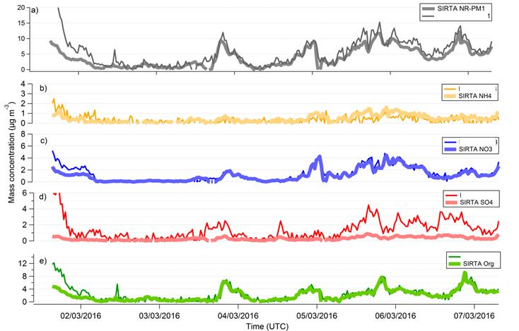
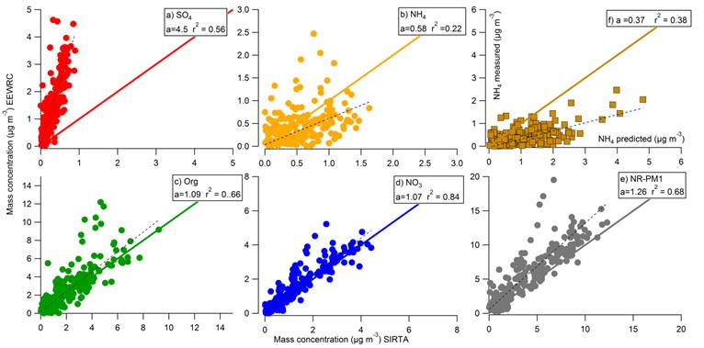
ACMCC: ACTRIS2_First intercomparison analysis and reporting
Some examples of individual instrument comparisons
Pre-calibration intercomparison. Comparison with reference instrument
BEFORE
Internal instrument reference
This can be compared with values of the instrument after the instrument goes back to the centre
Serial # | RFNO₃ | RIENH4 STD | RIESO4 STD | RIESO4 MIX | RIENH4 MIX
Original | 2.03e-11 | 6.23 | 0.42 | - | -
Calibrated | 4.28e-11 | 4.81 | 0.32 | 0.98 | 5.54

Slide 20
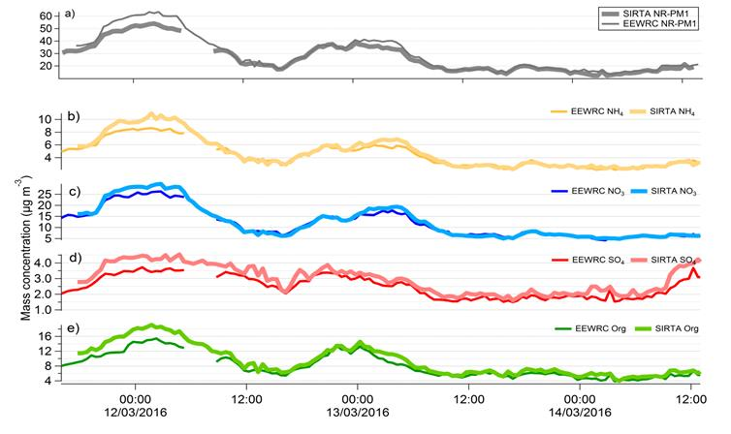
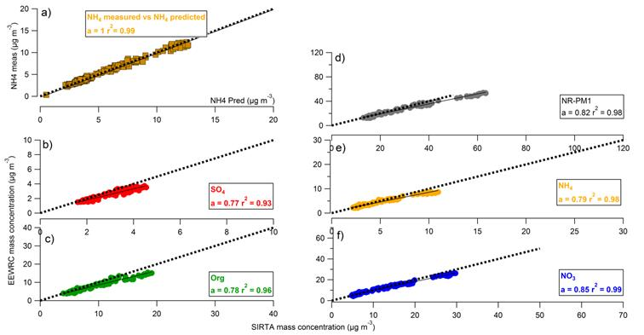
ACMCC: ACTRIS2_First intercomparison analysis and reporting
Some examples of individual instrument comparisons
Pre-calibration intercomparison. Comparison with reference instrument
AFTER
Internal instrument reference
This can be compared with values of the instrument after the instrument goes back to the centre
Serial # | RFNO₃ | RIENH4 STD | RIESO4 STD | RIESO4 MIX | RIENH4 MIX
Original | 2.03e-11 | 6.23 | 0.42 | - | -
Calibrated | 4.28e-11 | 4.81 | 0.32 | 0.98 | 5.54

Slide 21
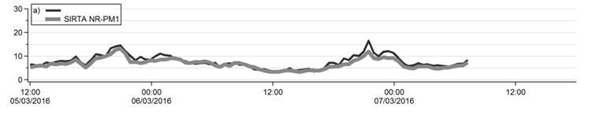
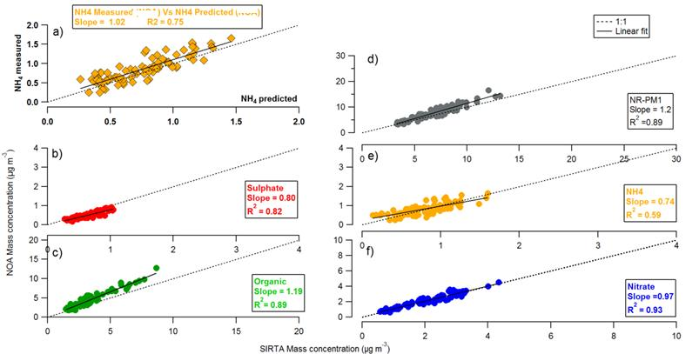
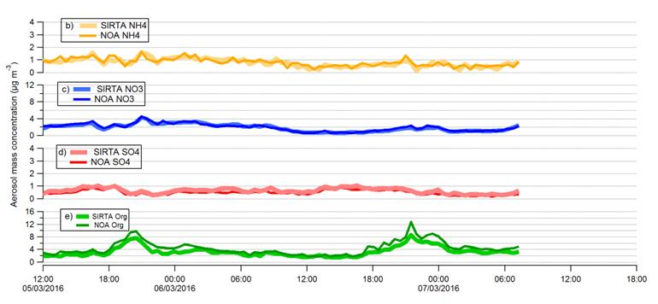
ACMCC: ACTRIS2_First intercomparison analysis and reporting
Some examples of individual instrument comparisons
Pre-calibration intercomparison. Comparison with reference instrument
BEFORE
Internal instrument reference
This can be compared with values of the instrument after the instrument goes back to the centre
Serial # | RFNO₃ | RIENH4 STD | RIESO4 STD | RIESO4 MIX | RIENH4 MIX
Original | 5.63e-12 | 5.11 | 0.76 | - | -
Calibrated | 3.21e-11 | 5.98 | 0.4 | 0.58 | 5.1

Slide 22
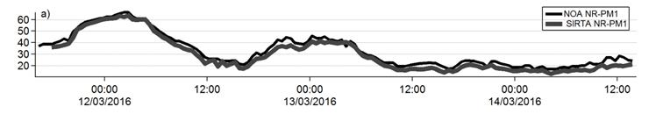
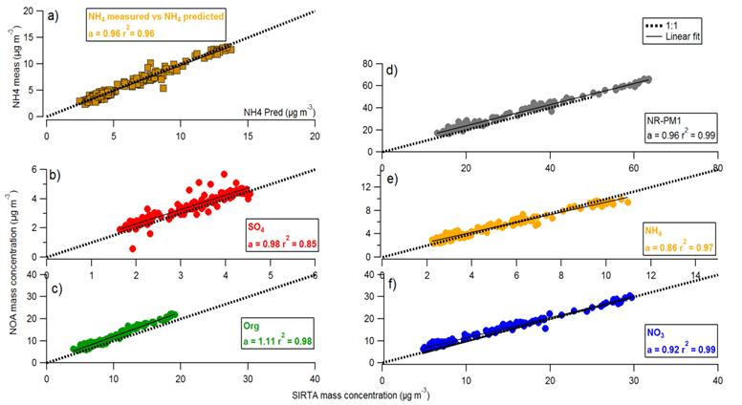
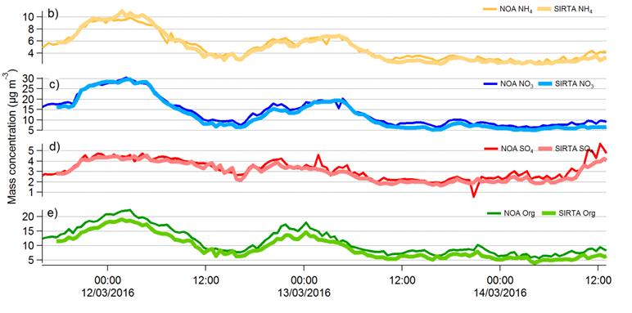
ACMCC: ACTRIS2_First intercomparison analysis and reporting
Some examples of individual instrument comparisons
Post-calibration intercomparison. Comparison with reference instrument
AFTER
Internal instrument reference
This can be compared with values of the instrument after the instrument goes back to the centre
Serial # | RFNO₃ | RIENH4 STD | RIESO4 STD | RIESO4 MIX | RIENH4 MIX
Original | 5.63e-12 | 5.11 | 0.76 | - | -
Calibrated | 3.21e-11 | 5.98 | 0.4 | 0.58 | 5.1

Slide 23
ACMCC: ACTRIS2_First intercomparison analysis and reporting
The ACSM instrument is a research instrument,
The ACMCC is an excellent tool to improve our understanding of the ACSM response to different atmospheric compounds.
The data acquired during the ACMCC intercomparison exercises will be used to determine robust uncertainties for these instruments.
***ACTIONS***
Stations should provide calibration value RIE NH₄, RF NO₃ at least every 6 months
Encourage users to perform calibrations at several particle diameters to characterise if the TE changes before/after shipping instrument.

