Slide 1


WP8: ECAC Calibration workshops and intercomparisons
Stephanie Schüttauf
Office ECAC

Slide 2
ECAC – European Center for Aerosol Calibration
Provide:
Calibration/Intercomparison workshops and Inter-laboratory Comparison
At:
WCCAP
ACMCC
ERLAP
Condensation Particle Counter (CPC)
Mobility Particle Size Spectrometer (MPSS)
...
Aerosol Chemical Specification Monitor (ACSM)
OC/EC Analysis (OCEC)
See:
http://www.actris-ecac.eu/index.html
Stephanie Schüttauf 13/10/2016 Bologna Second ACTRIS-2 WP3 Workshop

Slide 3
Requirements
Eligibility of the user:
Transnational: PI works in a country other than the country where the installation is located (except: ECAC-ERLAP)
Participants working outside the EU: eligible, but restrictions may apply (20%)
Only user groups that are allowed to disseminated the results they have generated under the action may benefit from the access (unless the users are working for SMEs)
User obligations:
Any outcome resulting from work carried out under the ACTRIS TNA activity must acknowledge the project
see: http://www.actris-ecac.eu
Stephanie Schüttauf 12/11/2015 Athens First ACTRIS-2 WP3 Workshop
Notes:
Rule for PI: does not apply: if access is provided by an International organisation, the JRC an ERIC or similar legal entities – ECAC-ERLAP
in case of remote access to a set of installations located in different countries offering the same type of service – AERONET-EU

Slide 4
Participation - Overview
1. Proposal
Online application form: http://www.actris-ecac.eu
Separate application for each instrument
2. Internal and external Evaluation
3.1 confirmation of participation
Project number
3.2 Acknowledge statement
4. WORKSHOP
5. ECAC-report
Summary of Intercomparison
Success of Intercomparison
Signed by both parties
Basis of pay-off
6. Confirmation of calibration
7. User Report
Short!
Mail: ecac@tropos.de
Stephanie Schüttauf 13/10/2016 Bologna Second ACTRIS-2 WP3 Workshop

Slide 5
Statistics – until the end of 2016
31 calibration & intercomparison workshops & inter-laboratory comparisons
176 users (instruments) in total
124 TNA
52 National
→ 438 RWD
...in detail:
Stephanie Schüttauf 13/10/2016 Bologna Second ACTRIS-2 WP3 Workshop

Slide 6
Statistics – WCCAP
 | 7-12/2015 |  | 1-12/2016
 | TNA | National | TNA | National
Absorption Photometer | 7 | - | 10 | 1
Condensation Particle Counter | 4 | - | 19 | 16
Extinction Monitor | 2 | - | 1 | -
Integrating Nephelometer | 6 | - | 11 | 1
Mobility Particle Size Spectrometer | 3 | 1 | 17 | 10
Cloud Condensation Nuclei Counter | - | - | 3 | -
On-site Intercomparison | - | 9 | 1 | 14
TNA RWD: 206/605
Stephanie Schüttauf 13/10/2016 Bologna Second ACTRIS-2 WP3 Workshop

Slide 7
Statistics – ACMCC
 | 2015 |  | 2016
 | TNA | National | TNA | National
Aerosol Chemical Speciation Monitor | - | - | 16 | -
TNA RWD: 160/80
Statistics – ERLAP
 | 2015 |  | 2016
 | TNA | National | TNA | National
OC/EC Analysis | - | - | 24 | -
TNA/RWD: 72/180
Stephanie Schüttauf 13/10/2016 Bologna Second ACTRIS-2 WP3 Workshop

Slide 8
Missing Stations I
Absorption Photometer:
Usti, Kresin, Waldhof, Schauinsland, Neuglobsow, Zugspitze, Schneefernerhaus, Bösel, Hyytiälä, Pallas, Pic du Midi, SIRTA, Puy de Dome, Finokalia, DEM Athens, Mace Head, Preila, Cabauw, Vavihill, Aspvreten
Condensation Particle Counter:
Montseny, Varriö, Hyytiälä, Puy de Dome, Kensington, Mt. Cimone
Integrating Nephelometer:
Kresin, Pallas, Puy de Dome, Finokalia, Mace Head, Mt. Cimone, Preila, Cabauw, Vavihill, Aspvreten, Trollhaugen
Mobility Particle Size Spectrometer:
Jungfraujoch, Madrid, Montseny, Varriö, Pic du Midi, Puy de Dome, Kensington, Mace Head, Mt. Cimone, Preila, Cabauw, Birkenes, Vavihill, Aspvreten
Cloud Condensation Nuclei Counter:
Paris, Puy de Dome, London, Mace Head, Cabauw, Birkenes, Vavihill
Stephanie Schüttauf 13/10/2016 Bologna Second ACTRIS-2 WP3 Workshop

Slide 9
Missing Stations II
OCEC Analysis:
Mesta, Hohenpeissenberg, Finokalia, K-Pustza, Mt. Cimone, Aspvreten
Aerosol Chemical Speciation Monitor:
Jungfraujoch, Madadino, Montsec, Montseny, Mace Head, Cabauw, Birkenes
Stephanie Schüttauf 13/10/2016 Bologna Second ACTRIS-2 WP3 Workshop

Slide 10
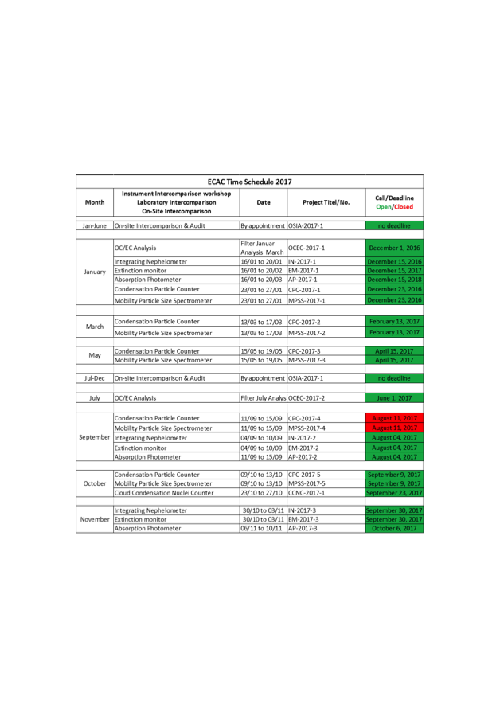
Stephanie Schüttauf 13/10/2016 Bologna Second ACTRIS-2 WP3 Workshop

